Slide 1
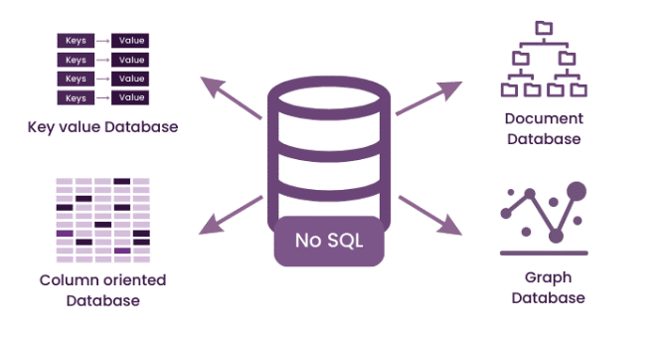
DSAI4205 Big Data Analytics
Lecture 9:
Big Data Storage, NoSQL
Dr. Ken FONG
Department of Data Science and Artificial Intelligence
chi-kit-ken.fong@polyu.edu.hk

Slide 2
Agenda
1. Recall transaction and acid property
2. nosql overview
2.1 Motivation of nosql
2.2 what is nOSQL
2.3 Drop acid, and use base instead
(CAP Theory)
2.4 major type of NOSQL databases

Slide 3
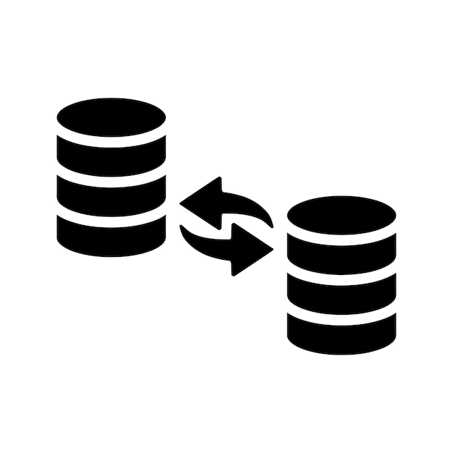
Recall Transactions and
ACID property

Slide 4
Motivation of Transactions
  If two users modify the same record in a table at the same time. How to avoid race condition ?
    Problem: Lost Updates
    Mechanism: Concurrency Control
  E.g. Suppose you are transferring $100 between two bank accounts, but there is a power failure.
    What is the correct database state ?
    Database needs to achieve Durability
      Mechanism: Recovery

Slide 5
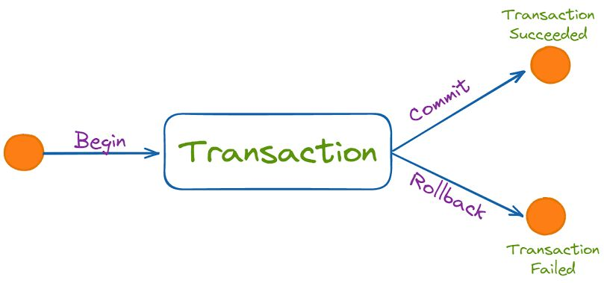
Database Transactions

Slide 6
Transactions
  A transaction is the execution of a sequence of one or more operations (e.g., SQL queries) on a database to perform some higher-level function.
  E.g., transfer $100 from bank account A to bank account B
    This operation needs to be completed by series of SQLs by certain order.
      Check whether the balance of account A > 100
      Deduct 100 from account A
      Increment the balance of account B by 100.
  Database not allow transactions to be executed partially.
  Should execute ALL or NOTHING.

Slide 7
Traditional Approach
  Execute each transactions one by one (i.e serial order) as they arrive at the DBMS.
    One and only one transaction can be executed at the same time in the DBMS
    Before the transaction executes, back up the entire database by copying the files, and make changes in the new copied files.
    If the transaction complete successfully, overwrite the original file with the new one.
    If the transaction failures, remove the new copy.

Slide 8
Problems with the Traditional Approach
  Problem with the traditional approach ?
    Running time is slow
  A better approach is to allow concurrent execution of independent transactions.
    Why do we want that ?
      Better utilization
      Increased response times to users.
    But we need to ensure:
      Correctness
      Fairness

Slide 9
Definition
  A transaction may carry out multiple operations on the data retrieved from the database.
  The database is only concerned about what data is READ / WRITTEN FROM/TO the database.
  Database: A fixed set of named data objects (e.g. A, B, C … )
    Transactions: A sequence of read and write operations (R(A), W(B), … )
    DBMS’s abstract view of a user program.

Slide 10
Transactions
  A new transaction starts with the BEGIN command.
  The transaction stops with either COMMIT or ABORT:
    If commit: the DBMS either save all the transaction’s changes or aborts it.
      If a user tells the system to commit, the system does not guarantee that the transcation must commit successfully.
      In some situation, we may not allow the transactions to be completed.
    If abort: all changes are undone.
      It’s like as if the transactions never executed at all.
Abort can be inflicted by the user or caused by the DBMS.

Slide 11
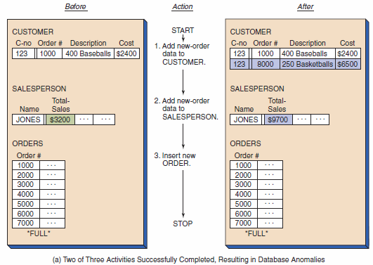
Transaction Example

Slide 12
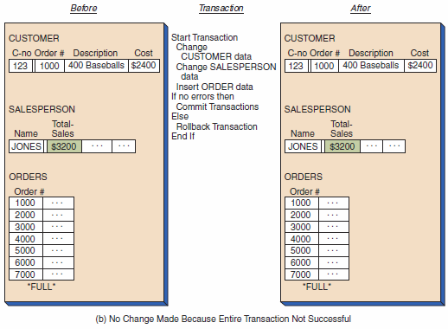
Transaction Example

Slide 13
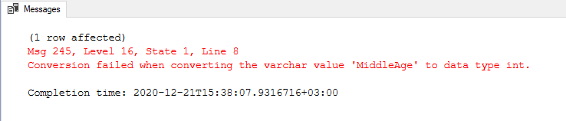
Transaction Example
BEGIN TRAN INSERT INTO Person VALUES('Bunny', 'Bugs','742 Evergreen Terrace','Springfield',54) UPDATE Person SET Age='MiddleAge' WHERE PersonID=7 SELECT * FROM Person COMMIT TRAN

Slide 14
Correctness of a database: ACID
  Atomicity: all operations in the transactions happen or none of them happen. (ALL or nothing)
  Consistency: If each transaction is consistent and the DB start in a consistent state, then it should also end up with a consistent state.
    The database always reflects a logically valid state of the world.
    All queries return logically correct answers based on defined rules.
  Isolation: Execution of one transaction is isolated from that of other transactions.
  If a user issue a transaction to DB system, the transaction should be executed as if I am the single solo user.
  Durability: If a transaction commits, its effects persistent.

Slide 15
Atomicity of Transactions
  Two possible outcomes of executing a transaction:
    Commit: after completing all its operations.
    Abort (or to be aborted by DBMS) after executing some actions.
  DBMS guarantees that transactions are atomic.
  Transactions always either execute all its operations or execute no actions at all.
    Scenario 1:
      We take $100 out of Peter’s account but then the DBMS abort the transaction before we transfer it.
    Scenario 2:
      We take $100 out of Peter’s account, then there is a power failure before we transfer it.

Slide 16
Consistency - From one valid state to another
  Database Consistency:
    The database accurately models the real world and follows integrity constraints.
    Transactions in the future see the effects of transactions committed in the past inside of the database.
      Before execute the transaction, the database should in some consistency state.
      E.g. If the total deposited amount of the bank is 10,000.
      If you add up all individual accounts at any time point, the value should always equal to the total amount of the bank.
  Transaction Consistency:
    If the database is consistent before executing the transactions, it should always end up with a consistent state after executing the transactions.
    Transaction consistency is the application’s responsibility. DBMS cannot control this.
    If the transaction try to moving money between accounts, we need to ensure that the money moving out from one account should be the same amount to deposit to another account.

Slide 17
Isolation of Transactions
  When users submit transactions, and each transaction executes as if it was running by itself.
  But the database achieve concurrency by interleaving the operations (read/writes of DB objects).
  We need a way to interleave transactions but still make it appear as if they ran one at a time.
  A concurrency control protocol is how the DBMS decides the proper interleaving of operations from multiple transactions.

Slide 18
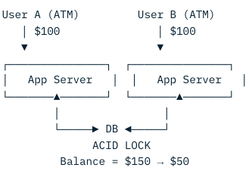
What is OLTP ?
  OLTP (Online Transaction Processing) supports transaction-oriented applications in a 3-tier architecture. (Web → App → DB)
  Handles day-to-day transaction of an organization.
  The main objective is data-processing with fast, correct, concurrent transactions.
  E.g., ATM center:
  OLTP is optimized for transactions instead of data analysis.
    Suppose a couple has a joint account with a bank with total balance = 150.
    One day both simultaneously reach different ATMs.
    Each of them try to withdrawn $100 each at the same time.
    They are unable to draw over the total amount of present in their bank account.
    The person who complete the operation first will be able to withdraw the money.

Slide 19
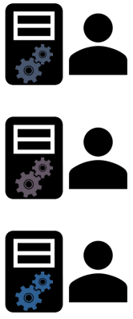

Client-Server Application
Difficult to scale connections for OLTP
Single server runs the entire database
Could be:
Your own computer
A server hosted in the data center
Cloud-hosted DB
Multiple client applications connect to DB Server

Slide 20


3-Tiered Web Architecture
Browsers allow to communicate to servers.
Web /App servers
(Easily replicated for more users)
How do we architect an OLTP solution?
HTTP/HTTPS
DB Connections

Slide 21
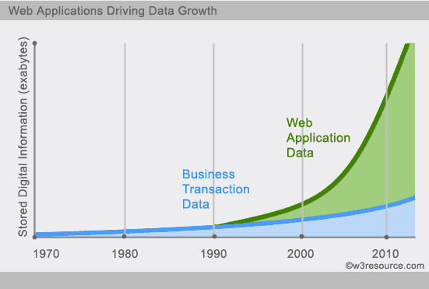

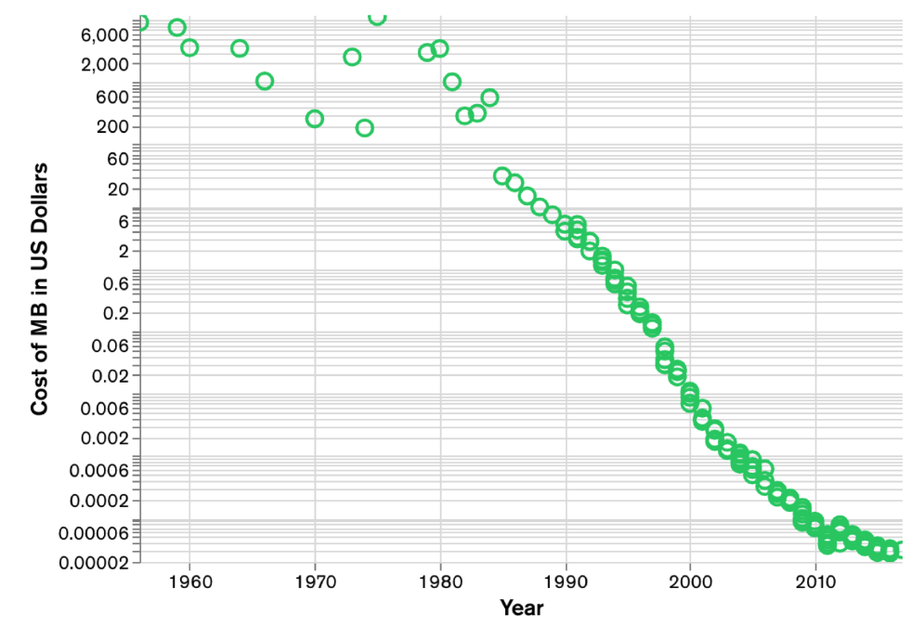
Web 2.0
  A new class of problem emerged in the late 90s
  and early 2000s
  What is web 2.0 ?
    Social network
    Services need to scale quickly by orders of magnitude

Slide 22
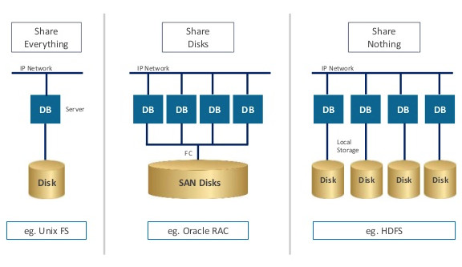
Shared-nothing architecture
  Each node is completely independent
    No shared resources → No bottlenecks
    shared resources refers to:
    (memory, disks, and CPUs)
    Utilize the distributed HDFS storage instead of using centralized storage.
      Local storage per node
      HDFS writes blocks locally, replicates 3x across nodes
  Distributed computing architecture in which each request is satisfied by a single host in a group of servers
    An update to a specific record is handled by exactly one host
    But different updates go to different hosts in parallel.
Scalable: because there are no shared resources, addition of nodes adds resources to the system and does not introduce further contention.
Fault-tolerant: each node is independent, so there are no single points of failure, and the system can quickly recover from a failure of an individual node.

Slide 23

Recall: Horizontal Scaling
  Horizontal scaling - add nodes, get more power.
    Change in the number of instances (Add and remove instances as needed)
  But how do you use 100 nodes for one database?
  There are two possible ways:
    Partitioning (“sharding”): splitting the dataset across nodes
    Replication: copies each segment to multiple nodes (e.g. 3x in HDFS)

Slide 24

Scaling Amazon RDS Writes With Database Sharding
  Without shards, all data resides in one partition.
    Example: Users by last name, A to Z, in one database.
  With sharding, split your data into large chunks (shards).
    Example: Users by last name:
      A through M, in one database;
      N through Z in another database.
  In many circumstances, sharding provide higher performance in terms of write, but break everything else (Read/ACID).
lastName = A to M
DB Server
Sharding software
lastName = N to Z
App Server
DB Server

Slide 25
Distributed RDBMS: A consistency bottleneck
  Partitioning - Use multiple machines to distribute data
    Write performance ok
    Read performance suffers!
      Join across servers may have huge network IO cost
  Replication - Create multiple copies of each database partition
    Improves fault tolerance
    Read performance ok
    Write performance suffers!
      Need to write same value to multiple servers
  RDBMS scaling makes consistency hard
    Partitioning- Need to coordinate server actions
    Replication - Need to prevent inconsistent versions
ACID is hard to maintain

Slide 26


What is NoSQL?
  NoSQL (Looser data model) refers to a non-relational database
    stores data in a format other than relational tables
  ”SQL” refers to traditional relational database management systems (“DBMS”)
    NoSQL systems can involve SQL-like querying languages in many cases.
  NoSQL has come to stand for “Not Only SQL”
    using relational and non-relational databases alongside one another,
    each for the tasks they are most suited for
  Give up built-in ACID consistency - Availability more important than consistency
        Don’t care if I don’t see every “like” in real time
        Do care if I can’t send a “like”
        Don’t care if my cart forgot an item
        Do care if I can’t put an item into my cart

Slide 27
We need to Sacrifice - CAP Theorem
  In a distributed data store, can only provide two of the following three guarantees:
    Consistency
      A read from any node results in the same data across multiple nodes (i.e., data must be up-to-date, same data across nodes)
    Availability
      a read/write request will always be noticed in the form of success or a failure (i.e., nodes always available)
    Partition tolerance
      the system can continue to operate even there are message drop or delay during data transmission between nodes (i.e., message drop/delay is okay)

Slide 28
CA vs CP vs AP
  CA: When consistency (C) and availability (A) are needed
    The system always has response, with the latest data,
    Then partition tolerance (P) is not possible (i.e., message delay/drop is NOT okay)
  CP: When consistency (C) and partition tolerance (P) are needed
    The system always return latest data.
    Then nodes cannot remain available (A)
      The nodes will become unavailable while achieving a state of consistency (C)
      (e.g., data may lock for update)
  AP: ﻿When availability (A) and partition tolerance (P) are needed
    Then consistency (C) is not possible
      Because of the data communication requirement between the nodes.
      The database can remain available (A) but with inconsistent results

Slide 29
We need to Sacrifice - CAP Theorem
  In a distributed data store:
    Partition tolerance is unavoidable (i.e., network failure)
    We need to choose among Consistency or Availability
  Traditional SQL chose Consistency + Partition tolerance:
    Strong consistency
    But unavailable during outages
  NoSQL chose Availability + Partition tolerance:
    Always available
    But eventually consistent

Slide 30
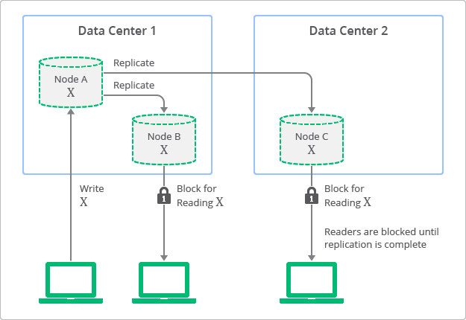
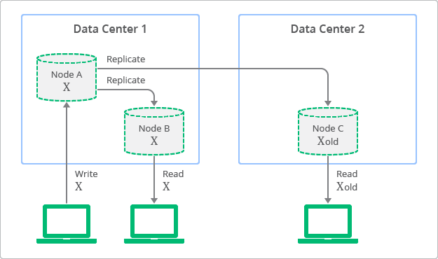
Strong vs Eventual Consistency
balance = 100
balance = 200
balance = 200
balance = 100
balance = 200
balance = 100
balance = 100
balance = 200
balance = 200
balance = 200
balance = 100
balance = 100
The value will be outdated while the update is propagating.
set balance = 200
set balance = 100
set balance = 100
set balance = 200
200
200
100
200
200
100
Strong consistency:
Any read operation that begins after a write has completed will return the updated value, as seen by all clients.
Eventual consistency:
If the system is given sufficient time to propagate changes, all subsequent reads will eventually return the most recent written value.
Implications:
Eventual consistency offers better availability at the cost
of a much weaker consistency guarantee. This may be acceptable for some applications (e.g. social network feed) but not for others (e.g. financial transactions)

Slide 31
BASE consistency model
  NoSQL system have the BASE consistency model
    BASE is a database design principle based on the CAP theory and applied by database systems that use distributed technology.
    Basically Available
      When a database is basically available (BA), it will always acknowledge requests, no matter it is in the form of the requested data or a success/failure message
    Soft state
      It means that a database can be in an inconsistent state, where some nodes contain the up-to-date data while some not
    Eventually consistent
      The database will attain consistency when all changes have been propagated to all nodes

Slide 32

RDBMS vs NoSQL Systems: Consistency
  CP: Consistency + Partition tolerance
    Consistency: Every read receives the most recent write or an error
    Partition tolerance: Continued operation in presence of dropped or delayed messages
RDMS Model
DB Node 1
DB Node 2
Tries, but fails, to
check consistency
of V
V₁
V₀
V₀
Error / Timeout
Read V
write v₁
Client

Slide 33
RDBMS vs NoSQL Systems: Availability
  AP: Availability + Partition tolerance
    Availability: Every request must respond with a non-error
    Partition tolerance: Continued operation in presence of dropped or delayed messages
NoSQL Model
DB Node 1
DB Node 2
Tries, but fails, to
check consistency
of V
V₁
V₀
V₀
V₀
Read V
write v₁
Client

Slide 34
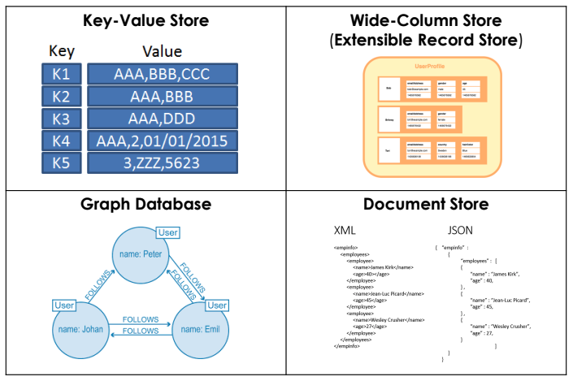
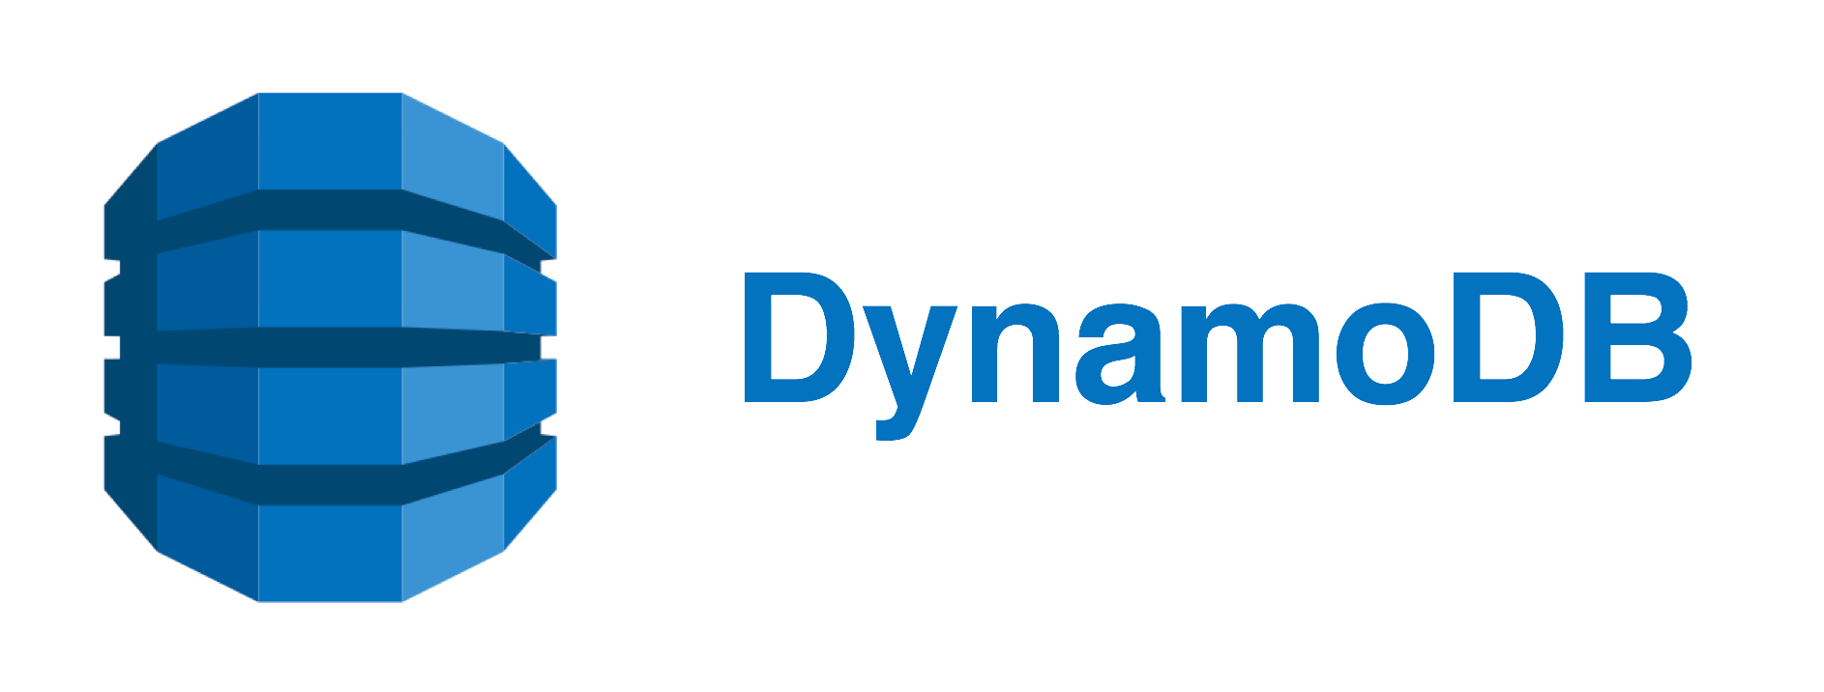







NoSQL Data Models

Slide 35
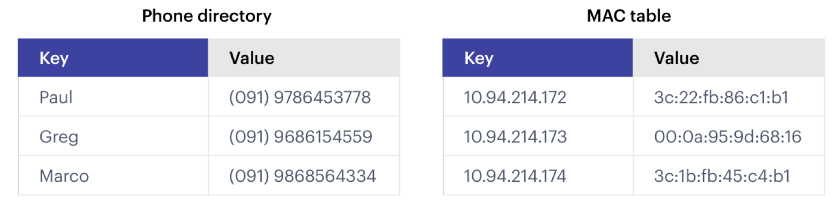
Key-Value Stores: Data Model
  Stores associations between keys and values
    Keys are usually primitives and can be queried
      For example, ints, strings, raw bytes, etc.
    Values can be primitive or complex; usually cannot be queried
      Examples: ints, strings, lists, JSON, HTML fragments, BLOB (basic large object), etc.

Slide 36
Example of Key-Value Store
  Represent all Flights as Key-Value pairs
  Potential schema
  Isn’t that there is a lot of duplicated data ?
    A single flight is stored in 3 different rows.
      How to update a flight’s duration?
  Key-Value Store: Optimized for Serving:
    Find and serve flight info quickly.
      No need to self-joins
      Key-Value stores are great for serving (relatively) static data
Key | Value
FID | Single flight record
Date | All flight records on that day
(origin, destination) | All flight records between the cities
Key | Value
FID | Single flight record
Date | All flight records on that day
Key | Value
FID | Single flight record

Slide 37
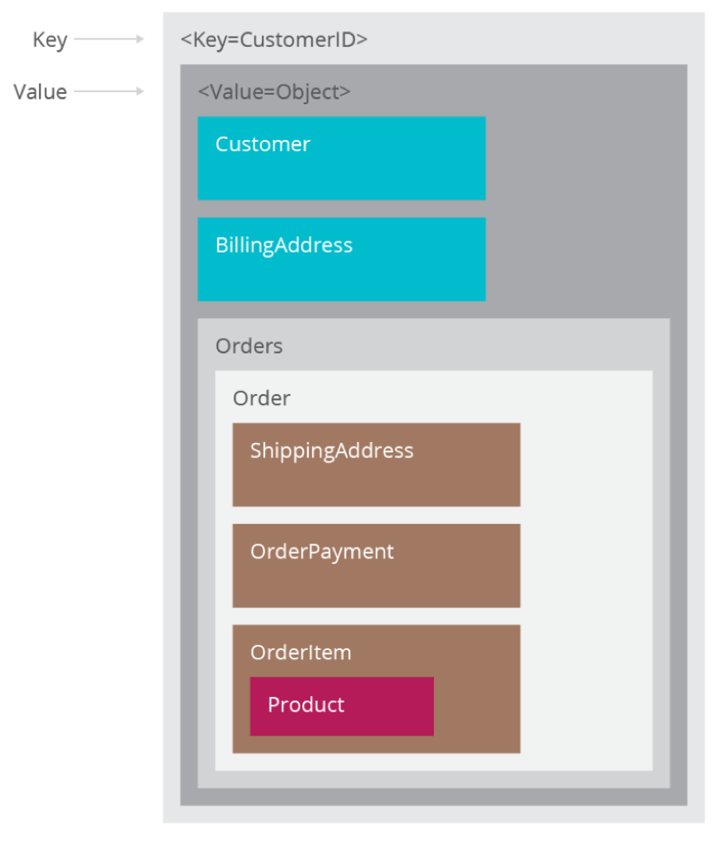
Key-Value Stores: Operations
  Simple API:
    Get – fetch value associated with key
    Put – set value associated with key
  Optional operations:
    Multi-get: retrieve multiple key-value pairs in a single request
    Multi-put: insert or update multiple key-value pairs in a single request
    Range queries: Retrieve keys in a certain range
  Suitable for:
    Small continuous read and writes
    Storing ‘basic’ information or no clear schema
    When complex queries are not required
  Example of usages:
    Storing user sessions, cache memory, etc.

Slide 38
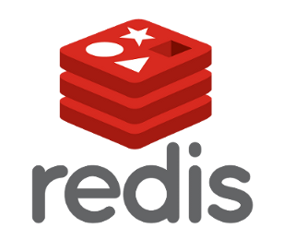

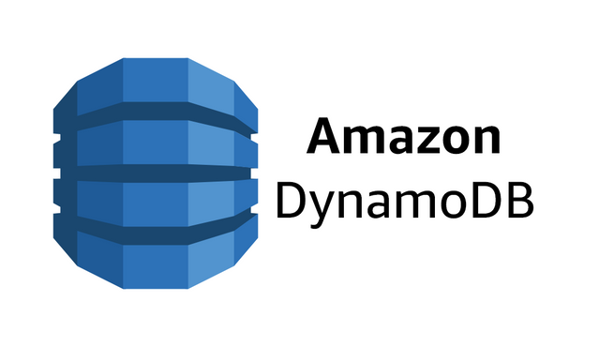

Key-Value Stores: Implementation
  Non-persistent: A big in-memory hash table
  Persistent: Data is stored persistently to disk

Slide 39
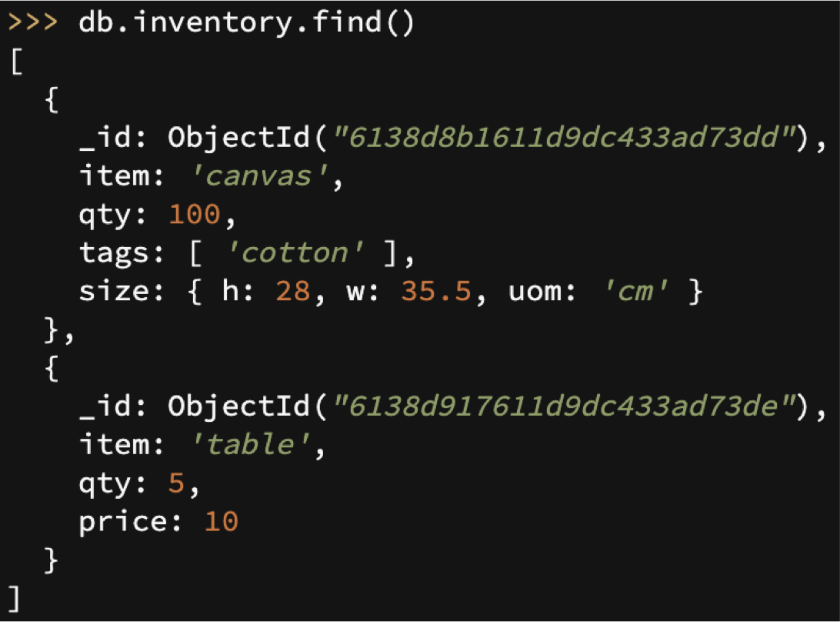
Semi-Structured Document Model
  A document is a Self-contained JSON/BSON object
  Document contains explicit tags to indicate metadata such as type or name
    Documents are self-describing!
    Schema is contained within the document body
  MongoDB can handle CSV files
    MongoDB stores data as BSON documents (CSV must be converted)
Fields
Document
Document

Slide 40
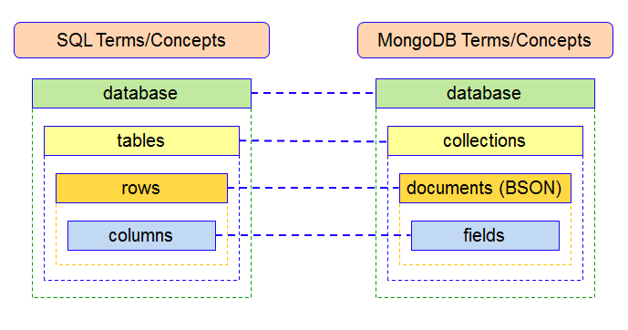
Semi-Structured Document Model
  A database can have multiple collections
  Collections have multiple documents
  A document is a JSON-like object: it has fields and values
    Different documents can have different fields
      Can be nested:
      JSON objects as values
RDBMS | MongoDB
Table, View | Collection
Row | Document
Column | Field
Join | Embedded Document
Foreign Key | Reference
Partition | Shard

Slide 41
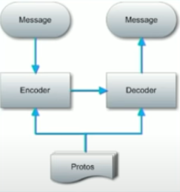
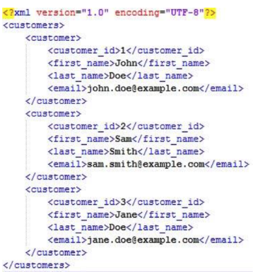
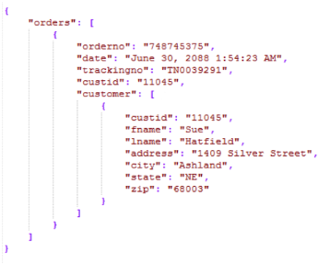
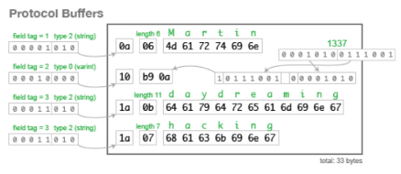
Examples: Semi-Structured Documents
XML
Protobuf
JSON
  Not human-readable in serialized format
  Tags introduce respective data
  (Many applications have phased out XML in favor of JSON)
  Tags surround respective data

Slide 42
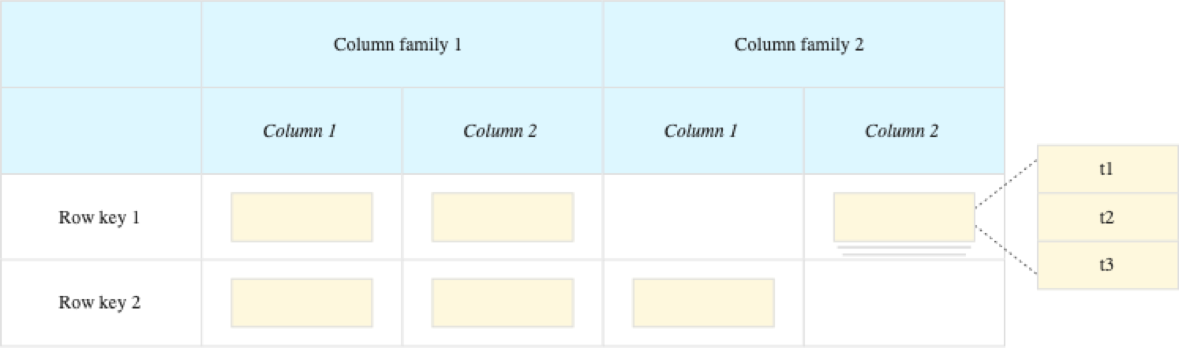
Wide Column Stores
  Row describe entities
  Related groups of columns are grouped as column families
  Sparsity: if a column is not used for a row, it doesn’t use space
  Able to store a huge number of columns.
  We may think of row as hash tables
  Examples: BigTable, Cassandra, HBase

Slide 43
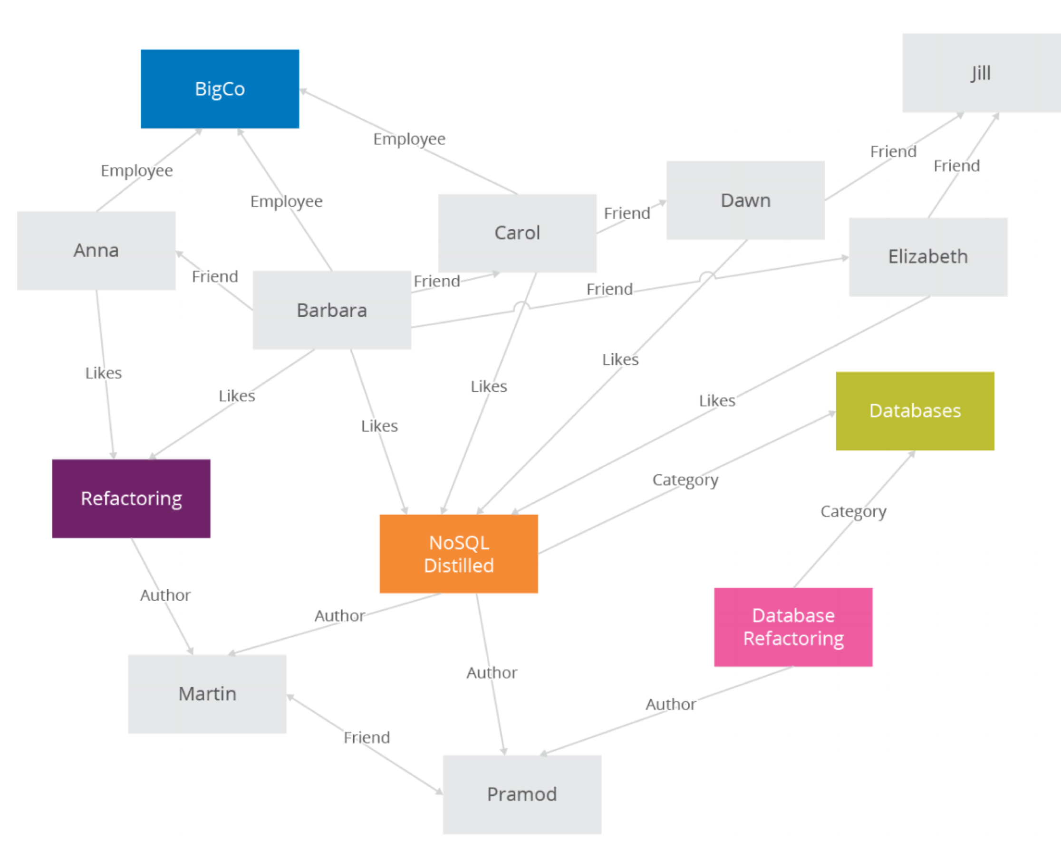
Graph Databases

Slide 44

Any Questions?

