Slide 1
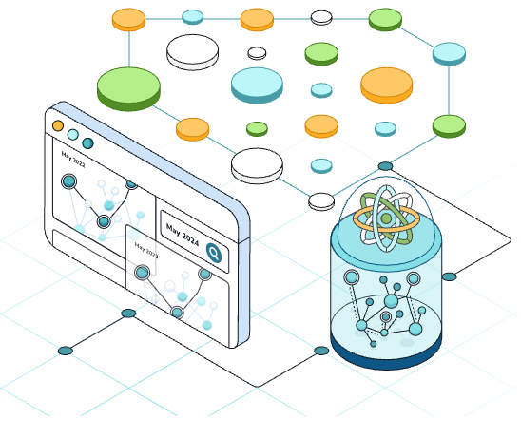
DSAI4205 Big Data Analytics
Lecture 8:
Graph Analytics
Dr. Ken FONG
Department of Data Science and Artificial Intelligence
chi-kit-ken.fong@polyu.edu.hk

Slide 2
Agenda
1. the basics of Graph Theory
2. Network Properties
2.1 Degree distributions
2.2 Diameter and Average Path Length
2.3 Clustering Coefficient
2.4 Connectivity
3. Visualize network properties in real network
4. Network centrality

Slide 3
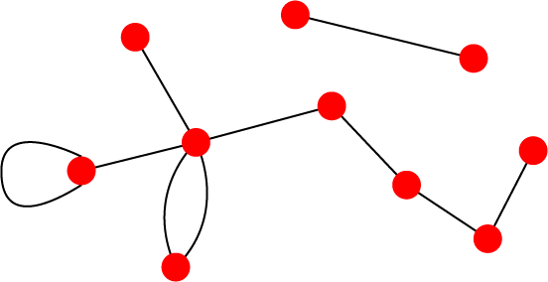
Undirected and Directed graphs
Directed graphs
Links: directed (arcs)
Examples of Undirected links
URLs on the www
Phone calls
Metabolic reactions
Undirected graphs
Links: undirected (symmetrical)
Examples of Undirected links
  Co-authorship links
  Actor network
  Protein interactions
B
D
C
G
E
A
F

Slide 4

In an undirected graph
In an undirected graph (or network), the nature of the relationship is symmetric
  If node $i$is connected to node $j$, then $j$ is also connected to $i$
  Facebook friendship is symmetric
Let $N$ denotes the number of nodes/vertices in $G$
What is the possible number of links or edges in a graph $G$ with $N$ number of nodes ?
  |edges| = $\left(n−1\right)+\left(n−2\right)+…+1 =\frac{n\left(n−1\right)}{2}$

Slide 5
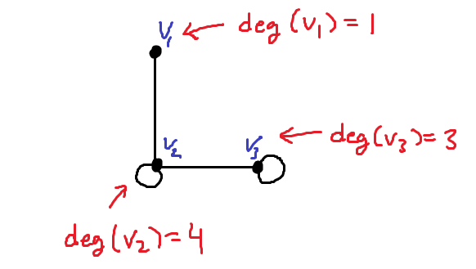
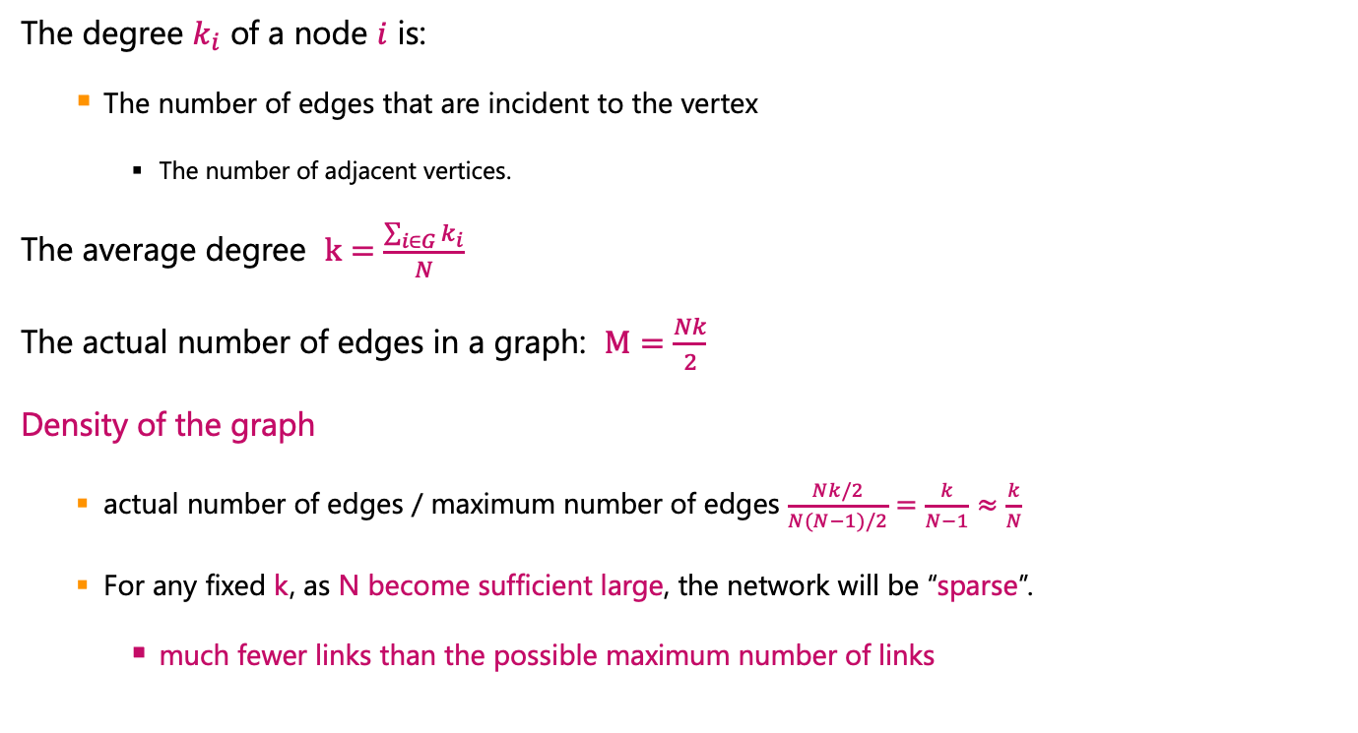
In an undirected graph
The degree $k_{i}$ of a node $i$ is:
    The number of edges that are incident to the vertex
      The number of adjacent vertices.
The average degree $k=\frac{\sum_{i∈G}{k_{i}}}{N}$
The actual number of edges in a graph: $M=\frac{Nk}{2}$
Density of the graph
    actual number of edges / maximum number of edges $\frac{Nk/2}{N(N−1)/2}=\frac{k}{N−1}≈\frac{k}{N}$
    For any fixed k, as N become sufficient large, the network will be “sparse”.
      much fewer links than the possible maximum number of links

Slide 6
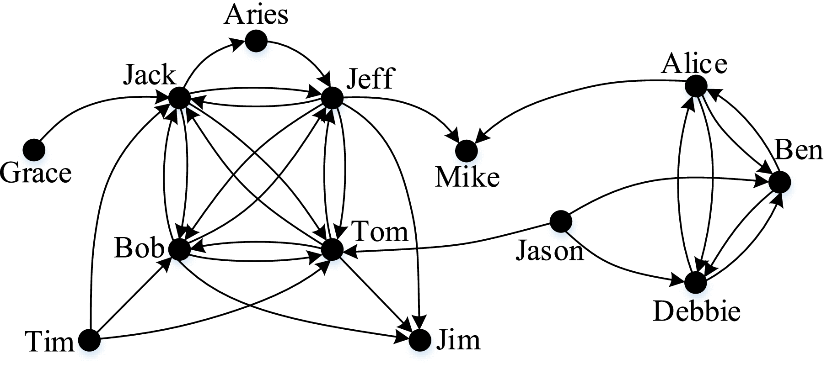
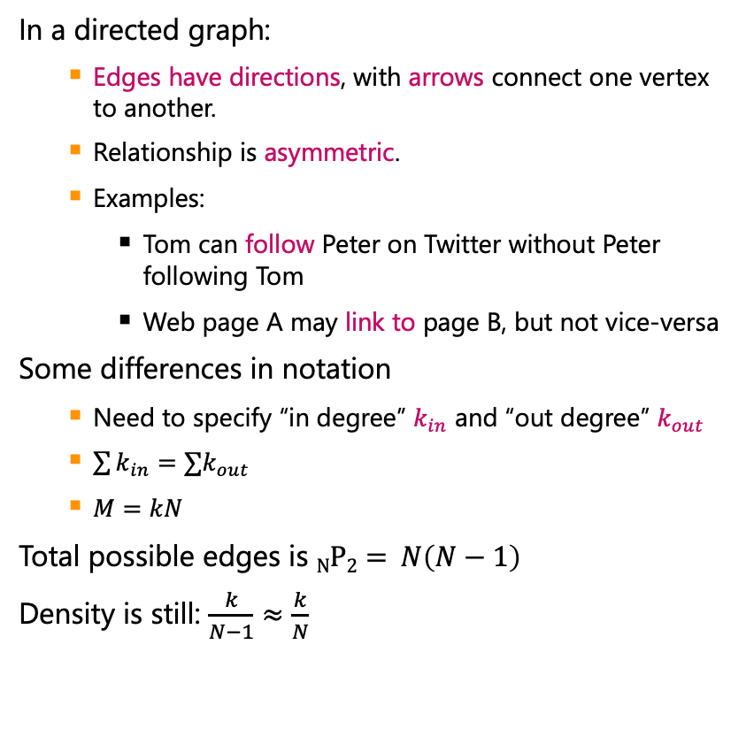
In a directed graph
In a directed graph:
    Edges have directions, with arrows connect one vertex to another.
    Relationship is asymmetric.
    Examples:
      Tom can follow Peter on Twitter without Peter following Tom
      Web page A may link to page B, but not vice-versa
Some differences in notation
    Need to specify “in degree” $k_{in}$ and “out degree” $k_{out}$
    $\sum{k_{in}}=∑k_{out}$
    $M=kN$
Total possible edges is $NP2= N\left(N−1\right)$
Density is still: $\frac{k}{N−1}≈\frac{k}{N}$

Slide 7
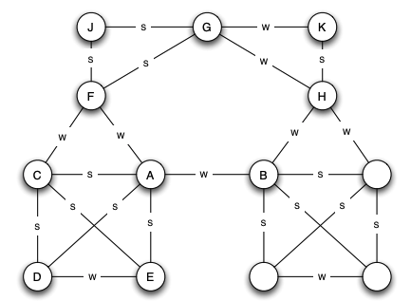
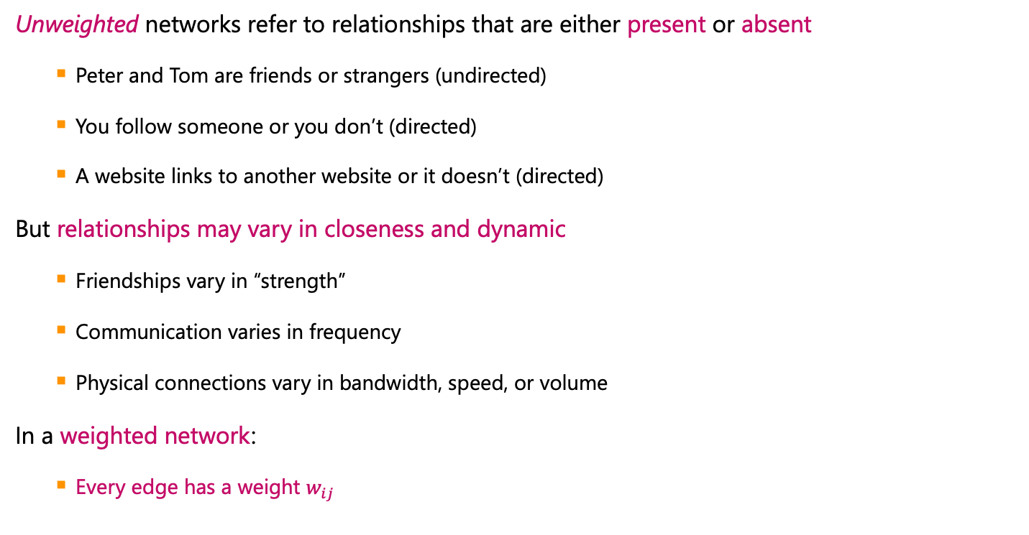
Weighted and Unweighted networks
Unweighted networks refer to relationships that are either present or absent
    Peter and Tom are friends or strangers (undirected)
    You follow someone or you don’t (directed)
    A website links to another website or it doesn’t (directed)
But relationships may vary in closeness and dynamic
    Friendships vary in “strength”
    Communication varies in frequency
    Physical connections vary in bandwidth, speed, or volume
In a weighted network:
    Every edge has a weight $w_{ij}$

Slide 8
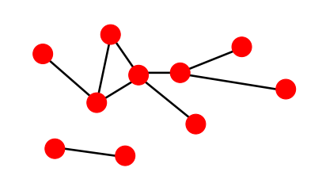
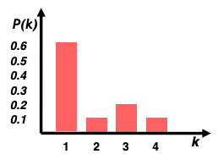

Degree Distribution
Degree distribution $P(k)$
    Probability that a random chosen node has degree $k$
      Let $N_{k}$ be the number of nodes with degree $k$
      $P\left(k\right)=\frac{N_{k}}{N}$

Slide 9
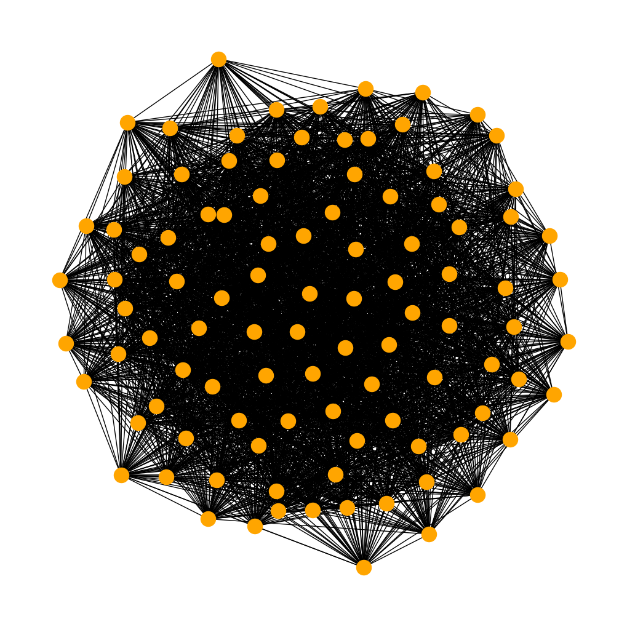
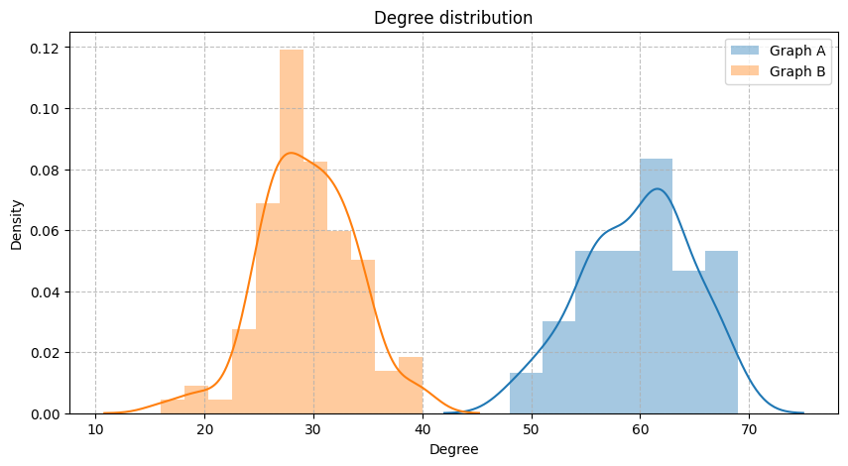
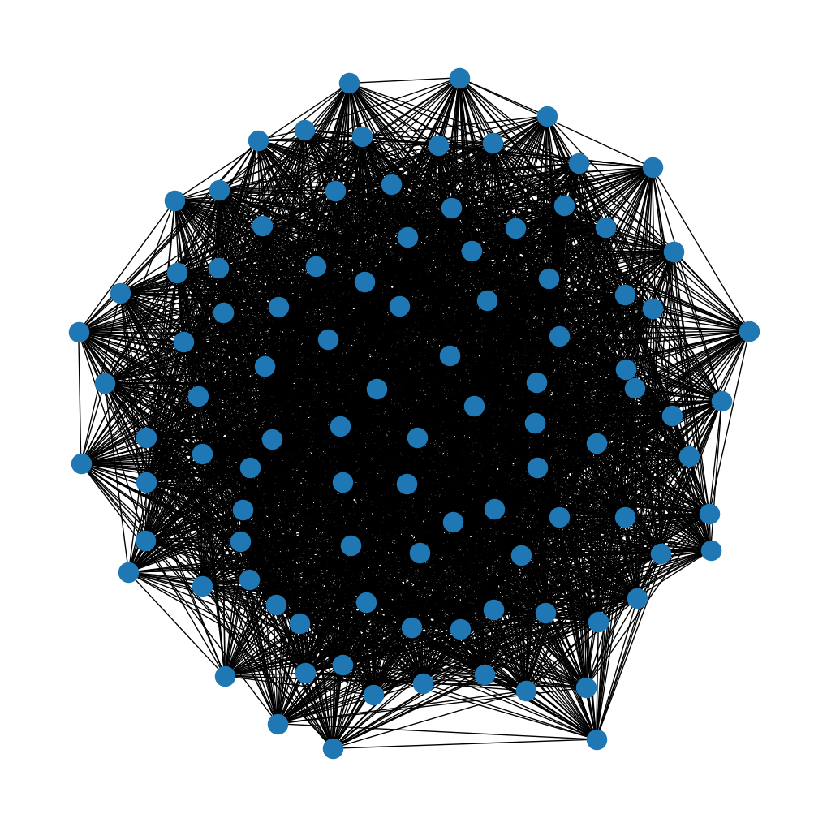

Degree Distribution
Notes:
100 nodes

Slide 10
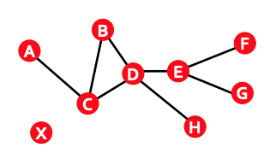

Paths in a graph
A path is a sequence of nodes in which each node is linked to the next one.
    $P_{n}=\left\{{(i}_{0}, i_{1}), \left(i_{1}, i_{2}\right), (i_{2}, i_{3}), …, (i_{n−1}, i_{n})\right\}$
Path can intersect itself and pass through the same edge multiple times.
    E.g. ACBDCDEG
    In a directed graph, a path can only follow the direction of the “arrow”

Slide 11
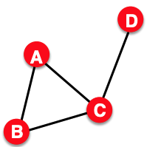


Distance in a Graph
In undirected graphs
    Distance (shortest path)
      The distance between a pair of nodes is defined as the number of edges along the shortest path connecting the nodes
        i.e., $d_{B,D}=2$
      If the two nodes are not connected, the distance is usually defined as infinite.
        i.e., $d_{A, X}= ∞$

Slide 12
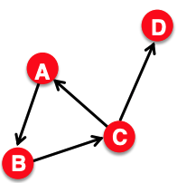

Distance in a Graph
In directed graphs
    Each paths need to follow the direction of the arrows
      i.e., $d_{B,c}=1$
    Distance is not symmetric
      i.e. $d_{B,c}≠d_{C,B}$
        $d_{B,c}=1$, $d_{C,B}=2$

Slide 13
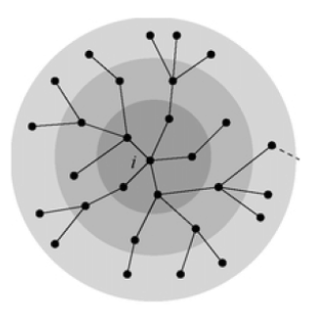
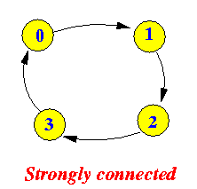
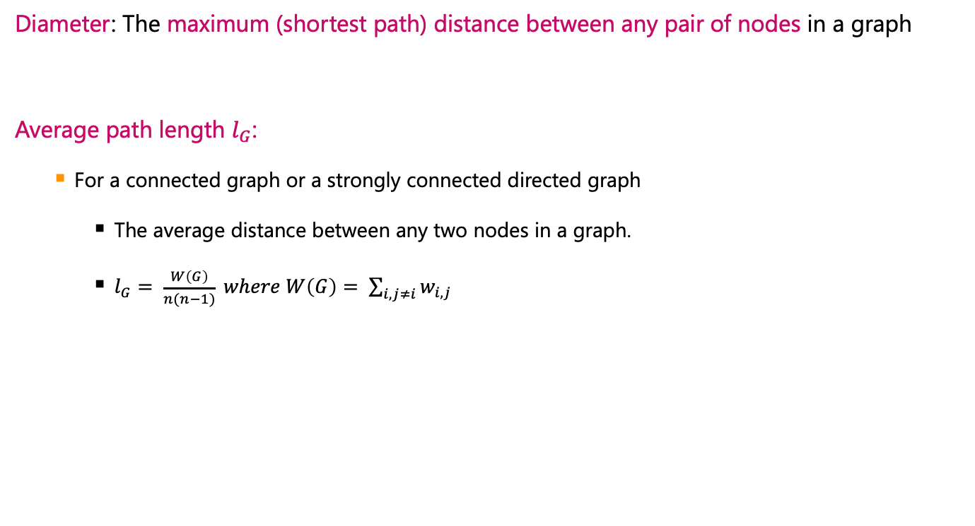
Network Diameter
Diameter: The maximum (shortest path) distance between any pair of nodes in a graph
Average path length $l_{G}$:
    For a connected graph or a strongly connected directed graph
      The average distance between any two nodes in a graph.
      $l_{G}= \frac{W\left(G\right)}{n(n−1)} where W\left(G\right)= \sum_{i,j≠i}{w_{i,j}}$

Slide 14
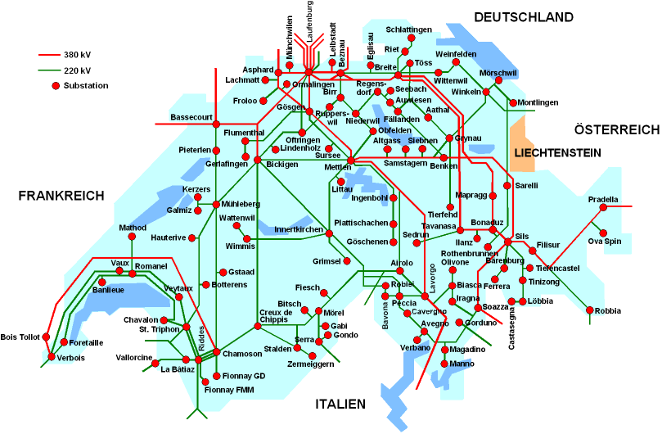
Motivation of Average path length
In Internet, a short average path length facilitates the quick transfer of information and reduces costs.
A power grid network will have fewer losses if its average path length is minimized.

Slide 15
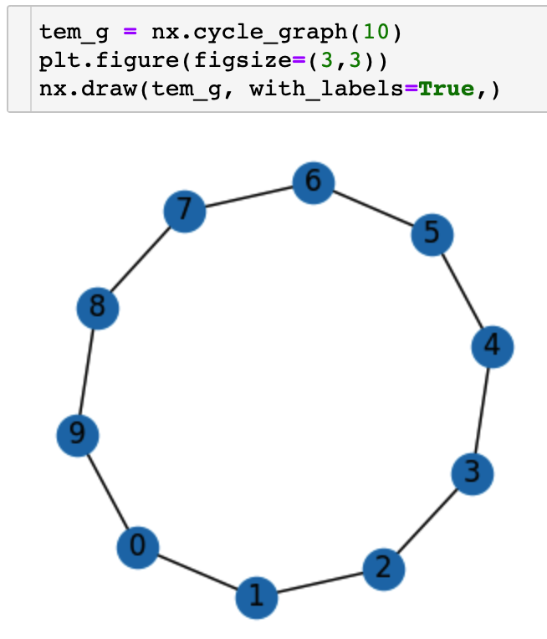
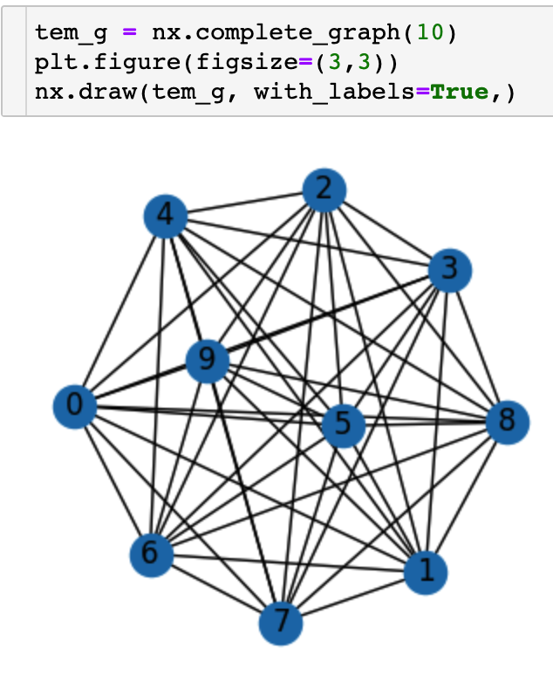
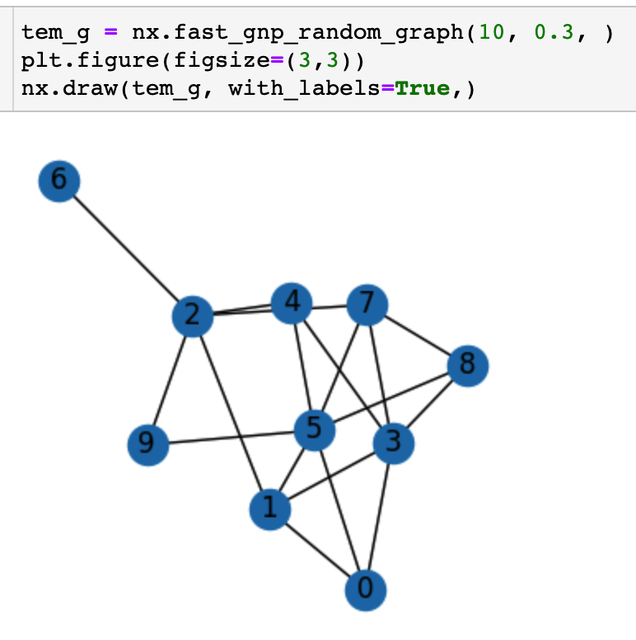
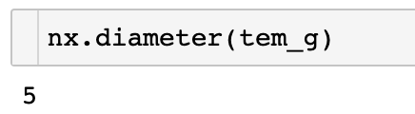
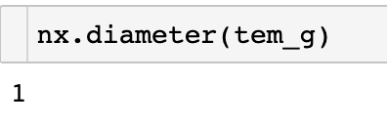
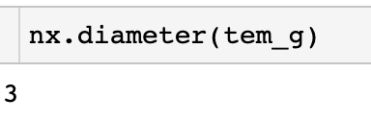
Network Diameter

Slide 16
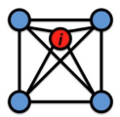
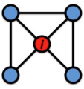
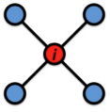





Clustering Coefficient
  What portion of $i^{′}s$ neighbors are connected ?
    Node $i$ with degree $k_{i}$
    $C_{i}∈[0, 1]$, $C_{i} =\frac{2e_{i}}{k_{i}\left(k_{i }−1\right)}$
    Average clustering coefficient: $C=\frac{1}{N}\sum_{i}^{N}{C_{i}}$
where $e_{i}$ is the number of edges between the neighbors of node $i$
$$c_{i}=1$$
$$c_{i}=0.5$$
$$c_{i}=0$$

Slide 17
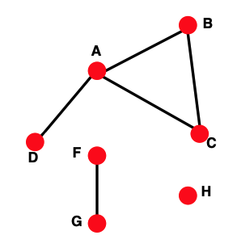
Connectivity
Size of the largest connected component
    Largest set where any two vertices can be joined by a path
    Largest component = Giant component
How to find connected components ?
Start from random node and perform BFS (Breadth First Search)
Label the nodes BFS visited
If all nodes are visited, the network is connected.
Otherwise, find an unvisited node and repeat BFS.

Slide 18

Visualize network properties in real network

Slide 19


MSN Messenger
1 month activity:
    245 million users logged in
    180 million users engaged in conversations
    More than 30 billion conversations
    More than 255 billion exchanged messages

Slide 20
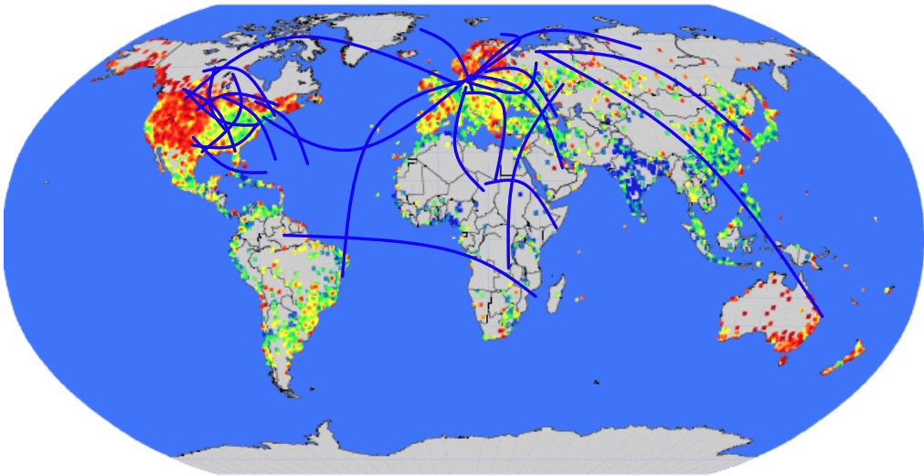
Communication Network
Network: 180 Million people, 1.3 Billion edges

Slide 21
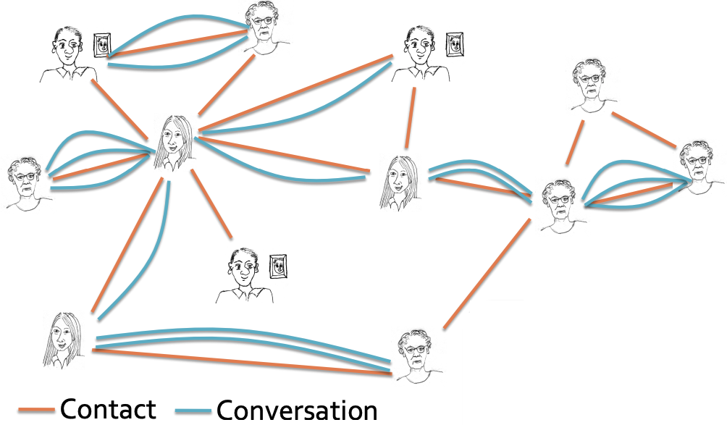
Network Construction
Messaging as an undirected graph
form an edge (u, v) if users u and v exchanged at least one message.
N = 180 million people
E = 1.3 billion edges

Slide 22
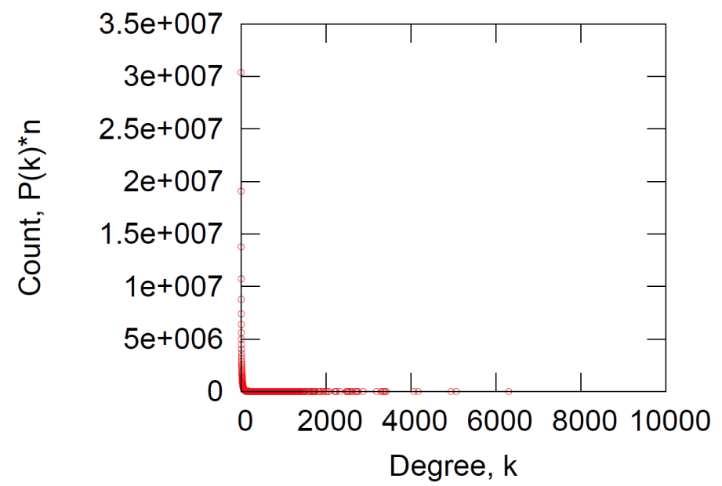
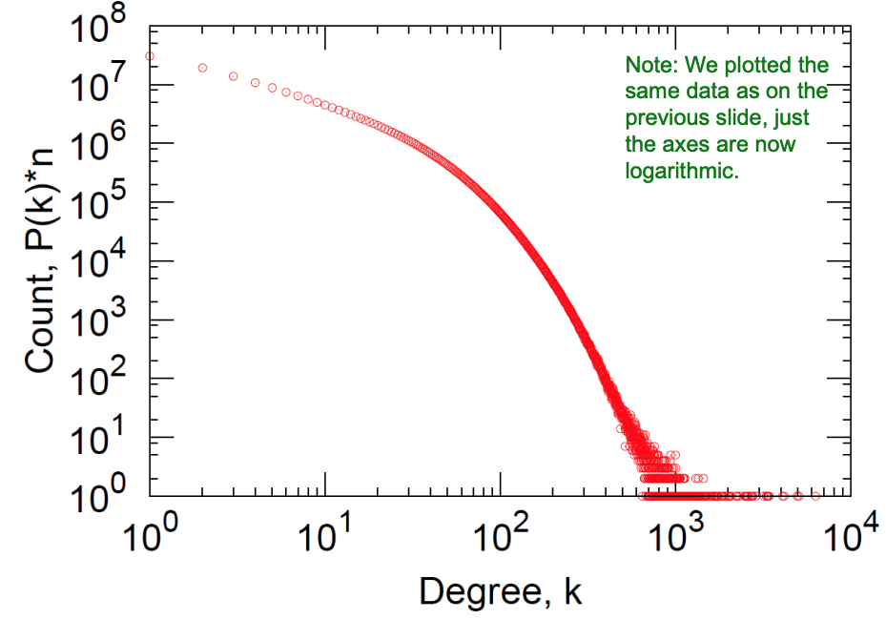
MSN: Degree distribution

Slide 23
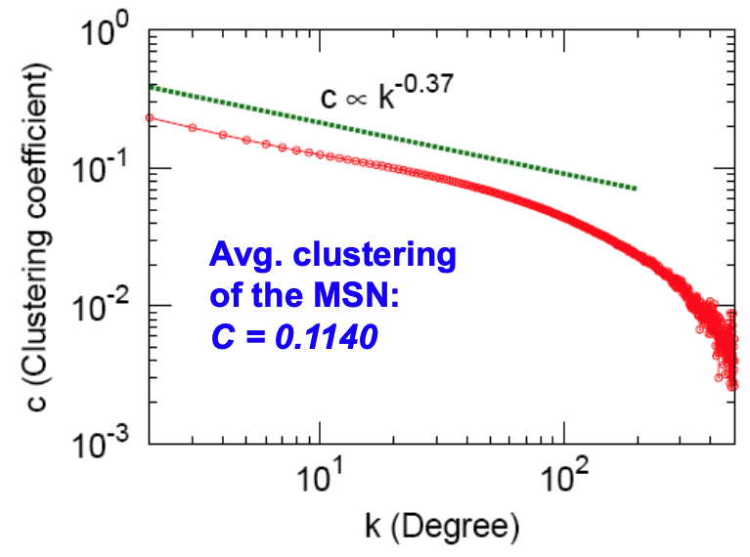
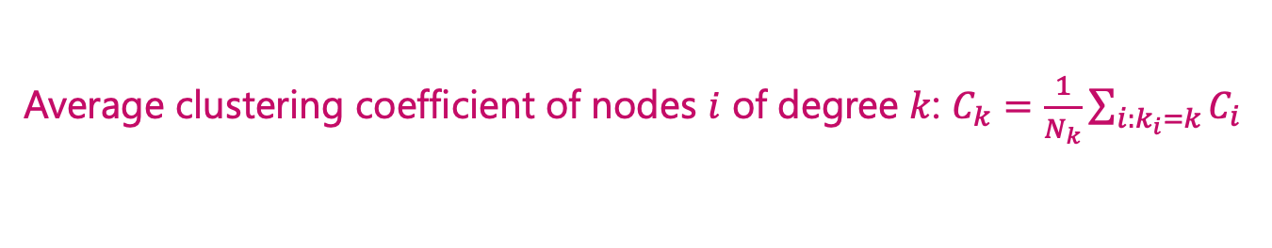
MSN: Clustering
Average clustering coefficient of nodes $i$ of degree $k$: $C_{k}=\frac{1}{N_{k}}\sum_{i:k_{i}=k}{C_{i}}$

Slide 24
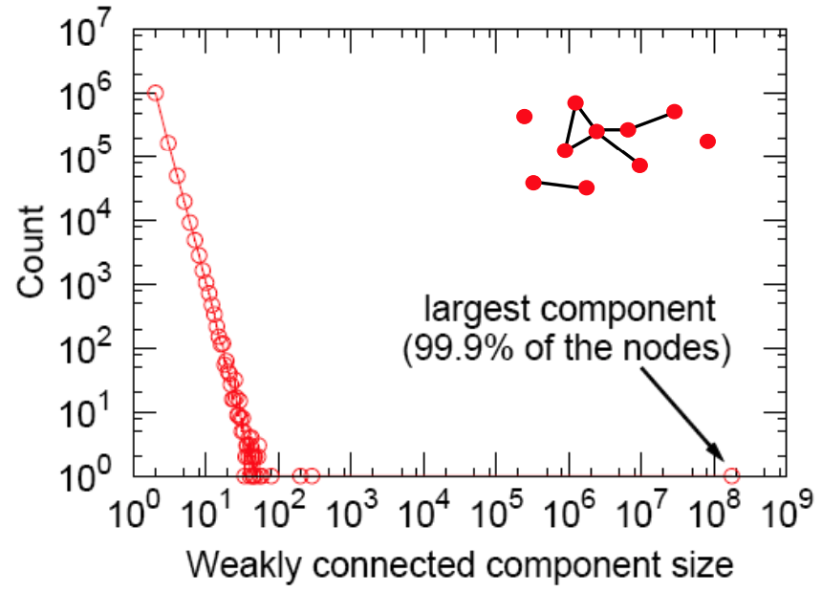
MSN: Connected Components

Slide 25
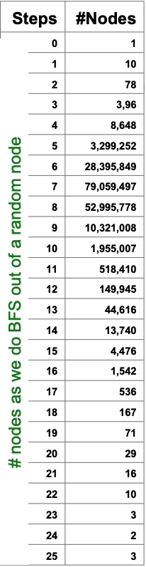
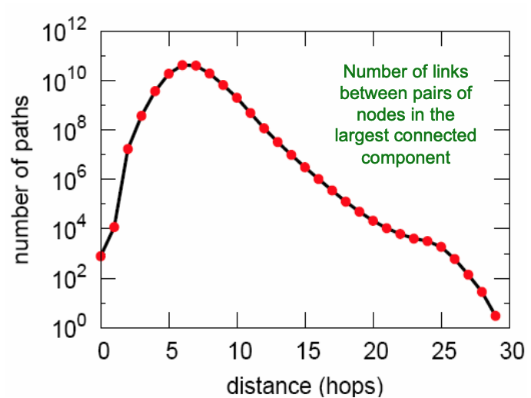
MSN: Diameter
Average path length: 6.6
90% of nodes can be reached in <8 hops

Slide 26
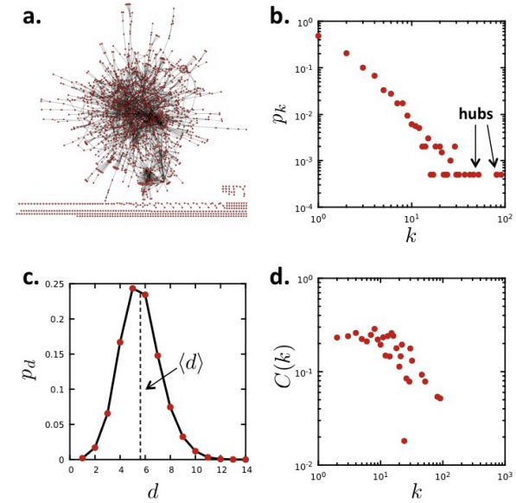
Key network properties of MSN
Degree distributions Heavily skewed, average degree = 14.4
Average Path length: 6.6
Clustering Coefficient: 0.11
Connectivity: giant component
Another example: PPI Network
Undirected network, Nodes = 2018 proteins,
Edges = 2930 binding interactions as links
Degree distribution: Skewed, average degree = 2.9
Average Path Length: 5.8
Clustering Coefficient: 0.12
Connectivity: 185 components,
the largest component 1647 nodes
(81% of nodes)

Slide 27
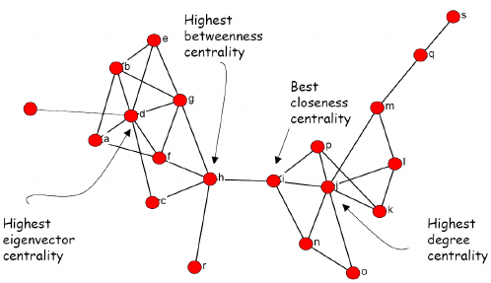
Network Centrality

Slide 28

Why measuring Node Importance ?
Many networks require knowledge of node importance to
    Find appropriate rankings
    Avoid single point of failure
    …
Applications
    Finding most vital node in satellite communication network
    Finding most influential node a social network
    …

Slide 29
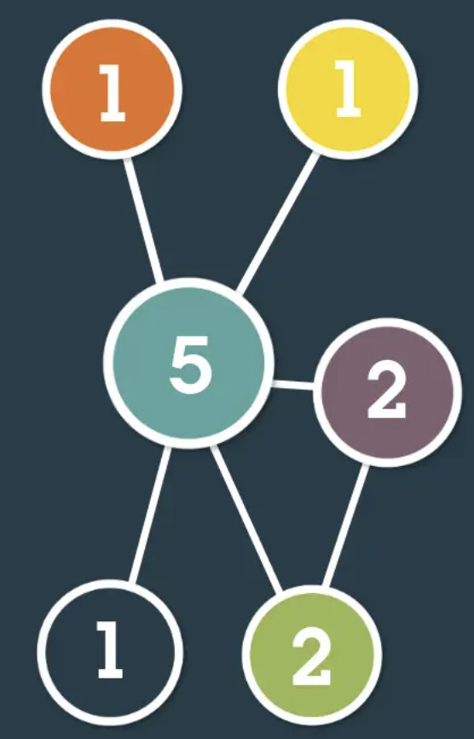
Network Centrality
  We can measure nodes importance using so-called centrality which were first developed in social network analysis.
  In graph theory and network analysis, indicators of centrality assign numbers or rankings to nodes within a graph corresponding to their network position.

Slide 30
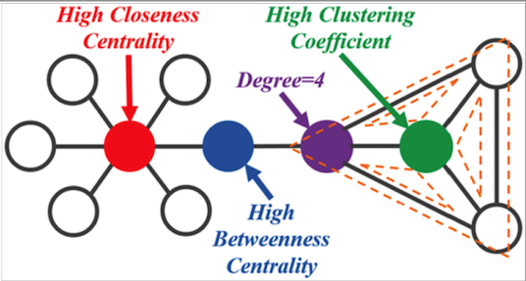
Network Centrality
  Given a social network, which nodes are more important or influential?
  Centrality measures were proposed to account for the importance of the nodes of a network.

Slide 31
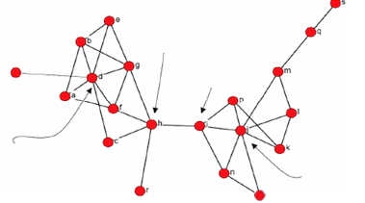
Types of Centrality Measures
  Geometric Measures
    Importance is a function of distance to other nodes
  Connectivity-based centralities
    Based on the eigen-structure of some graph related matrix
Highest betweenness centrality
Best closeness centrality
Highest eigenvector centrality
Degree Centrality

Slide 32

Network Centrality
Centrality is used often for detecting:
    How influential a person is in a social network?
    How well used a road is in a transportation network?
    How important a web page is?

Slide 33
A Leading Question
  Given a social network of different individuals
  Which nodes are the most important?
  A feasible solution
    The larger the node degree, the higher its centrality

Slide 34

Degree Centrality
  Degree Centrality:
    How many neighbors does a node have
    Often enough to find important nodes
      e.g., main characters of a movie talk with more people
    But not always
      Twitter users with the most contacts are spam
      Webpages/wikipedia pages with most links are often lists of references

Slide 35


In-degree Centrality
  (In-)Degree Centrality:
    The number of incoming links: $C_{deg}\left(x\right)=d_{in}(x)$
    Or equivalently, number of nodes at distance one.
      Equivalent to majority voting

Slide 36

Types of Centrality Measures
Geometric Measures
  Importance is a function of distances to other nodes.

Slide 37


Closeness Centrality
Geometric measures
    Closeness Centrality:
    Who are the bridges?
    $C_{clos}\left(x\right)=\frac{1}{\sum_{y}{d(y,x)}}$
    Nodes that are more central have smaller distances
d(y, x) is the distance (length of the shortest path) between vertices x and y.

Slide 38


Closeness Centrality
Geometric measures
    Closeness Centrality:
    How much a vertex can communicate without relying on third parties for his messages to be delivered.
$$C_{clos}\left(x\right)=\frac{1}{\sum_{y}{d(y,x)}}$$
d(y, x) is the distance (length of the shortest path) between vertices x and y.
How to compute C_{clos}(A) ?
Nodes that are more central have smaller distances

Slide 39

Closeness Centrality
  What’s your average distance with regards to the rest of the network?
    To normalize this score so that it represents the average length of the shortest paths rather than their sum.
    Highest closeness = More central
    Closeness=1: directly connected to all other nodes
    Well defined only on connected networks
$$C_{close}\left(x\right)=\frac{n−1}{\sum_{y}{d(y,x)}}$$

Slide 40



Limitation of Closeness Centrality
We get null values for all nodes, if the graph is not connected.
Distance is infinity if a pair of nodes x and y are not connected. Any number divided by infinity is zero.

Slide 41

Harmonic Centrality
  Replace the average distance with the harmonic mean of all distances.
    The $n(n−1)$ distances between every pair of distinct nodes.
    $C_{har}\left(x\right)=\sum_{x≠y}{\frac{1}{d(y,x)}}$
    Strongly correlated to closeness centrality
    Naturally also accounts for nodes y that cannot reach node x.
    Can be applied to graphs that are not strongly connected

Slide 42


Harmonic Example
$$C_{harm}=\frac{1}{1}+\frac{1}{2}\left(2\right)+\frac{1}{3}+\frac{1}{4}=2.5$$

Slide 43


Closeness vs Harmonic Centrality
Closeness
Harmonic
Red nodes are close to all the other nodes.
Red nodes are close to all the other nodes and have larger degrees.

Slide 44

Brokerage not captured by degree
Brokerage: a node lies between other people.
E.g. X plays more of a brokerage role than Y

Slide 45



Betweenness Centrality
Intuition:
    How many pairs of individuals would have to go through you in order to reach one another in the minimum number of hops.
$$C_{bet}\left(v\right)=\sum_{s,t∈V}{\frac{g_{s,t}\left(v\right)}{g_{s,t}}}$$
where $g_{s,t}$ = the number of shortest paths connecting node s with node $t$

Slide 46


Example of Betweenness
$$C_{bet} =\frac{5\left(5−1\right)}{2}$$

Slide 47

Example of Betweenness
  A lies between no two other vertices
  B lies between A and 3 other vertices: C, D, and E
  C lies between 4 pairs of vertices (A,D),(A,E),(B,D),(B,E)
  There are no alternate paths for these pairs to take, so C gets full credit.

Slide 48

Example of Betweenness

Slide 49

Example of Betweenness
Why do C and D each have betweenness of 1 ?
Why B has betweenness of 3.5 ?
What is the betweenness of node E ?

Slide 50


Betweenness Centrality
Edge Betweenness:
    Number of shortest paths passing over the edge.

Slide 51

Example of Betweenness
Example of Facebook network:
    nodes are:
      sized by degree
      coloured by betweenness

Slide 52

Comparing Centrality Measures

Slide 53



Comparing Centrality Measures
Degree Centrality
Closeness Centrality
Betweenness Centrality

Slide 54

Types of Centrality Measures
Connectivity-based Measures
    Based on the eigen-structure of some graph-related matrix.

Slide 55
Connectivity-based Measures
Intuition: A node’s centrality is a function of the centrality of its neighbors.
    Nodes connected to central nodes has a larger centrality score than those connected to non-central nodes.
      Eigenvector Centrality
      Katz’s Index

Slide 56

Eigenvector Centrality
Your centrality depends on the centralities of your neighbors.

Slide 57


Degree Centrality vs Eigenvector Centrality

Slide 58



Eigenvector Centrality
Measure of the influence of a node in a network.
    Every node starts with the same score
    Each node gives away its score to its successors
    $C_{eig}\left(x\right)=\frac{1}{λ}\sum_{y→x}{C_{eig}(y)}$
      $C_{eig}$converges to the dominant eigenvector of adjacent matrix A
      $λ$converges to the dominant eigenvalue of adjacent matrix A
    Equivalently, eigen-centrality is the eigenvector corresponds to the dominant eigenvalue($λ$) of A
      $AX=λX$
    Problem: Graph should be strongly connected !
$$\sqrt{\sum_{i}{C_{i}^{2}}}$$
where $λ=$Normalization constant

Slide 59




How to compute?
Power Iteration:
    Step 1: Set c(0) = 1, k = 1
    Step 2: $c^{(k)} = Ac\left(k−1\right)$
    Step 3: $c^{(k)} =c^{\left(k\right)}/{\left|\left|c^{\left(k\right)}\right|\right|}_{2}$
    Step 4 if $\left|\left|c^{\left(k\right)}−C^{\left(k−1\right)}\right|\right|>ε:$
    $k=k+1;Go to step 2$
A =
C⁽⁰⁾ =

Slide 60






How to compute?
Power Iteration:
Iteration 1
$$\sqrt{\sum_{i}{C_{i}^{2}}}$$
A
c⁽⁰⁾
c⁽¹⁾ = Ac⁽⁰⁾
c⁽¹⁾ = c⁽¹⁾/||c⁽¹⁾||₂
Iteration 2
Iteration 3
Iteration k

Slide 61

Eigencentrality Example

Slide 62

Connectivity-based Centralities
  Eigenvector centrality (also called eigencentrality) is a measure of the influence of a node in a network.
    It assigns relative scores to all nodes in the network based on the concept that connections to high-scoring nodes contribute more to the score of the node in question than equal connections to low-scoring nodes.
    Google's PageRank and the Katz centrality are variants of the eigenvector centrality.
Notes:
卡茨

Slide 63

Which Centrality is the Best?
No one is the best!
Share of network centrality measurements in 63 studies
Vignery, K., & Laurier, W. (2020). A methodology and theoretical taxonomy for centrality measures: What are the best centrality indicators for student networks?. PLoS One, 15(12), e0244377.

Slide 64

Limitations of Centrality
  The obvious limitation is that
    a centrality which is optimal for one application is often sub-optimal for a different application.
  An illustration of this phenomenon is provided by the Krackhardt kite graph
    Three different notions of centrality give three different choices of the node centrality.

Slide 65
Limitations of Centrality
  Centrality are not designed to measure the influence of nodes in general.
  A ranking only orders vertices by importance, it does not quantify the difference in importance between different levels of the ranking
  The features which (correctly) identify the most important vertices in a given network/application do not necessarily generalize to the remaining vertices

Slide 66

Any Questions?

