Slide 1

DSAI4205 Big Data Analytics
Lecture 6:
Intro to Large Language Model (LLM)
Dr. Ken FONG
Department of Data Science and Artificial Intelligence
chi-kit-ken.fong@polyu.edu.hk

Slide 2
Agenda
1. text similarities
2. text embedding: text2vec
2.1 skip-gram
2.2 continuous bag of words (CBOW)
2.3 skip-gram with negative sampling (SGNS)
2.4 The glove model
3. Word Embedding Programming

Slide 3
Categories of Text Similarity Algorithms
  Edit-based Similarity Algorithms
    These algorithms are based on the number and type of edits (insertions, deletions, substitutions) required to transform one string into another.
  Token-based Similarity Algorithms
    These algorithms compare sets of tokens (words, phrases, etc.) in texts and mainly focus on the overlap of these tokens.
  Hybrid Similarity Algorithms
    These algorithms combine different types of similarity measures to improve performance or to handle more complex comparison tasks. There is only one method: Monge-Elkan. It is a mix of edit based and token based distance.

Slide 4
Edit-based Similarities
  Edit distance is a measure of the dissimilarity between two strings, which we refer to as the source and target.
  The less the number of operations needed to transform the source into the target, the more similar the two strings are.
    Hamming Distance
      Measure of the minimum number of substitutions required to change one string into the other
    Levenshtein Distance
      Minimum number of single-character edits (insertions, deletions, substitutions) required to change one word into the other.

Slide 5
Hamming Distance
  Hamming Distance is a measure of the minimum number of substitutions required to change one string into the other.
  Example
    For "taking" and "making":
      t a k i n g
      m a k i n g
    For “dump” and “puma”:
      d u m p
      p u m a
Only the first character is different, so the Hamming distance, d("taking", "making") = 1.
    The first and the fourth characters are different, so the Hamming distance, d("dump", "puma") = 2.

Slide 6
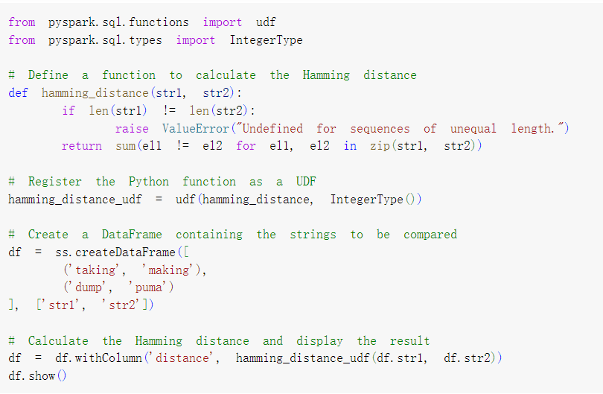
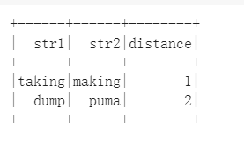
Hamming Distance
  Strengths: Simple and fast to compute.
  Weaknesses: Only applicable for strings of the same length.
  Does not consider insertions or deletions.

Slide 7
Levenshtein Distance
  Levenshtein Distance is the minimum number of single-character edits required to change one word into the other.
    insertions, deletions, substitutions
  Example: let's consider the two words "kitten" and "sitting":
    "kitten" -> "sitten" (replace "k" with "s")
    "sitten" -> "sittin" (replace "e" with "i")
    "sittin" -> "sitting" (insert "g" at the end)
    Therefore, the Levenshtein Distance between "kitten" and "sitting" is 3.
      Three operations to transform one word into the other.

Slide 8
Operations of Levenshtein Distance
  Operations:
    Replace
    Insert
    Delete
A | N
0 | 1
A | N | T
0 | 1 | 2
Match
B | U | T
0 | 1 | 2
B | U
0 | 1
Convert to sub-problem

Slide 9
Operations of Levenshtein Distance
  Operations:
    Replace
    Insert
    Delete
U
1
A | N
0 | 1
Perform one operation of a replacement
A
0
B
0
B | U
0 | 1
Proceed to the next sub problem

Slide 10
Operations of Levenshtein Distance
  Operations:
    Replace
    Insert
    Delete
A | N
0 | 1
U
2
A | N
0 | 1
B
0
B | U
0 | 1
Proceed to the next sub problem

Slide 11
Operations of Levenshtein Distance
  Operations:
    Replace
    Insert
    Delete
A | N
0 | 1
A
0
B | U
0 | 1
B | U
0 | 1
Proceed to the next sub problem

Slide 12
DP table for BUT to ANT
Source Word
 | ”” | A | N | T
””
B
U
T
 | ”” | A | N | T
”” | 0 | 1 | 2 | 3
B
U
T
Steps to convert from ANT to “”
Target Word
Steps to convert from AN to “”
Deletions
Steps to convert from “” to “”
Steps to convert from A to “”

Slide 13
DP table for BUT to ANT
Source Word
 | ”” | A | N | T
””
B
U
T
 | ”” | A | N | T
”” | 0 | 1 | 2 | 3
B | 1
U | 2
T | 3
Target Word
Steps to convert from “” to B
Steps to convert from “” to BU
(Insertions)
Steps to convert from “” to BUT

Slide 14
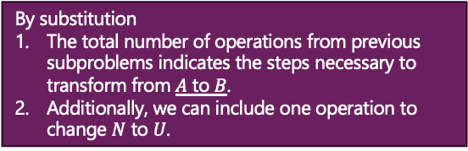
DP table for BUT to ANT
By substitution
The total number of operations from previous subproblems indicates the steps necessary to transform from $A$ to $B$.
Additionally, we can include one operation to change $N$ to $U$.
Source Word
 | ”” | A | N | T
””
B
U
T
 | ”” | A | N | T
”” | 0 | 1 | 2 | 3
B | 1 | 1 | 2
U | 2 | 2
T | 3
DP[1][1] + 1 = 2
By insertion:
We consider how to transform AN to B, by remove N from AN and substitute A to B, this take two operations.
Target Word
DP[1][2] + 1 = 3
AN
U
AN→B
BU
By deletion:
We consider how to transform A to BU, by remove N from AN and substitute A to B, this take two operations.
The minimum steps require to transform AN → BU
DP[2][1] + 1 = 3
AN
A→BU
BU

Slide 15
DP table for BUT to ANT
Source Word
 | ”” | A | N | T
”” | 0 | 1 | 2 | 3
B | 1 | 1 | 2 | 3
U | 2 | 2 | 2 | 3
T | 3 | 3 | 3 | 2
Target Word

Slide 16
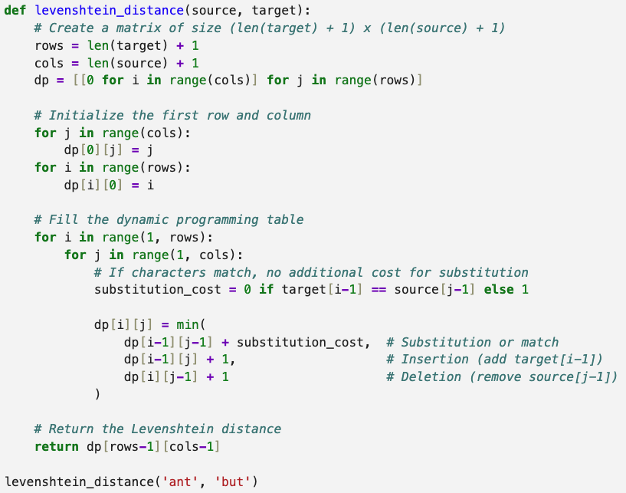
Levenshtein Distance
  Strengths: More flexible than Hamming distance as it allows insertions and deletions.
  Weaknesses: Computationally more expensive than Hamming distance.
Notes:
the function does:
1. Lines 2-5: The function starts by checking if `s1` is shorter than `s2`. If it is, it swaps them by recursively calling itself with `s2` and `s1` reversed (`levenshtein_distance(s2, s1)`). If `s2` is an empty string, it returns the length of `s1` which is the number of deletions needed to transform `s1` into an empty string.
2. Line 7: Creates a list named `previous_row` representing the Levenshtein distance from every character in `s2` to an empty string.
3. Lines 8-16: The function then iterates over every character `c1` in `s1` (along with its index `i`). For each character, it creates a new list `current_row`, which will represent the Levenshtein distance from substrings of `s1` to `s2`.
4. Lines 9-14: For each `current_row`, it iterates over every character `c2` in `s2` (along with its index `j`). For each pair of characters `c1` and `c2`, it computes the cost of insertion, deletion, and substitution operations and appends the minimum cost to the `current_row` list.
5. Line 15: After computing the entire `current_row`, it assigns `current_row` to `previous_row` for use in the next iteration.
6. Line 17: After all iterations, the function returns the last value in `previous_row`, which represents the Levenshtein distance between `s1` and `s2`.
So, for example, if you pass in "kitten" and "sitting" as `s1` and `s2`, the function will return 3, because you need at least three single-character edits to transform "kitten" into "sitting":
1. Replace "k" with "s".
2. Replace "e" with "i".
3. Append "g" to the end.

Slide 17
Token-based Similarity
  Token-based similarity is a method of determining the similarity between two texts by treating the texts as collections of tokens, usually words.
  The similarity is then determined based on the overlap of these tokens.
    Jaccard Index
    Sørensen-Dice Coefficient
    Tversky Index
    Overlap Coefficient
    Tanimoto Distance
    Cosine Similarity

Slide 18
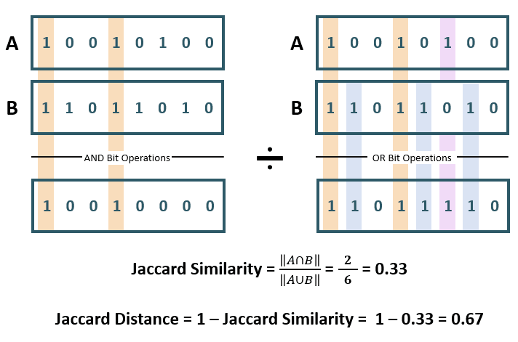
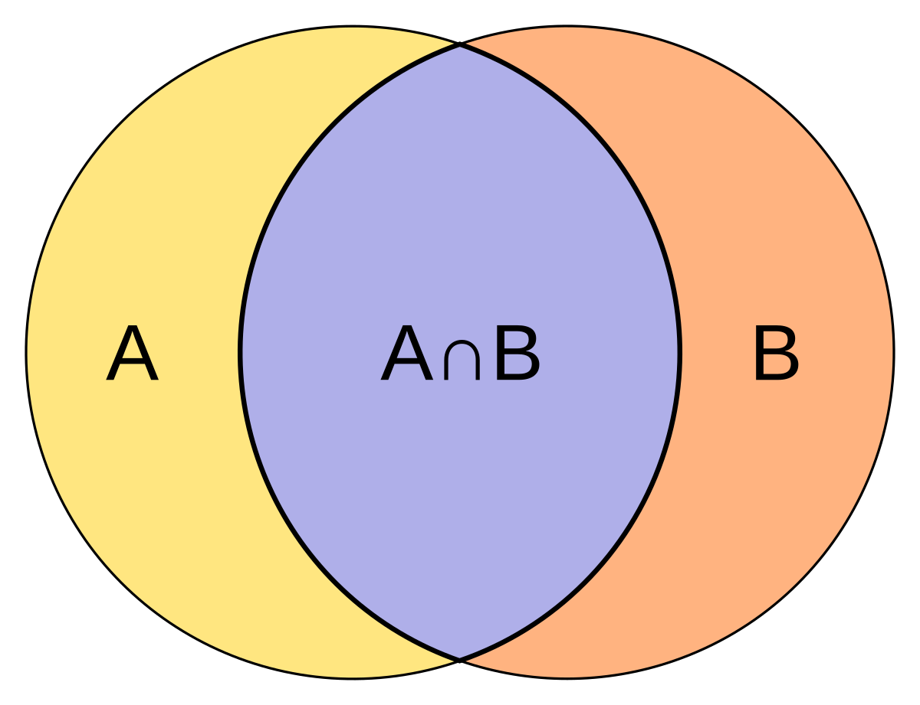
Jaccard Index
  The Jaccard Index measures the similarity between two sets as the size of the intersection divided by the size of the union of the sets.

Slide 19
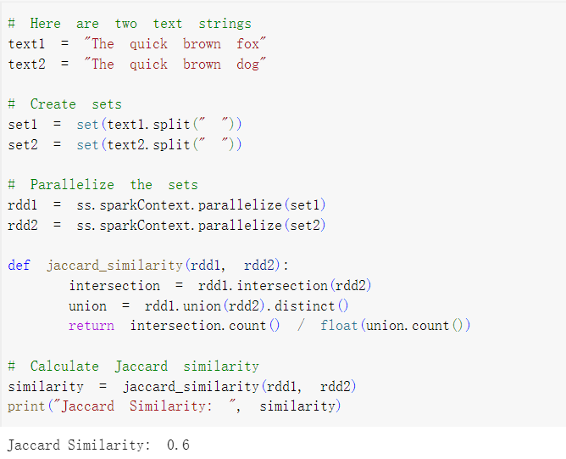
Jaccard Index Example
  Example: "The quick brown fox" and "The quick brown dog":
    Convert the sentences into sets of words:
      text1: {"The", "quick", "brown", "fox"}
      text2: {"The", "quick", "brown", "dog"}
    Calculate the intersection and union of the two sets:
      Intersection: {"The", "quick", "brown"}
      (these words appear in both sentences)
      Union: {"The", "quick", "brown", "fox", "dog"} (these words appear in either or both sentences)
    Jaccard Index
    = Size of Intersection / Size of Union
    = 3 / 5 = 0.6
  Strengths: Simple to understand and calculate.
  Weaknesses: Sensitive to the size of the data sets.

Slide 20

Sørensen-Dice Coefficient
  The Sørensen-Dice Coefficient measures the similarity between two sets as twice the size of the intersection divided by the sum of the sizes of the two sets.
  Example: "The quick brown fox" and "The quick brown dog":
    Convert the sentences into sets of words:
      text1: {"The", "quick", "brown", "fox"}
      text2: {"The", "quick", "brown", "dog"}
    Calculate the intersection and the sizes of the two sets:
      Intersection: {"The", "quick", "brown"}
      (these words appear in both sentences)
      Size of set 1: 4 (four words in text1)
      Size of set 2: 4 (four words in text2)
    Dice's Coefficient = 2 * (size of intersection) / (size of set 1 + size of set 2) = 2 * 3 / (4 + 4) = 0.75

Slide 21
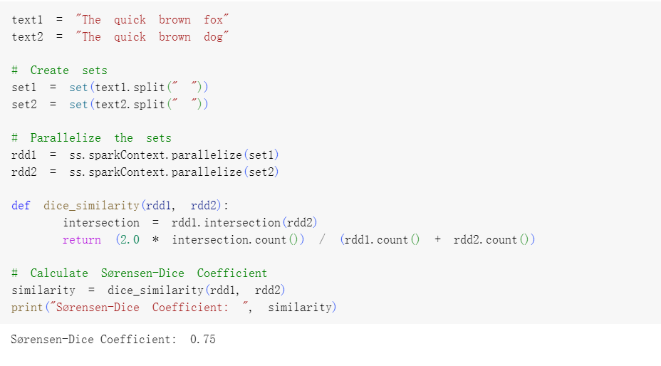
Sørensen-Dice Coefficient
  Strengths: Gives more weight to the overlap between sets compared to the Jaccard Index.
  Weaknesses: Still sensitive to the size of the data sets.

Slide 22

Tversky Index
  The Tversky Index is a generalization of the Jaccard Index and Sørensen-Dice Coefficient,
    allowing different weights for false positives and false negatives.
  Example: "The quick brown fox" and "The quick brown dog":
    Convert the sentences into sets of words:
      text1: {"The", "quick", "brown", "fox"}
      text2: {"The", "quick", "brown", "dog"}
    Calculate the intersection and the sizes of the two sets:
      Intersection: {"The", "quick", "brown"}
      (these words appear in both sentences)
      X \ Y: {"fox"} (these words appear only in text1)
      Y \ X: {"dog"} (these words appear only in text2)
    Use the Tversky Index formula to calculate. Suppose we choose α = 0.5 and β = 0.5
      give less weight to the differences than the intersection.
|X ∩ Y| / (|X ∩ Y| + α * |X \ Y| + β * |Y \ X|)
= 3 / (3 + 0.5 * 1 + 0.5 * 1) = 0.75

Slide 23
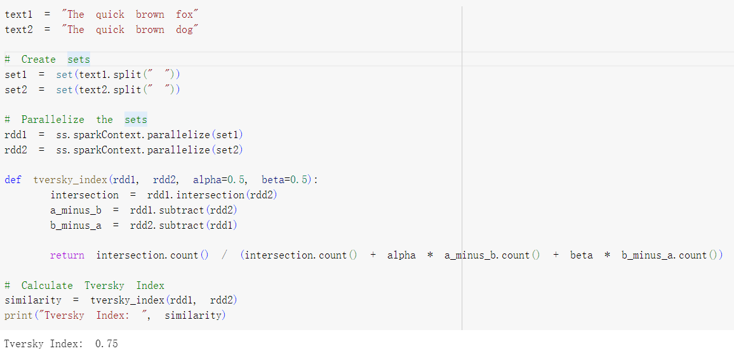
Tversky Index
  Strengths: More flexible in handling different types of data.
  Weaknesses: More complex to calculate and interpret.

Slide 24

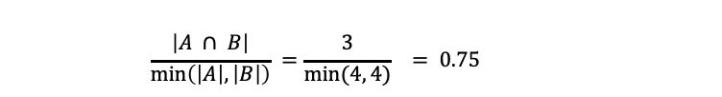
Overlap Coefficient
  The Overlap Coefficient measures the similarity between two sets as the size of the intersection divided by the size of the smaller set.
  Example: "The quick brown fox" and "The quick brown dog":
    Convert the sentences into sets of words:
      text1: {"The", "quick", "brown", "fox"}
      text2: {"The", "quick", "brown", "dog"}
    Calculate the intersection of the two sets:
      Intersection: {"The", "quick", "brown"} (these words appear in both sentences)
      Overlap Coefficient =
      $$\frac{\left|A ∩ B\right|}{\min\left(\left|A\right|, \left|B\right|\right)} =\frac{3}{min⁡(4, 4)} = 0.75$$

Slide 25
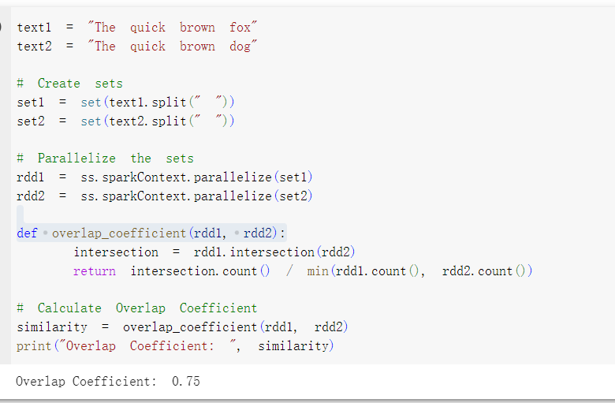
Overlap Coefficient
  Strengths: Less sensitive to the size of the data sets.
  Weaknesses: May not work well with very unevenly sized sets.

Slide 26
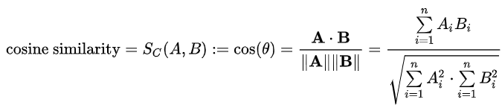
Cosine Similarity
  Cosine Similarity measures the cosine of the angle between two n-dimensional vectors.
  Example: "The quick brown fox" and "The quick brown dog":
  Convert the sentences into vectors of word counts:
    vector1: {"The": 1, "quick": 1, "brown": 1, "fox": 1, "dog": 0}
    vector2: {"The": 1, "quick": 1, "brown": 1, "fox": 0, "dog": 1}
  Next, we compute the dot product of these two vectors, which is done by multiplying the corresponding elements and then summing the results:
    (1*1) + (1*1) + (1*1) + (1*0) + (0*1) = 1 + 1 + 1 + 0 + 0 = 3
    Calculate the magnitudes of the vectors:
      Magnitude of vector1 = sqrt(1^2 + 1^2 + 1^2 + 1^2 + 0^2) = 2
      Magnitude of vector2 = sqrt(1^2 + 1^2 + 1^2 + 0^2 + 1^2) = 2
    Cosine similarity:
      Dot product / (Magnitude of vector1 * Magnitude of vector2) = 3 / (2 * 2) = 0.75

Slide 27
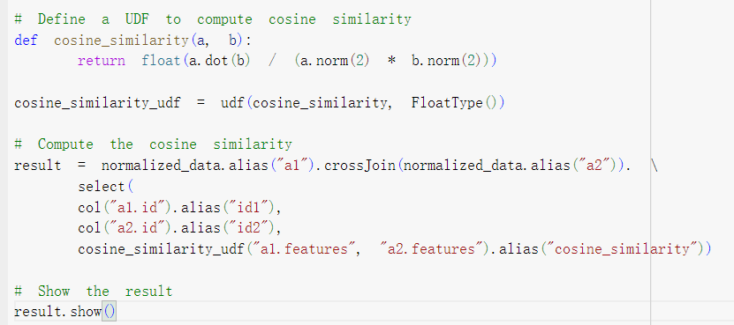
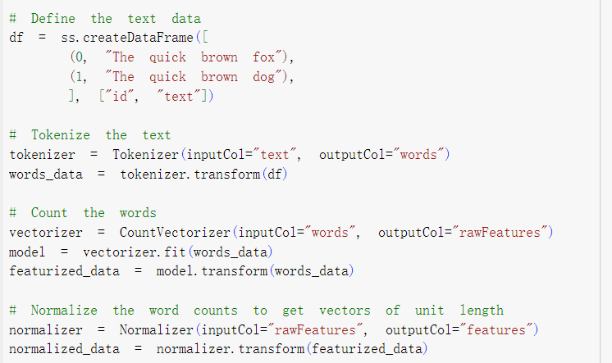
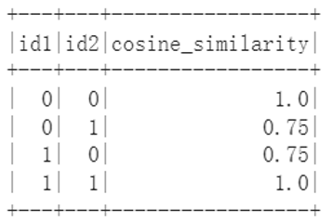
Cosine Similarity
  Strengths: Works well even with high-dimensional data.
  Weaknesses: Does not consider the magnitude of the vectors.

Slide 28
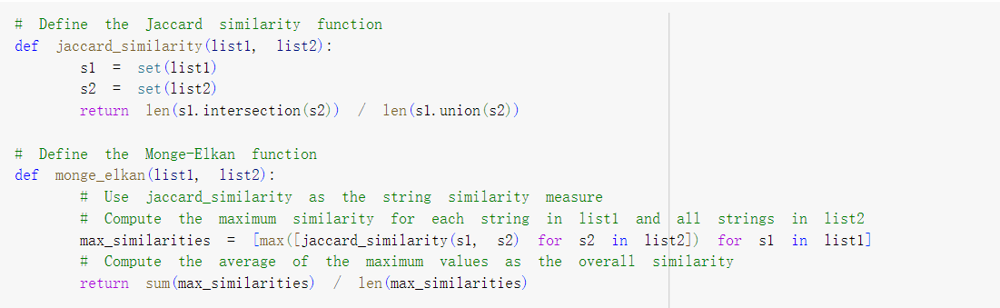
Hybrid Similarities
  Hybrid similarity is a concept in text mining that combines multiple similarity measures to compare text strings.
    It allows for a more comprehensive and accurate analysis by leveraging the strengths of different approaches.
  Monge-Elkan:
    The Monge-Elkan method is a hybrid similarity measure that compares two sets of text strings.
    It applies a secondary similarity function (like Jaccard, cosine, etc.) to every possible pair of elements from the two sets.
    The overall similarity is the average of the maximum values obtained for each element in the first set.

Slide 29
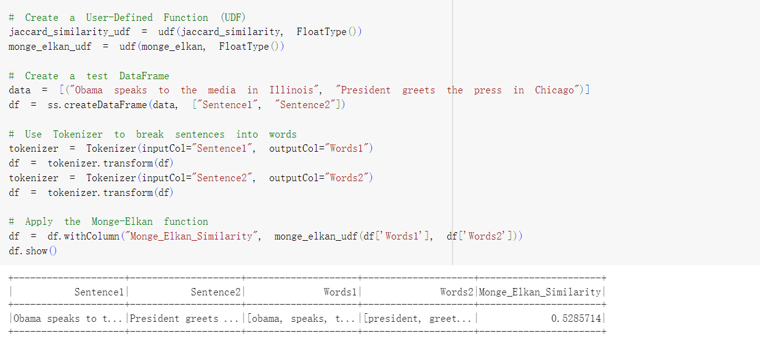
Monge-Elkan
  Strengths:
    Can capture complex similarities by combining different measures.
    Can handle variable-sized sets of text strings.
  Weaknesses:
    Computationally intensive due to the need to compare each element in one set with each element in the other set.
    Depends on the choice of the secondary similarity function.

Slide 30
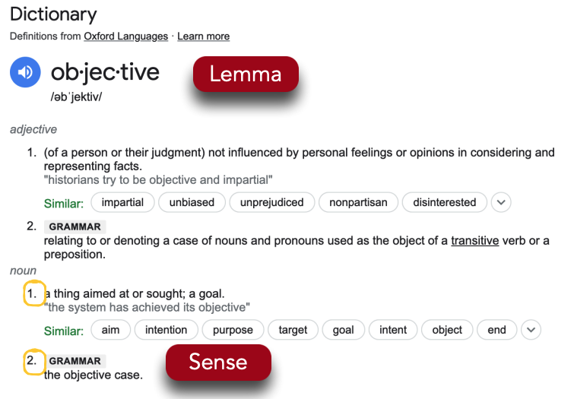
What do words mean?
  A sense or “concept” is the meaning component of a word
  Canonical form (Lemmas)
    For example:
      break, breaks, broke, broken and breaking all share the lemma “break”
  May have multiple meanings

Slide 31
Synonymy
  Synonyms: words that have the same meaning in some or all contexts
    couch / sofa
    big / large / huge
    automobile / vehicle / car
    water / H₂0
  Perfect Synonymy might not be possible…
  Still may differ based on politeness, slang, register, genre, etc.
    e.g. cannot use H20 in a surfing guide!

Slide 32
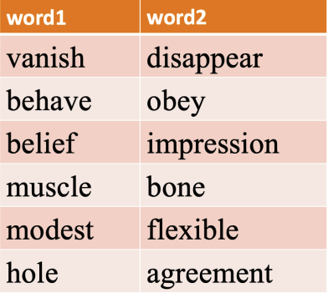


Similarity
  Words with similar meanings. Not synonyms, but sharing some element of meaning
Not to be confused with word association / relatedness:
couch / sofa vs. couch / pillow

Slide 33
Antonymy
  Senses that are opposites with respect to only one feature of meaning
  Otherwise, they are very similar!
    e.g. dark/light, short/long, fast/slow, rise/fall, hot/cold, up/down, in/out
  More formally: antonyms can
    Define a binary opposition or be at opposite ends of a scale
      e.g. long/short, fast/slow
    Denote opposing processes
      rise/fall, up/down

Slide 34







Semantic Relationships Captured within Word
  A word embedding is a function that maps each word type to a single vector
  It represents words as vectors, where each word is associated with a list of numbers
apple
tropical
mango
[0.50, 0.30, -0.10, 0.20, 0.60]
[0.80, 0.15, 0.35, -0.65, 0.45]
[0.73, -0.19, 0.42, -0.85, 0.36]

Slide 35

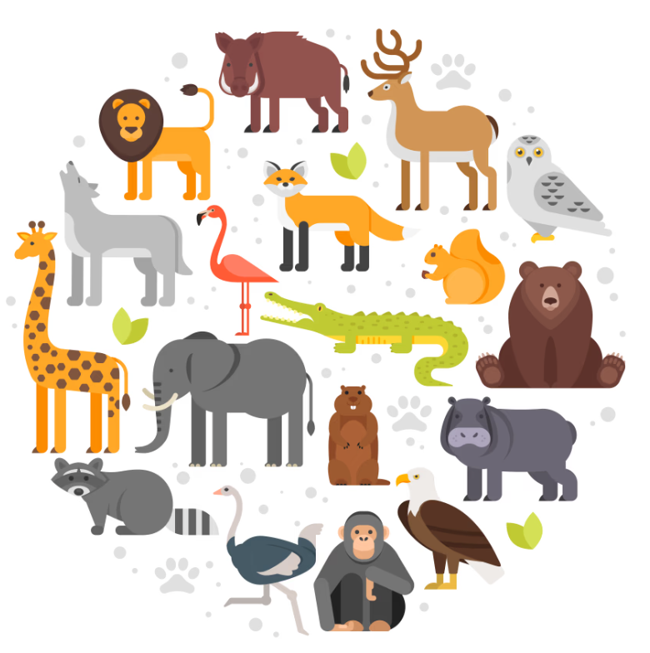
Understanding word vectors
  Suppose we have a small subset of English words for animals
  Objective: Find similarities among these words
  In order to find similarities between different animal words, we may first need to quantify them !
  We can quantify animal in terms of:
Cuteness
Size

Slide 36
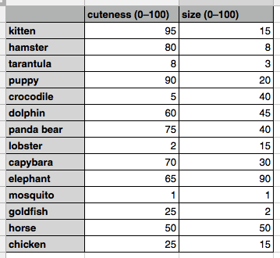


Understanding word vectors
  The values themselves are simply based on my own judgment
  Your taste in cuteness and evaluation of size may differ significantly from mine
  These values give us everything we need to make determinations about which animals are similar
Which animal is most similar to a capybara ?

Slide 37
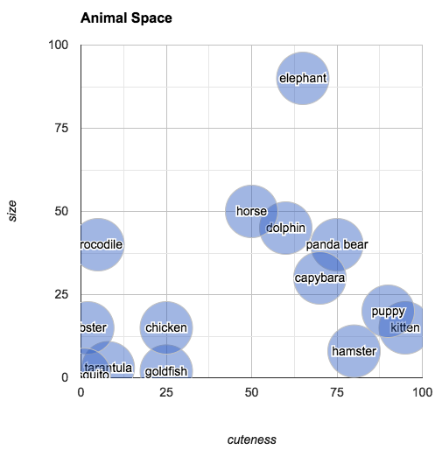



Understanding word vectors
Closest animal to the capybara: panda bear
104.1
11.180
We can measure the similarities between two data points by Euclidean distance
$$\sqrt{{{(x}_{1}−x_{2})}^{2}+{(y_{1}−y_{2})}^{2}}$$

Slide 38
Understanding word vectors
  Based on the plot, we can provide interesting visualization:
    Random walk: we can pick an arbitrary point in "animal space"
    and then find the animal closest to that point
      E.g. an arbitrary point with size 25 and cuteness 25
    what's halfway between a chicken and an elephant?
    What’s the difference between a goldfish and hamster?
  A sequence of numbers used to identify a point is called a vector
  A set of vectors that are all part of the same data set is often called a vector space.
    The vector space of animals in this example has two dimensions,
      Each vector in the space has two numbers associated with it
      (i.e., two columns in the table).
    The fact that this space has two dimensions just happens to make it easy to visualize the space by drawing a 2D plot.
Mid Point
X

Slide 39
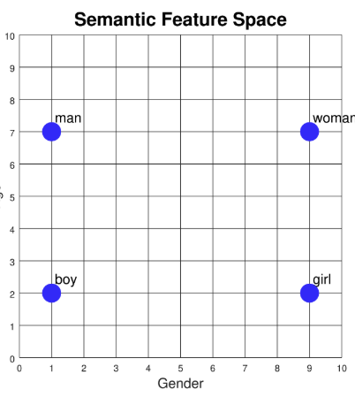
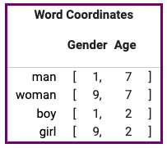
Semantic Feature Space
  Consider we have 4 data points in a 2-dimension space.
    Two of them refer to adults, and two are children.
    We can plot these on a graph where
      x axis represents gender
      y axis represents age:
  Gender and age are called semantic features:
    represent part of the meaning of each word
grandfather
adult
child
infant
We can add new words to the plot based on their meanings.
For example:
Where should the words "adult" and "child" go?
How about "infant"? Or "grandfather"?

Slide 40


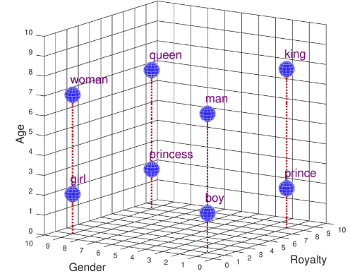
Semantic Feature Space
  Consider the words "king", "queen", "prince", and "princess".
    They have the same gender attribute as
    May have similar age attributes as
    They don't mean the same thing
    We need to introduce a new semantic feature in which they differ.
      Let's call it "royalty".
"man", "woman", "boy', and "girl".

Slide 41
Uses of Semantic Feature Vectors
  What can we do with these numerical representations?
    We can use them for is judging similarity between words.
    For example, "boy" is more similar to "girl" than to "queen"
      because the distance from "boy" to "girl" is less than the distance from "boy" to "queen".
  We have several ways to measure the similarities:
    Simply way: to count the number of features where the words differ.
      "Boy" and "girl" differ on only one feature (gender)
      " Boy " and "queen" differ on all three features (gender, age, and royalty).
    A better way, since each word is represented by coordinate values, is to compute the Euclidean distance between those points.
      But if we do take this approach, the distance between "boy" and "girl" turns out to be 8.0, while the distance between "boy" and "queen" comes out to 11.75.

Slide 42
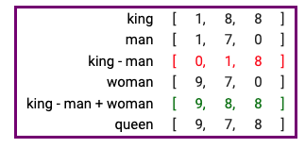
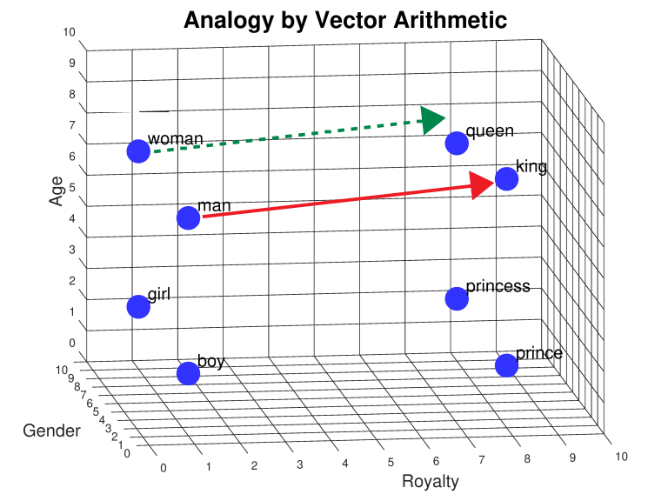
Analogies By Vector Arithmetic
  Analogies express the relationships between concepts
  For example:
    First find the relationship between man and king.
    We can do this numerically by calculating "king" - "man” + “woman”
      Subtract each coordinate separately, giving (1 - 1) , (8 - 7), and (8 - 0), or [0, 1, 8]
      Add this to "woman", treating each coordinate separately, meaning (0 + 9), (1 + 7), (8 + 0) or [9, 8, 8].
  "man is to king as woman is to _____".

Slide 43
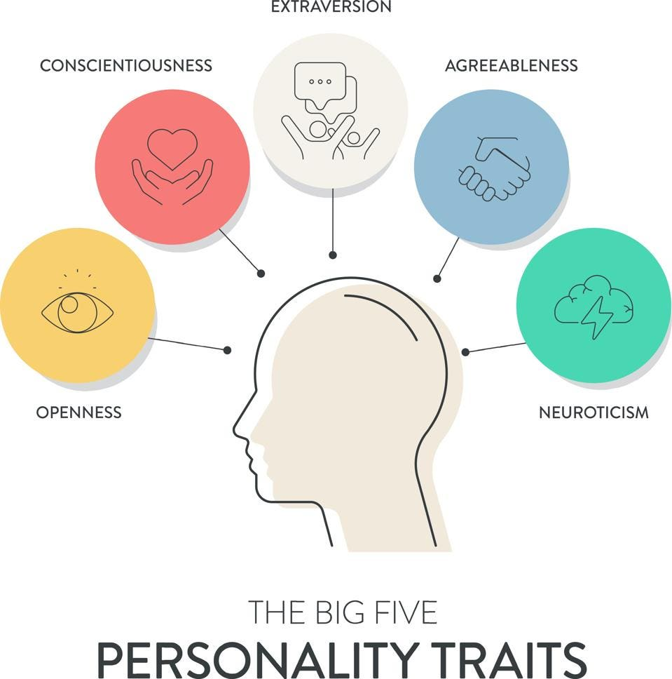
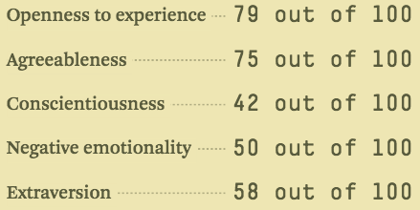

Understanding word vectors
  Have you ever taken a personality test like the Big Five Personality Test ?
[79, 75, 42, 50, 58]
[0.58, 0.5, -0.16, 0, 0.16]
Let’s switch the range to be from -1 to 1
Jay

Slide 44


Understanding word vectors
[0.58, 0.5, -0.16, 0, 0.16]
Jay
[0.34, -0.1, 0.52, 0.06, 0.24]
[0.42, -0.02, 0.16, 0.48, -0.14]
Steven
Allie
How to compare the similarities between them ?

Slide 45
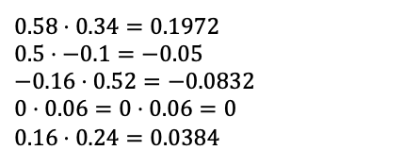
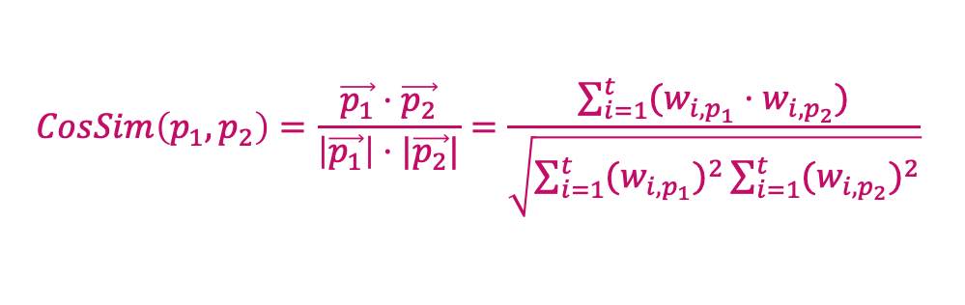
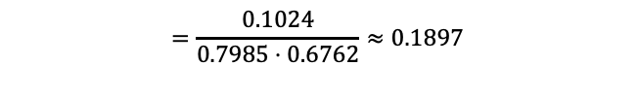
Cosine similarity
t₃
  Cosine similarity measures the cosine of the angle between two vectors.
  Inner product normalized by the vector lengths.
θ₁
$$CosSim\left(p_{1}, p_{2}\right)=\frac{\vec{p_{1}}⋅\vec{p_{2}}}{\left|\vec{p_{1}}\right|⋅|\vec{p_{2}}|}=\frac{\sum_{i=1}^{t}{(w_{i,p_{1}}⋅w_{i, p_{2}})}}{\sqrt{\sum_{i=1}^{t}{{{(w}_{i,p_{1}})}^{2}}\sum_{i=1}^{t}{{{(w}_{i,p_{2}})}^{2}}}}$$
P₁
P₃
θ₂
t₁
$$0.58⋅0.34=0.1972$$
$$−0.16⋅0.52=−0.0832 \\ 0⋅0.06=0⋅0.06=0 \\ 0.16⋅0.24=0.03840.5⋅−0.1=−0.05$$
$$0⋅0.06=0⋅0.06=0 \\ 0.16⋅0.24=0.0384$$
t₂
P₂
0.1024
Jay
Steven
[0.58, 0.5, -0.16, 0, 0.16]
[0.34, -0.1, 0.52, 0.06, 0.24]
cosine_similarity( [0.58, 0.5, -0.16, 0, 0.16], [0.34, -0.1, 0.52, 0.06, 0.24])
$$∥p_{1}∥=\sqrt{{\left(0.58\right)}^{2}+{\left(0.5\right)}^{2}+{\left(−0.16\right)}^{2}+{\left(0\right)}^{2}+{\left(0.16\right)}^{2}}=\sqrt{0.3364+0.25+0.0256+0+0.0256}=\sqrt{0.6376}≈0.7985$$
$$∥p_{2}∥=\sqrt{{\left(0.34\right)}^{2}+{\left(−0.1\right)}^{2}+{\left(0.52\right)}^{2}+{\left(0.06\right)}^{2}+{\left(0.24\right)}^{2}}=\sqrt{0.1156+0.01+0.2704+0.0036+0.0576}=\sqrt{0.4572}≈0.6762$$
$$=\frac{0.1024}{0.7985⋅0.6762}≈0.1897$$

Slide 46
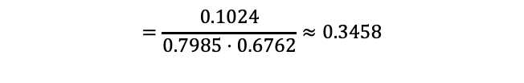
Cosine similarity
Jay
Allie
[0.58, 0.5, -0.16, 0, 0.16]
[0.42, -0.02, 0.16, 0.48, -0.14]
$$p_{1}⋅p_{2}=\left(0.58⋅0.42\right)+\left(0.5⋅−0.02\right)+\left(−0.16⋅0.16\right)+\left(0⋅0.48\right)+\left(0.16⋅−0.14\right)$$
$$∥p_{1}∥=\sqrt{{\left(0.58\right)}^{2}+{\left(0.5\right)}^{2}+{\left(−0.16\right)}^{2}+{\left(0\right)}^{2}+{\left(0.16\right)}^{2}}=\sqrt{0.3364+0.25+0.0256+0+0.0256}=\sqrt{0.6376}≈0.7985$$
$$∥p_{2}∥=\sqrt{{\left(0.42\right)}^{2}+{\left(−0.02\right)}^{2}+{\left(0.16\right)}^{2}+{\left(0.48\right)}^{2}+{\left(−0.14\right)}^{2}}=\sqrt{0.1764+0.0004+0.0256+0.2304+0.0196}=\sqrt{0.4524}≈0.6723$$
$$=\frac{0.1024}{0.7985⋅0.6762}≈0.3458$$
cosine_similarity (Jay, Steven) = 0.1897
Jay
cosine_similarity (Jay, Allie) = 0.3458
Steven
Allie

Slide 47
Word Embeddings
  However, it is not enough to use 3-5 semantic features to represent a word.
  To represent the complexity of a typical English vocabulary word requires hundreds of features
    Designing all these features manually, and assigning accurate coordinates to all these words, would be tedious and impossible!
    Instead, let the computer create the feature space by supplying a machine learning algorithm with a large amount of text
      Such as Wikipedia, or a huge collection of news articles.
    The algorithm discovers statistical relationships between words by looking at what other words they co-occur with.
    Uses this information to create word representations in a semantic feature space.
  These representations are called word embeddings.
    A typical embedding might use a 300 dimensional space, so each word would be represented by 300 numbers.
How can we represent words such as "humble", "smiled", or "honesty” ?

Slide 48
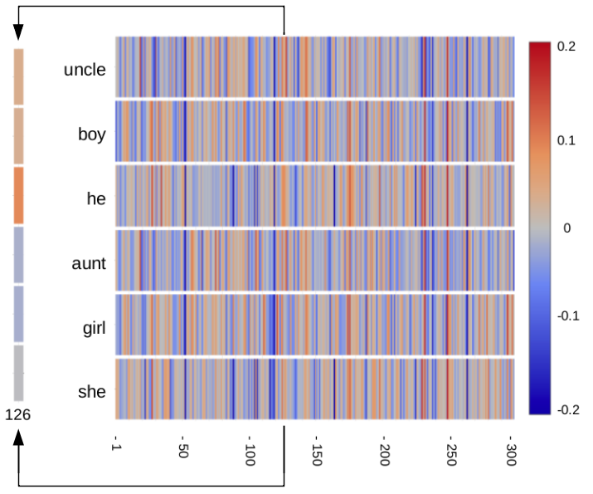
Word Embeddings
  Each word is represented by 300 numbers with values between -0.2 and +0.2.
  Component number 126 is shown magnified to the left.
    Component 126 appears to correlate with gender
Demo: https://www.cs.cmu.edu/~dst/WordEmbeddingDemo/index.html

Slide 49

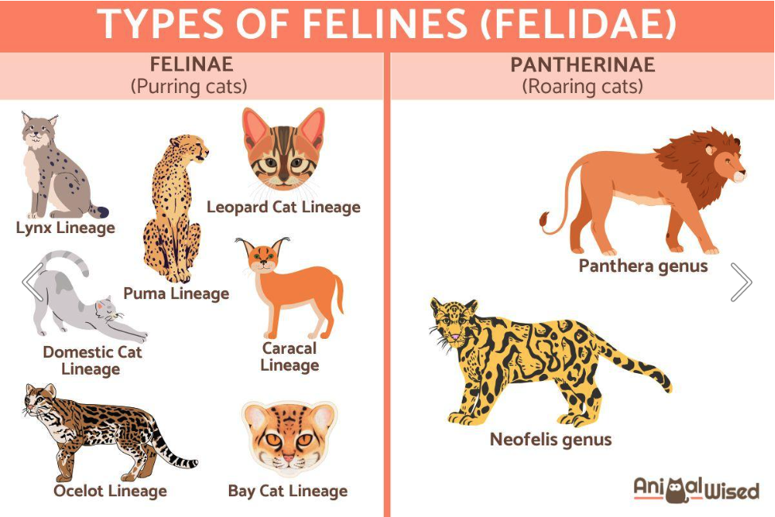
Motivation of Word Embedding
  lions are beautiful _______
  What would be the next word?
Cats?
Feline?

Slide 50
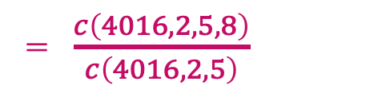
Motivation of Word Embedding
  In most of the machine learning algorithms, they cannot process string data.
  Instead, they will convert to the number form
    E.g. using an index for each unique word as the collection of words named as vocabulary.
vocabulary (v) = { 0, 1, 2, …, 5, …, 8, … 11, …, 40000, …, 49999, 50000 }
<s>
are
cats
feline
zoo
</s>
aardvark
beautiful
c( 4016, 2, 5, 8)
8
c( 4016, 2, 5, 11)
4016
2
5
Cats?
  lions are beautiful _______
11
p(cat | lions are beautiful)
Feline?
= $\frac{c\left(4016, 2, 5, 8\right)}{c\left(4016, 2, 5\right)}$
This approach ignores that there are some subtle relationship between cats and felines

Slide 51
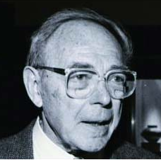
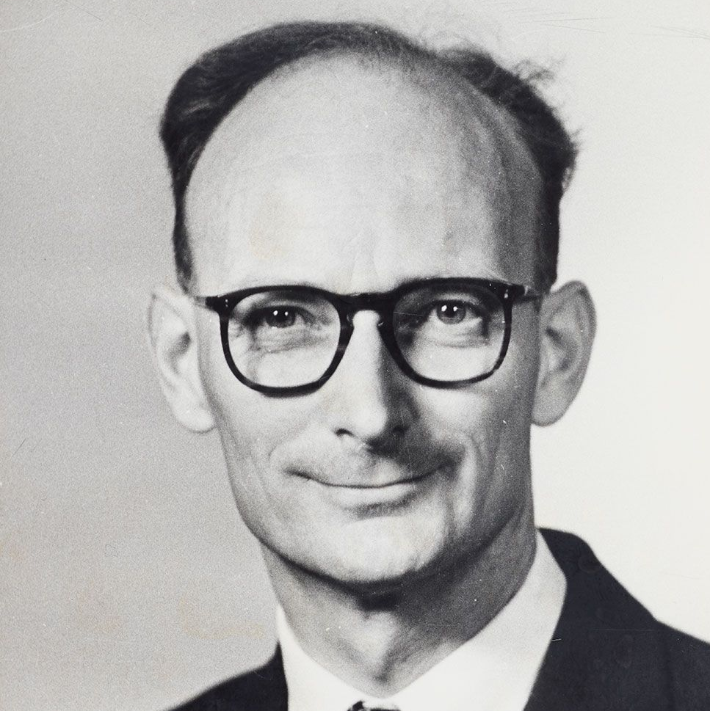
Intuitions: representing words by their context
  Zellig Harris (1954):
  Distributional hypothesis: words that occur in similar contexts tend to have similar meanings
    “oculist and eye-doctor … occur in almost the same environments”
    “If A and B have almost identical environments we say that they are synonyms.”
You shall know a word by the company it keeps!
One of the most successful ideas of modern statistical NLP!
Firth (1957)
Two words are similar if they have similar word contexts

Slide 52
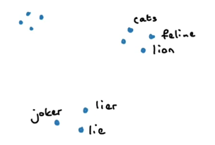
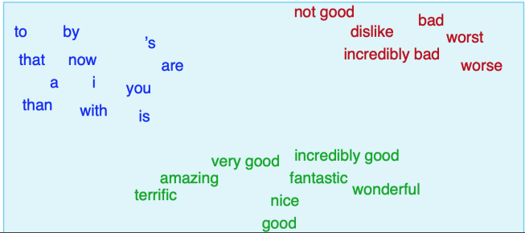
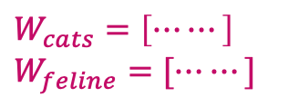
Motivation of Word Embedding
  If you treat each individual word in the vocabulary as a distinct word / integer.
    You may not be able to model anything very subtle.
  The concept of word embedding is to shift from viewing words as mere discrete entities to considering word types as more than just distinct categories
    Each word is going to be assigned a continuous vector.
$$W_{cats}=\left[⋯⋯\right]$$
$$W_{feline}=[⋯⋯]$$
The relationship between these two vectors can tell me something about cats and feline
Similar words are “nearby in semantic space”

Slide 53
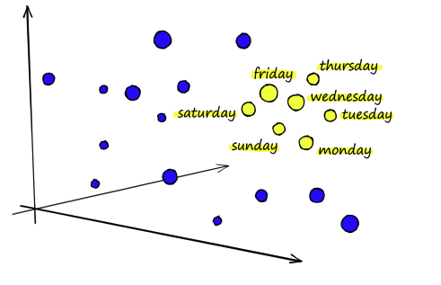
Word Embeddings
  Represent a word as a point in a multidimensional semantic space
    Space itself constructed from distribution of word neighbors
  Called an "embedding" because it's embedded into a space
  Every modern NLP algorithm uses embeddings as the representation of word meaning

Slide 54
One-hot vectors
  Each word is represented as a vector with length of v
  v is the size of the vocabulary. (Number of distinct words in the vocabulary)
  Similar as one-hot encoding, we use all zeros except a one at the index representing the word.
  Obviously, we cannot capture similarity between cat and feline
  Cosine-similarity between two one-hot vectors is always zero.
Example:
cat = [0 0 0 0 0 0 0 0 0 1 0 0 0 0 0 0 0 0 0 0]
feline = [0 0 0 0 0 0 0 0 0 0 0 0 0 0 0 0 1 0 0 0]

Slide 55
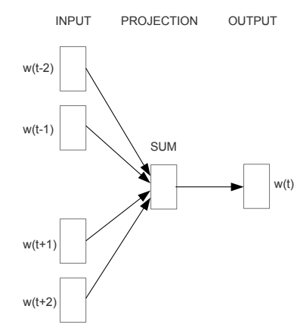
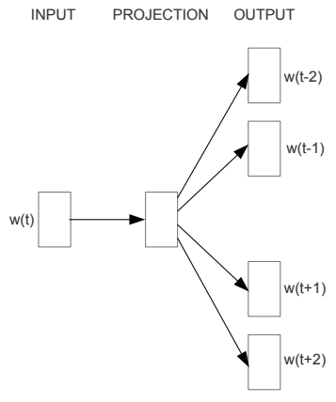
Word2Vec
  Word2vec (Mikolov et al, 2013) is a framework for learning word embeddings.
  Based on the idea that is the foundation of many modern NLP approaches.
    A word’s meaning is given by the words that frequently appear close-by.
  Two model variants:
    Skip-grams: Predicting context words by given the center word
    Continuous bag-of-words (CBOW): Predicting center word by given the context words
    (the words surrounding the center word)
CBOW
Skip-gram

Slide 56









Skip-gram
  Example window in skip-gram:
$$P(w_{t}−2|w_{t})$$
$$P(w_{t}+2|w_{t})$$
$$=P(son|loves)$$
window
…
since
the
man
loves
his
son
so
much
…
$$P(w_{t}−1|w_{t})$$
$$P(w_{t}+1|w_{t})$$
$$P(w_{t}−2|w_{t})$$
$$P(w_{t}+2|w_{t})$$
window
…
since
the
man
loves
his
son
so
much
…
$$P(w_{t}−1|w_{t})$$
$$P(w_{t}+1|w_{t})$$

Slide 57
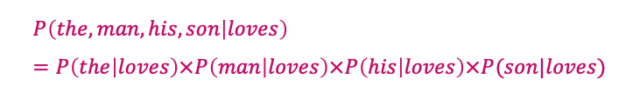


Skip-gram
  Three assumptions of Skip-gram:
    Each window is identically and independently distributed sample.
      Each of these windows can be treated as an independent input/output sample.
      Input: center word
      Output: the context words, the words appear before/after the center word.
    Each context word is conditionally independent by given the center word.
    Only model the probability of a word that occurs somewhere in the context window, we do not care about the sequence.
    No matter whether the word is 1 word before the center word, 2 words before the center word, or after the center word.
$$P(w_{t}−2|w_{t})$$
$$P(w_{t}+2|w_{t})$$
window
the
man
loves
his
son
$$P\left(the, man, his, son | loves\right)=P\left(the | loves\right)×P\left(man | loves\right)×P\left(his | loves\right)×P(son|loves)$$
$$P(w_{t}−1|w_{t})$$
$$P(w_{t}+1|w_{t})$$

Slide 58


Skip-gram
  A dataset then gives a large number of ($w_{t}, w_{t+1}$) input-output word pairs.
  Our next questions:
    How are we going to train the word-embedding
    What loss function are we going to use to train our model.
    How are we going to map the inputs to outputs.
$$p(w_{t+j}|w_{t})$$
center word
context word

Slide 59
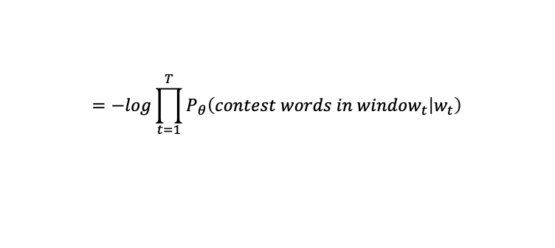

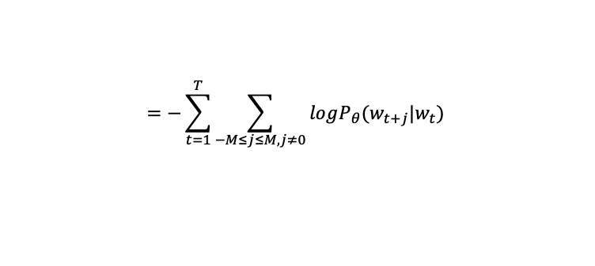
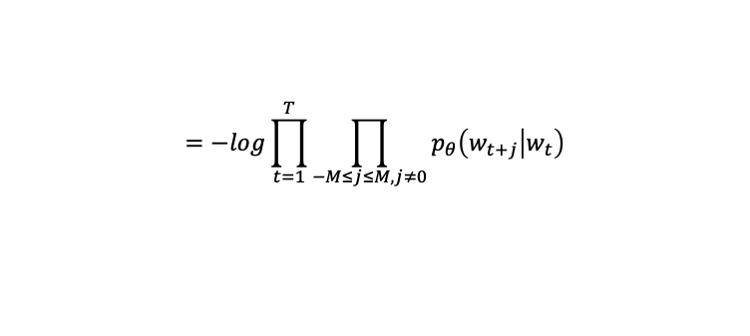

Loss function
From the 1st assumption, each window is independent
End up with multiplying the probabilities of each of the window together
  Skip-gram loss function
    Minimize the negative log likelihood (NLL) of the parameters.
    $J\left(θ\right)=−\log\left[P_{θ}\left(win_{1} | w_{1}\right)×P_{θ}\left(win_{2} | w_{2}\right)×…×P_{θ}\left(win_{T} | w_{t}\right)\right]$
$$=−log\prod_{t=1}^{T}{P_{θ}\left(contest words in window_{t} | w_{t}\right)}$$
$$=−log\prod_{t=1}^{T}{P_{θ}\left(w_{t−M}, ⋯, w_{t−1, }w_{t+1},⋯,w_{t+M} | w_{t}\right)}$$
$$=−log\prod_{t=1}^{T}{\prod_{−M≤j≤M, j≠0}{p_{θ}\left(w_{t+j} | w_{t}\right)}}$$
$$=−\sum_{t=1}^{T}{\sum_{−M≤j≤M, j≠0}{logP_{θ}(w_{t+j}|w_{t})}⁡}$$

Slide 60





Skip-gram Model Structure
  How do we model $P_{θ}(w_{t+j}|w_{t})$?
  Based on the third assumption, each context word can be predicted from the center word in the same way regardless of the position.
    E.g. the prediction of $w_{t−2}$and $w_{t−1}$ is done the same way from $w_{t}$.
  For each word, we have two word-vectors:
    $v_{w}$ when w is a center word (center-word embeddings)
    $u_{w}$ when w is a context word (context-word embeddings)
  For center word c and context word o we use the following model:
    $p_{θ}\left(w_{t+j}=o | w_{t}=c\right)=p\left(o | c\right)$
$$\vec{v_{c}} ⋅\vec{u_{o}}$$
When we consider all the different types of words that can be used in a context, their sum should equal to 1
$$e$$
$$=softmax_{o}(U⋅V_{c})$$
${\sum_{k=1}^{V}{e}}^{\vec{v_{c}} ⋅\vec{u_{k}}}$
Normalize the value to a range between 0 and 1

Slide 61



Skip-gram Model Structure
  For input $w_{t} = c$, the model outputs a probability distribution over the vocabulary:
  Word embeddings
    We obtained two vector representations for a single word type
      $v$for the center words
      $u$ for the context words
    In skip-gram:
      We use v vectors as word embeddings (Represented together in matrix V)
      We don’t use the context vectors U at test time (only in training)
$$f_{θ}\left(w_{t}=c\right)=\left[\begin{matrix}p(1|c) \\ \begin{aligned}p(2|c) \\ ⋮ \\ p(V|c)\end{aligned}\end{matrix}\right]=\frac{1}{{\sum_{k=1}^{V}{e}}^{\vec{v_{c}} ⋅\vec{u_{k}}}}\left[\begin{matrix}e^{\vec{v_{c}} ⋅\vec{u_{1}}} \\ \begin{aligned}e^{\vec{v_{c}} ⋅\vec{u_{2}}} \\ ⋮ \\ e^{\vec{v_{c}} ⋅\vec{u_{V}}}\end{aligned}\end{matrix}\right]=softmax(UV_{c})$$
$$θ=\{U, V\}$$

Slide 62





Gradient Descent on Skip-gram Model
  Reduce the value of the Loss function
  𝜃={𝑈, 𝑉}
  Perform the gradient descent on each parameter vector
    $v_{c}=v_{c}−η\frac{∂J\left(θ\right)}{∂v_{c}}$
    $u_{o}=u_{o}−η$ $\frac{∂J\left(θ\right)}{∂u_{o}}$
start at some random values for the parameters, and determine what direction to move to minimize the value of the loss function J.
$$J\left(θ\right)=−\sum_{t=1}^{T}{\sum_{−M≤j≤M, j≠0}{logP_{θ}(w_{t+j}|w_{t})}⁡}$$
$$J_{c,o}\left(θ\right)=−\log{P_{θ}\left(o | c\right)}=−log\frac{e^{\vec{v_{c}} ⋅\vec{u_{o}}}}{{\sum_{k=1}^{V}{e}}^{\vec{v_{c}} ⋅\vec{u_{o}}}}$$
$$=−\left[loge^{\vec{v_{c}} ⋅\vec{u_{o}}}−log\sum_{k=1}^{V}{e^{\vec{v_{c}} ⋅\vec{u_{o}}}}\right]$$
$$=−\left[\vec{v_{c}} ⋅\vec{u_{o}}−log\sum_{k=1}^{V}{e^{\vec{v_{c}} ⋅\vec{u_{o}}}}\right]$$
Take the partial derivatives of the Loss function with respect to the parameter that you currently looking at.
$$\frac{{∂J}_{c,o}\left(θ\right)}{∂v_{c}}=−u_{o}+\sum_{j=1}^{v}{\frac{e^{\vec{v_{c}} ⋅\vec{u_{j}}}}{{\sum_{k=1}^{V}{e}}^{\vec{v_{c}} ⋅\vec{u_{k}}}}}⋅\vec{u_{j}}$$
$=$ $−u_{o}+$ $\sum_{j=1}^{v}{P\left(j | c\right)\vec{u_{j}}}$

Slide 63












Neural Network Vector Diagram
x
(V-dim)
w
(V x N)
v_{c}
(N-dim)
W’ or U
(N x V)
man
passes
sentence
should
the
who
$$\left[\begin{matrix}0 \\ \begin{aligned}1 \\ 0 \\ 0 \\ 0 \\ 0\end{aligned}\end{matrix}\right]$$
$$\left[\begin{matrix}2 & 0.5 & 4 \\ \begin{aligned}0.1 \\ 0.3 \\ −2 \\ 1 \\ 3\end{aligned} & \begin{aligned}0.2 \\ −2 \\ 0.2 \\ 0.7 \\ 5\end{aligned} & \begin{aligned}0.7 \\ 0.2 \\ 0.8 \\ 3 \\ 0.2\end{aligned}\end{matrix}\right]$$
$$\left[\begin{matrix}0.1 \\ \begin{aligned}0.2 \\ 0.7\end{aligned}\end{matrix}\right]$$
$$\left[\begin{matrix}0.3 & 0.1 & 0.4 & 0.3 & 0.1 & −0.4 \\ \begin{aligned}0.1 \\ 0.1\end{aligned} & \begin{aligned}0.3 \\ 0.2\end{aligned} & \begin{aligned}−1.1 \\ 0.4\end{aligned} & \begin{aligned}0.2 \\ 0.5\end{aligned} & \begin{aligned}0.2 \\ 0.3\end{aligned} & \begin{aligned}0.3 \\ 0.1\end{aligned}\end{matrix}\right]$$
$$⋅$$
$$=$$
$$⋅$$
$$\left[\begin{matrix}0.12 \\ \begin{aligned}0.21 \\ 0.10 \\ 0.42 \\ 0.11 \\ 0.09\end{aligned}\end{matrix}\right]$$
$$\left[\begin{matrix}0.156624 \\ \begin{aligned}0.171374 \\ 0.153522 \\ 0.21142 \\ 0.155065 \\ 0.151995\end{aligned}\end{matrix}\right]$$
Input-layer
one-hot encoded vector
Word-Embedding Matrix
(Look up table)
$$J\left({θ,w}_{t+j}\right)=−logP_{θ}(w_{t+j}|w_{t})$$
loss= $−log\left(0.155065\right)=$0.8094862165
loss= $−log\left(0.151995\right)=$0.8181706983

Slide 64






High Level Neural Network Diagram
passes
Output layer
$$f_{θ}(w_{t}=c)$$
$$w_{t}=c$$
Logits
$$u_{1}⋅v_{c}$$
$$u_{2}⋅v_{c}$$
men
softmax
sum to 1
$$u_{3}⋅v_{c}$$
sentence
$$u_{o}⋅v_{c}$$
should
the

Slide 65





Continuous bag-of-words (CBOW)
  The continuous bag of words (CBOW) predicts a center word by given the context words.
$$w_{t}−2$$
$$w_{t}+2$$
$$P(love|the, man, his, son)$$
…
since
the
man
loves
his
son
so
much
…
$$w_{t}−1$$
$$w_{t}+1$$
Same assumption:
1. Each window is identically and independently distributed sample.
2. Characterize each of the context words in the same way regardless of its position

Slide 66

Loss function
  CBow loss function
    Minimize the negative log likelihood (NLL) of the parameters.
    $J\left(θ\right)=−log\prod_{t=1}^{T}{P_{θ}\left(w_{t} | w_{t−M},w_{t−M+1},⋯,w_{t−1},w_{t+1},⋯,w_{t+M}\right)}$
    $=−\sum_{t=1}^{T}{logP_{θ}\left(w_{t} | w_{t−M},w_{t−M+1},⋯,w_{t−1},w_{t+1},⋯,w_{t+M}\right)}$
    We need to define a structure on how do we to output this probability for Center word by given the context words.
context words
center word

Slide 67


Model Structure of CBOW
    To take the dot product between the center word embedding (u_{c}) and context words embedding (V_{o})
    For CBOW, it is common to use the context vectors as our word embeddings
    (denoted as v for CBOW)
$$P_{θ}\left(w_{t}=c | w_{t−M}=o1,w_{t−M+1}=o2,⋯, w_{t+M}=o2M\right)$$
=$\frac{e^{\frac{1}{2m}\vec{u_{c}} ⋅(v_{o1}+v_{o2}+v_{o3}+⋯+v_{o2m})}}{\sum_{k=1}^{V}{e^{\frac{1}{2m}\vec{u_{k}} ⋅(v_{o1}+v_{o2}+v_{o3}+⋯+v_{o2m})}}}$

Slide 68







CBOW Example
$$W=\left[\begin{matrix}0.38 & 0.42 \\ −0.12 & 0.46 \\ −0.11 & 0.1 \\ −0.24 & 0.29\end{matrix}\right]$$
cat | 1
sit | 0
on | 0
mats | 0
$$W^{′}=\left[\begin{matrix}0.2 & −0.3 & 0.1 & 0.4 \\ −0.1 & 0.5 & 0.2 & −0.2\end{matrix}\right]$$
$$\frac{1}{2m}\vec{u_{c}} ⋅(v_{o1}+v_{o2}+v_{o3}+⋯+v_{o2m})$$
$$\frac{0.38+(−0.11)}{2}=0.135$$
one hot encoding of “cat”
$$∑$$
cat | 0.001
sit | 0.0895
on | 0.0655
mats | 0.002
cat | 0.2404
sit | 0.2626
on | 0.2564
mats | 0.2406
cat | 0
sit | 0
on | 1
mats | 0
$$∑$$
one hot encoding of “on”
$$\frac{0.42+0.1}{2}=0.26$$
$$Loss =−\sum_{i=1}^{T}{\log\left(p_{θ}\right)}$$
$$Loss = −\log\left(0.2626\right)$$

Slide 69





Skip-gram with Negative Sampling (SGNS)
  Mikolov (2013) proposed an extension of original skip-gram to overcome some of its shortcoming.
  In standard skip-gram:
  Negative sampling:
    Treat this as a binary logistic regression problem
    y = 1, when a center word $w_{t} = c$is paired with a word $w_{t+j}=o$occurring in its context window.
    y = 0, when a center word $w_{t} = c$ is paired with a randomly sampled word $w_{t+j}=k$ not occurring in the same context.
$$\vec{v_{c}} ⋅\vec{u_{o}}$$
$p_{θ}\left(w_{t+j}=o | w_{t}=c\right)=p\left(o | c\right)=$
$$e$$
${\sum_{k=1}^{V}{e}}^{\vec{v_{c}} ⋅\vec{u_{k}}}$
The normalization is over V terms, v can be a huge number
The idea is to train a model which doesn’t give us the probability of context word by given the center word p(o|c).
Instead, the model should return either 1 or 0.
positive sampling
negative sampling

Slide 70


Skip-gram with Negative Sampling (SGNS)
Taking the dot product between center word embeddings and context word embedding
  The model becomes
    If the dot product is extremely large, the sigmoid function will output 1.
    Otherwise, if the dot product is extremely small (i.e. a negative value),
    then the sigmoid function will output 0.
  If we consider a single positive sampling pair ($w_{t}=c, w_{t+j}=o$) in
  the training set.
    The negative log likelihood (NLL) would be:
  If we only had the positive example (y = 1), we could easily hack the loss by just making $\vec{u_{o}}⋅\vec{v_{c}}$ really large.
    To address this issue, we need negative sampling !
$p_{θ}\left(y=1 | w_{t}=c, w_{j+t}=o\right)=p\left(o | c\right)=σ\left(\vec{u_{o}}⋅\vec{v_{c}}\right)=\frac{1}{1+e^{−\vec{u_{o}}⋅\vec{v_{c}}}}$
$$J_{c,o}\left(θ\right)=−logP_{θ}\left(y=1 | w_{t=c},w_{t+j}=o\right)=−logσ\left(\vec{u_{o}}⋅\vec{v_{c}}\right)$$

Slide 71





Skip-gram with Negative Sampling (SGNS)
  For each positive pair ($w_{t}=c, w_{t+j}=o$), we randomly sample $k$ words not appearing in the context window of $c$.
  The loss becomes:
$$σ\left(\vec{u_{o}}⋅\vec{v_{c}}\right)$$
$$σ\left(\vec{u_{w_{1}}}⋅\vec{v_{c}}\right)$$
$$1−$$
$J_{c,o}\left(θ\right)=−log⁡[P_{θ}\left(y=1 | w_{t=c},w_{t+j}=o\right)×P_{θ}\left(y=0 | w_{t=c},w_{t+j}=w_{1}\right)$ $⋅$
$P_{θ}\left(y=0 | w_{t=c},w_{t+j}=w_{2}\right) ×⋯× P_{θ}\left(y=0 | w_{t=c},w_{t+j}=w_{k}\right)$
$$=−\log\left[σ\left(\vec{u_{o}}⋅\vec{v_{c}}\right)⋅\prod_{j=1}^{k}{1−σ\left(\vec{u_{w_{j}}}⋅\vec{v_{c}}\right) }\right]$$
$$=−logσ\left(\vec{u_{o}}⋅\vec{v_{c}}\right)−\sum_{j=1}^{k}{\log\left(1−σ\left(\vec{u_{w_{j}}}⋅\vec{v_{c}}\right)\right)}$$

Slide 72
The Glove Model
  GloVe (Global Vectors), created by Jeffrey Pennington, Richard Socher, and Christopher Manning from Stanford.
  Traditionally, before neural-network models:
    Text-embeddings were based on co-occurrence counts.
  A co-occurrence count matrix was normally constructed
    The output matrix is in the size of V x V, which is a high dimensional matrix.
    Decomposed using some matrix factorization approach to get lower-dimensional word embeddings.
  Compare with word2vec:
    It is very fast
    Could capture some global statistics that word2vec misses.
      Word2Vec considers window within batches
      By counting all possible co-occurrence counts: can tell how words co-occur over an entire corpus.
    Besides these advantages, word2vec normally works better.

Slide 73



The Glove Model
  Instead of using a neural network to build a language model, GloVe attempts to learn the co-occurrence statistics of words.
    Denote $C_{c,o}$ as the total number of times in a corpus that center word $c$ occurs with context word $o$ in the same context window.
    Loss function:
  It outperformed many common Word2vec models on the word analogy task.
bias terms
$$f_{θ}\left(c,o\right)=\vec{u_{c}}⋅\vec{v_{o}}+b_{c}+c_{o}$$
Utilize the co-occurrence count as the True values, try to minimize the difference between $f_{θ}\left(c,o\right)$ and $\log{C_{c,o}}$
$$J\left(θ\right)=\sum_{c=1}^{V}{\sum_{o=1}^{V}{{\left(f_{θ}\left(c,o\right)−\log{C_{c,o}}\right)}^{2}}}$$
If the center word or context words appear frequently, $\log{C_{c,o}}$ will dominate the loss function.
Leading to the introduction of bias parameters.

Slide 74




The Glove Model
  We may not care about much about the rare word pairs.
    The word pairs with few counts
  We can add a weigh function to the equation.
For rare pairs, the weight is low but non-zero, ensuring they contribute to the model without being ignored.
For frequent pairs, the weight grows sub-linearly, preventing overly common pairs
(e.g., stop words like "the" and "is") from dominating the loss.
$$J\left(θ\right)=h(C_{c,o})\sum_{c=1}^{V}{\sum_{o=1}^{V}{{\left(f_{θ}\left(c,o\right)−\log{C_{c,o}}\right)}^{2}}}$$
weight function to weight a particular combinations based on the count
$$f\left(x\right)=\left\{\begin{matrix}{\left(\frac{x}{x_{\text{max}}}\right)}^{0.75} & \text{if} x<x_{\text{max}} \\ 1 & \text{if} x≥x_{\text{max}}\end{matrix}\right.$$
The paper set $x_{max}⁡$to 100

Slide 75

Word2vec
  This is a word embedding for the word “king” (GloVe vector trained on Wikipedia):
  It’s a list of 50 numbers. We can’t tell much by looking at the values. But let’s visualize it a bit so we can compare it other word vectors. Let’s put all these numbers in one row:

Slide 76

Import Text

Slide 77

Pre-process the text

Slide 78


Give ID to each unique word in the document

Slide 79



Represent each word in document sentence as word ID

Slide 80

Create training data with window size = 4

Slide 81

Start Training

Slide 82

Create a class to wrap up the training for the word2vec, for later visualization

Slide 83

Visualize the results

Slide 84

Visualize the results
  Let's look at the results from the 10th epoch. First, let's look at the words similar to "king." This is a list of the nearest 10 words to "space" by cosine similarity.

Slide 85

Use Pre-trained Word Vector for Data Analysis
  Instead of training your own vector, you can use pre-trained model for data analysis.
  These pre-trained models are already trained by other people and share to public for freely-used.

Slide 86

Any Questions?

