Slide 1
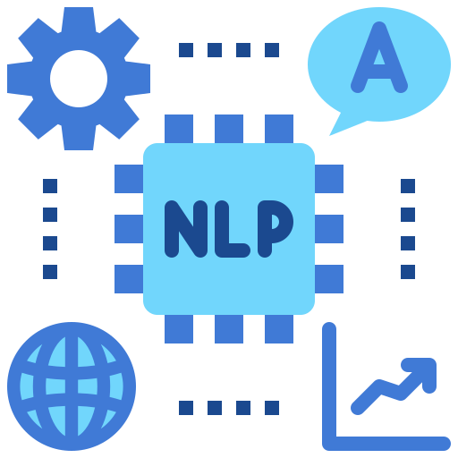
DSAI4205 Big Data Analytics
Lecture 5:
Intro to Natural Language Processing (NLP)
Dr. Ken FONG
Department of Data Science and Artificial Intelligence
chi-kit-ken.fong@polyu.edu.hk

Slide 2
Agenda
1. nlp overview and its applications
2. text pre-processing:
Cleaning and Structuring Language Data
3. text processing: Vectorizing Text

Slide 3
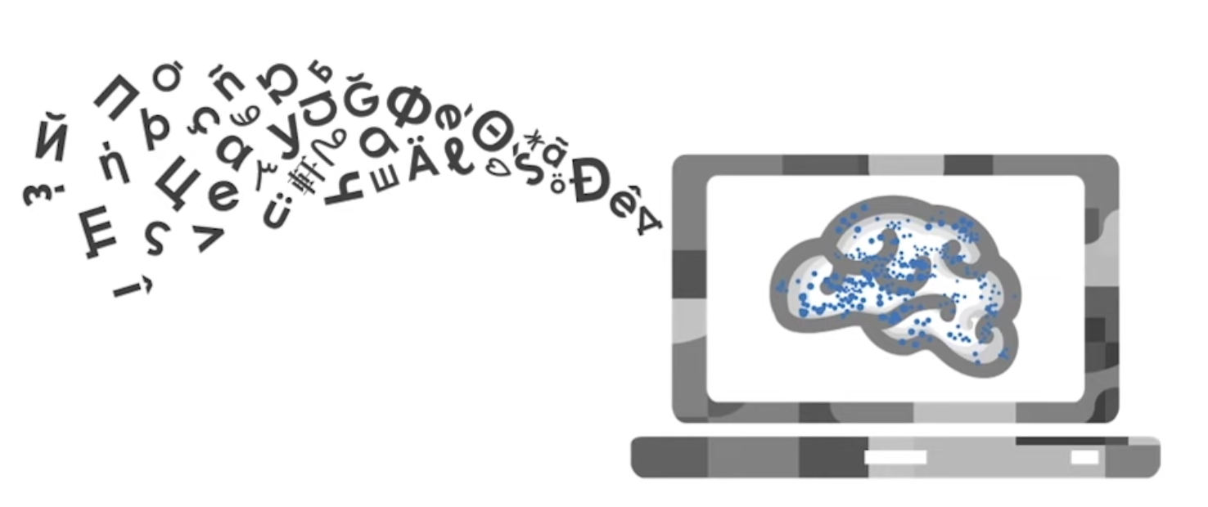
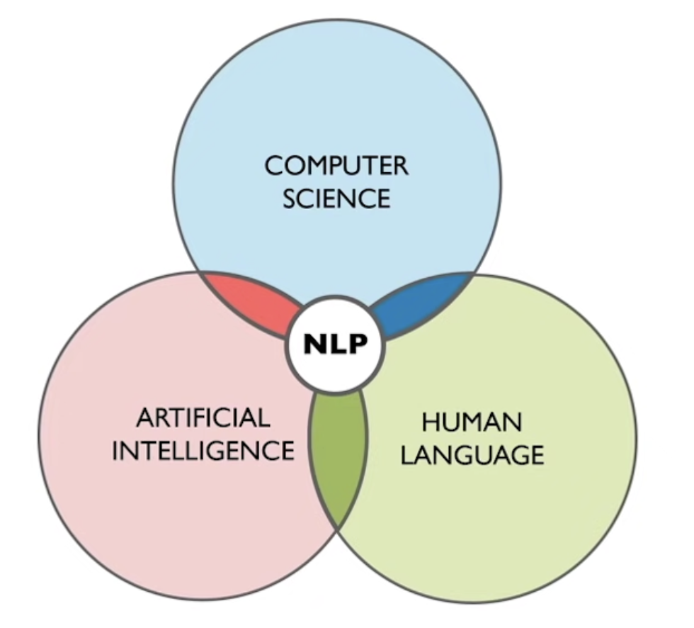
What is NLP ?
  Natural language is a structured system for communication, consisting of a vocabulary and a grammar.
    Language is, at its core, a system that is both digital (discrete) and infinite.
  Natural language processing is the set of methods for making human language accessible to computers
    Make computers to understand natural language to do certain task humans can do such as Machine translation, Summarization, Questions answering
    Is the field at the intersection of computer science, artificial intelligence and human languages.

Slide 4
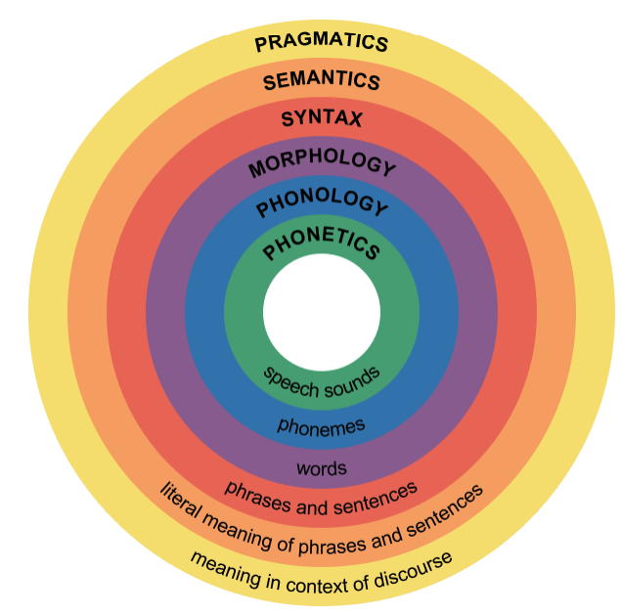
What is Linguistics (human languages)?
  Linguistics is the scientific study of language.
    The relationship between language form and language meaning.
  Another important subject of study for linguistics is how language is used in context.
  Noam Chomsky, is an American scientist who has started the development of a new framework for the study of language, called generative linguistics.
  The kind of structures that are studied in generative linguistics seem to be universal across languages.

Slide 5
Phonetics and Phonology
  Phonetics: The "physics" of speech sounds. It studies:
    how sounds are physically produced
    transmitted through the air: frequency and amplitude
    perceived by the ear/brain: how we distinguish similar vowels
  Phonology: knowledge about linguistic sounds.
    The "rules of the game" in a specific language.
    How sounds function as meaningful units (phonemes) within that language's system.

Slide 6
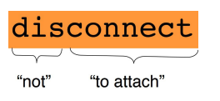
Morphology
  Morphology: is the study of how words are composed by morphemes, which are the smallest meaningful units of language
    The structure of a word consists of several morphemes:
      one root or stem
      zero or more affixes, such as prefixes and suffixes
    Example : draw, draw+s, draw+ing+s, un+draw+able
  The study of the sub-word units of meaning
    Inflectional morphology: no change in the grammatical category
      Example : give, given, gave, gives
    Derivational morphology: change in the grammatical category
      Example : process, processing, processable, processor, processabilty

Slide 7
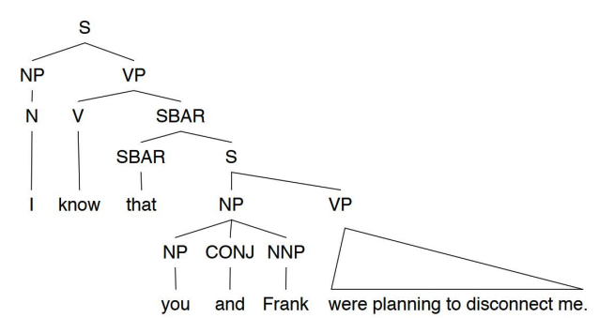
Syntax and Semantics
  Syntax: knowledge of the structural relationships between words
  The study of the structural relationships between words
    E.g. I know that you and Frank were planning to disconnect me.
  Semantics: knowledge of meaning
  The study of the literal meaning
    I know that you and Frank were planning to disconnect me.
      ACTION = disconnect, ACTOR = you and Frank, OBJECT = me

Slide 8
Pragmatics
  Pragmatics: knowledge of the relationship of meaning to the goals and intentions of the speaker
  The study of how language is used to accomplish goals
    What should you conclude from the fact I said something?
    How should you react?
      I’m sorry Dave, I’m afraid I can’t do that.
      Includes notions of polite and indirect styles

Slide 9

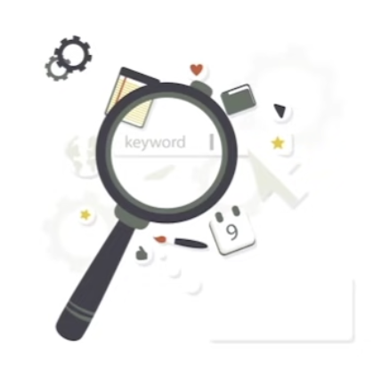

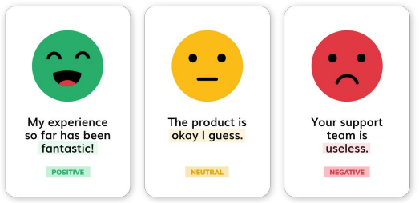
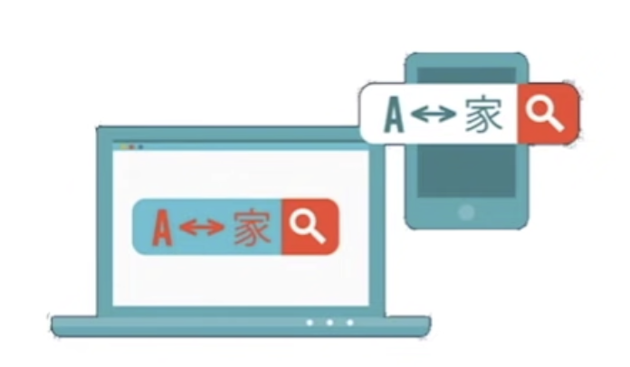
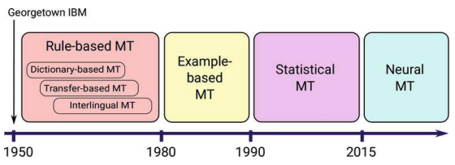
Applications in NLP
Spell Checking
Keyword search
Information Extraction
Machine Translation
Sentimental Analysis
Determine whether the meaning behind data is positive, negative, or neutral

Slide 10
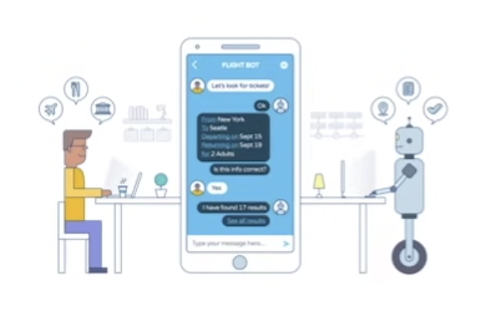
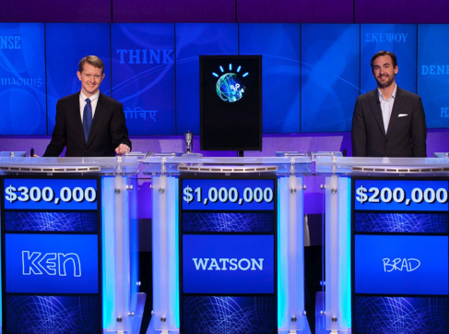

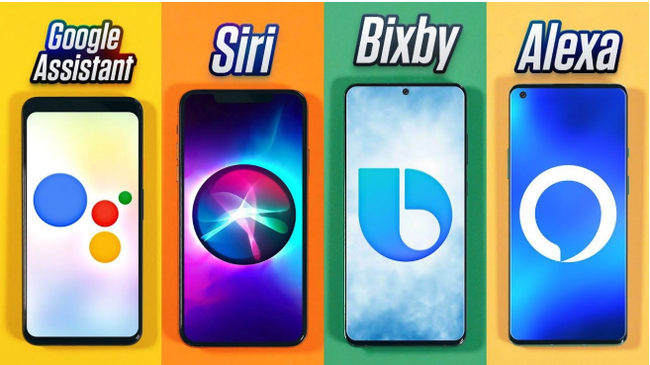
Applications in NLP
Chatbot
IBM-Watson Defeats Humans in "Jeopardy!"
Speech Recognition
Spoken Dialog Systems

Slide 11
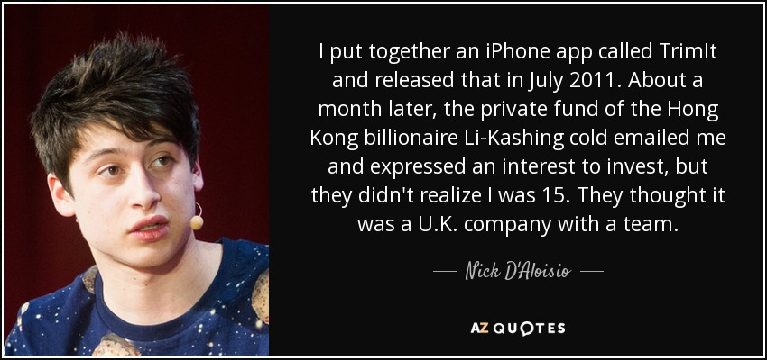
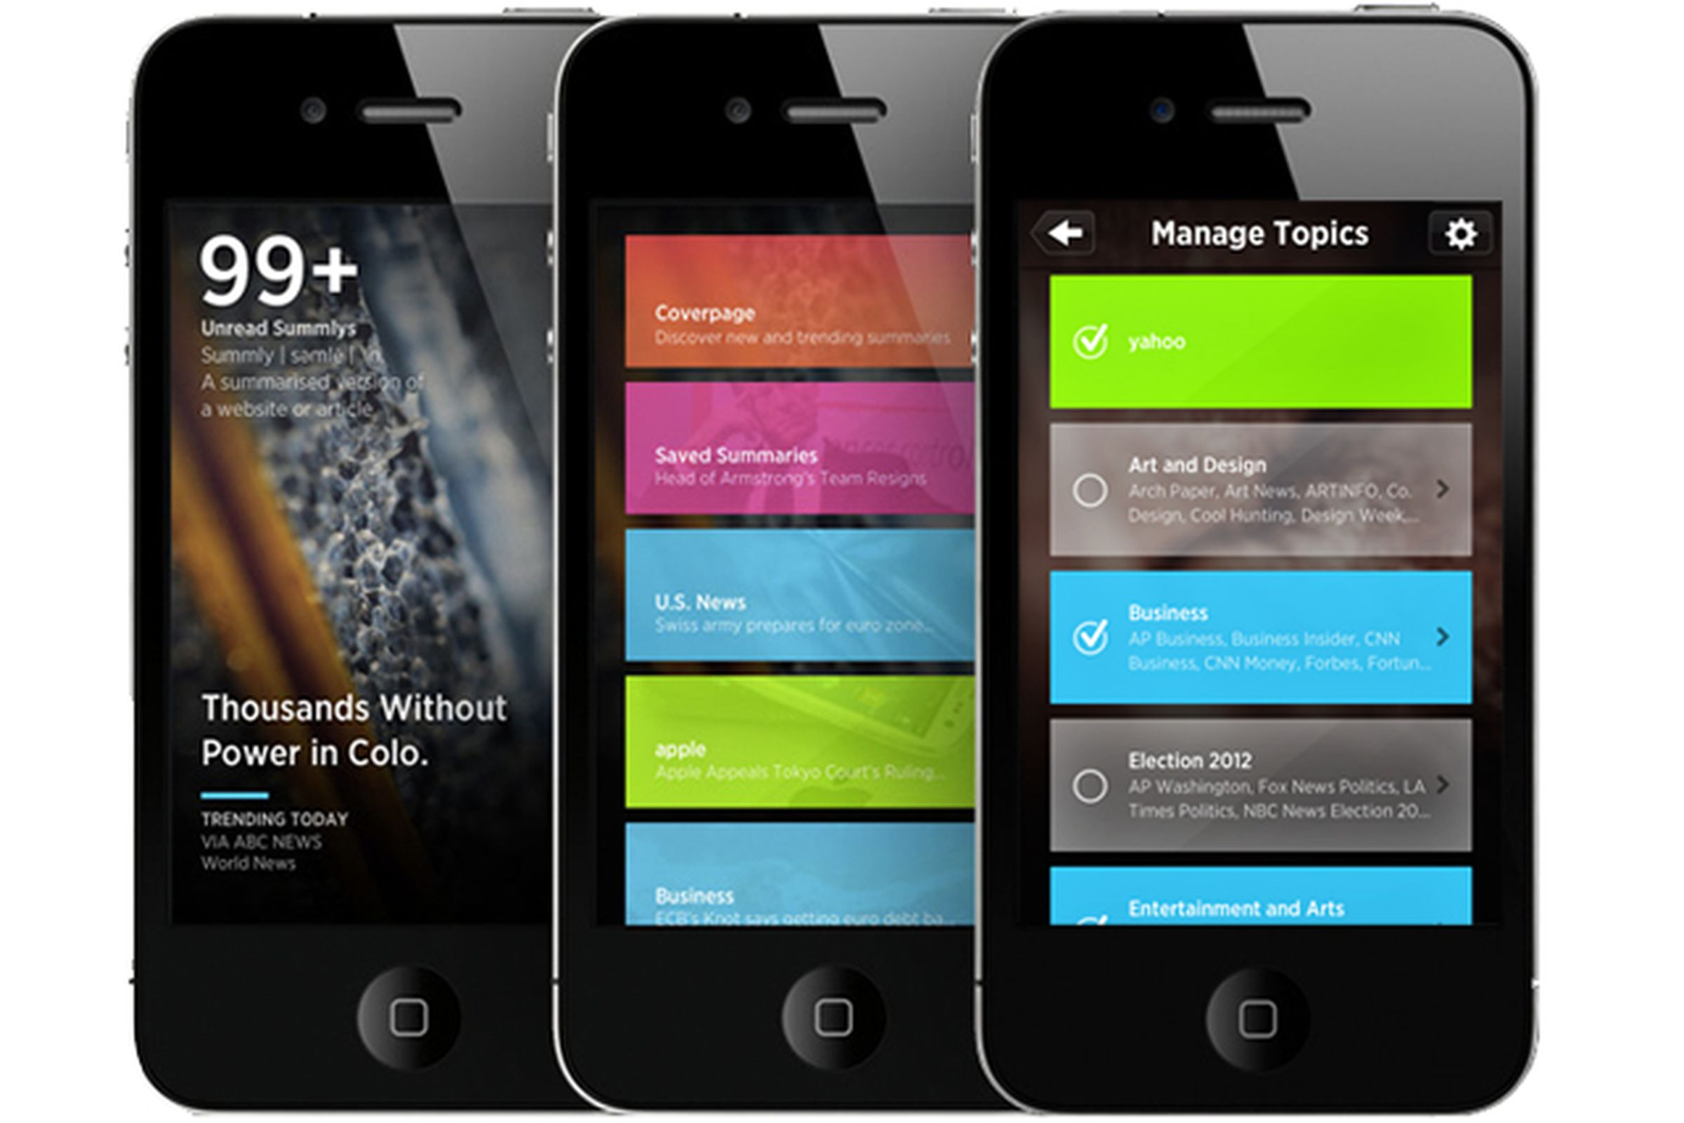
Investor Li Ka-shing who wired D’Aloisio £265,060 on his 16th birthday
Summly uses a combination of natural language processing from the famed scientists at the Stanford Research Institute (SRI) to pick out only what's important from news articles.

Slide 12
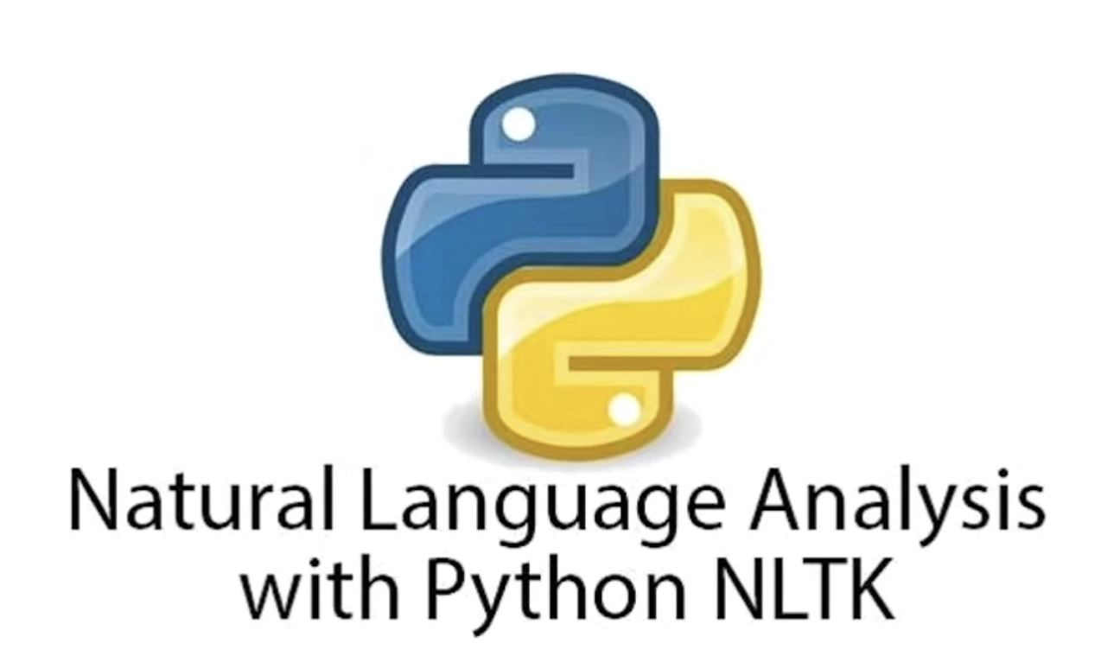

NLTK Library
NLTK is the natural language toolkit, is a leading platform for building python programs to work with human language data.
Contains a number of text processing libraries, such as
Classification
Tokenization
Stemming
Tagging
More…

Slide 13
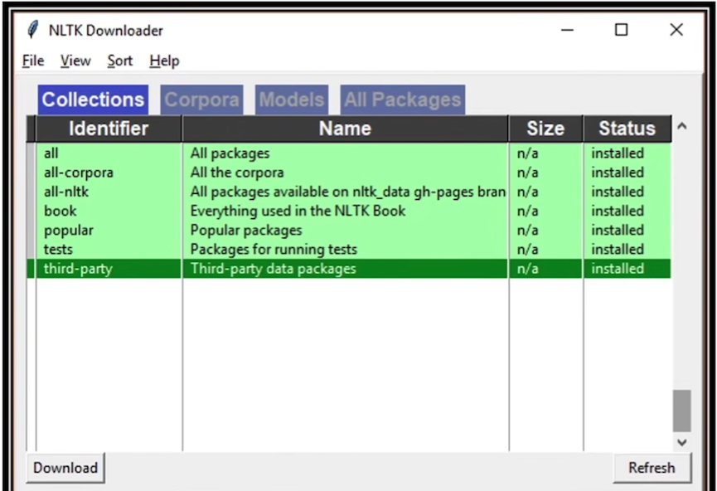

NLTK Library

Slide 14




Pre-Processing Tasks:
Tokenization, Stemming, Lemmatization, StopWords Removal, POS, …

Slide 15
Common Tasks in Text Processing
  Data Cleaning: Strip unwanted characters/markup (e.g. HTML tags, punctuation, numbers, etc.)
  Tokenization: Tokenization is the process of segmenting text into units called tokens.
  Stemming: reduce inflected word to their word stems
    computational → comput
    computing → comput
  Lemmatization: return the word in its root form (e.g., run, ran > run)
  Stop words removal: Remove frequent words that are not informative
    e.g. a, an, the, it, she, it, …
  POS Tagging: extract the word form of text (e.g., noun, verb, etc.)

Slide 16
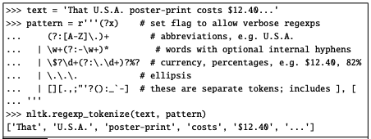
Tokenization
  Tokenization techniques can be grouped into three families - word tokenization
    Common approach for European Languages
    Utilize the following libraries
      NLTK: word.tokenize
      Spacy: Tokenization
    Use of regular expression is recommended in this situation.
    A Python trace of regular expression tokenization in the NLTK Python-based natural language processing toolkit

Slide 17
Tokenization
  Tokenization techniques can be grouped into three families - character tokenization
    Major east Asian languages (e.g. Chinese, Japanese, Korean, and Thai) write text without any space between words.
    For most Chinese NLP tasks, character tokenization works better than word tokenization.
      Each character generally represents a single unit of meaning
      Word tokenization results in huge vocabulary, with large number of very rare words.
      Consider the statement: 姚明進入總決賽 (YaoMing reaches finals)
      姚明 進入 總決賽
Chinese Treebank
      YaoMing reaches finals
      姚 明 進入 總 決賽
Peking University
      Yao Ming reaches overall finals
      姚 明 進 入 總 決 賽
Just use characters
      Yao Ming enter enter overall decision game

Slide 18
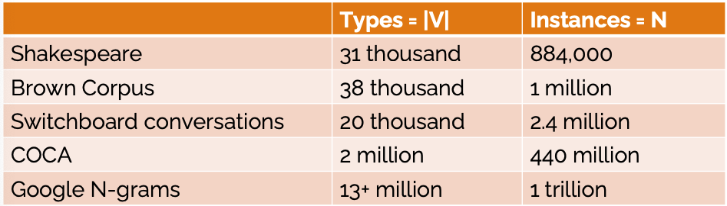
Tokenization
  In Chinese we use characters as tokens
  But that doesn't work for other languages , e.g., Thai and Japanese
  These differences make it hard to use words as tokens
  Another reason why we don't use words as tokens because of too many words!
number of words you've read, tokens processed, or items sampled from a collection
size of the unique vocabulary

Slide 19
Subword Tokenization
  Tokenization techniques can be grouped into three families – Subword Tokenization
    Many Natural Language Processing (NLP) systems must address the challenge of unknown words.
      Words that are not included in the system's vocabulary
    Example:
      If the training data (corpus) includes the words "foot" and "ball," but omits "football," the system will be unable to process "football" when it appears in the test data.
      Similarly, if the training data contains "low," "new," and "newer," but does not include "lower," the system will not know how to handle "lower" when it appears in the test data.
    To tackle this issue, one approach is to include a set of tokens that consists of smaller units than complete words, known as subwords.
      Subword Tokenization:
        Reduces the vocabulary size.
        Has become the most widely used tokenization method.
        Is inspired by algorithms from information theory, serving as a simple and efficient means of data compression.

Slide 20
Subword Tokenization
  The scheme consists of THREE algorithms
    Token learner:
      Processes a raw training corpus to generate a set of tokens, referred to as the vocabulary.
      Training Steps:
        1. Starts with splitting the input words into single characters (each of them corresponds to a symbol in the final vocabulary)
        2. Find the most frequent occurring pair of symbols from the current vocabulary
        3. Add this to the vocabulary and size of vocabulary increases by one
        4. Repeat steps (2) and (3) till the defined number of tokens are built or no new combination of symbols exist with required frequency
    Token Segmenter (Encoder)
      Utilizes the vocabulary and a raw test sentence to segment the sentence into tokens.
    Token Merger (Decoder)
      Takes a sequence of tokens and reconstructs the original sentence.

Slide 21
BPE Learner Example
  Given the sample sentence "hug", "pug", "pun", "bun", "hugs”
  The base vocabulary will then be ["b", "g", "h", "n", "p", "s", "u"]
  ("hug", 10), ("pug", 5), ("pun", 12), ("bun", 4), ("hugs", 5)
  We start the training by splitting each word into characters (the ones that form our initial vocabulary) so we can see each word as a list of tokens:
h | u | g |  | p | u | g |  | p | u | n |  | b | u | n |  | h | u | g | s
vocab = ['b', 'g', 'h', 'n', 'p', 's', 'u', 'Ġ']
h | ug |  | p | ug |  | p | u | n |  | b | u | n |  | h | ug | s
vocab = ['b', 'g', 'h', 'n', 'p', 's', 'u', ‘Ġ’, ‘ug’]
h | ug |  | p | ug |  | p | un |  | b | un |  | h | ug | s
vocab = ['b', 'g', 'h', 'n', 'p', 's', 'u', ‘Ġ’, ‘ug’, ‘un’]
hug |  | p | ug |  | p | un |  | b | un |  | hug | s
vocab = ['b', 'g', 'h', 'n', 'p', 's', 'u', ‘Ġ’, ‘ug’, ‘un’, ‘hug’]
hug | p | ug | p | un |  | b | un |  | hug | s
vocab = ['b', 'g', 'h', 'n', 'p', 's', 'u', ‘Ġ’, ‘ug’, ‘un’, ‘hug’, ‘Ġp’]
If size of vocab = 20:
Merge Rules:
{('u', 'g'): 'ug', ('u', 'n'): 'un', ('h', 'ug'): 'hug', ('Ġ', 'p'): 'Ġp', ('Ġ', 'hug'): 'Ġhug', ('Ġp', 'un'): 'Ġpun', ('Ġp', 'ug'): 'Ġpug', ('b', 'un'): 'bun', ('Ġhug', 's'): 'Ġhugs', ('Ġ', 'bun'): 'Ġbun’}
Vocab:
['<|endoftext|>', 'b', 'g', 'h', 'n', 'p', 's', 'u', 'Ġ', 'ug', 'ug', 'un', 'hug', 'Ġp', 'Ġhug', 'Ġpun', 'Ġpug', 'bun', 'Ġhugs', 'Ġbun']
Spaces are converted in a special character (the Ġ )

Slide 22
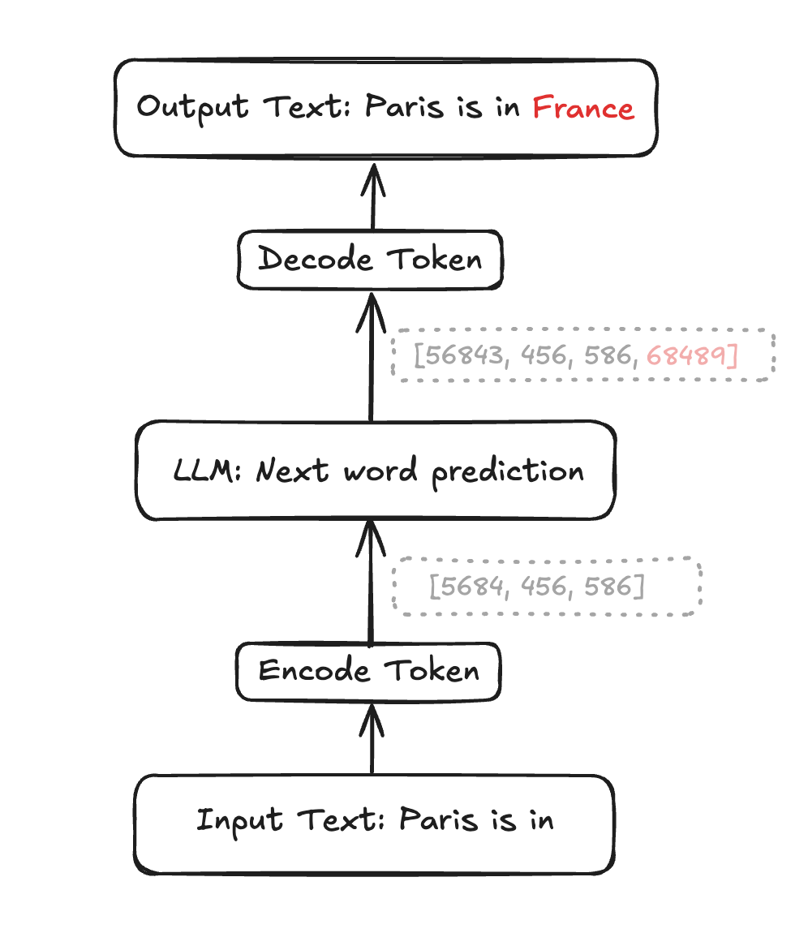
Tokenizing a new sentence
  fred fed ted bread, and ted fed fred bread
  vocabulary = {‘a’, ‘b’, ‘d’, ‘e’, ‘f’, ‘n’, ‘r’, ‘t’, ‘ ‘}
  vocabulary = {‘a’, ‘b’, ‘d’, ‘e’, ‘f’, ‘n’, ‘r’, ‘t’, ‘ ‘, ’d ‘, ‘ed ’, ‘fr’, ‘fred’}
  Tokenize a new sentence
1
2
3
4
5
6
7
8
9
10
11
12
13
  Decoder: reconstructs the original sentence
t | e | d | _ | a | n | d | _ | f | r | e | d | _ | a | r | e | _ | f | r | i | e | n | d | s
t | e | d_ | a | n | d_ | f | r | e | d_ | a | r | e | _ | f | r | i | e | n | d | s
t | ed_ | a | n | d_ | f | r | ed_ | a | r | e | _ | f | r | i | e | n | d | s
t | ed_ | a | n | d_ | fr | ed_ | a | r | e | _ | fr | i | e | n | d | s
t | ed_ | a | n | d_ | fred_ | a | r | e | _ | fr | i | e | n | d | s
8
11
1
6
10
13
1
7
4
9
12
?
4
6
3
?

Slide 23
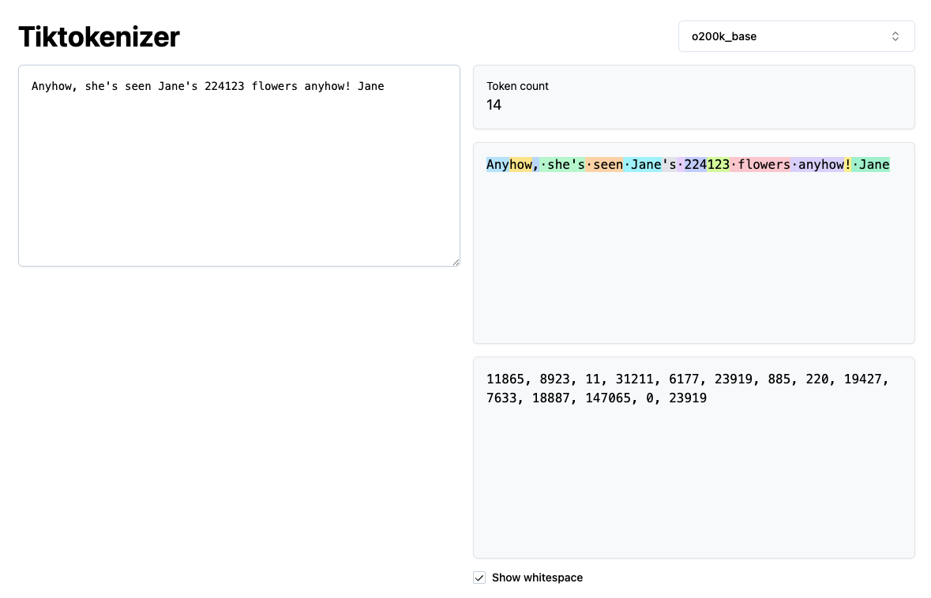
Visualize BPE Tokenizer used in Large Systems
https://tiktokenizer.vercel.app/?model=o200k_base

Slide 24
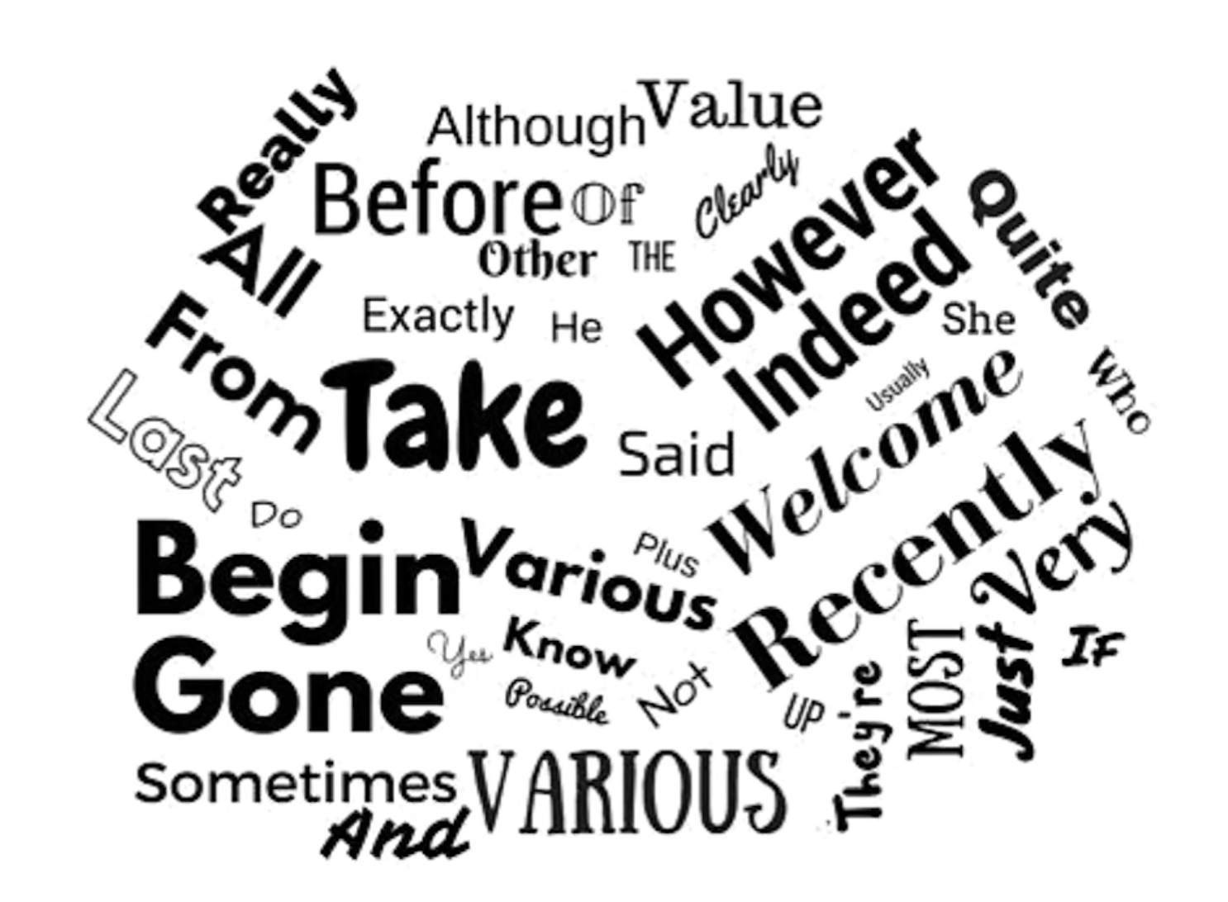
Stop Words
Are they helpful or not ?

Slide 25
Stop Words
  Some words are frequent words that are not informative. E.g., I, a, an, the
  It is typical to exclude high-frequency words:
    They have little semantic content: the, a, and, to, be, he, she, it
    Typical stop word list has 200 to 300 words
  However, it is little harm for not considering stop words. Consider these phrases:
    Phrase queries: “President of University of Hong Kong”
    Various song titles, etc.: “Let it be”, “To be or not to be”
    “Relational” queries: “flights to London”
  Phrases: require NLP (natural language processing) analysis
    Example: Name Entities Recognition (NER)

Slide 26
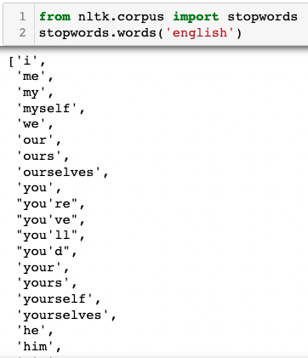

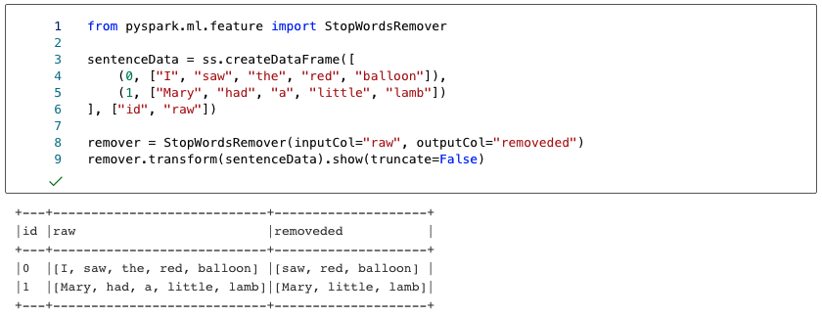
Stop Words in NLTK/PySpark

Slide 27
Stemming
  Reduce terms to their “roots” form
  “Stemming” suggests crude affix chopping
    language dependent
    e.g., give, giving, gave, given all reduced to give.
for example compressed
and compression are both
accepted as equivalent to
compress.
for exampl compress and
compress are both accept
as equival to compress

Slide 28
Porter’s Stemming
  Common algorithm for stemming English
    Results suggest it’s at least as good as other stemming options
  Five phases of reductions
    phases are applied sequentially
    each phase consists of a set of commands
RULE EXAMPLE
s → cats → cat
sses → ss classes → class
ies → i companies → compani
ational → ate international → internate
tional → tion conventional → convention
(m > 1)ement → replacement → replac
cement → cement

Slide 29
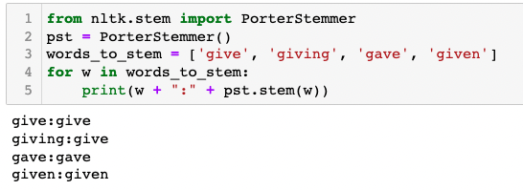
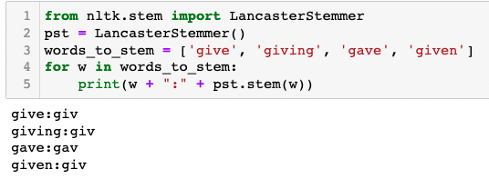
Stemming in NTLK

Slide 30
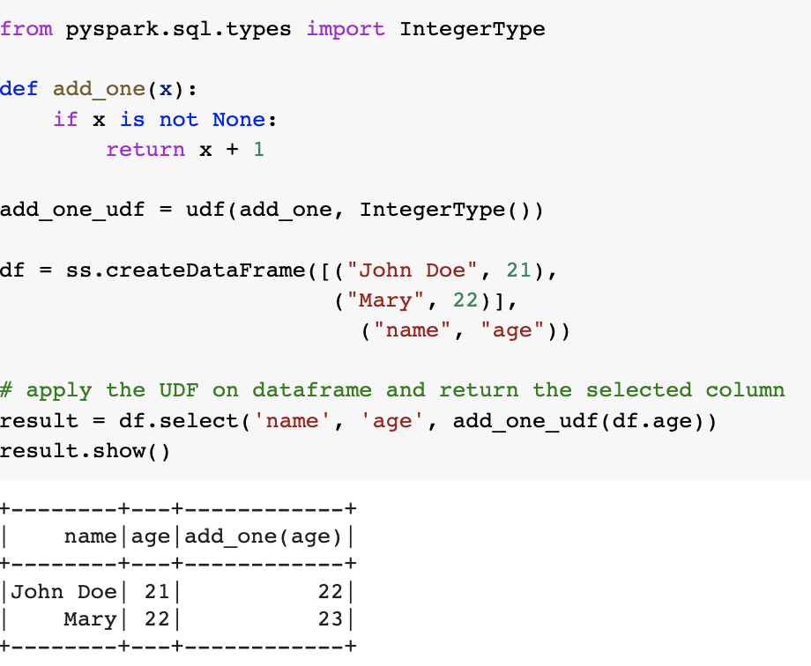
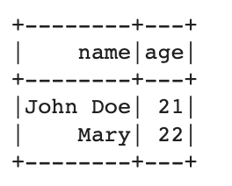
User-Define Function (UDF)
  A UDF contains 2 parts: a function and the output datatype

Slide 31
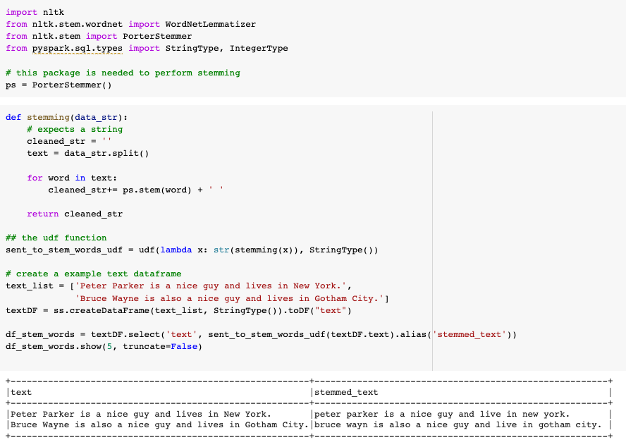
Stemming in Pyspark

Slide 32
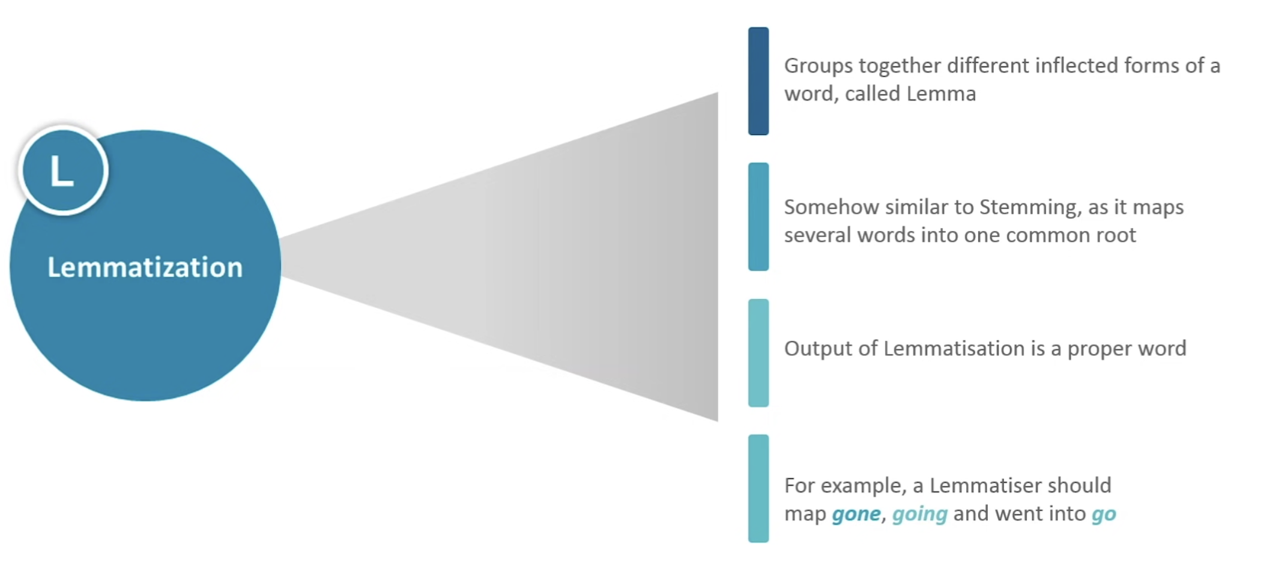
Lemmatization

Slide 33
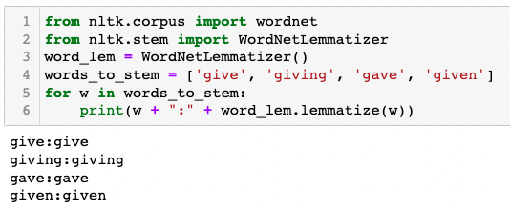
Lemmatization
  Reduce inflectional/variant forms to base form. E.g.,
    am, are, is → be
    car, cars, car's, cars' → car
    the boy's cars are different colors → the boy car be different color
  Lemmatization implies doing “proper” reduction to dictionary headword form

Slide 34
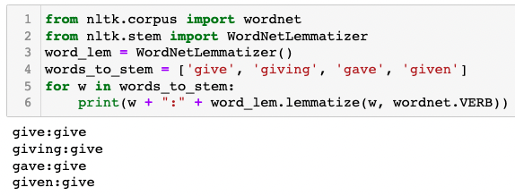
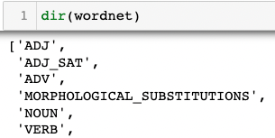
Lemmatization in NTLK

Slide 35
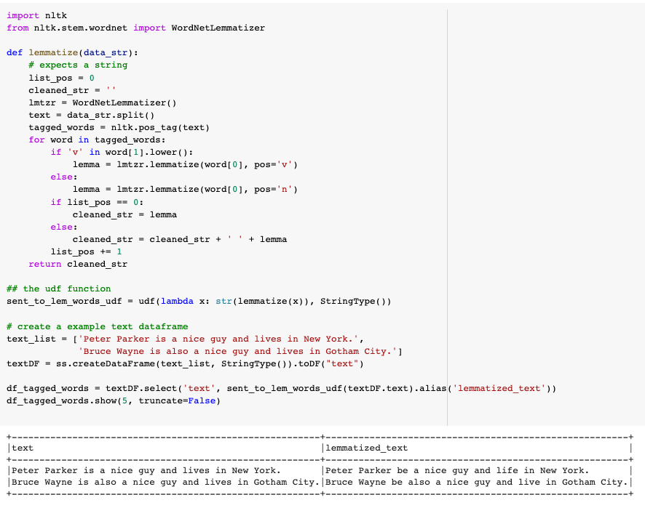
Lemmatization in PySpark

Slide 36
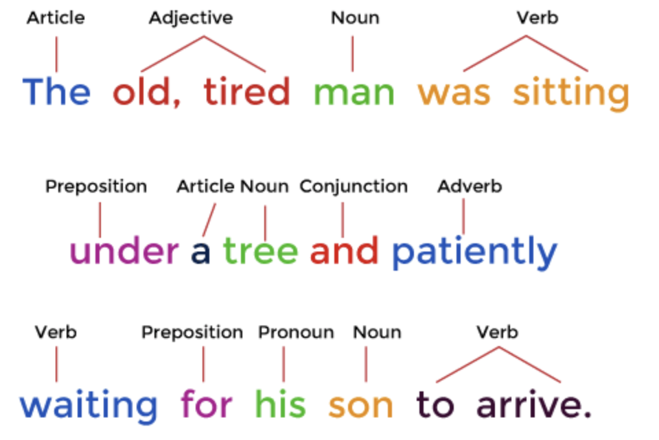
Corpus Annotation
  A CORPUS: a collection of "naturalistic" text, or transcribed/recorded spoken or signed language
  Corpus Annotation: The process of adding explicit, interpretative linguistic information to a corpus in the form of tags or labels
    One common type of annotation is the addition of tags, or labels, indicating the word class to which words in a text belong
    Part-Of-Speech Tagging (or POS tagging)
      Is a category for words that play similar roles within the syntactic structure of a sentence.
      Identify the grammatical type of the word (verb, the noun, the adjective, the adverb, etc)
      Indicates how a word functions in meaning as well as grammatically within a sentence.
      Useful in distinguishing words which have the same spelling, but different meanings or pronunciation.

Slide 37
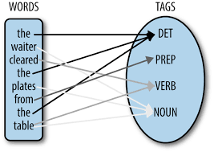
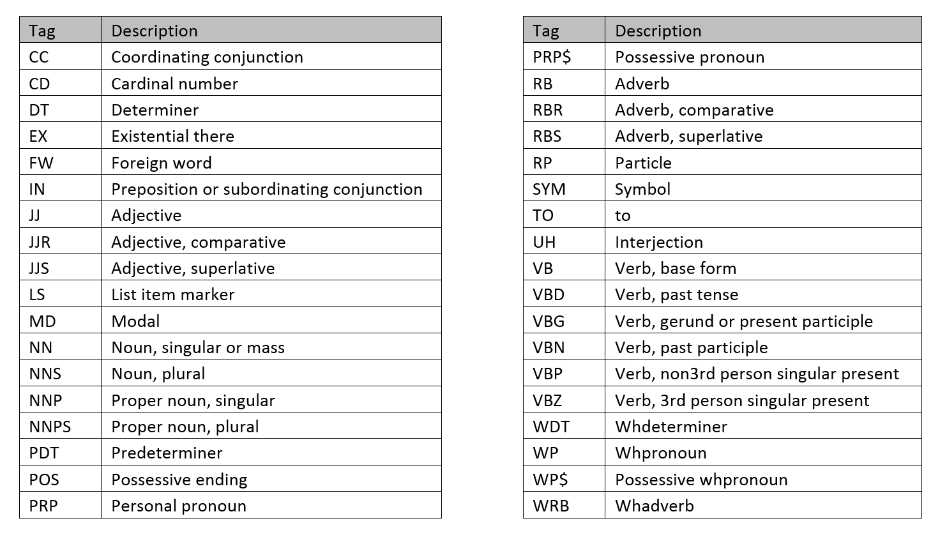
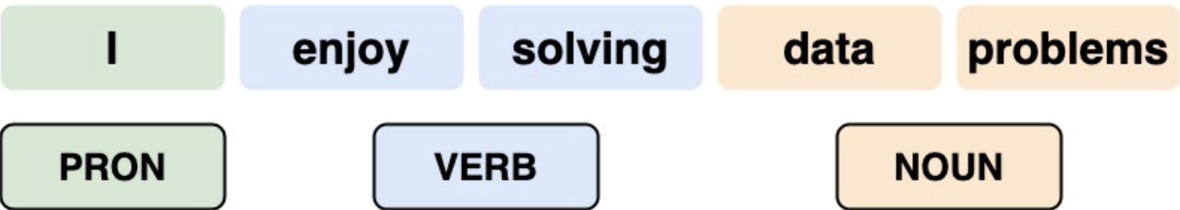
POS Examples
  E.g. If a word in a text is spelt present, it may be:
    A noun (= 'gift’)
    A verb (= 'give someone a present’)
    An adjective (= 'not absent’).

Slide 38
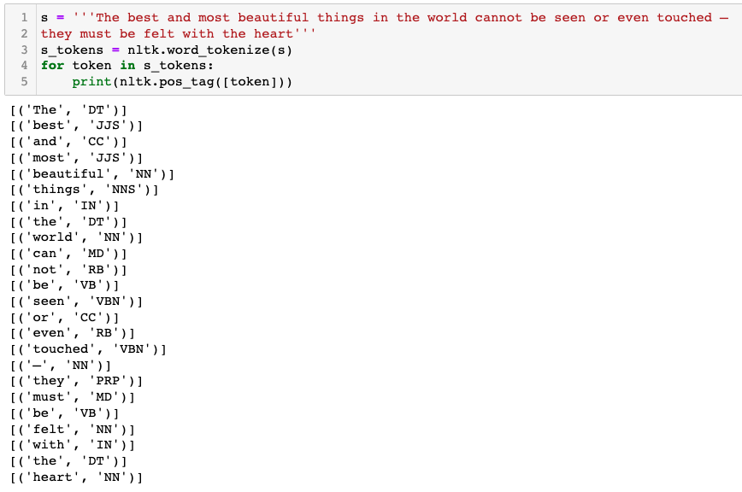
POS Tagging in NLTK

Slide 39
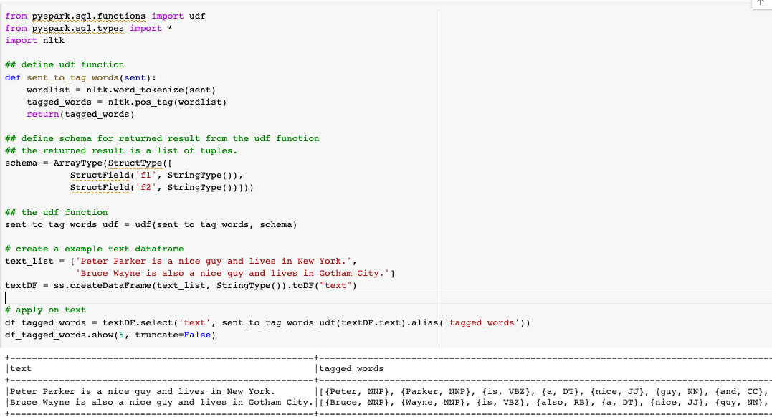
POS Tagging in Pyspark
Define our own function that utilize NTLK pos_tag function
Output format: [(string, string), (string, string)]
UDF
Apply UDF on the chosen column

Slide 40
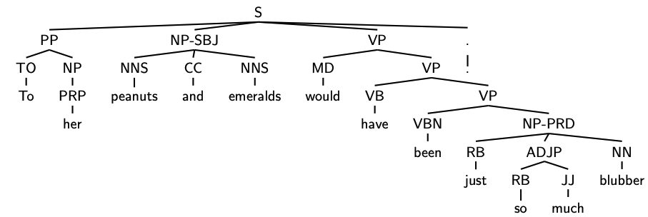
Syntactic Annotation
  Penn Treebank of English
    A linguistic resource that provides a large, annotated corpus of English text, featuring syntactic annotations that represent the grammatical structure of sentences.
    Example:
      ( (S (PP (TO To) (NP (PRP her))) (NP-SBJ (NNS peanuts) (CC and) (NNS emeralds)) (VP (MD would) (VP (VB have) (VP (VBN been) (NPPRD (RB just) (ADJP (RB so) (JJ much)) (NN blubber))))) (. .)))
Noun Phase – Subject of the sentence
Verb Phase
Prepositional Phase
Nouns

Slide 41
Penn Treebank phrasal categories
There are some other phrasal categories to annotate spoken transcripts,
1 | ADJP | Adjective phrase
2 | ADVP | Adverb phrase
3 | NP | Noun phrase
4 | PP | Prepositional phrase
5 | S | Simple declarative clause E.g. My name is Alex . (Subject: "My name," Predicate: "is Alex")
6 | SBAR | Clause introduced by subordinating E.g. because, when, if, or who
7 | SBARQ | Direct question introduced by wh-word or E.g. who, what, where, when, why, which, whose, and how
8 | SINV | Declarative sentence with subject-auxiliary (a subject and an auxiliary verb) She is reading a book
9 | SQ | Subconstituent of SBARQ excluding wh-word E.g. [What] did you say?
10 | VP | Verb phrase
11 | WHADVP | Wh-adverb phrase begins with a wh-word (like when, where, why, how) E.g. When did you arrive?
12 | WHNP | Wh-noun phrase a type of noun clause that begins with a wh-word (e.g., who, what, where, when, why, how, which) E.g. What color is the car?
13 | WHPP | Wh-prepositional phrase prepositional phrase that contains a "wh-word” E.g. By whose authority was this order given?
14 | X | Constituent of unknown or uncertain

Slide 42
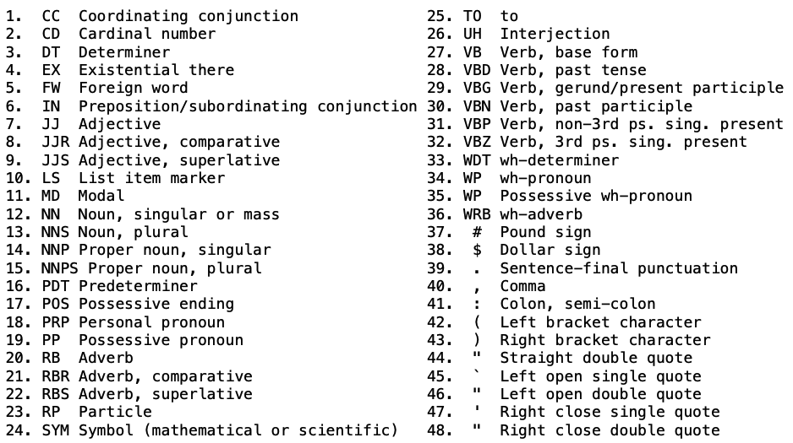
Penn Treebank TagSet

Slide 43
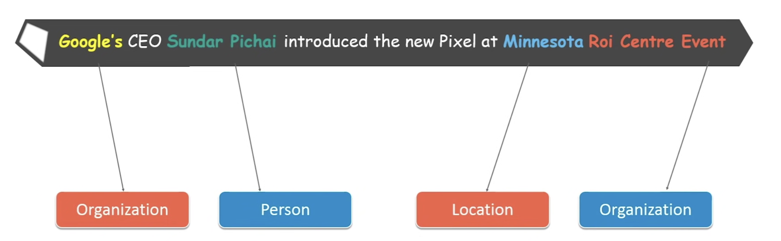
Name Entity Recognization
  Automatic identification of named entitles in a collection of information.
  NER helps in adding more meaning to the textual data.

Slide 44
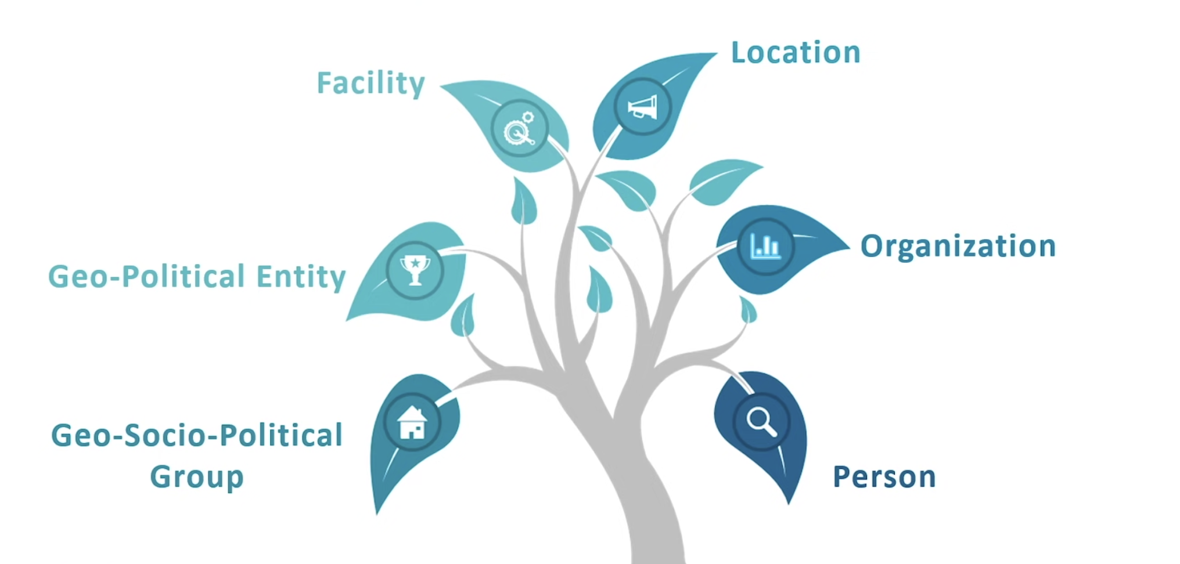
NER Entities List in NLTK

Slide 45
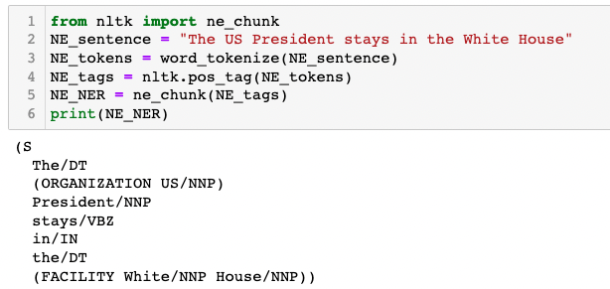
NER in NLTK

Slide 46
NLP Process
  Clean up the text to make it easier to use and more consistent to increase prediction accuracy later on.
  Regular Expression with Pandas to perform data cleaning
  Perform tokenization, stop words removal, stemming, lemmatization, etc.
Text Processing
Feature Engineering & Text Representation
Learning Models
Learn how to extract information from text and represent it numerically.
Use learning models to identify parts of speech, entities, sentiment, and other aspects of the text.
(You already learnt those models in previous courses, such as naïve bayes, decision tree, KNN algorithm, neural network, etc.)
Textual Data
Feature Engineering: The process of transforming the raw data to improve the accuracy of models by creating new features from existing data.
Numerical Data

Slide 47
Feature Engineering and Text Representation
One-Hot Encoding
Vectorization
N-Gram Encoding
TFIDF
Transforms categorical feature into binary features
Bag of Words Model
Captures word order in a vector model
Converts a collection of raw documents to a matrix of TFIDF features

Slide 48
One Hot Encoding
  Encodes categorical data as real numbers such that the magnitude of each dimension is meaningful.
  For each distinct possible value (unique value), a new feature is created.
  Example:
 | name | kind | age
0 | Goldy | Fish | 0.5
1 | Scooby | Dog | 7.0
2 | Brian | Dog | 3.0
3 | Francine | Cat | 10.0
4 | Goldy | Dog | 1.0
Q: How one hot encoding turns data into numerical data ?
A: For each distinct possible value for each feature, create a new binary variable.

Slide 49
One Hot Encoding
 | name | kind | age
0 | Goldy | Fish | 0.5
1 | Scooby | Dog | 7.0
2 | Brian | Dog | 3.0
3 | Francine | Cat | 10.0
4 | Goldy | Dog | 1.0
 | age
0 | 0.5
1 | 7.0
2 | 3.0
3 | 10.0
4 | 1.0
name_Brian | name_Francine | name_Goldy | name_Scooby
0 | 0 | 1 | 0
0 | 0 | 0 | 1
1 | 0 | 0 | 0
0 | 1 | 0 | 0
0 | 0 | 1 | 0
kind_Cat | kind_Dog | king_Fish
0 | 0 | 1
0 | 1 | 0
0 | 1 | 0
1 | 0 | 0
0 | 1 | 0

Slide 50
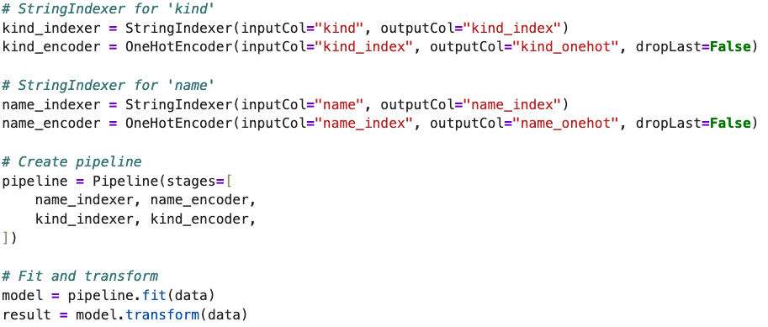
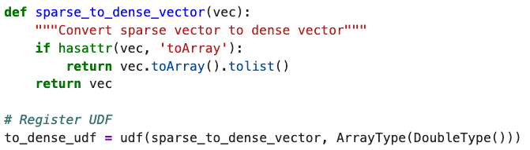
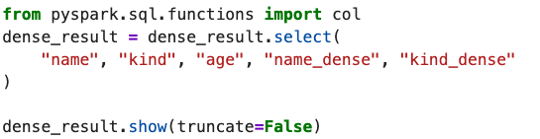
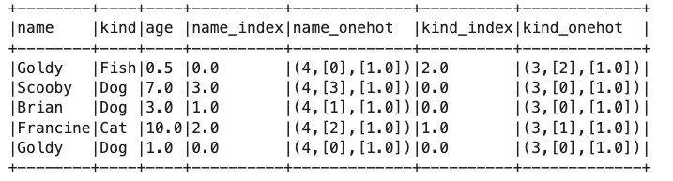
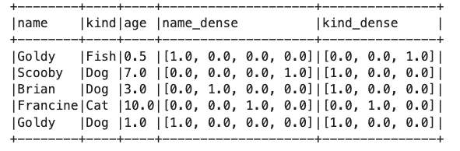
One Hot Encoding

Slide 51

Bag of Words Model
  Extracts features from text
    Stop words should not be included
    Word order is lost
    Sparse encoding

Slide 52


Bag of Words Model

Slide 53


Vector
  Vector is one of the most frequent data we use in data analytics and machine learning.
  Dense Vector (keep all values) e.g., [1.0, 0.0, 3.0]
  Sparse Vector (keep non-zero values only) e.g., (3, [0, 2], [1.0, 3.0])
    3: vector size
    [0,2]: indices of non-zero elements
    [1.0, 3.0]: values of non-zero elements

Slide 54

RDD to VectorRDD
  We can convert a RDD to VectorRDD

Slide 55

N-gram Encoding

Slide 56

N-gram Encoding
  Extracts features from text while capturing local word order by defining counts over sliding windows.
  Example with N=2 (bigram encoding):

Slide 57

N-Gram in PySpark

Slide 58
Text Features
  TFIDF is a technique to quantify the word features (e.g., the word importance) in a set of documents
  In real-world data:
    We are interested in not only word, but also multi-word phrase features (a.k.a. N-grams)
    For example, the phrase 'don't like' can imply that the customer hates the product, if we consider only a single word (i.e., like), we may have wrong analytics.
  Additionally, some frequent words (e.g., Hello) are less informative and many time irrelevant in our analysis (stopword)
  Thus, taking careful consideration into data cleaning can often improve model performance in big data analytics.

Slide 59

Vector Space Model
  Assume $t$ distinct terms in a document collection
    Vocabulary of words (or terms)
    These “orthogonal” terms form a vector space.
      Dimension: t = |vocabulary|
      Each term, $i$, in a document or query, $j$, is given a real-valued weight, $w_{ij}$.
      Both documents and queries are expressed as
    t-dimensional vector: $dj = (w1j, w2j, …, wtj)$

Slide 60
Graphical Representation
Example:
D₁ = 2T₁ + 3T₂ + 5T₃
D₂ = 3T₁ + 7T₂ + T₃
Q = 0T₁ + 0T₂ + 2T₃
T₃
5
D₁ = 2T₁+ 3T₂ + 5T₃
Q = 0T₁ + 0T₂ + 2T₃
2
3
T₁
D₂ = 3T₁ + 7T₂ + T₃
Is D₁ or D₂ more similar to Q?
How to measure the degree of similarity? Distance? Angle? Projection?
7
T₂

Slide 61



Document Collection
  A collection of n documents can be represented in the vector space model by a term-document matrix.
  An entry in the matrix corresponds to the “weight” of a term in the document
    zero means the term has no significance in the document or it simply doesn’t exist in the document.
T₁ T₂ …. T_{t}
D₁ w₁₁ w₂₁ … w_{t1}
D₂ w₁₂ w₂₂ … w_{t2}
: : : :
: : : :
D_{n} w_{1n} w_{2n} … w_{tn}

Slide 62

Term Frequency (TF)
  More frequent terms in a document are more important
    i.e. more indicative of the topic.
    f_{ij} = frequency of term i in document j
  May want to normalize term frequency (tf) by dividing by the frequency of the most common term in the document:
    $tfij = fij / maxi\{fij\}$

Slide 63
Document Frequency (DF)
  Frequent terms are less informative than rare terms
  A document containing such a term is more likely to be relevant than a document that doesn’t
  But it’s not a sure indicator of relevance.
  We will use document frequency (df) to capture this
term | Document frequency
handover | 100
history | 1,000
Hong Kong | 10,000
under | 100,000
the | 1,000,000

Slide 64
Inverse Document Frequency (IDF)
  Terms that appear in many different documents are less indicative of overall topic.
df _{i} = document frequency of term i
= number of documents containing term i
idf_{i} = inverse document frequency of term i,
= log₂ (N/ df _{i})
(N: total number of documents)
  An indication of a term’s discrimination power.

Slide 65

Term Weighting: TF-IDF
  A typical combined term importance indicator is tf-idf weighting:
$$wij = tfij idfi = tfij log2 (N/ dfi)$$
  A term occurring frequently in the document but rarely in the rest of the collection is given high weight.
  Many other ways of determining term weights have been proposed.
  Experimentally, tf-idf has been found to work well.

Slide 66
TF-IDF: Example
  Given a document containing terms with given frequencies:
  A(3), B(2), C(1)
  Assume collection contains 10,000 documents and document frequencies of these terms are:
  A(50), B(1300), C(250)
  Then:
  A: tf = 3/3; idf = log₂(10000/50) = 7.6; tf-idf = 7.6
  B: tf = 2/3; idf = log₂ (10000/1300) = 2.9; tf-idf = 2.0
  C: tf = 1/3; idf = log₂ (10000/250) = 5.3; tf-idf = 1.8

Slide 67



TFIDF in PySpark
  the constant “1” is added to the numerator and denominator of the idf
  if an extra document was seen containing every term in the collection exactly once, which prevents zero divisions:
    $idf(t) = log⁡[ (1 + n) / (1 + df(t)) ] .$
Tokenizer: Split each doc into word by space
IDF: compute IDF based on TF
CountVectorizer: Word count for each document

Slide 68

Any Questions?

