Slide 1

DSAI4205 Big Data Analytics
Lecture 3:
Introduction to Spark
Dr. Ken FONG
Department of Data Science and Artificial Intelligence
chi-kit-ken.fong@polyu.edu.hk

Slide 2
Agenda
intro to Map reduce
limitation of map reduce
Intro to spark
Spark architecture and
Resilient Distributed Datasets (RDD)
spark programming
Application of spark

Slide 3


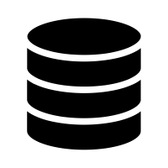
Recall: Traditional Data Processing
Data
Single Machine
Results
  Disadvantage:
    Sequential process
    Slow
    Not fully utilize the computation power
How do we scale-up for Large-Scale Data Analytics?

Slide 4
Parallelize Systems – Divide and Conquer
Data
Partitions
…
Partition 1
Partition 2
Partition N-1
Partition N
…
Workers
A Worker can be:
a distinct server in different locations
a local machine
a CPU core in a machine, etc.
Worker 1
Worker 2
Worker N-1
Worker N
…
Sub-result 1
Sub-result 2
Sub-result N-1
Sub-result N
Combined Results

Slide 5
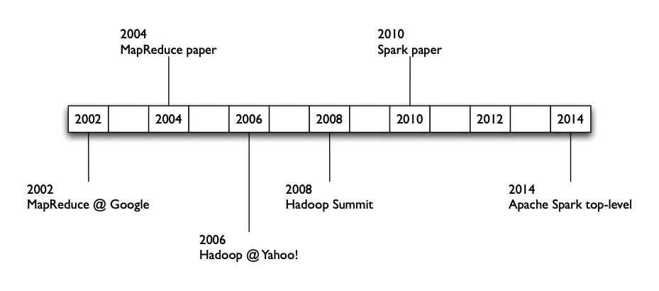
A Brief History…

Slide 6
Map Reduce
  Map Reduce (invented at Google in 2004) is a first widely adopted framework for distributed big data processing.
    Offered a solution that combined several key advantages:
      A simplified programming model: map and reduce
      Massive scalability on inexpensive hardware
      Built-in fault tolerance
    Is a high-level programming model that targets interaction with semi-structure or unstructured data that is stored across many different machines.
  Solving problem:
    Read a lot of data (i.e. reading all the webpages in the web)
      (1) Map: extract information from each record/document that we have read
      (2) Shuffle and Sort: shuffle records and documents across different machines.
      (3) Reduce: aggregate, summarize, filter, transform.
      (4) Write the results
Ensure the paradigm stays the same.
Modify map and reduce function to suit for different problems

Slide 7
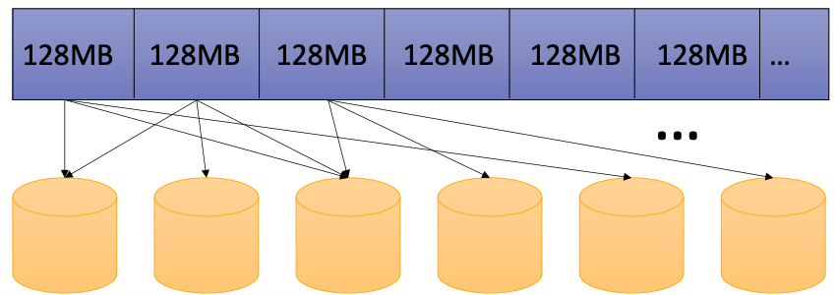
Data Model
  In HDFS, assume that data is stored in flat files.
  A file = A bag of (key, value) pairs
  Map reduce program:
    Input: a bag of (key, value) pairs
    Output: a bag of (key, value) pairs
      key is optional in the output.
      E.g. if we would like to count the number of pairs,
      then we do not care what are the keys in our results.

Slide 8
Map Reduce Example
  Counting the number of occurrences of each word in a large collection of documents.
  Each document:
    The key = document id (did)
    The value = set of words (word)
map(String key, String value):
// key: document name
// value: document contents
for each word w in value:
emitIntermediate(w, 1)
reduce(String key, Iterator values):
// key: a word
// values: a list of counts
sum = 0
for each v in values:
sum += v
emit(key, sum)

Slide 9
Map Reduce Example
Map
Shuffle
Reduce
(did1, v1)
(did1, v2)
...
(did2, v1)
(did2, v2)
...
(w1,1)
(w2,1)
(w3,1)
…
(w1,1)
(w2,1)
…
(w1, (1,1,1,…1))
(w2, (1,1,…))
(w3, (1,…))
(w1,25)
(w2,77)
(w3,12)
…

Slide 10
Map Reduce Example
I often repeat repeat myself
I often repeat repeat
I don’t don’t know why know why
I simply know that I I I
am am inclined to say to say
a lot a lot this way this way
I often repeat repeat myself
I often repeat repeat
Mapper1
I: 1, often: 1, repeat: 1, repeat: 1, myself: 1, I: 1, often: 1, repeat: 1, repeat: 1, I: 1, don’t: 1, don’t: 1, know: 1, why: 1, know: 1, why: 1
I often repeat repeat myself
I often repeat repeat
I don’t don’t know why know why
Mapper2
I simply know that I I I
am am inclined to say to say
a lot a lot this way this way
I: 1, simply: 1, know: 1, that: 1, I: 1, I: 1, I: 1, am: 1, am: 1, inclined: 1, to: 1, say: 1, to: 1, say: 1, a: 1, lot: 1, a: 1, lot: 1, this: 1, way: 1, this: 1, way: 1
Mapper3
I often repeat repeat myself
I often repeat repeat
I: 1, often: 1, repeat: 1, repeat: 1, myself: 1, I: 1, often: 1, repeat: 1, repeat: 1

Slide 11
Map Reduce Example
Reducer 1
I: 1, often: 1, repeat: 1, repeat: 1, myself: 1, I: 1, often: 1, repeat: 1, repeat: 1, I: 1, don’t: 1, don’t: 1, know: 1, why: 1, know: 1, why: 1
a: [1,1]
am: [1,1]
don’t: [1,1]
I: [1,1,1,1,1,1,1,1,1]
inclined: [1]
know: [1,1,1]
lot: [1,1]
myself: [1,1]
often: [1,1,1,1]
repeat: [1,1,1,1,1,1,1,1]
say: [1, 1]
simply: [1]
that: [1]
this: [1,1]
to: [1,1]
way: [1,1]
why: [1,1]
a: 2
am: 2
don’t: 2
I: 9
inclined: 1
know: 3
a: 2
am: 2
don’t: 2
I: 9
inclined: 1
know: 3
lot: 2
myself: 2
often: 4
repeat: 8
say: 2
simply: 1
that: 1
this: 2
to: 2
way: 2
why: 2
Reducer 2
I: 1, simply: 1, know: 1, that: 1, I: 1, I: 1, I: 1, am: 1, am: 1, inclined: 1, to: 1, say: 1, to: 1, say: 1, a: 1, lot: 1, a: 1, lot: 1, this: 1, way: 1, this: 1, way: 1
lot: 2
myself: 2
often: 4
repeat: 8
say: 2
simply: 1
Reducer 3
I: 1, often: 1, repeat: 1, repeat: 1, myself: 1, I: 1, often: 1, repeat: 1, repeat: 1
that: 1
this: 2
to: 2
way: 2
why: 2

Slide 12

Issues with MapReduce
…
map
reduce
  In MapReduce:
    Everything must be expressed using mappers and reducers
    Write all intermediate results to disk for fault tolerance
    Only way to share data between iterations / phases is through shared storage
    Slow due to replication and disk I/O, but necessary for fault tolerance
  Ideally, through memory instead of disk-based storage
…
operation
operation

Slide 13
Challenges
  How to design a distributed memory abstraction that is both fault-tolerant and efficient?
  Existing storage systems enable precise modifications to the state.
    In-memory key-value stores (e.g., Redis, Memcached) store data in RAM as simple key-value pairs (e.g., key: "user1", value: "John").
    Requires replicating data or logs across nodes for fault tolerance
      Costly for data-intensive apps
      10-100x slower than memory write
    Require costly on-the-fly replication for mutations
  Idea: to apply similar coarse-grained approach that transform the entire dataset per operation, which is similar to MapReduce (batch processing)
allow precise updates to small pieces of data
copying changes to other nodes in real-time as mutations occur.

Slide 14
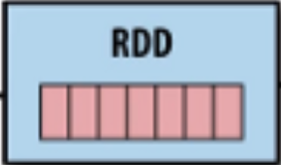
Solution: Resilient Distributed Dataset (RDDs)
  RDD is a fundamental data structure used in Apache Spark.
  Restricted form of distributed shared memory
    an immutable, distributed collection of objects/records
    Can only be build through coarse-grained, deterministic transformations
      Such as map, filter, join, etc.
  Efficient fault recovery using lineage
    Log one operation to apply to many elements
    Recompute lost partitions on failure
    No cost if nothing fails

Slide 15
Spark Features
A managing framework for parallel data processing, which supports:
Large scale data processing
Storing data on In-memory/local machine
Resources arrangement across workers
Fast processing
In-memory computing
Flexible
All-in-one
Spark operates on Resilient Distributed Datasets (i.e., parallelize dataset), which speed up data reading and writing operations.
In Spark, data is stored in the RAM, so it can access the data quickly and accelerate the speed of analytics
Spark supports multiple programming languages and allows the developer to write application in Java, Scala, R, Python, etc.
Spark has a rich set of SQL, machine learning and visualization components, which make analytics easier.

Slide 16
Components of Spark
S
Spark Core
Spark SQL
Spark Streaming
MLlib
GraphX

Slide 17
Spark Core
Spark Core is the base engine for large-scale parallel and distributed data processing
It is responsible for:
S
Spark Core
Memory Management
Fault Tolerance
Scheduling, distributing and monitoring jobs on a cluster
Interacting with storage systems

Slide 18
Resilient Distributed Dataset
Spark Core is embedded with RDDs (Resilient Distributed Datasets), an immutable, distributed collection of objects that can be operated in parallel on multiple machines/nodes)
RDD
S
Transformation
Action
Spark Core
These are operations (e.g., filter, join, union) that are performed on an RDD that yields a new RDD containing the results
These are operations (e.g., count) that return a value after running a computation on an RDD
Action: (RDD → Output)
Transformation: (RDD₁ → RDD₂)

Slide 19
Spark SQL
Spark SQL framework component is used for structured and semi-structured data processing
Spark SQL Architecture
Data Frame API
Data Source API
CSV
JSON
…
Structured Data
Semi-Structured Data

Slide 20
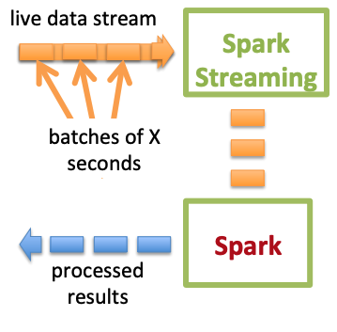
Spark Streaming
Spark Steaming is a lightweight API that allows developers to perform batch processing and real-time streaming of data with ease
Chop up the live stream into batches of X seconds
Batch sizes as low as half second, latency around 1 second.
Spark treats each batch of data as RDDs and processes them using RDD operations
Finally, the processed results of the RDD operations are returned in batches

Slide 21
Spark MLlib
MLlib is a low-level machine learning library that is simple to use, is scalable, and compatible with various programming languages
MLlib eases the deployment and development of scalable machine learning algorithms
It contains few libraries that have an implementation of various machine learning algorithms
…
Clustering
Classification

Slide 22
GraphX
GraphX is Spark’s own Graph Computation Engine and data store
Provides a uniform tool for ETL graph data
Exploratory Data Analysis (EDA)
GraphX
Graph Computations

Slide 23
Spark Architecture and
Resilient Distributed Datasets (RDD)

Slide 24
Spark Architecture
Apache Spark uses a master-slave (or worker) architecture that consists of a driver, that runs on a master node, and multiple executors which run across the worker nodes in the cluster
Worker Node
Master Node
Executor
Cache
Cluster Manager (CM)
Driver Program
Task
Task
SparkContext
Worker Node
CM split a job into multiple tasks and distributed over the worker node
When an RDD is created in Spark context, it can be distributed across various nodes
Worker nodes are slaves that run different tasks
Cache
Executor
Master Node has a Driver Program
The Spark code behaves as a driver program and creates a SparkContext, which is a gateway to all the Spark functionalities
Task
Task

Slide 25

A Conceptual Diagram of Apache Spark's Data Processing Model
operation
operation
…
operation
Results

Slide 26
Resilient Distributed Datasets (RDD)
  A Resilient Distributed Dataset (RDD) is the basic abstraction (i.e., object) in Spark. Represents an immutable, partitioned collection of elements that can be operated on in parallel.
  Lazy evaluation:
    Operators are not executed immediately
    A operator tree is constructed in memory
    Computation only done when results needed (to write file, make plot, etc.)
  Data lineage:
    Record series of operations on the data necessary to obtain results
  Immutability:
    You can’t change an RDD, but you can define a new one

Slide 27
Partitions
  Granularity of Data Flow in Transformations
  Whole Dataset: The entire dataset can be processed through one transformation at a time. However, this approach may not fit into memory.
  Row: Each row can be processed independently in this pipeline. While this allows for flexibility, it is likely to be slower than processing in bulk.
  Partition: Users of Spark can define the number of partitions for a Resilient Distributed Dataset (RDD).
This breakdown should help clarify the options for data flow granularity during transformations
sc.parallelize(data, 2)
A | 1
B | 2
A | 3
B | 4
A | 1
B | 2
A | 3
B | 4
partition 1
partition 2
single partition
sc.parallelize(data, 1)

Slide 28
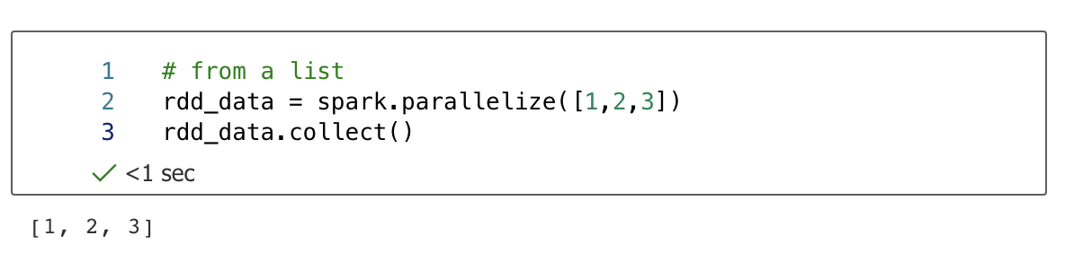
How to create RDD
RDD
Transformation
Action
These are operations (e.g., filter, join, union) that are performed on an RDD that yields a new RDD containing the results
These are operations (e.g., count) that return a value after running a computation on an RDD
  parallelize(): distribute a local python object to form an RDD
  collect(): to obtain values from RDD

Slide 29
Transformations & Actions Example
  Let's return double the value and filter the results where the key is 'A'.
data = (“A”, 1), (“B”, 2), (“A”, 3), (“B”, 5)]
spark = ss.sparkContext
rdd = spark.parallelize(data)
double = rdd.map(multipleTwoToTheValue)
doubleA = double.filter(filterA)
doubleA.collect()
def multipleTwoToTheValue(item):
key, value = item
return(key, value * 2)
map()
def filterA(item):
key, value = item
return key == 'A'
[('A', 2), ('A', 6)]
filter()
  The computation is a sequence of FOUR operations in TWO types.
    Transformation (parallelize, map and filter): Create a new RDD (lazy, no execution yet)
    Action (collect): Perform all operations in the graph to get the actual result.

Slide 30
Transformations & Actions Example
T
T
T
(filter)
(parallelize)
(map)
[('A', 2), ('A', 6)]
A
(collect)
Question: Are there different paths you can establish from the initial node to the final node?

Slide 31
Better Approach?
  Transaction vs action
    Transformation: intermediate results
    Action: Final results
    Selecting a more effective sequence of transformations to achieve the same outcome, along with optimizing the computation through pipelining.
spark = ss.sparkContext
rdd = spark.parallelize(data)
double = rdd.map(multipleTwoToTheValue)
doubleA = double.filter(filterA)
doubleA.collect()
[('A', 2), ('A', 6)]
A
(collect)
T
T
T
(parallelize)
(filter)
(map)

Slide 32
Transformation: Narrow vs Wide
  Any transformation where a single output partition can be computed from a single input partition is a narrow transformation.
  Others are wide transformations.
  Wide transformations often require network resources. Unless all input partitions are on the same machine, some will need to be transferred.
A | 1
B | 2
A | 3
B | 4
A | 1
B | 2
A | 3
B | 4
A | 1
A | 3
B | 2
B | 4
A | 1
A | 3
filtered
(narrow)
sortBy
(wide)

Slide 33
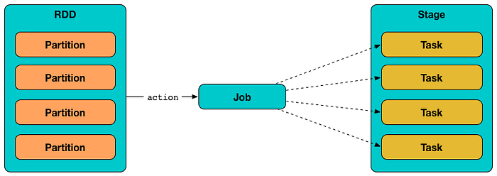
Job, Stage and Task
  Spark code is transformed into jobs, which are made up of stages, each of which contains tasks.
    A task operates on a single CPU core and processes a single partition, which is fully loaded into memory.
a sequence of transformations that can be executed in a single pass
An operation involves data shuffling will lead to the creation of a new stage.
Each job gets divided into smaller sets of tasks called stages that depend on each other.
Each action operation will create one Spark job.
sequence of transformations on data
If your dataset has 2 Partitions, an operation such as a filter() will trigger 2 Tasks, one for each Partition.
A single unit of work or execution that will be sent to a Spark executor.

Slide 34
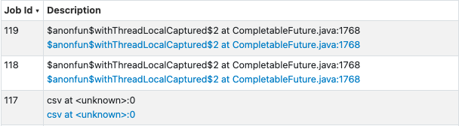
Jobs Creation
from pyspark.sql import SparkSession
spark = SparkSession.builder.appName("example").getOrCreate()
df = spark.read.option("header", True).csv('ratings.csv')
df_filtered = df.filter(df['rating'] > 3)
df_result = df_filtered.groupBy("movieID").count()
Reading the CSV is a separate I/O operation (Job 1).
Filtering is a narrow transformation that may be executed as a distinct job due to optimization (Job 2).
Grouping and counting involve shuffling, which creates a new stage and job, followed by collecting results for show (Job 3).
To visualize the job, stages, and tasks, you can use the Spark web UI at http://localhost:4040

Slide 35
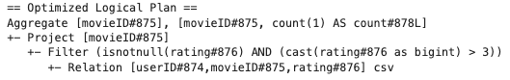
Data Lineage Example
from pyspark.sql import SparkSession
spark = SparkSession.builder.appName("example").getOrCreate()
df = spark.read.option("header", True).csv('ratings.csv')
df_filtered = df.filter(df['rating'] > 3)
df_result = df_filtered.groupBy("movieID").count()
  Data Lineage
    High-level trace of transformation, stored as part of the logical plan.
    csv (read ratings.csv) → Filter (rating > 3) → Aggregate (group by and count)
    If a partition is lost, Spark uses this lineage to recompute the data by reapplying these transformations.

Slide 36
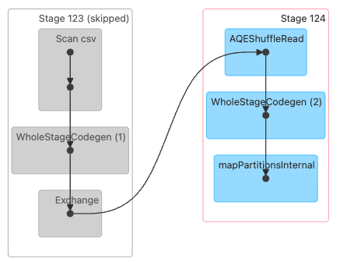
DAG Visualization
Handles the initial data read and filtering.
Handles the post-shuffle aggregation.
Reads data from a CSV file. It’s the initial step, scanning the input data into an RDD or DataFrame.
Read data shuffled from the previous stage
Fuses the groupBy("movieID").count() operation into a single function, involves reading shuffled data (AQEShuffleRead) and performing the aggregation
Combine the Scan csv and filter(df['rating'] > 3) operations into one function
Applies a function to each partition of the data in parallel.
A shuffle operation, where data is redistributed across the cluster. Shuffles occur due to operations like groupBy, join, or repartition
query optimization in Spark SQL that fuses multiple physical operators together into a single Java function.

Slide 37
The Impact of Partition Size on Performance
  Choosing a partition count directly affects the number of tasks necessary to do a job.
  When choosing large partitions:
    Advantage: Less overhead in starting tasks
    Disadvantages:
      Might not expose enough parallelism to fully utilize all available cores
      Harder to balance work evenly
      Uses more memory
The key trade-offs are between the overhead of starting more tasks with smaller partitions, versus the potential underutilization of resources with larger partitions.
The optimal choice depends on the specific requirements and constraints of the job.

Slide 38

Caching
  Some RDDs might be used repeatedly
  Similar as persist() in dask
  Spark can also cache a copy of the intermediate results
Average Temp
weather data
Hong Kong Weather Data
all_weather = …
hk_weather = all_weather.filter(…)
hk_weather.cache()
...
hk_weather.unpersist()
Rainfall prediction
Correlation between Rainfall and Temp

Slide 39
Join and Partition
Anthony | 1
Bob | 2
Anthony | M
Bob | M
Anthony | 1 | M
Bob | 2 | M
Machine 1
⨝
=
Machine 2
Cindy | 3
Cindy | F
Cindy | 3 | F
Anthony | 11
Anthony | 12
Anthony | 13
Bob | 21
Bob | 22
Cindy | 33
Cindy | 34
Cindy | 7
Bob | 9
Anthony | 2
Bob | 4
Anthony | 3
Bob | 1
Cindy | 8
If partitioning doesn’t match, then need to carry out all-to-all network communication to match pairs.
Machine 1
To ensure rows with the same key (e.g., a join key) are on the same node. Each node sends portions of its data to all other nodes (or a subset, depending on the partitioning) and receives data from all other nodes.
Machine 2

Slide 40
Join and Partition
If the two tables (RDDs or DataFrames) are partitioned in the same way:
using the same key (e.g., customer_id), the same partitioner (e.g., HashPartitioner for RDDs or equivalent hashing for DataFrames), and the same number of partitions.
Anthony | 11
Anthony | 12
Anthony | 13
Bob | 21
Bob | 22
Cindy | 33
Cindy | 34
Anthony | 2
Anthony | 3
Bob | 1
Bob | 4
Bob | 9
Cindy | 7
Cindy | 8
Machine 1
partitionBy()is specific to key-value pair RDDs. It is used to partition RDDs based on keys, by default using a hash partitioner
Machine 2

Slide 41

Spark Runtime
lines = sc.textFile('/tmp/large_test_application.txt')3)
errors = lines.filter(lambda line: 'ERROR' in line)
messages = errors.map(lambda error: error.split('\t')[2])
messages.cache()
API_error = messages.filter(lambda line: 'API' in line).count()
TO_error = messages.filter(lambda line: 'Timeout' in line).count()
message.collect()
Base RDD
Transformed RDD
Another transformed RDD
Ask workers to cache it to memory
Action
Once action issued (i.e. count())
1. read the file
2. perform the transformation
3. carry out the action and send back results to driver
Driver
Worker
Worker

Slide 42
Fault Tolerance
  Immutability and Lineage:
    Spark RDDs are immutable and retain the lineage of the deterministic operations used to create them from a fault-tolerant input dataset.
  Fault Tolerance:
    If a partition of an RDD is lost due to a worker node failure, it can be recomputed using the lineage of operations from the original dataset.
  Deterministic Transformations:
    When all RDD transformations are deterministic (producing the same output for the same input), the data in the final transformed RDD will always be consistent.

Slide 43
Fault Tolerance
Worker failure:
    Tasks assigned to the worker are lost
    Spark can recover by using the lineage information of RDDs to recompute the lost partitions from the original dataset.
    Driver program automatically reassigns these tasks to other available worker nodes, allowing the job to continue progressing despite the failure.
Driver failure:
    leads to the loss of the application's state and all information about running jobs
    do not have automatic recovery mechanisms
    requiring the application to be restarted from the beginning.

Slide 44
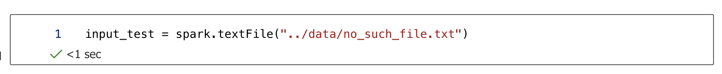
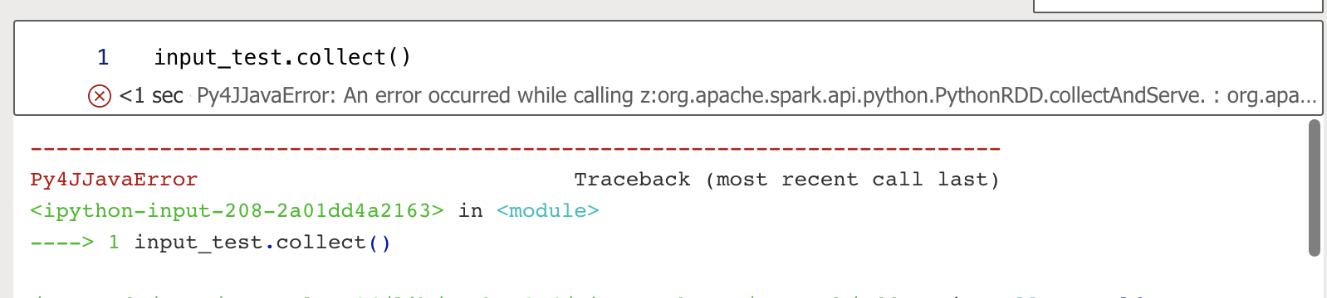
RDD Transformation (laziness)
  Transformation will not process until we call action
  For example, if we import an non-existing file, no error found.
  Error comes only when we call action (here, collect())
  Advantage of laziness
    Allow the context manager to optimize the whole task by merging, transforming and reducing repeated processes
    Saves time and unwanted processing power

Slide 45

Spark Programming

Slide 46
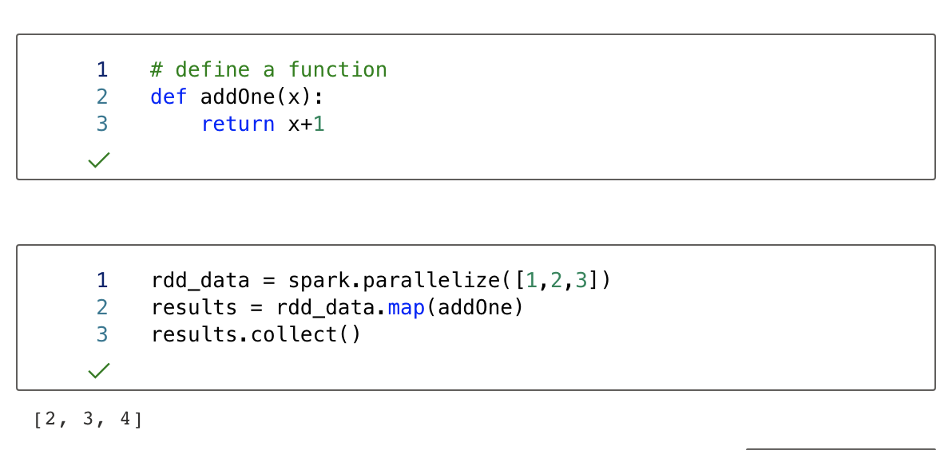
RDD Transformation (Single RDD)
  RDD transformation is a list of operations that apply on the source RDD and construct a new RDD
  Map(): return a new RDD by passing each element of the source RDD through a function

Slide 47
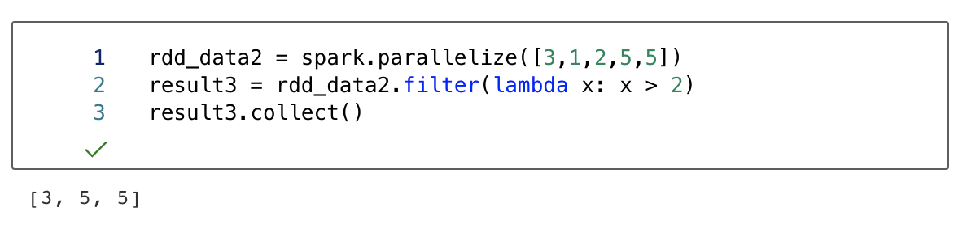
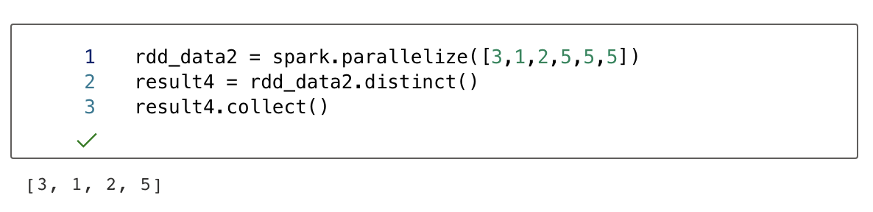
RDD Transformation (Single RDD)
  filter(): returns a new dataset formed by selecting those elements of the source on which filter return true
  distinct(): is used to filter out repetitive items

Slide 48
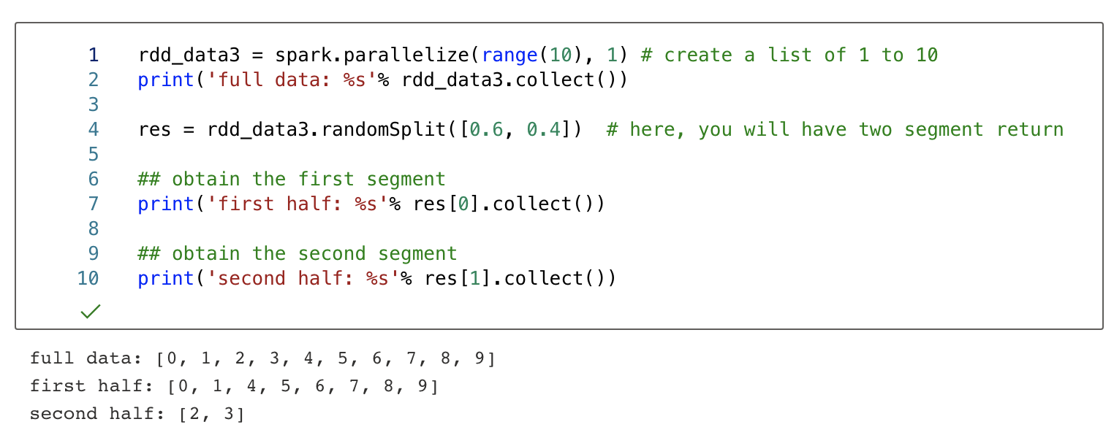
RDD Transformation (Single RDD)
  randomSplit() can be used to divided an RDD into multiple sub segments, it can randomly split this RDD with the provided weights.

Slide 49
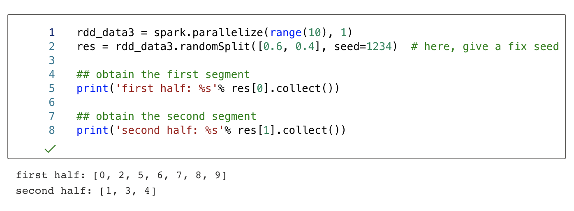
RDD Transformation (Single RDD)
  Often, you need to split the dataset in a way that you can reproduce the result. Then you will pre-define a seed so that each time the splitting pattern is identical.

Slide 50
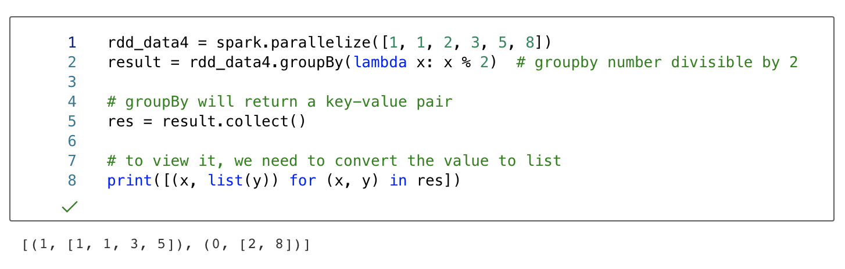
RDD Transformation (Single RDD)
  groupBy(): Return an RDD of grouped items based on a pre-defined condition

Slide 51
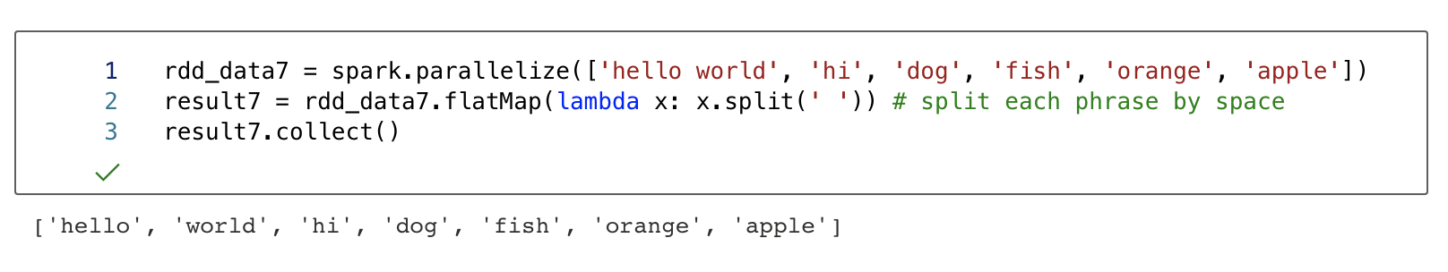
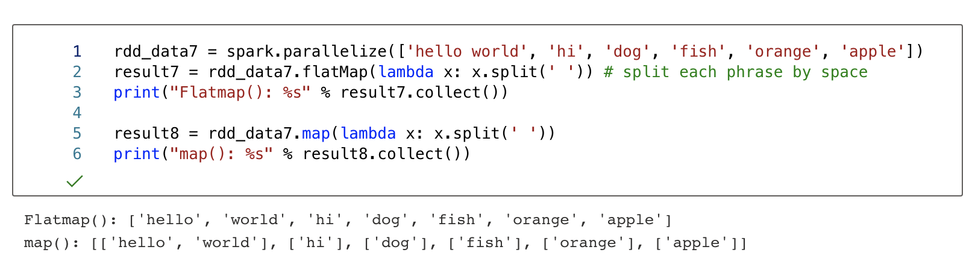
RDD Transformation (Single RDD) (flatMap)
  Sometimes we want to produce multiple output elements for each input elements. The operation to do this is called flatMap()
  map()will not flatten the results. Hence, 6 input will have 6 output.
  In contrast, flatMap()flatten the output, so 6 input will have 1 output.
1 vs 6 output

Slide 52
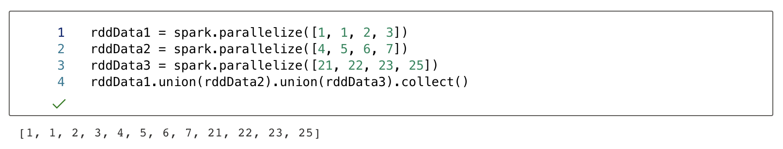
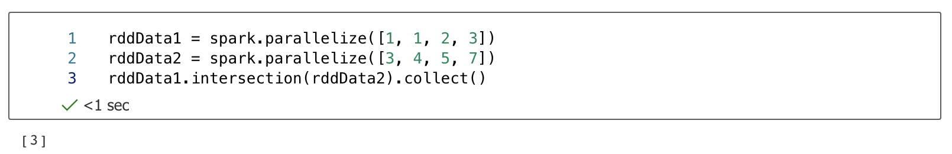
RDD transformation (Multiple RDD)
  In previous slides, we introduce operators that operates on single RDD.
  Here we are going to introduce few operators that can be used to combine multiple RDDS. They are union(), intersection(), subtract(), cartesian()
  union(): Return the concatenation of all input RDD
  intersection(): Return the overlap of all input RDD

Slide 53
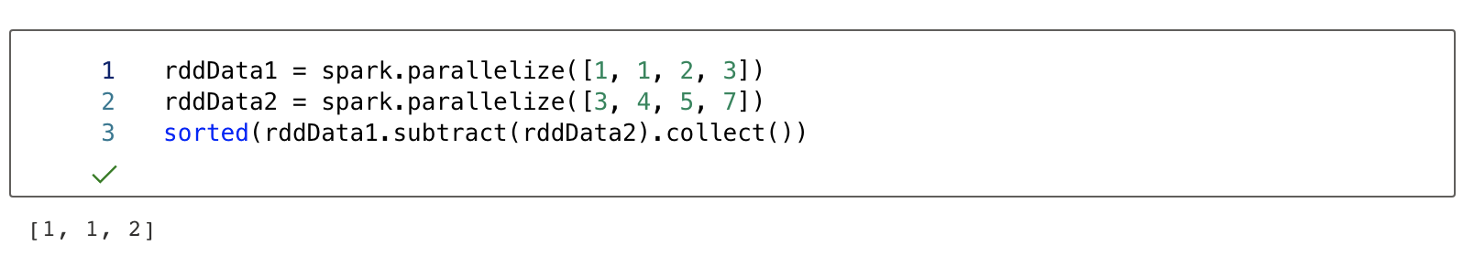
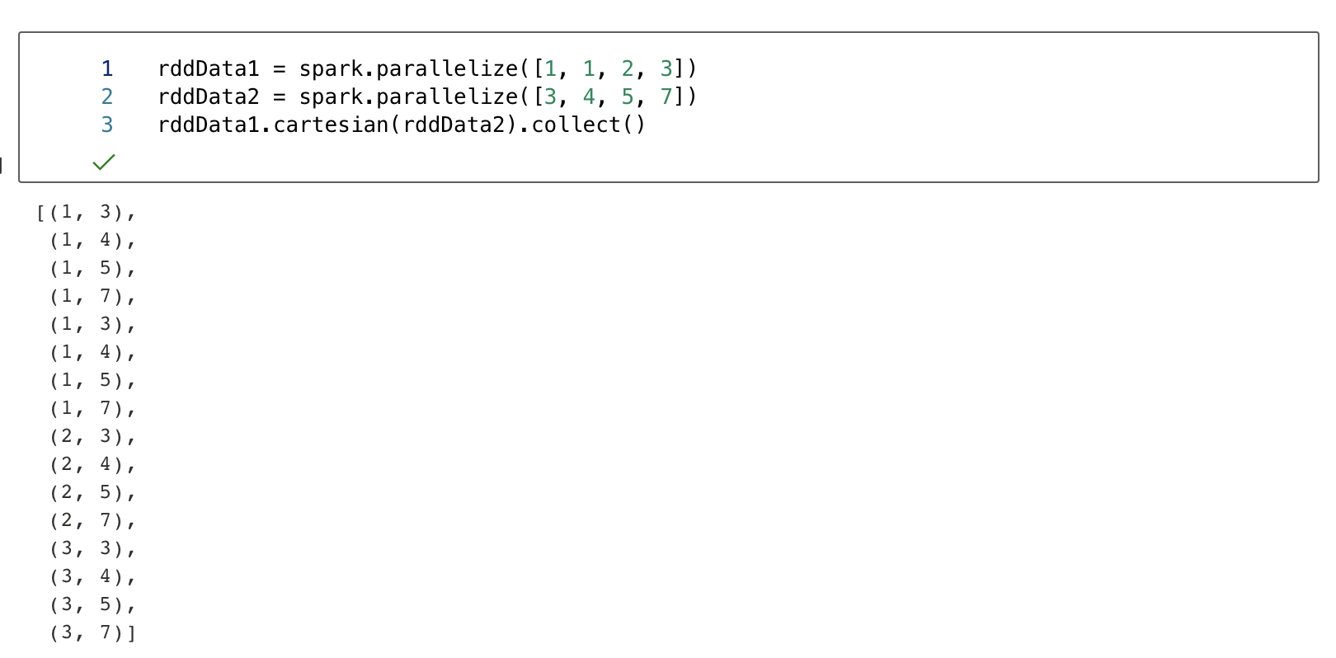
RDD transformation (Multiple RDD)
  subtract(): return each value in self that is not contained in other
  For example {1,2,3} subtract {3,4,5} = {1,2}
  Cartesian(): Return the Cartesian product of multiple RDDs
  For example, {1,2,3} cartesian {3,4,5} = {{1,3}, {1,4}...{3,5}}

Slide 54
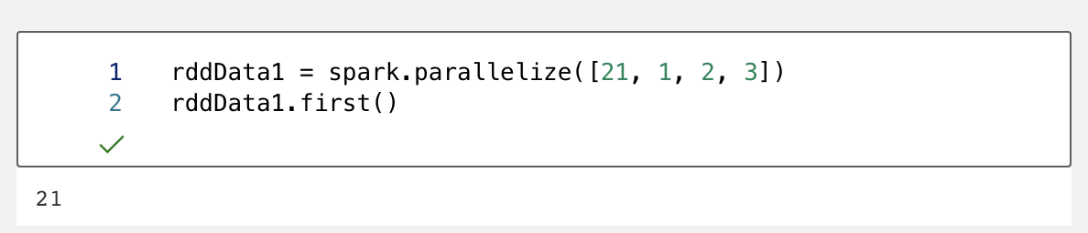
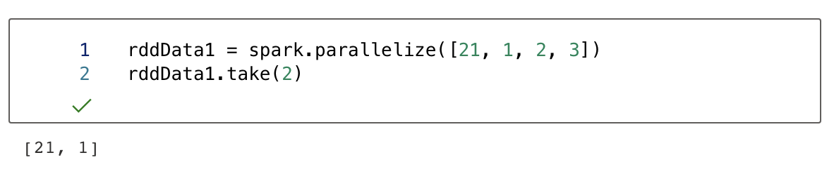
RDD Actions
  Actions operators will create real (non-rdd) values (we will talk more this concept on later slides).
  Here, we will introduce first(), take()
  first(): Return the first element in the RDD
  take(): Get the first N elements in the RDD

Slide 55
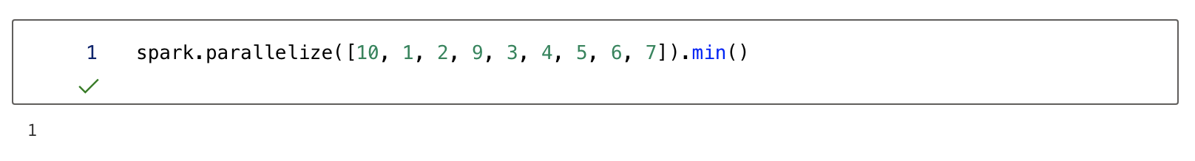
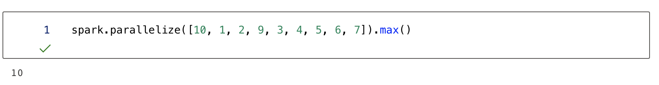
Basic Statistics in RDD
  Here, we will have few RDD operators for getting the statistics in RDD
  They are min(), max(), stdev(), mean(), count(), sum()
  min():Get the minimum value in the RDD
  max():Get the maximum value in the RDD
  stdev():Get the standard deviation in the RDD

Slide 56
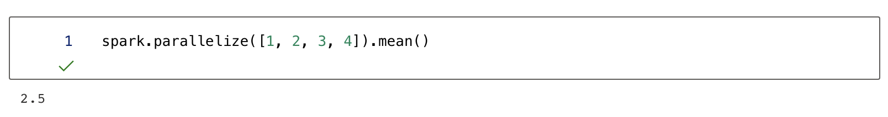
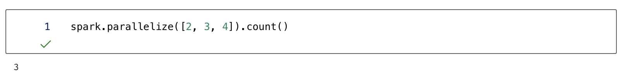
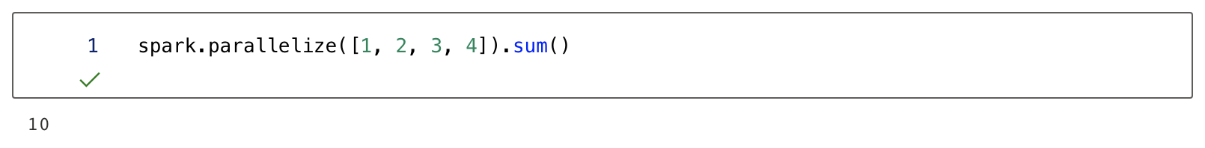
Basic Statistics in RDD
  Mean(): Find the average of elements in this RDD
  count(): Find the number of elements in this RDD
  Sum(): Find the sum of elements in this RDD

Slide 57
Single Key-Value Pair RDD Transformation
  Key-value pair RDD is a specific type of RDD, in which the data will be stored in key-value format (like dict). The key serves as a unique ID for retrieving the values in the RDD.
  We will introduce few operators for key-pair RDD. They are filter(), mapValues(), reduceByKey()
  Example of dictionary datatype
Keys | Values
Tom | 1
Mary | 2
John | 3

Slide 58
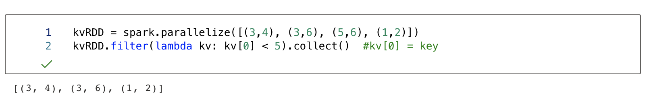
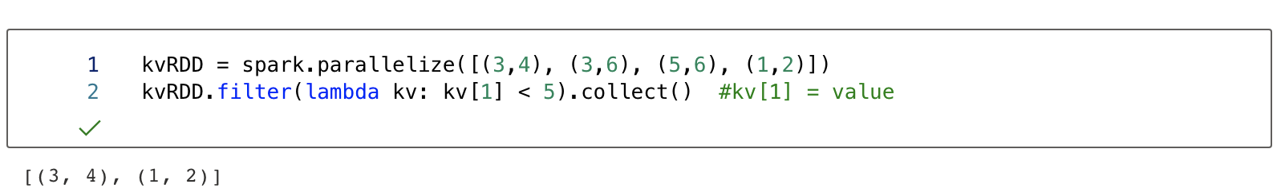
Single Key-Value Pair RDD Transformation
  We can filter elements in RDD, by their keys or values

Slide 59
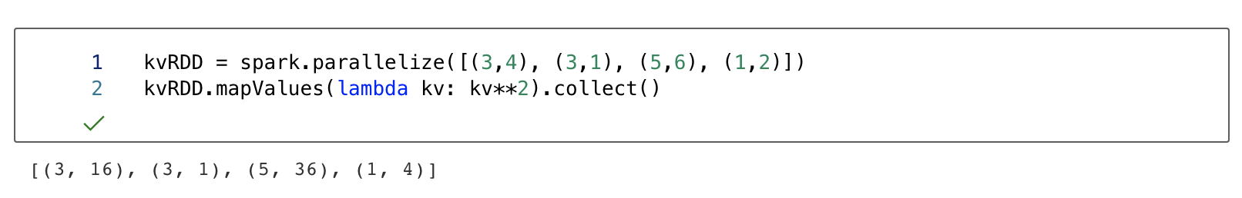
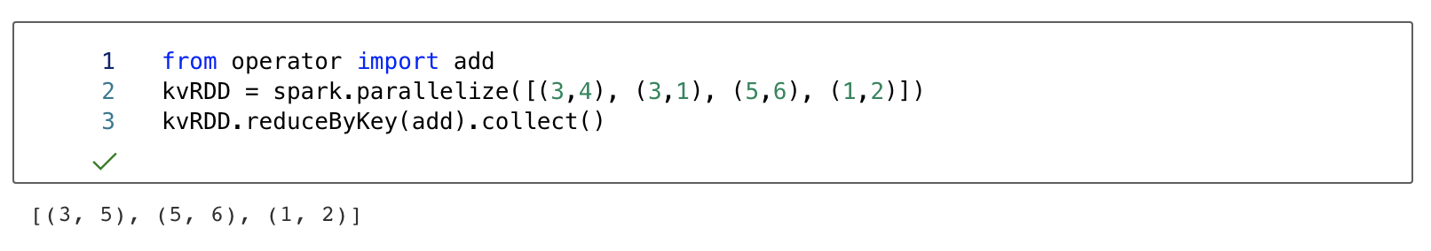
Single Key-Value Pair RDD Transformation
  MapValue(): apply function on each value element
  reduceByKey()means grouping the keys together, and apply an aggregated function on merge its values (e.g., sum, mean).
  For example, we can group all data with key=3, then add their values

Slide 60
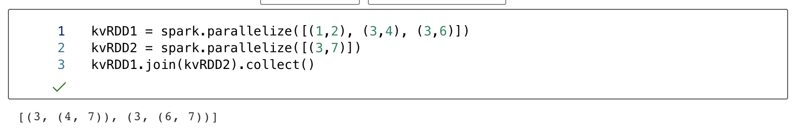
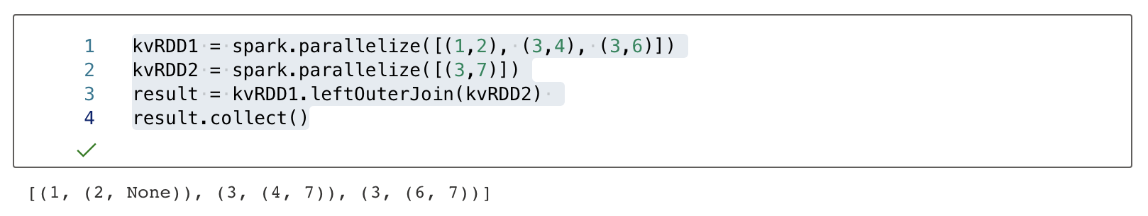
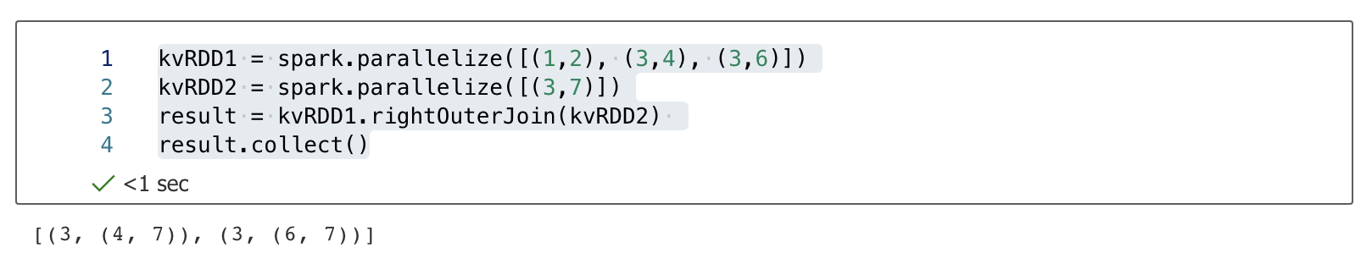
Multiple Key-Value Pair RDDs Transformations
  Here, we test operator for joining multiple key-pair RDDs
  For join() (i.e., inner join), two elements will join only if they shared same keys.
  For leftOuterJoin(), keys must exist in the left RDD
  For rightOuterJoin(), keys must exist in the right RDD

Slide 61
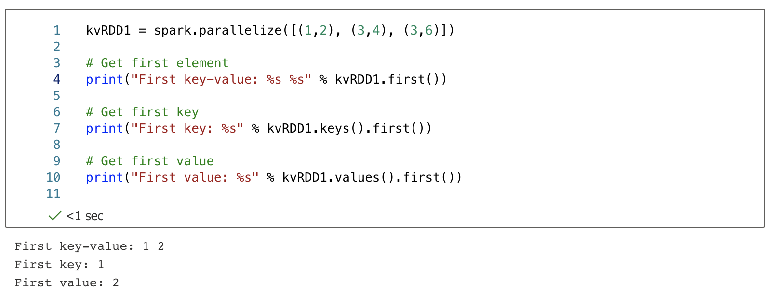
Key-Value Pair RDD Actions
  We can use back the action operators learned previously, and apply them on key-value pairs
  For example, we can use first() and take() to get the elements in Key-value pair RDD, either by their keys or values.
  first()

Slide 62
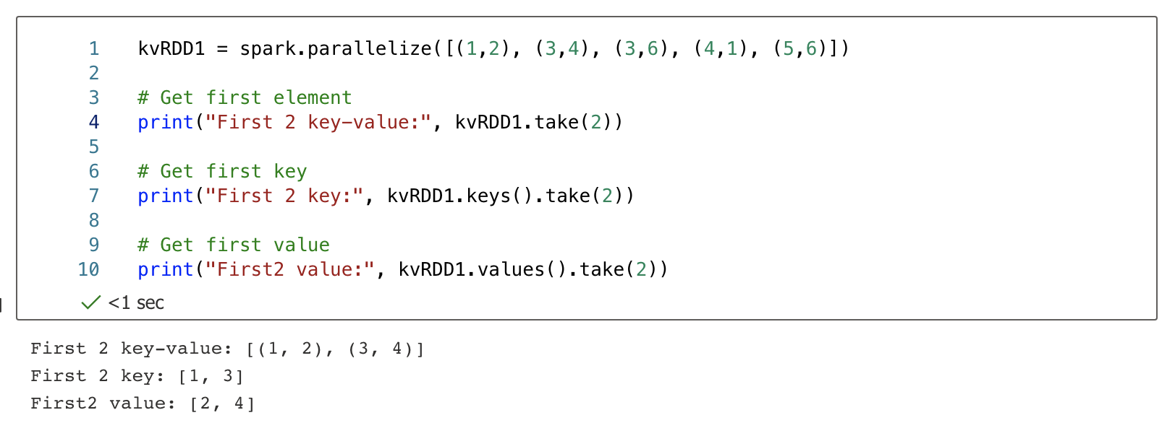
Key-Value Pair RDD Actions (take)
  take()

Slide 63
Applications of Spark
JPMorgan uses Spark to detect fraudulent transactions, analyze the business spends of an individual to suggest offers, and identify patterns to decide how much to invest and where to invest
Alibaba uses Spark to analyze large sets of data such as real-time transaction details, browsing history, etc, in the forms of Spark jobs and provides recommendations to its users
IQVIA is a leading healthcare company that uses Spark to analyze patient’s data, identify possible health issues, and diagnose it based on their medical history
Entertainment and gaming companies like Netflix and Riot games use Apache Spark to showcase relevant advertisements to their users based on the videos that they watch, share and like.
Banking
E-Commerce
Healthcare
Entertainment

Slide 64

Spark Use Case
Netflix is one of the world’s leading video streaming companies
Video streaming is a challenge, especially with increasing demand for high-quality streaming experience
Netflix collects data about video streaming quality to give their customers visibility into the end-user experience when they are delivering
Using Apache Spark, Netflix delivers a better quality of service to its customers by removing the screen buffering and learning in detail about the network conditions in real-time
The information is stored in the video player in different regions to manage live video traffic coming from a billion video feeds every month, to ensure maximum retention

Slide 65
In class exercise
  In building a search engine over a large corpus of text documents (e.g., web pages, articles), to enable fast keyword search, we need to construct an inverted index that maps each word → list of document IDs where it appears. (maps each word to the list of document IDs in which it appears)
Sample Input
Expected Output
D1 || the cat sat on the mat D2 || a quick brown fox jumps D3 || the quick brown fox D4 || sat on the brown mat
a: [D2] brown: [D2, D3, D4] cat: [D1] fox: [D2, D3] jumps: [D2] mat: [D1, D4] on: [D1, D4] quick: [D2, D3] sat: [D1, D4] the: [D1, D3, D4]

Slide 66
In class exercise
Please provide the pseudocode of one MapReduce job to build the inverted index
function MAP(doc_id, document_text):
function REDUCE(word, doc_ids_list):

Slide 67
Take Home Exercise
Please implement the inverted index using PySpark RDDs
You may assume that the input is stored in the file documents.txt.
from pyspark.sql import SparkSession from operator import add ss = SparkSession.builder \ .appName("Spark PageRank") \ .master("local[4]")\ .getOrCreate() spark = ss.sparkContext # TODO 1: read and convert the documents.txt to RDD #TODO 2: split the data into two parts (document Id, words) #TODO 3: Form a pair for each distinct word (e.g. (brown, D2), (brown, D3), …) #TODO 4: Group the results in TODO3 #TODO 5: Perform sorting
Here are some functions you might need:
textFile()
map()
flatMap()
distinct()
groupByKey()
sortByKey()
collect()

Slide 68

Any Questions?

