Slide 1

DSAI4205 Big Data Analytics
Lecture 10:
Recommendation System
Dr. Ken FONG
Department of Data Science and Artificial Intelligence
chi-kit-ken.fong@polyu.edu.hk

Slide 2
Agenda
1. example of recommendation system
2. motivation
3. Utility matrix
4. content-based filtering
5. collaborative filtering
6. Evaluations

Slide 3
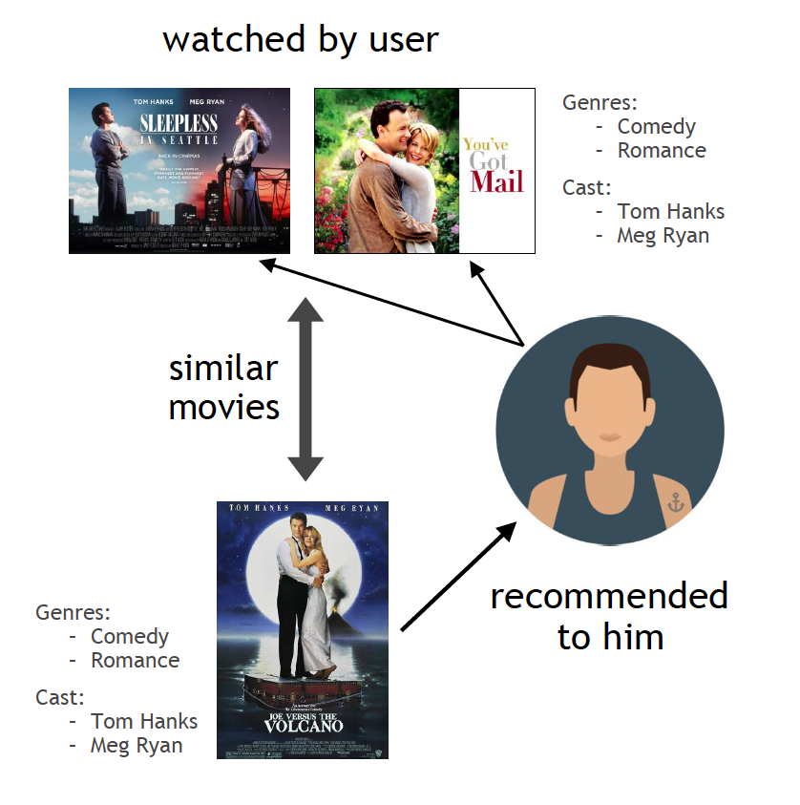
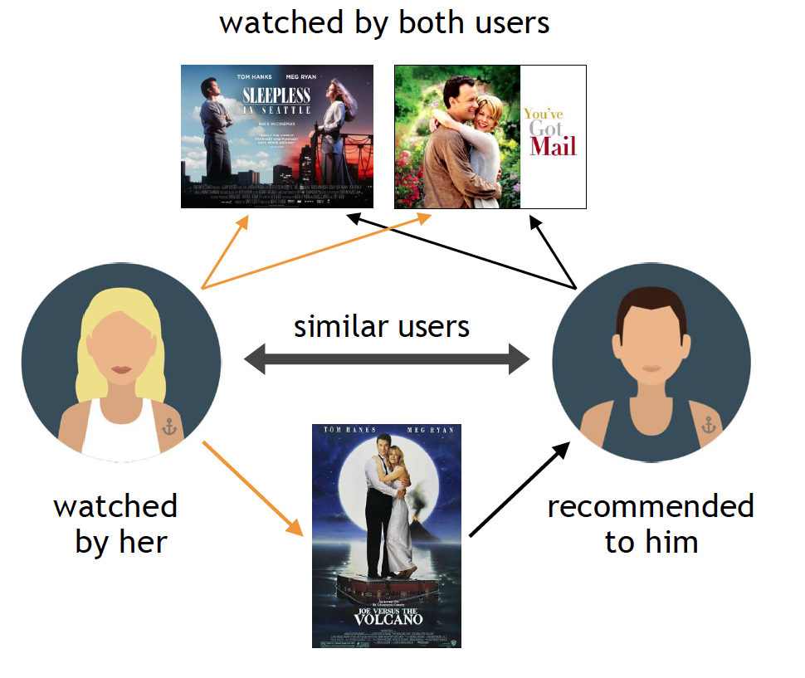
Example of Recommendation System

Slide 4










Recommendations
Examples:
Search
Recommendations
Items
Products, web sites,
blogs, news items, …

Slide 5


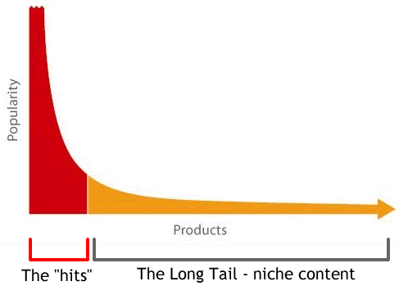

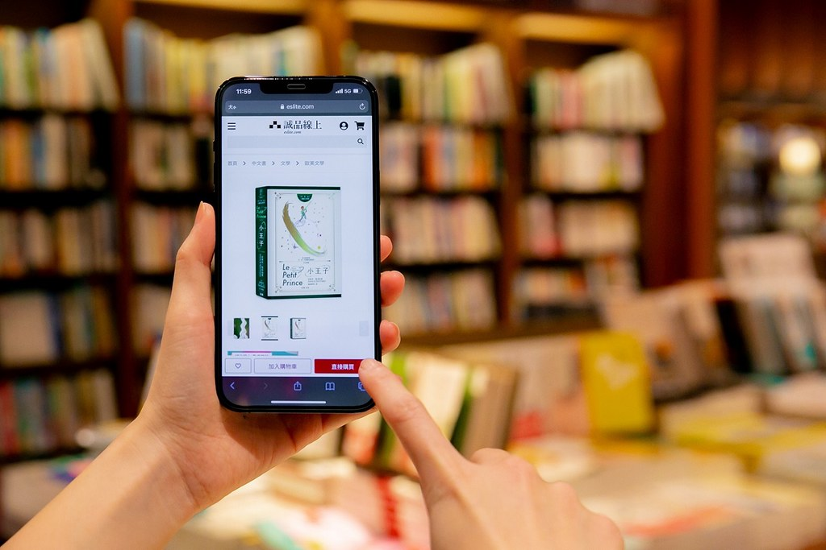
Origin of Web Shopping
  Does eslite bookstore has everything you need ?
  A lot of products are only of interest to a small population.
  However, most people buy many products that are from the long-tail

Slide 6
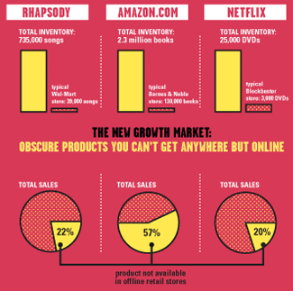
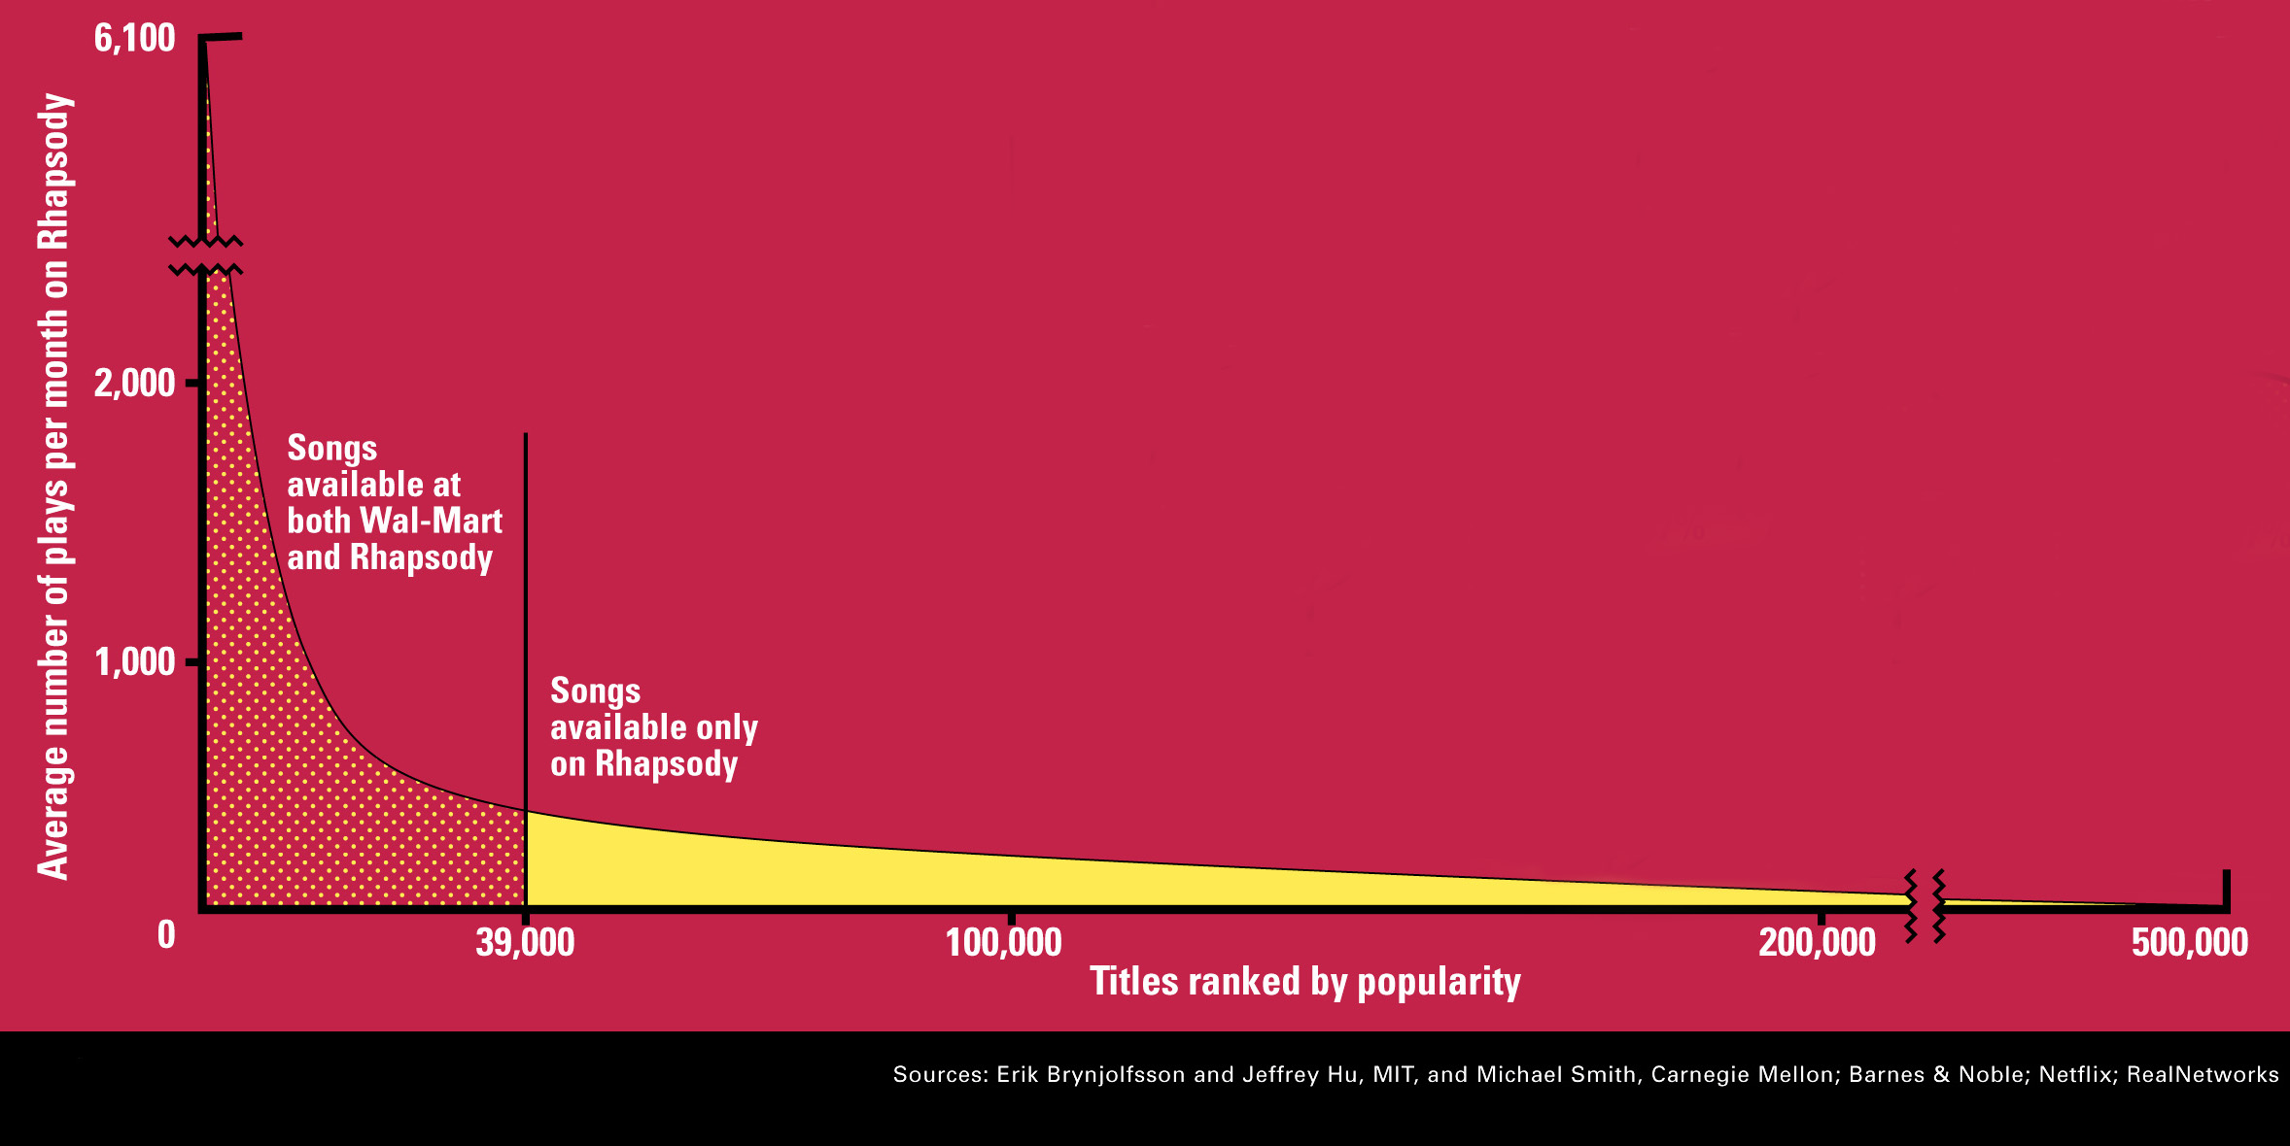
Origins: Web Shopping
  Shelf space is a limited resource for traditional retailers.
  Web enables near-zero-cost dissemination of information about products

Slide 7
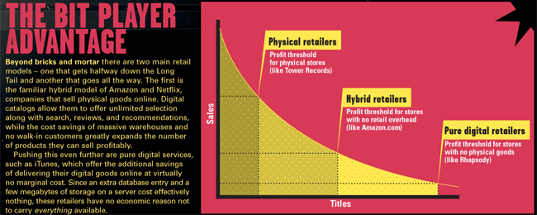
Origins: Web Shopping

Slide 8
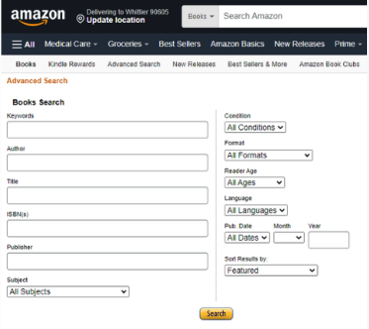
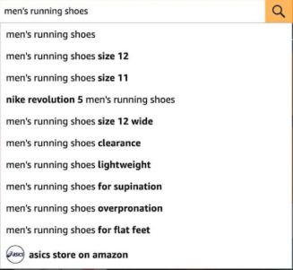
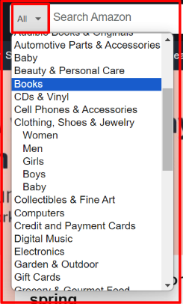

Origins: Web Shopping
  Web shopping enables more choices
    Hard to search
    Recommendation engines to the rescue

Slide 9
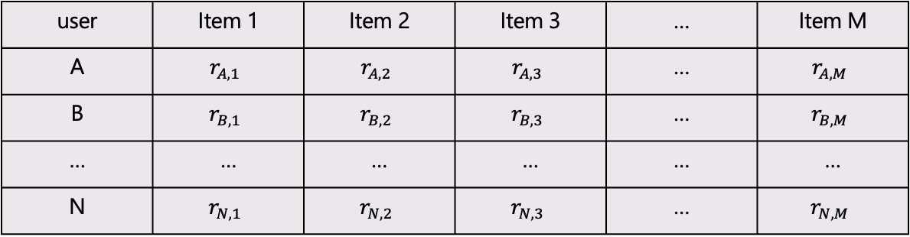

Formal Model
  Given:
    X = set of N Customers
    S = set of M Items
    Utility function u: X $×$S → R
      R: set of ratings
      e.g. 1-5 stars, can be real number in [0, 1]
user | Item 1 | Item 2 | Item 3 | … | Item M
A | $$r_{A, 1}$$ | $$r_{A, 2}$$ | $$r_{A, 3}$$ | … | $$r_{A, M}$$
B | $$r_{B, 1}$$ | $$r_{B, 2}$$ | $$r_{B, 3}$$ | … | $$r_{B, M}$$
… | … | … | … | … | …
N | $$r_{N, 1}$$ | $$r_{N, 2}$$ | $$r_{N, 3}$$ | … | $$r_{N, M}$$

Slide 10






Utility Matrix
  Given $n$ users and $m$ items, we have the utility matrix:
user | Squid Game | Alice in Borderland | The Devil's Plan | Kingdom | Happiness
A | 5 | 4 | 2 |  | 3
B | 4 |  |  | 4 | 3
C |  |  | 4
?
?
?
?
?
?

Slide 11
Key problems
  (1) Gathering “known” ratings for matrix
    How to collect the data in the utility matrix ?
  (2) Estimating unknown ratings from the known ones.
    Interested in high unknown ratings
    But we may not be interested in knowing what you don’t like.
  (3) Evaluation
    How to measure success/performance of recommendation methods?

Slide 12
(1) Gather rating
  Explicit
    Ask people/users to rate items
    Doesn’t work well in practice
      People usually don’t like being bothered.
    Pay people to label items.
  Implicit:
    Learn ratings from user actions. (E.g. purchases, clicks)
    Problem: hard to learn low ratings.

Slide 13

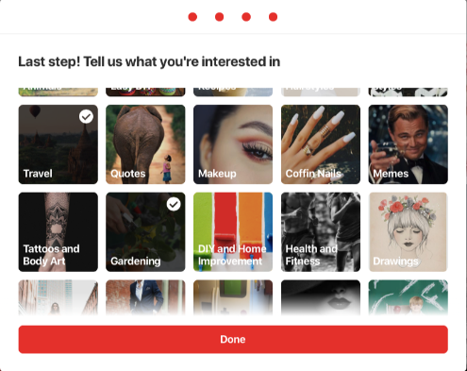
(2) Estimate unknown ratings
  Key problem: Utility matrix is sparse
    Most users have not rated most items.
    Cold start:
      New items have no ratings
      New users have no history
    Jump starting:
      When you create your Netflix account, or add a new profile in your account,
        They ask you to choose a few titles that you like.

Slide 14
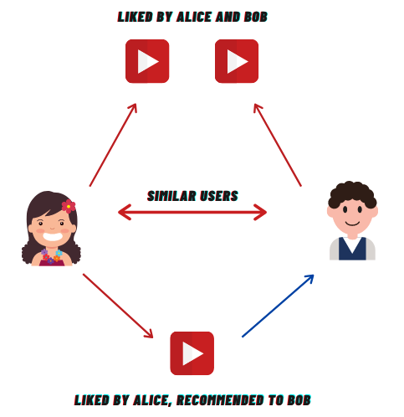
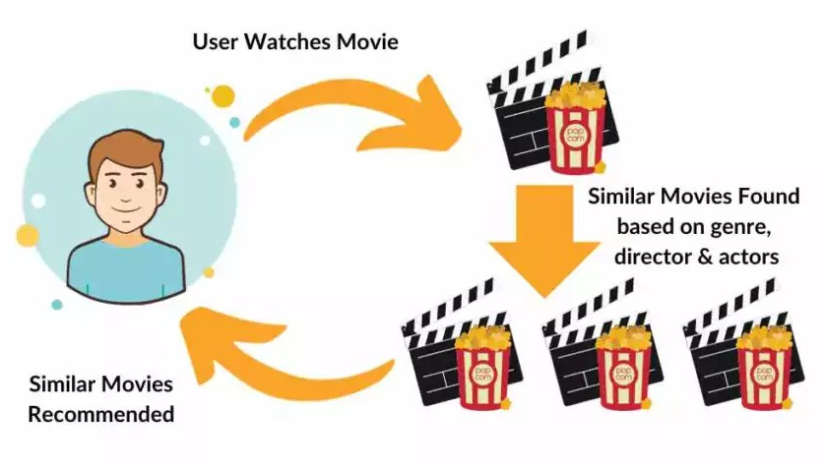
Approaches…
  Three approaches to recommendation systems:
    1) Content-based filtering
2) Collaborative filtering

Slide 15
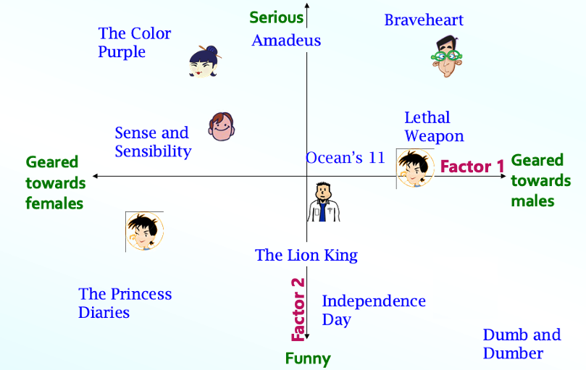
Approaches…
  Three approaches to recommendation systems:
Latent Factor Model

Slide 16
Content-based Recommendation System

Slide 17


Content-based Recommendation System
  Main idea:
    Items have profiles
    Based on similarity of items to past items that they have rated.
      Recommend items to customer $x$ similar to previous items rated highly by $x$.

Slide 18
Plan of Action
Item profiles
likes
build
recommend
match
Red
Circles
Triangles
User profile

Slide 19
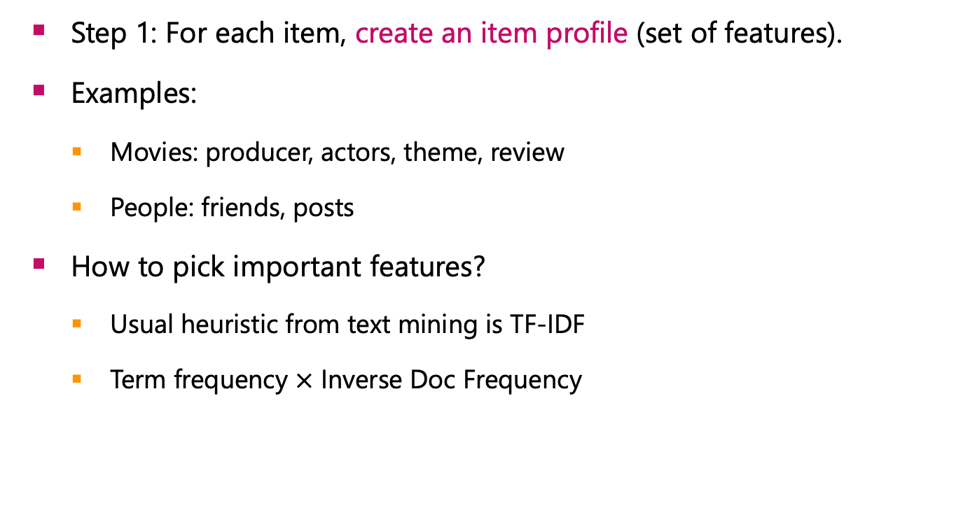
Item Profiles
  Step 1: For each item, create an item profile (set of features).
  Examples:
    Movies: producer, actors, theme, review
    People: friends, posts
  How to pick important features?
    Usual heuristic from text mining is TF-IDF
    Term frequency $×$ Inverse Doc Frequency

Slide 20
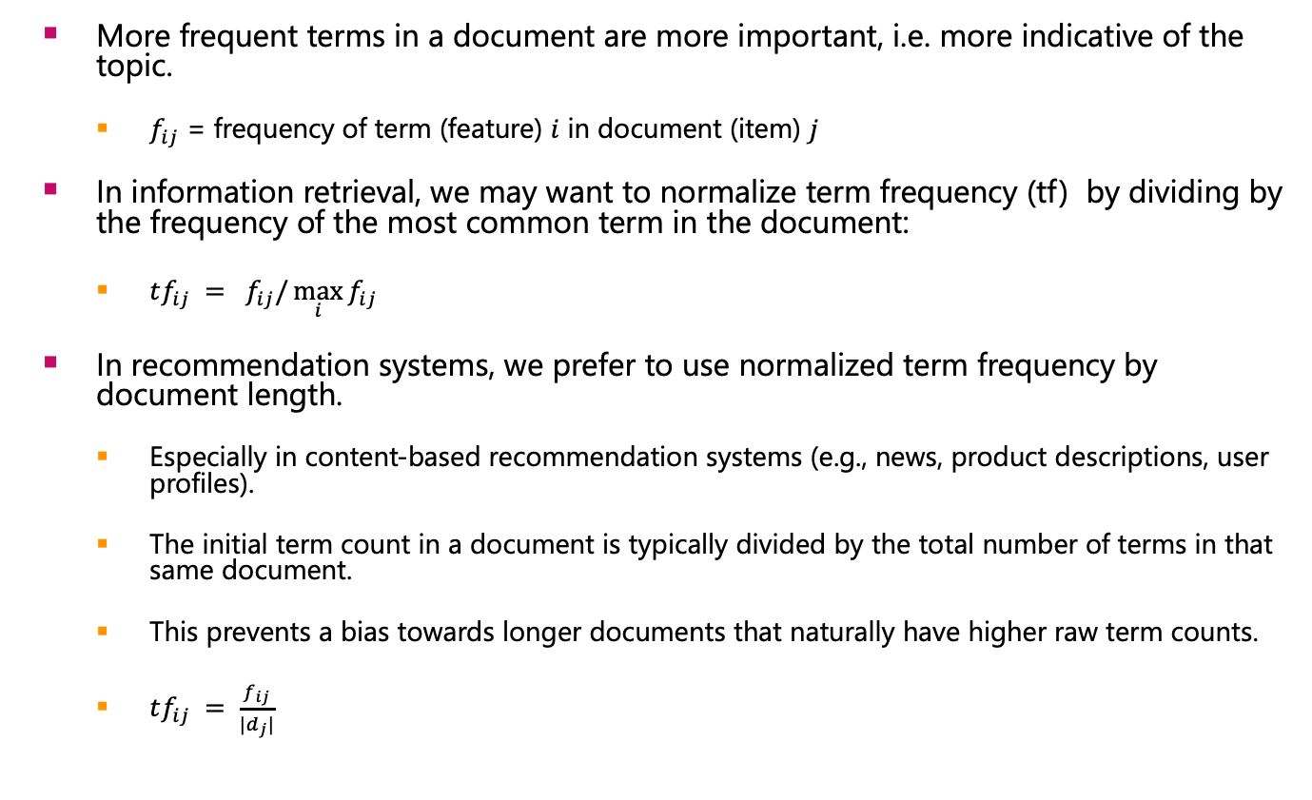
Term Frequency (TF)
  More frequent terms in a document are more important, i.e. more indicative of the topic.
    $f_{ij}$ = frequency of term (feature) $i$ in document (item) $j$
  In information retrieval, we may want to normalize term frequency (tf) by dividing by the frequency of the most common term in the document:
    $tf_{ij} = f_{ij}/\max_{i}{f_{ij}}$
  In recommendation systems, we prefer to use normalized term frequency by document length.
    Especially in content-based recommendation systems (e.g., news, product descriptions, user profiles).
    The initial term count in a document is typically divided by the total number of terms in that same document.
    This prevents a bias towards longer documents that naturally have higher raw term counts.
    $tf_{ij} = \frac{f_{ij}}{|d_{j}|}$

Slide 21
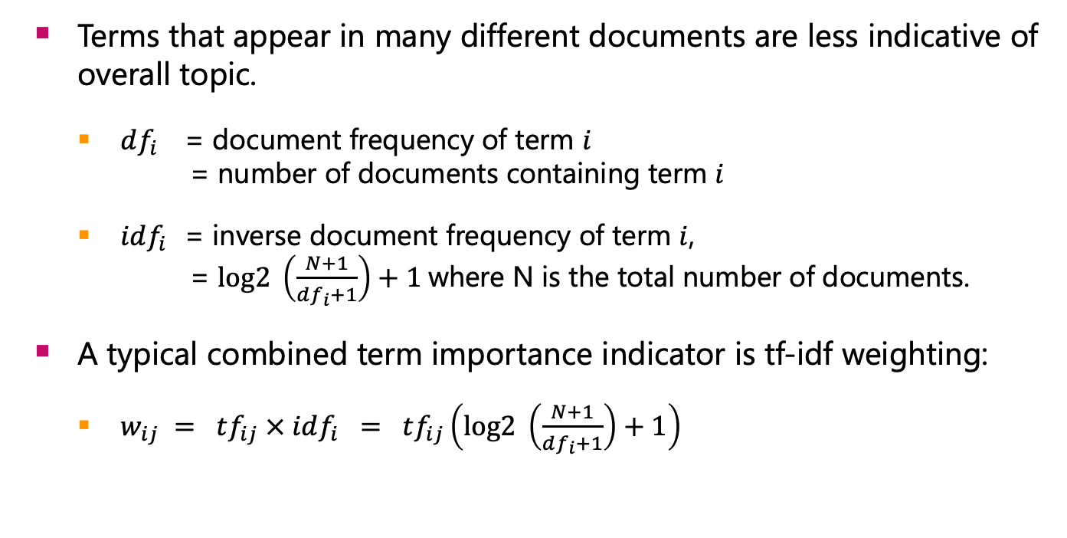
Recal Term Frequency - Inverse Document Frequency (TFIDF)
  Terms that appear in many different documents are less indicative of overall topic.
    $df_{i}$ = document frequency of term $i$
    = number of documents containing term $i$
    $idf_{i}$ = inverse document frequency of term $i$,
    = $log2 \left(\frac{N+1}{df_{i}+1}\right)+1$where N is the total number of documents.
  A typical combined term importance indicator is tf-idf weighting:
    $w_{ij} = tf_{ij} × idf_{i} = tf_{ij}\left(log2 \left(\frac{N+1}{df_{i}+1}\right)+1\right)$

Slide 22

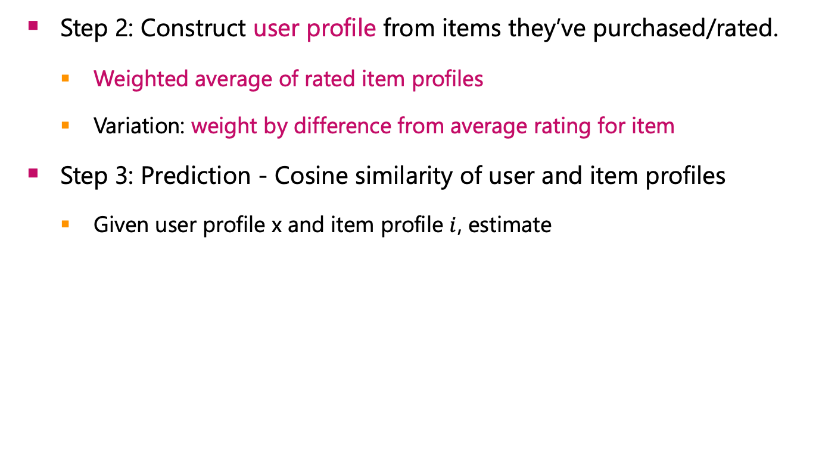
User Profiles and Prediction
  Step 2: Construct user profile from items they’ve purchased/rated.
    Weighted average of rated item profiles
    Variation: weight by difference from average rating for item
  Step 3: Prediction - Cosine similarity of user and item profiles
    Given user profile x and item profile $i$, estimate
t₃
sim(x, i) = cos(x, i) = $\frac{x⋅i}{||x||⋅|\left|i\right||}$
θ₁
D₁
Q
D₁ = 2T₁ + 3T₂ + 5T₃
D₂ = 3T₁ + 7T₂ + 1T₃
Q = 0T₁ + 0T₂ + 2T₃
CosSim(D₁ , Q) = 10 / √(4+9+25)(0+0+4) = 0.81
CosSim(D₂ , Q) = 2 / √(9+49+1)(0+0+4) = 0.13
θ₂
t₁
t₂
D₂

Slide 23
Simple example
  Suppose we have 4 movies, and their associated reviews as follow:
    Movie 1:
      "This action movie has intense fights and explosions." (User rating: 4.5, Avg rating: 3.5)
    Movie 2:
      "A romantic story with love, drama, and heartfelt moments." (User rating: 2.0, Avg rating: 3.0)
    Movie 3:
      "Thrilling action adventure full of chases and suspense." (User rating: 4.0, Avg rating: 3.5)
    Movie 4:
      "Comedy with laughs, romance, and funny dialogues." (User rating: 3.0, Avg rating: 3.0)
  Item Profiles: Each movie is represented by a TF-IDF vector of length V, where V is the number of unique words in the vocabulary

Slide 24
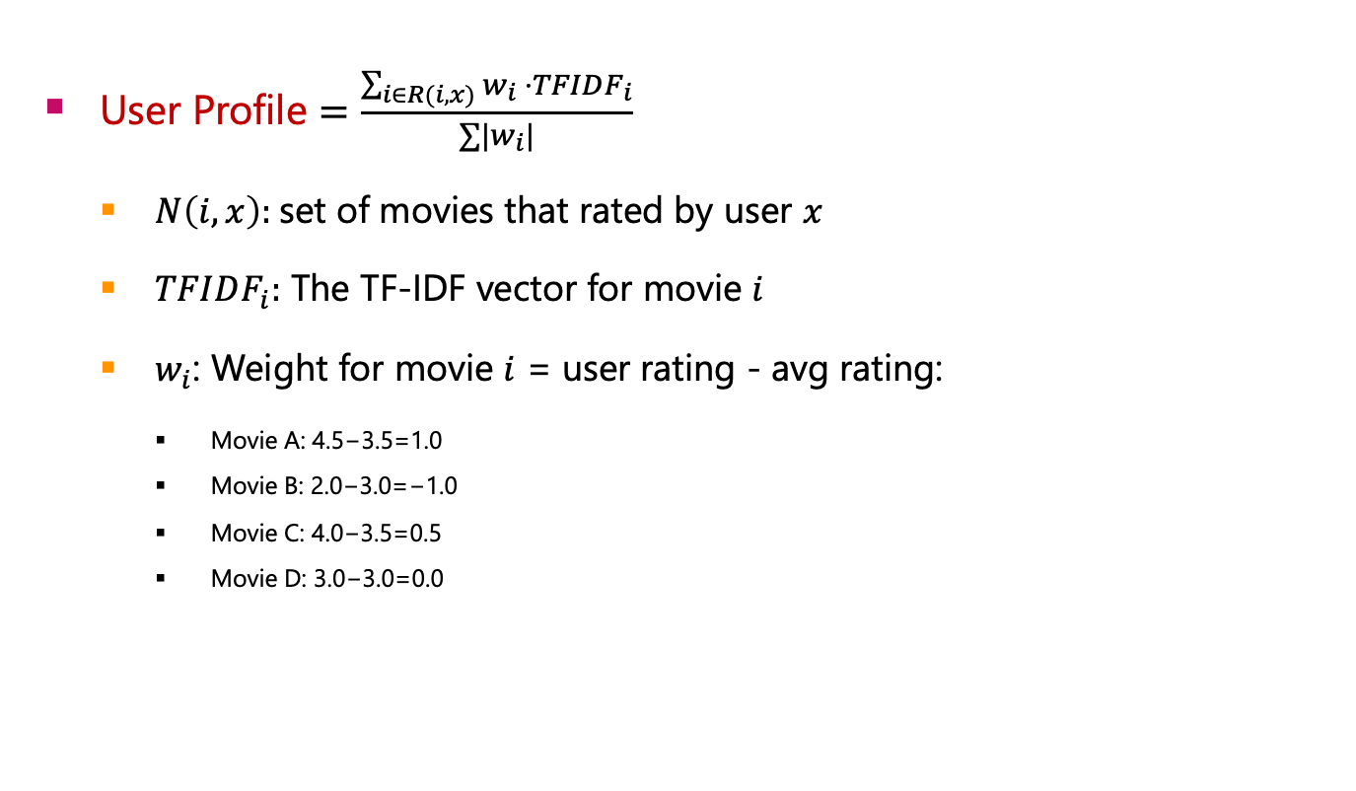
Simple example – User Profile
  User Profile $=\frac{\sum_{i∈R(i,x)}{w_{i} ⋅TFIDF_{i}}}{{∑|w}_{i}|}$
    $N\left(i,x\right):$set of movies that rated by user $x$
    $TFIDF_{i}:$ The TF-IDF vector for movie $i$
    $w_{i}$: Weight for movie $i$ = user rating - avg rating:
      Movie A: 4.5−3.5=1.0
      Movie B: 2.0−3.0=−1.0
      Movie C: 4.0−3.5=0.5
      Movie D: 3.0−3.0=0.0

Slide 25
Simple example – User/Items Profile
 | P | M1 | M2 | M3 | M4 |  | P | M1 | M2 | M3 | M4
a | -0.1032 | 0 | 0.2580 | 0 | 0 | intense | 0.1161 | 0.2902 | 0 | 0
action | 0.1303 | 0.2171 | 0 | 0.2171 | 0 | laughs | 0 | 0 | 0 | 0 | 0.3317
adventure | 0.0580 | 0 | 0 | 0.2902 | 0 | love | -0.1032 | 0 | 0.2580 | 0 | 0
and | 0.0306 | 0.1250 | 0.1111 | 0.1250 | 0.1429 | moments | -0.1032 | 0 | 0.2580 | 0 | 0
chases | 0.0580 | 0 | 0 | 0.2902 |  | movie | 0.1161 | 0.2902 | 0 | 0 | 0
comedy | 0 | 0 | 0 | 0 | 0.3317 | of | 0.0580 | 0 | 0 | 0.2902 | 0
dialogues | 0 | 0 | 0 | 0 | 0.3317 | romance | 0 | 0 | 0 | 0 | 0.3317
drama | -0.1032 | 0 | 0.2580 | 0 | 0 | romantic | -0.1032 | 0 | 0.2580 | 0 | 0
explosions | 0.1161 | 0.2902 | 0 | 0 | 0 | story | -0.1032 | 0 | 0.2580 | 0 | 0
fights | 0.1161 | 0.2902 | 0 | 0 | 0 | suspense | 0.0580 | 0 | 0 | 0.2902 | 0
full | 0.0580 | 0 | 0 | 0.2902 | 0 | this | 0.1161 | 0.2902 | 0 | 0 | 0
funny | 0 | 0 | 0 | 0 | 0.3317 | thrilling | 0.0580 | 0 | 0 | 0.2902 | 0
has | 0.1161 | 0.2902 | 0 | 0 | 0 | with | -0.0772 | 0 | 0.1930 | 0 | 0.2481
heartfelt | -0.1032 | 0 | 0.2580 | 0 | 0

Slide 26
Simple example - Results
  Recommendations based on weighted user profile:
    Movie 1: similarity score 0.6958
    Movie 3: similarity score 0.3956
    Movie 4: similarity score -0.0417
    Movie 2: similarity score -0.6170

Slide 27
Pros: Content-based Approach
  No need for data on other users
    No item cold-start problem, no sparsity problem
  Able to recommend to users with unique tastes
  Able to recommend new & unpopular items
    No first-rater problem
  Able to provide explanations
    Can provide explanations of recommended items by listing content-features that caused an item to be recommended

Slide 28
Cons: Content-based Approach
  Finding the appropriate features is hard
    E.g., images, movies, music
  Recommendations for new users
    How to build a user profile?
  Overspecialization
    Never recommends items outside user’s content profile
    People might have multiple interests
    Unable to exploit quality judgments of other users

Slide 29
Collaborative Filtering

Slide 30
Collaborative Filtering
  Do not require to build item/user profiles.
  In place of item/user-profile
    We use the ratings in the utility matrix.
  Comes with two variants:
    User-user collaborative filtering
    Item-item collaborative filtering

Slide 31
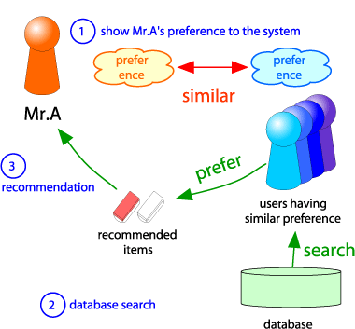

User-User Collaborative Filtering
  Consider user $x$
    Find a set $S$ of other users whose ratings are “similar” to $x$’s ratings.
    Estimate $x$’s ratings based on ratings of user in $S$.

Slide 32
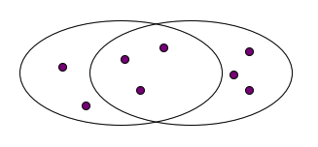
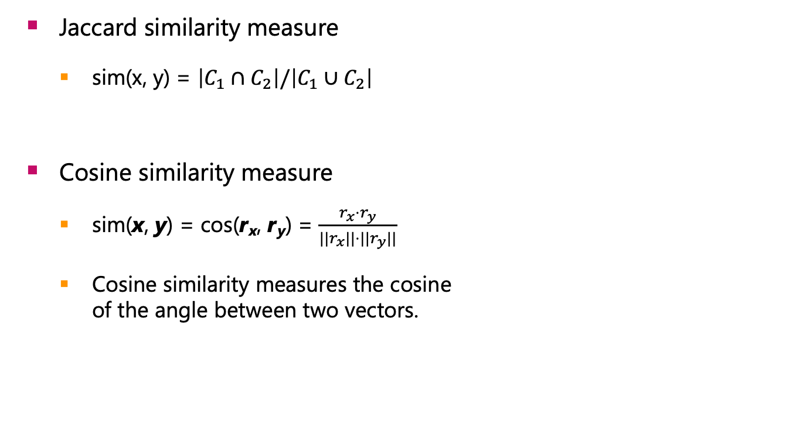


Finding ”Similar” users
  Jaccard similarity measure
    sim(x, y) = $\left|C_{1}∩C_{2}\right|/\left|C_{1}∪C_{2}\right|$
  Cosine similarity measure
    sim(x, y) = cos(r_{x}, r_{y}) = $\frac{r_{x}⋅r_{y}}{||r_{x}||⋅{||r}_{y}||}$
    Cosine similarity measures the cosine
    of the angle between two vectors.
$$x$$
$$y$$
3 in intersection.
8 in union.
Jaccard similarity = 3/8

Slide 33
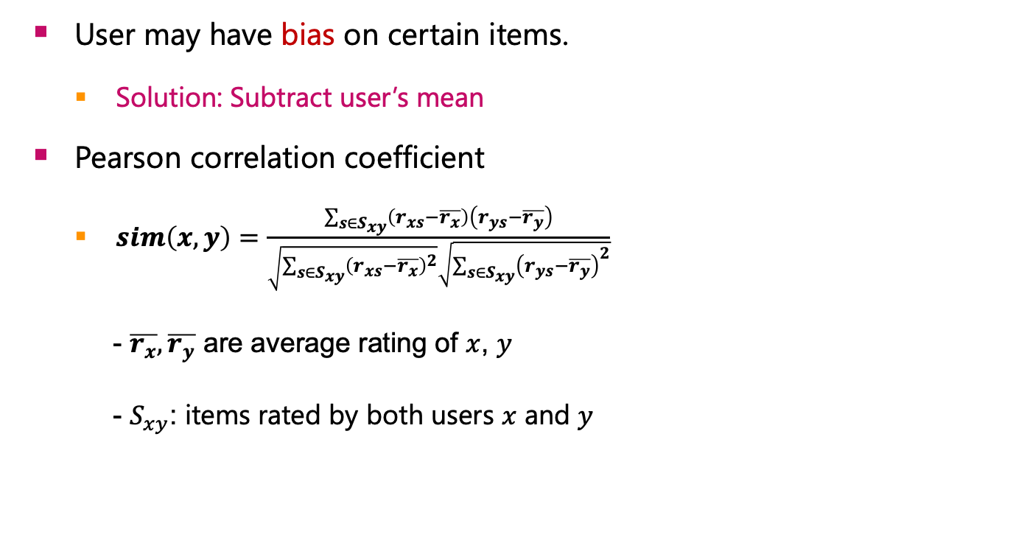
Finding “Similar” Users
  User may have bias on certain items.
    Solution: Subtract user’s mean
  Pearson correlation coefficient
    $sim\left(x,y\right)=\frac{\sum_{s∈S_{xy}}{\left(r_{xs}−\overline{r_{x}}\right)\left(r_{ys}−\overline{r_{y}}\right)}}{\sqrt{\sum_{s∈S_{xy}}{{\left(r_{xs}−\overline{r_{x}}\right)}^{2}}}\sqrt{\sum_{s∈S_{xy}}{{\left(r_{ys}−\overline{r_{y}}\right)}^{2}}}}$
    - $\overline{r_{x}},\overline{r_{y}}$ are average rating of $x$, $y$
    - $S_{xy}$: items rated by both users $x$ and $y$

Slide 34
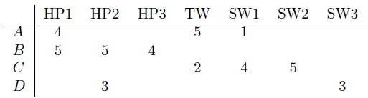
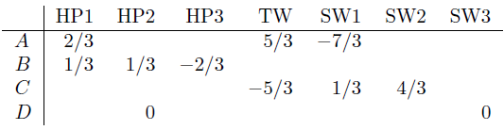
Similarity Metric
  Jaccard similarity: sim(A, B):1/5 < sim(A, C): 2/4
    Problem: Ignores the value of the rating
  Cosine similarity: sim(A, B): 0.386 > sim(A, C): 0.322
    Missing values contribute zero to the dot product, which can decrease the overall similarity score.
    Solution: subtract the (row) mean

Slide 35
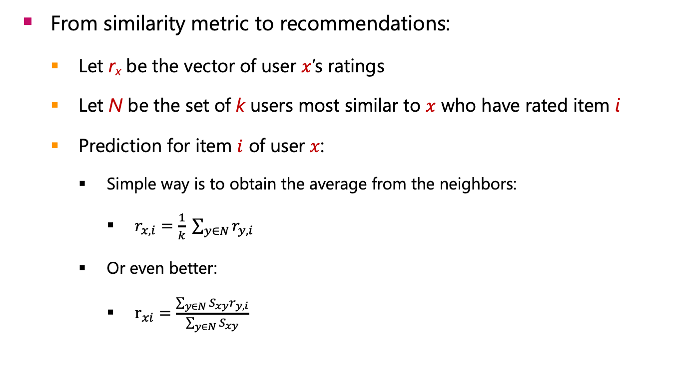
Rating Predictions
  From similarity metric to recommendations:
    Let r_{x} be the vector of user $x$’s ratings
    Let N be the set of k users most similar to $x$ who have rated item i
    Prediction for item $i$ of user $x$:
      Simple way is to obtain the average from the neighbors:
        $r_{x,i}=\frac{1}{k} \sum_{y∈N}{r_{y,i}}$
      Or even better:
        $r_{xi}=\frac{\sum_{y∈N}{{S_{xy}r}_{y,i}}}{\sum_{y∈N}{S_{xy}}}$
s_{xy} similarity between user x and y

Slide 36
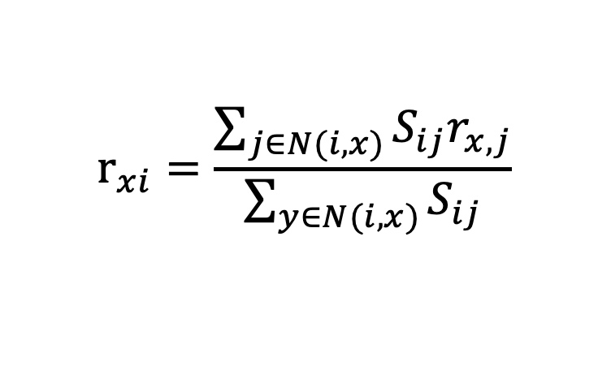

Item-Item Collaborative Filtering
  Another view: Compare an item with another items.
    For item $i$, find other similar items
    ﻿﻿Estimate rating for item $i$ based on ratings for similar items
    ﻿﻿Can use same similarity metrics and prediction functions as in user-user model
$$r_{xi}=\frac{\sum_{j∈N(i,x)}{{S_{ij}r}_{x,j}}}{\sum_{y∈N(i,x)}{S_{ij}}}$$
s_{ij}… similarity of items i and j
r_{x,j}…rating of user u on item j
N(i,x)… set items rated by x similar to i

Slide 37
Item-Item Collaborative Filtering (|N|=2)
users
estimate rating of movie 1 by user 5
12 | 11 | 10 | 9 | 8 | 7 | 6 | 5 | 4 | 3 | 2 | 1
 | 4 |  | 5 |  |  | 5 |  |  | 3 |  | 1 | 1
3 | 1 | 2 |  |  | 4 |  |  | 4 | 5 |  |  | 2
 | 5 | 3 | 4 |  | 3 |  | 2 | 1 |  | 4 | 2 | 3
 | 2 |  |  | 4 |  |  | 5 |  | 4 | 2 |  | 4
5 | 2 |  |  |  |  | 2 | 4 | 3 | 4 |  |  | 5
 | 4 |  |  | 2 |  |  | 3 |  | 3 |  | 1 | 6
?
movies
- unknown rating
- rating between 1 to 5

Slide 38
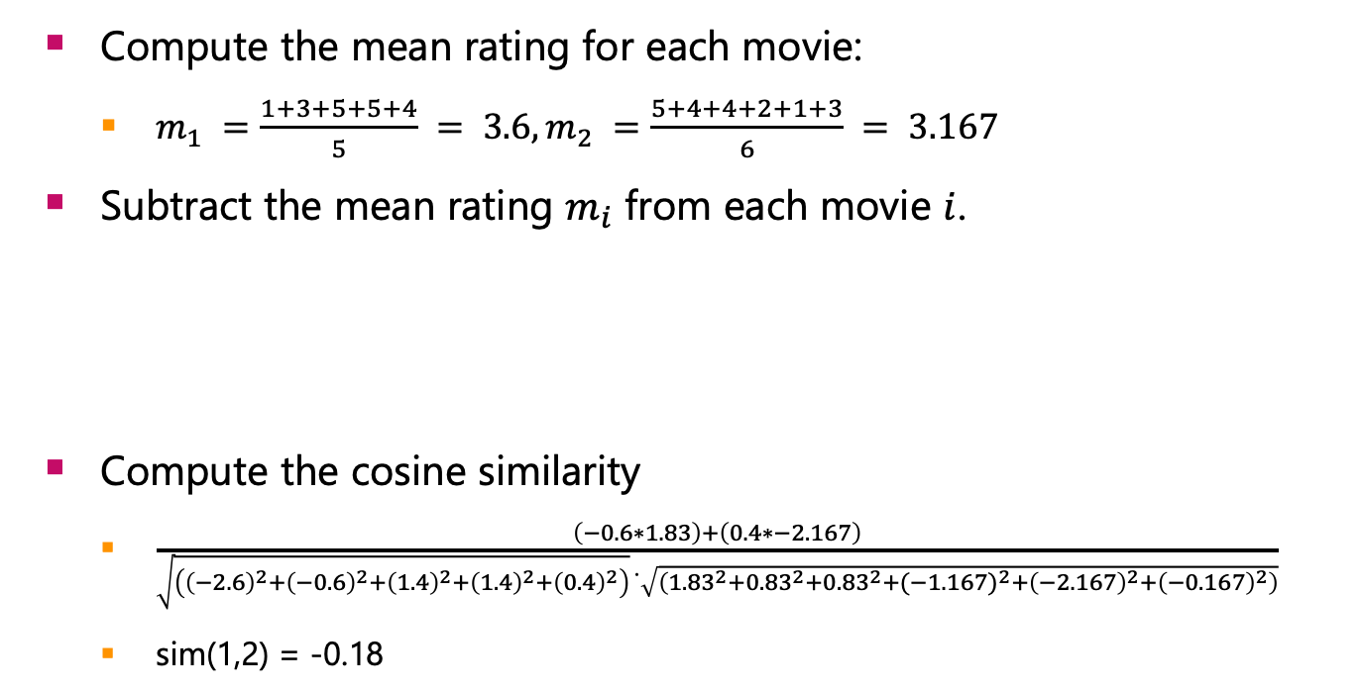
Item-Item Collaborative Filtering (|N|=2)
12 | 11 | 10 | 9 | 8 | 7 | 6 | 5 | 4 | 3 | 2 | 1
 | 4 |  | 5 |  |  | 5 |  |  | 3 |  | 1 | 1
3 | 1 | 2 |  |  | 4 |  |  | 4 | 5 |  |  | 2
  Compute the mean rating for each movie:
    $m_{1} =\frac{1+3+5+5+4}{5} = 3.6, m_{2} =\frac{5+4+4+2+1+3}{6} = 3.167$
  Subtract the mean rating $m_{i}$ from each movie $i$.
  Compute the cosine similarity
    $\frac{\left(−0.6∗1.83\right)+\left(0.4∗−2.167\right)}{\sqrt{\left({\left(−2.6\right)}^{2}+{\left(−0.6\right)}^{2}+{\left(1.4\right)}^{2}+{\left(1.4\right)}^{2}+{\left(0.4\right)}^{2}\right)} ̇\sqrt{\left({1.83}^{2}+{0.83}^{2}+{0.83}^{2}+{(−1.167)}^{2}+{\left(−2.167\right)}^{2}+{\left(−0.167\right)}^{2}\right)}}$
    sim(1,2) = -0.18
 | 0.4 |  | 1.4 |  |  | 1.4 |  |  | -0.6 |  | -2.6 | 1
-0.167 | -2.167 | -1.167 |  |  | 0.83 |  |  | 0.83 | 1.83 |  |  | 2

Slide 39
Item-Item Collaborative Filtering (|N|=2)
users
estimate rating of movie 1 by user 5
12 | 11 | 10 | 9 | 8 | 7 | 6 | 5 | 4 | 3 | 2 | 1
 | 4 |  | 5 |  |  | 5 |  |  | 3 |  | 1 | 1
3 | 1 | 2 |  |  | 4 |  |  | 4 | 5 |  |  | 2
 | 5 | 3 | 4 |  | 3 |  | 2 | 1 |  | 4 | 2 | 3
 | 2 |  |  | 4 |  |  | 5 |  | 4 | 2 |  | 4
5 | 2 |  |  |  |  | 2 | 4 | 3 | 4 |  |  | 5
 | 4 |  |  | 2 |  |  | 3 |  | 3 |  | 1 | 6
sim(1,m)
?
1.00
-0.18
0.41
-0.10
-0.31
0.59
movies
- unknown rating
- rating between 1 to 5

Slide 40
Item-Item Collaborative Filtering (|N|=2)
users
estimate rating of movie 1 by user 5
12 | 11 | 10 | 9 | 8 | 7 | 6 | 5 | 4 | 3 | 2 | 1
 | 4 |  | 5 |  |  | 5 |  |  | 3 |  | 1 | 1
3 | 1 | 2 |  |  | 4 |  |  | 4 | 5 |  |  | 2
 | 5 | 3 | 4 |  | 3 |  | 2 | 1 |  | 4 | 2 | 3
 | 2 |  |  | 4 |  |  | 5 |  | 4 | 2 |  | 4
5 | 2 |  |  |  |  | 2 | 4 | 3 | 4 |  |  | 5
 | 4 |  |  | 2 |  |  | 3 |  | 3 |  | 1 | 6
sim(1,m)
?
1.00
-0.18
0.41
-0.10
-0.31
0.59
movies
- unknown rating
- rating between 1 to 5

Slide 41

Item-Item Collaborative Filtering (|N|=2)
  Predict by taking weighted average:
    $r_{ix}=\frac{\sum_{j∈N(i;x)}{s_{ij}⋅r_{jx}}}{∑s_{ij}}$
    r_{1.5} = (0.41*2 + 0.59*3) / (0.41+0.59) = 2.6
12 | 11 | 10 | 9 | 8 | 7 | 6 | 5 | 4 | 3 | 2 | 1
 | 4 |  | 5 |  |  | 5 |  |  | 3 |  | 1 | 1
3 | 1 | 2 |  |  | 4 |  |  | 4 | 5 |  |  | 2
2.6

Slide 42

Common Practice
  Define similarity s_{ij} of items i and j
  Select k nearest neighbors N(i, x)
    Items most similar to i, that were rated by x
  Estimate rating r_{xi} as the weighted average:
μ = overall mean movie rating
b_{x} = rating deviation of user x
= (avg. rating of user x) – μ
b_{i} = rating deviation of movie i
baseline estimate for r_{xi}
$$b_{xi}=μ+b_{x}+b_{i}$$

Slide 43
Item-Item vs User-User
  In practice, it has been observed that item-item often works better than user-user
  Why? Items are simpler, users have multiple tastes
    Users tend to be more different from each other than items are from other items.
      Items tend to be classifiable in simple terms.
        For example, music tends to belong to a single category.
      Users may prefer multiple genres, and their preferences may change from time to time.
    It is easier to discover items that are similar
      Because they belong to the same genre.
    It is challenging to detect that two users are similar:
      Because they prefer one genre in common, while each also likes some genres that the other doesn’t care for.

Slide 44
Pros/Cons of Collaborative Filtering
  + Works for any kind of item
    No feature selection needed
  - Cold Start:
    Need enough users in the system to find a match
  - Sparsity:
    The user/ratings matrix is sparse
    Hard to find users that have rated the same items
  - First rater:
    Cannot recommend an item that has not been previously rated
    New items, Esoteric items
  - Popularity bias:
    Cannot recommend items to someone with unique taste
    Tends to recommend popular items

Slide 45
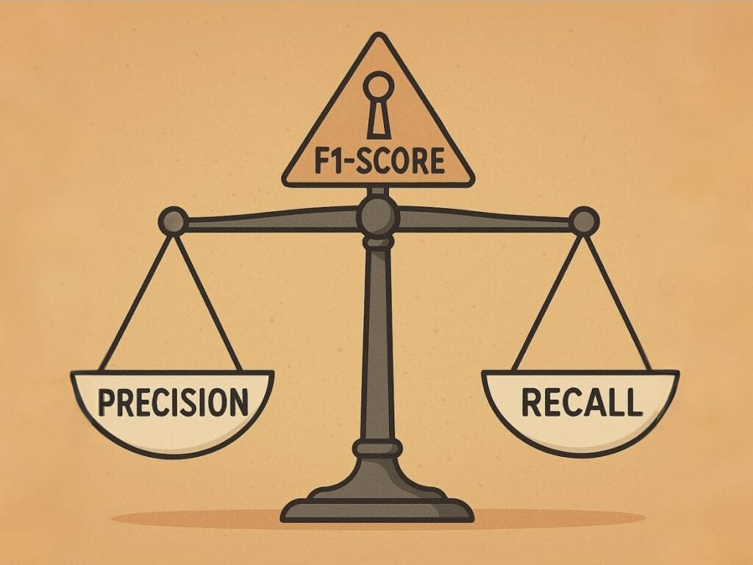
Evaluation

Slide 46
Evaluation
movies
1 | 3 | 4
 | 3 | 5 |  |  | 5
 |  | 4 | 5 |  | 5
 |  | 3
 |  | 3
2 |  |  | 2 |  | 2
 |  |  |  | 5
 | 2 | 1 |  |  | 1
 | 3 |  |  | 3
1
users

Slide 47
Evaluation
movies
1 | 3 | 4
 | 3 | 5 |  |  | 5
 |  | 4 | 5 |  | 5
 |  | 3
 |  | 3
2 |  |  | ? |  | ?
 |  |  |  | ?
 | 2 | 1 |  |  | ?
 | 3 |  |  | ?
1
users
Test Data Set

Slide 48
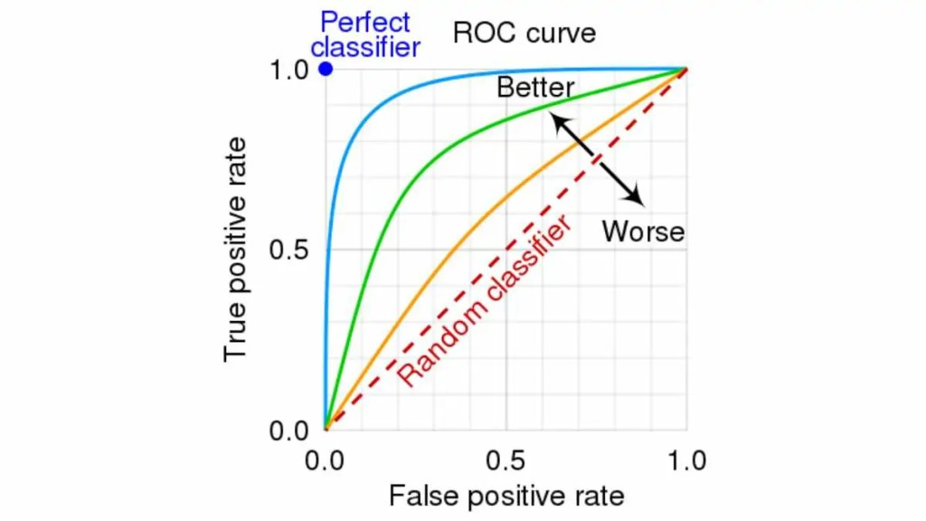
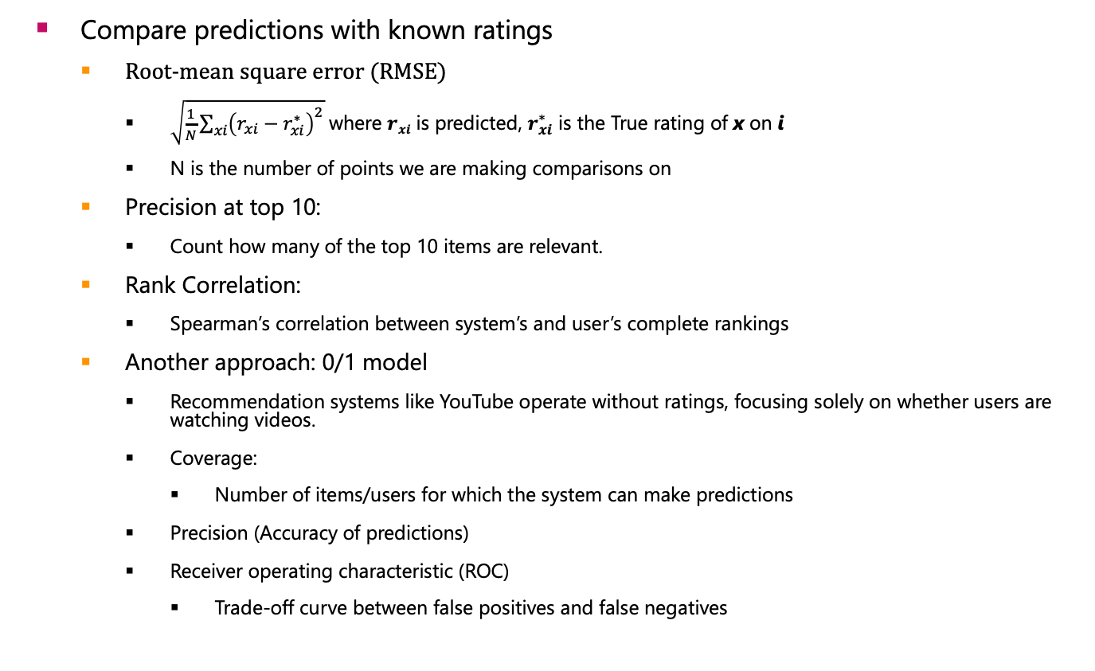
Evaluating Predictions
  Compare predictions with known ratings
    Root-mean square error (RMSE)
      $\sqrt{\frac{1}{N}\sum_{xi}{{\left(r_{xi}−r_{xi}^{∗}\right)}^{2}}}$ where $rxi$ is predicted, $r_{xi}^{∗}$ is the True rating of x on i
      N is the number of points we are making comparisons on
    Precision at top 10:
      Count how many of the top 10 items are relevant.
    Rank Correlation:
      Spearman’s correlation between system’s and user’s complete rankings
    Another approach: 0/1 model
      Recommendation systems like YouTube operate without ratings, focusing solely on whether users are watching videos.
      Coverage:
        Number of items/users for which the system can make predictions
      Precision (Accuracy of predictions)
      Receiver operating characteristic (ROC)
        Trade-off curve between false positives and false negatives

Slide 49
Problem with Error Measures
  Narrow focus on accuracy sometimes misses the point
    Prediction Diversity
    Prediction Context
    Order of predictions
  In practice, we care only to predict high ratings:
    RMSE might penalize a method that does well for high ratings and badly for others

Slide 50

Any Questions?

