Slide 1
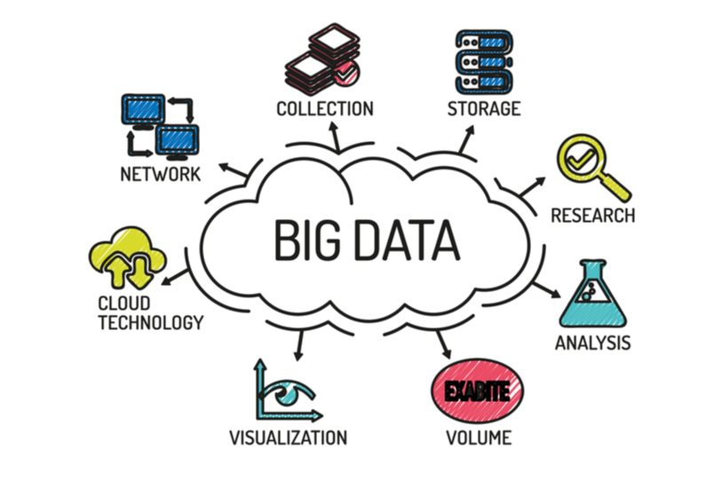
DSAI4205 Big Data Analytics
Lecture 1:
Introduction to Big Data Analytics
Dr. Ken FONG
Department of Data Science and Artificial Intelligence
chi-kit-ken.fong@polyu.edu.hk

Slide 2
Agenda
Data and big data, what the differences?
2. big data characteristics (6V_{s})
3. why big data?
4. applications of big data
6. Data analytics process

Slide 3
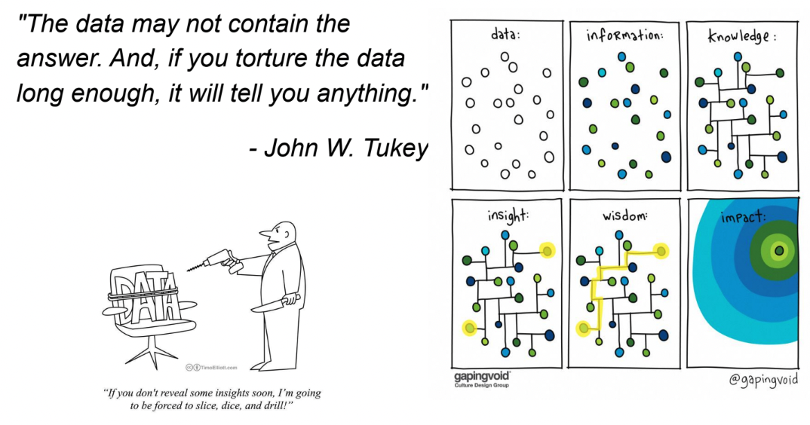
What is Data?

Slide 4
What is Big Data ?
  What make data “BIG”?
  We can think Big Data as:
    Too complex for human to understand
    May require multiple computers to work together to process
    Not able to fit into a single computer’s memory
    Needs more than brute force algorithms to analyze
    May have many dimensions
    May be changing rapidly (high velocity)
There is No clear definition

Slide 5
Why Big Data ?
  Data collection is inexpensive!
    Smartphones, embedded systems, inexpensive sensors,
    Medical devices, simulators, …
  Data storage is inexpensive!
  Parallel (compute cluster) computation is inexpensive
    The Cloud, clusters of computers, GPUs, …

Slide 6
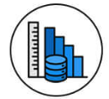
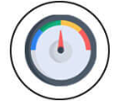



Big Data vs Traditional Data
Massive data volumes, often in the petabytes or more… | Manageable data sizes, generated relatively steadily from structured sources, like databases.
Volume
Big data is generated and processed at high speed in real time or near real time. | Traditional data is usually processed at a slower pace.
Velocity
Diverse data types, including structure, semi-structure, and unstructured data | Structured data with predefined formats.
Variety
Utilize distributed computing techniques like Hadoop and Spark to process data in parallel | Relies on traditional relational database management systems that process data using a single server
Processing Technique
Various tools will be used, including Hadoop, Spark, NoSQL databases and ML Libraries | SQL-based databases
Tool & Technologies

Slide 7
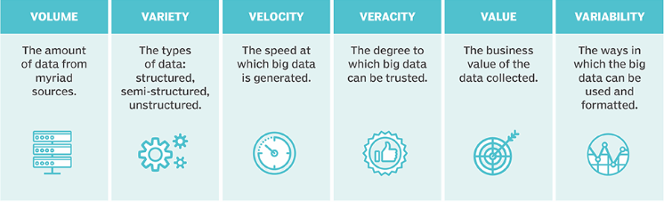
The Six Vs of Big Data

Slide 8
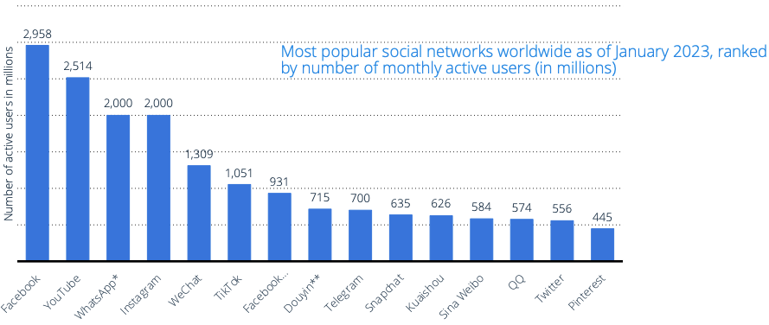
Volume
  The amount of data. The Data volume is increasing exponentially.
    Generated by huge number of devices and sensors.
    The number of smartphone mobile network subscriptions worldwide reached almost 6.4 billion in 2022

Slide 9
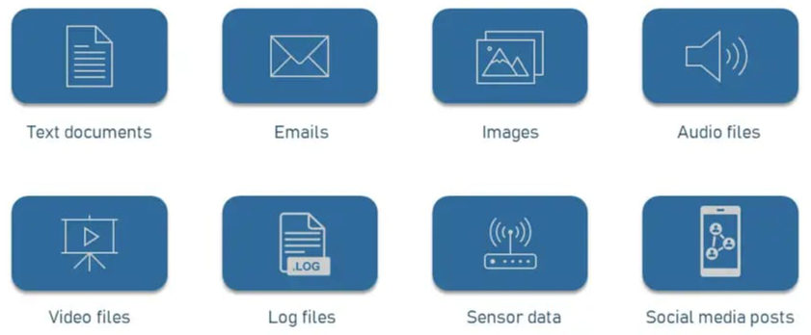
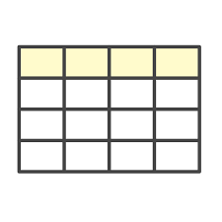
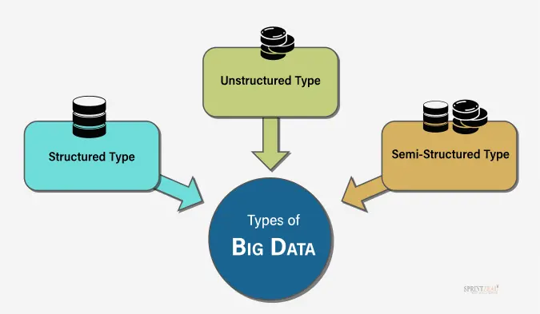

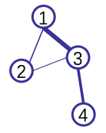
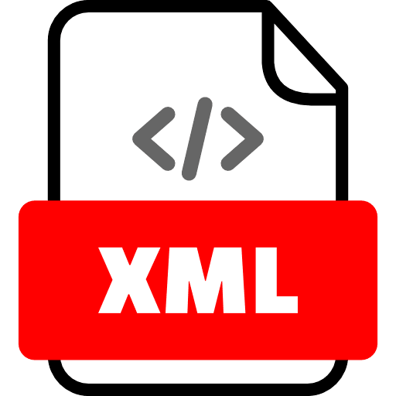
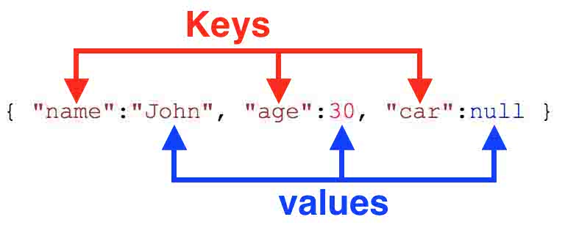
Variety
  The diversity of data types.
    A single application may generate/collect many types of data
Columns
Rows

Slide 10
Velocity
  How quickly data is generated and processed. (streaming data)
  Data is generated fast and need to be processed fast.
    Big Data velocity data flows in from sources like machines, networks, social media, mobile phones, etc.
    Example: There are approximately 16.4 billion searches on Google every day
    Streaming data: continuous flow of big data
      Make decision in real time or near real time.
      Online Data Analytics: late decisions mean missing opportunities
      Recommendation:
        Based on your current location and your purchase history, send promotions right now for store next to you
      Medical devices monitoring:
        Sensors monitoring your activities and body, notify you if there are abnormal measurements

Slide 11
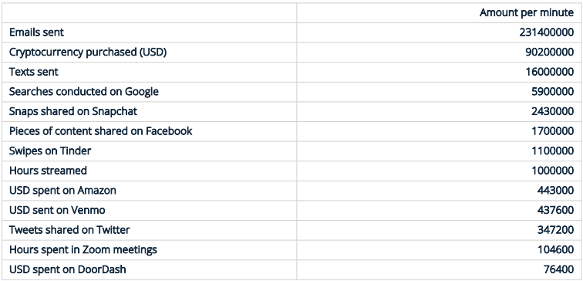
Velocity
Media usage in an internet minute as of April 2022

Slide 12
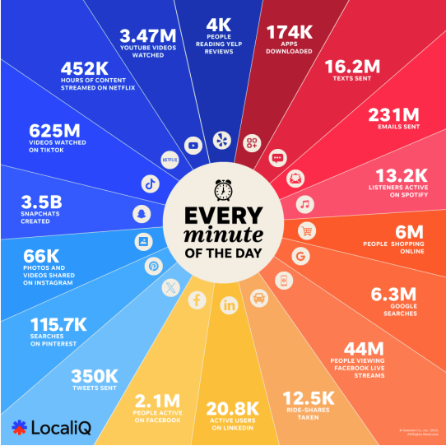
Sources of Big Data
Big data generated comes from three primary sources:
social data, machine data and transactional data
  Social data
    Tweets/Posts/Likes/Stories on Social media sites
    Digital images/videos
  Social data provides invaluable insights into consumer behaviour and sentiment.
  Social data can be enormously influential in marketing analytics.

Slide 13
Sources of the Big Data
Big data generated comes from three primary sources:
social data, machine data and transactional data
  Machine Data
    generated by industrial equipment,
    sensors that are installed in machinery
    web logs which track user behaviour
  Machine data expected to grow exponentially as the internet of things grows
  Sensors such as medical devices, smart meters, road cameras, satellites, games and the rapidly growing Internet Of Things (IoTs) will deliver high velocity, value, volume and variety of data

Slide 14
Sources of the Big Data
Big data generated comes from three primary sources:
social data, machine data and transactional data
  Transactional Data
    Generated by from all the daily transactions that take place both online and offline.
    Invoices, payment orders, storage, records, delivery receipts, etc.

Slide 15
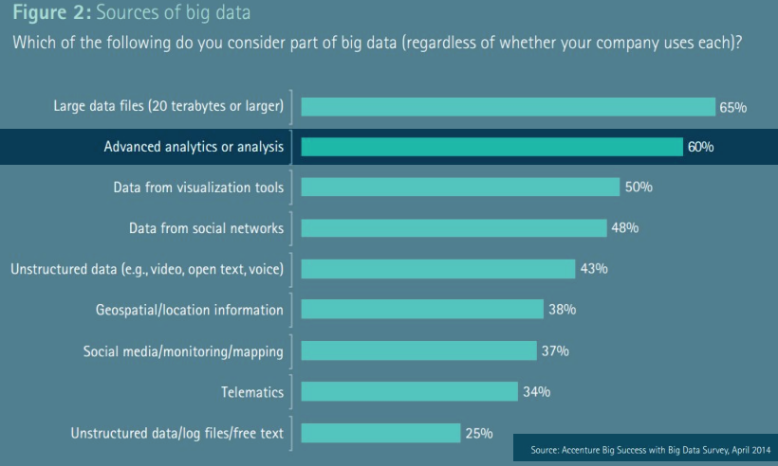
Sources of Big Data

Slide 16
Veracity
  The quality and accuracy of data (Trustworthiness of Data)
    It is useless if the data being analysed are inaccurate or incomplete.
    Data which is available can sometimes
      Get messy
      Quality and accuracy are difficult to control
        Measurement error
        Human errors like typos in names/addresses
        Data from different sources may not be consistent

Slide 17
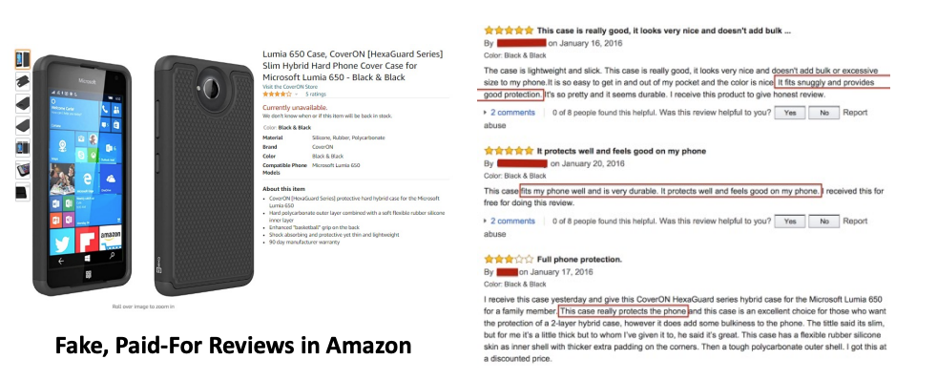
Veracity

Slide 18
Value
  The usefulness of data for an enterprise
    Not all the data collected has real business value.
    The value characteristics is related to the veracity
      The higher the data fidelity, the more value it holds for the business
    The data may not match your big data problem.
      Need to ensure the data is relevant and understand its potential business value.
    Value is also related to how long data processing takes.
      The longer it takes for data to be turned into meaningful information, the less value it has for a business

Slide 19

Variability
  How fast and to what extent data under investigation is changing.
    Data may change over time.
    A single word may have multiple meanings
    E.g. Netflix user’s preference, users’ taste changes over time.
      Viewing habits and preferences due to factors like new content releases, personal experiences, or cultural trends.

Slide 20

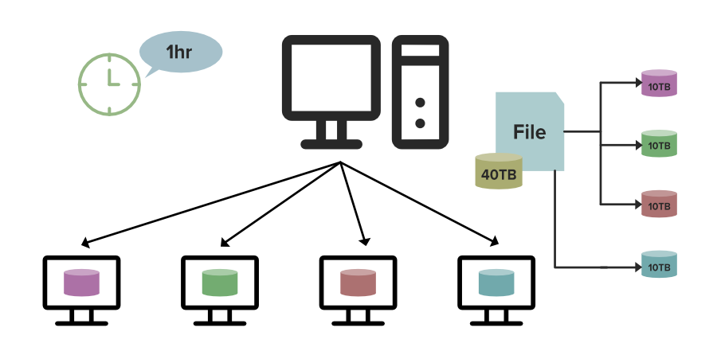
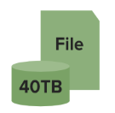

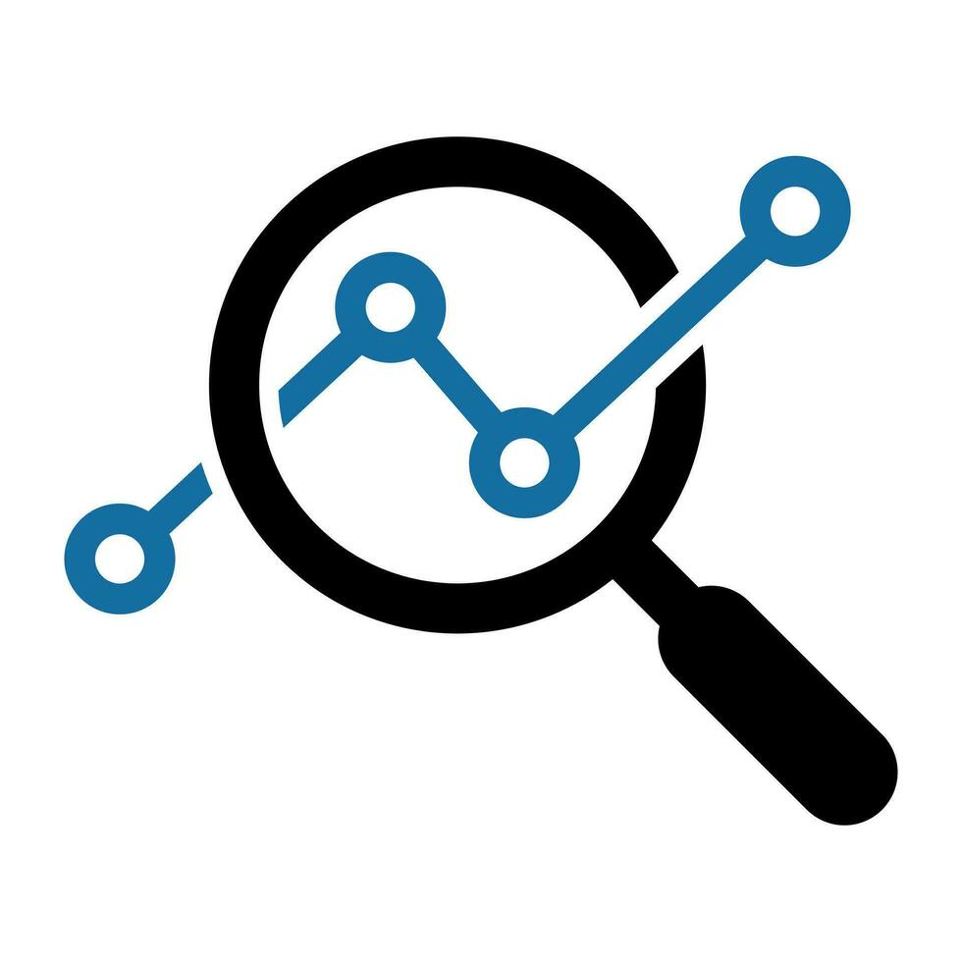

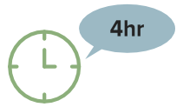




What is Big Data Analytics?
  Big data Analytics is a field of data science that explores how different tools, methodologies and techniques can be used to analyze extremely large and complex data sets, break them down and systematically derive insights and information from them.
  Basic idea:
Matlab
Traditional computer science, we can use standalone workstation to carry out data analysis
Python
R

Slide 21
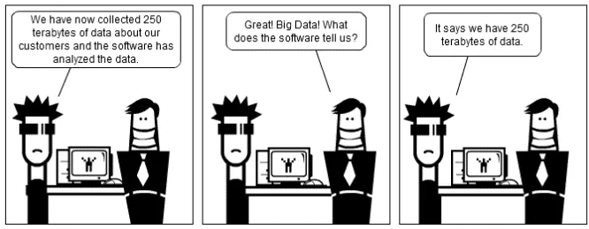
The Big Data Challenge

Slide 22
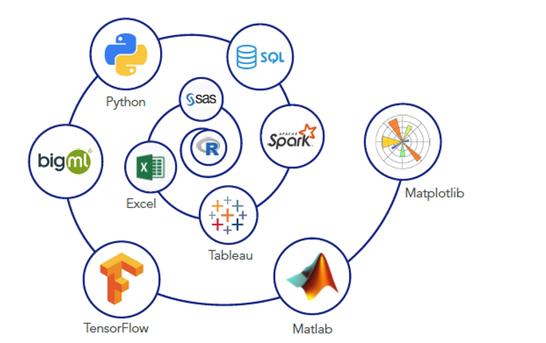
Insight
  Good data analysis is not:
    Simple application of a statistics recipe.
    Simple application of statistical software.
  There are many tools out there for data science, but they are only tools.
    “The purpose of computing is insight, not numbers.”

Slide 23
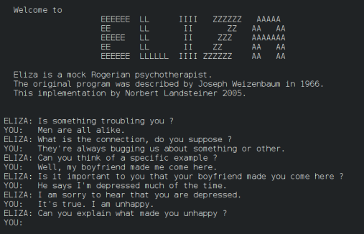
Applications of Big Data in AI
  The theory and development of computer systems able to perform tasks normally requiring human intelligence
  Big data has changed AI:
    “AI Would Be Nothing Without Big Data”
  ELIZA is an early natural language processing computer program created from 1964 to 1967 at MIT
ELIZA relies on a pattern-matching algorithm, where the user’s input is parsed for key phrases, and corresponding predefined responses are generated.

Slide 24
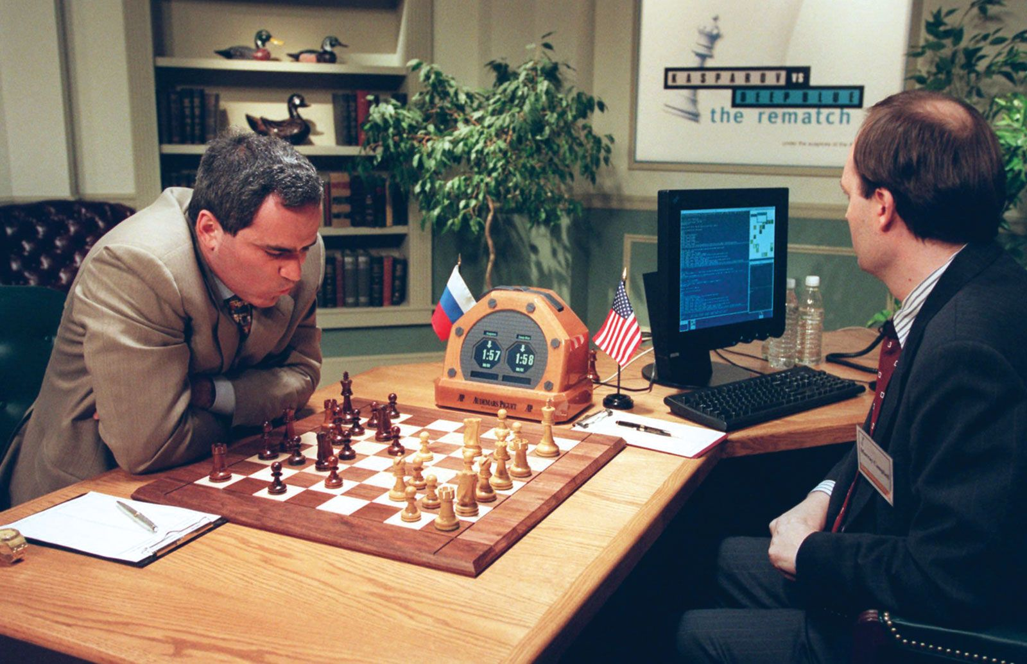

Applications of Big Data in AI
  On May 11, 1997, an IBM computer called IBM Deep Blue beat the world chess champion after a six-game match
  On March 15, 2016, DeepMind's AlphaGo defeated the world Go champion Lee Sedol after a five-game match.

Slide 25
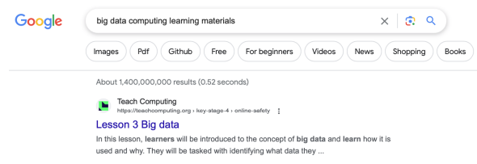
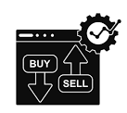
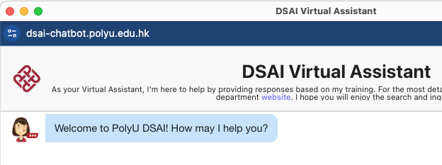
Application: Web search
  High Frequency Trading
  Web/Image search
  Virtual assistant

Slide 26









Application: Recommendation System
Examples:
Search
Recommendations
Items
Products, web sites,
blogs, news items, …

Slide 27
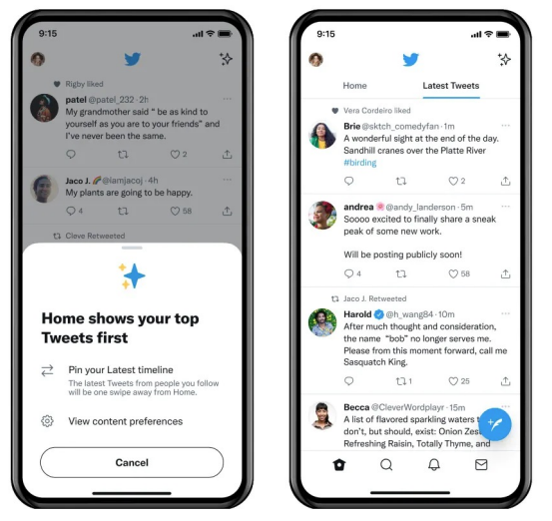
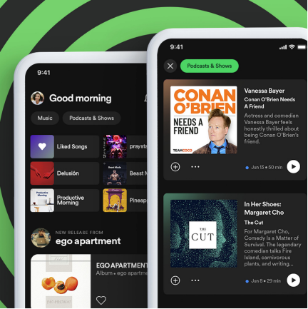
Application: Recommendation System
  More recommendation systems:
    News feed
    Music feed
    Twitter feed

Slide 28
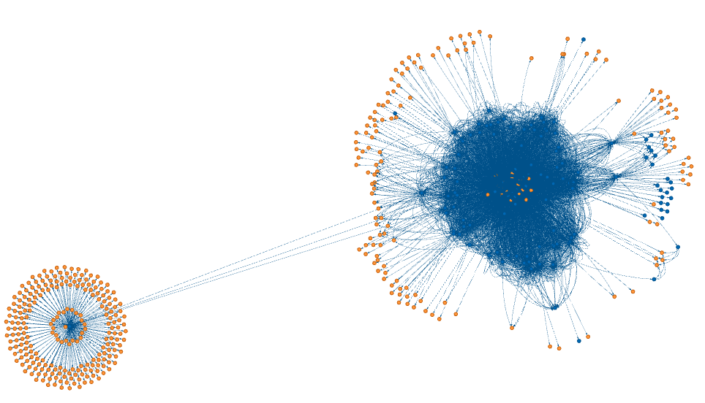
Application: Graph Analytics
  If we analyze our department webpage:
    https://www.polyu.edu.hk/dsai/
> python3 site_graph.py https://www.polyu.edu.hk/dsai/
Visiting https://www.polyu.edu.hk/dsai/ from None
Visiting https://www.polyu.edu.hk/dsai/Sitemap from https://www.polyu.edu.hk/dsai/
Visiting https://www.polyu.edu.hk/dsai/News-and-Events/News/2025/20250703-Welcome-Prof-Yang-Xingyi from https://www.polyu.edu.hk/dsai/
Visiting https://www.polyu.edu.hk/dsai/News-and-Events/News/2025/20250624-IEEE-Best-Paper-Award from https://www.polyu.edu.hk/dsai/News-and-Events/News/2025/20250703-Welcome-Prof-Yang-Xingyi
…
You can try this: https://github.com/tomlinsonk/site-graph

Slide 29
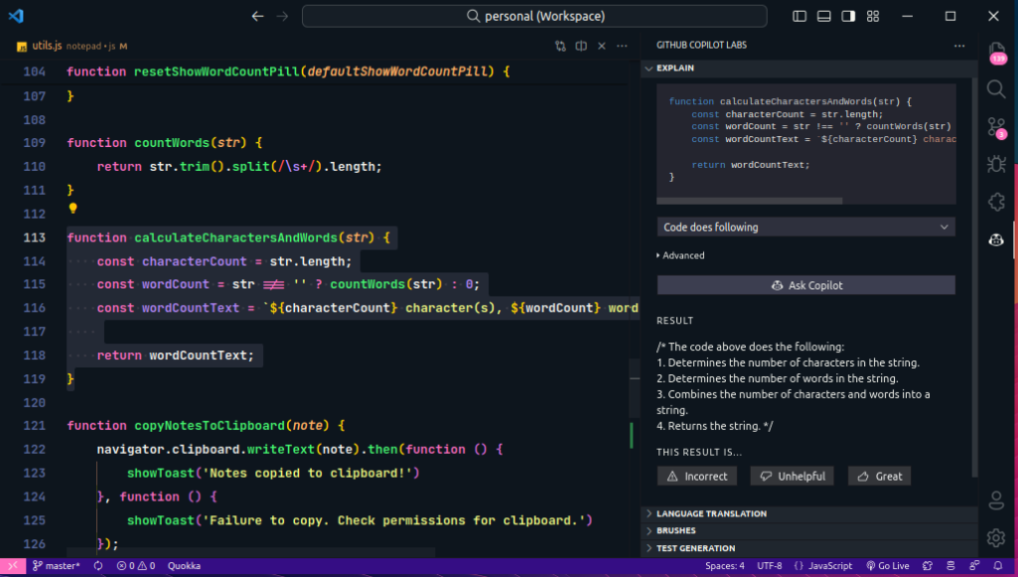

Application: Chatbot (e.g., ChatGPT)
  Programming with CoPilot
  Image Generator with Chatbot

Slide 30
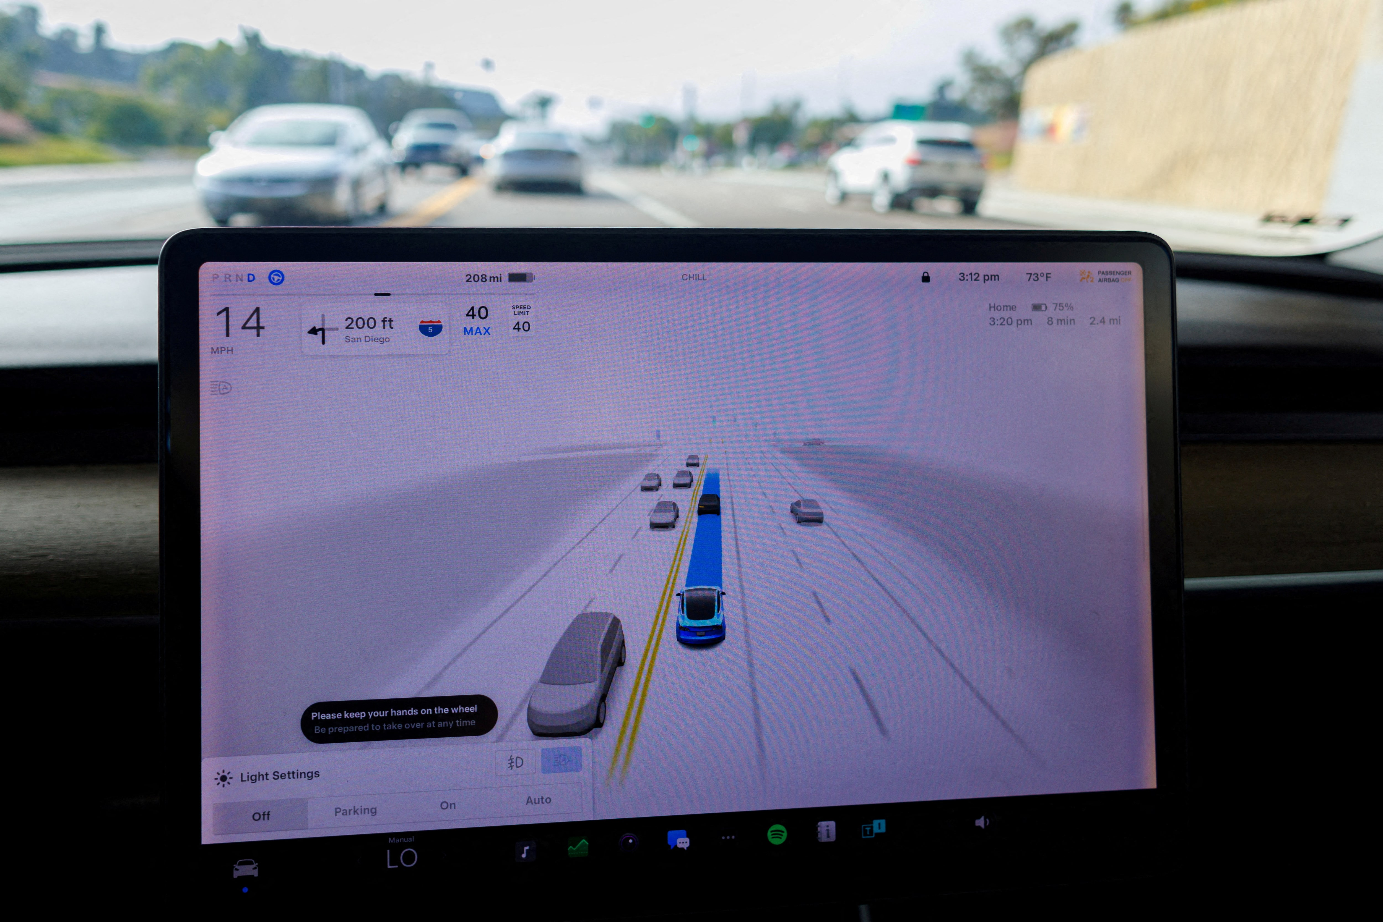
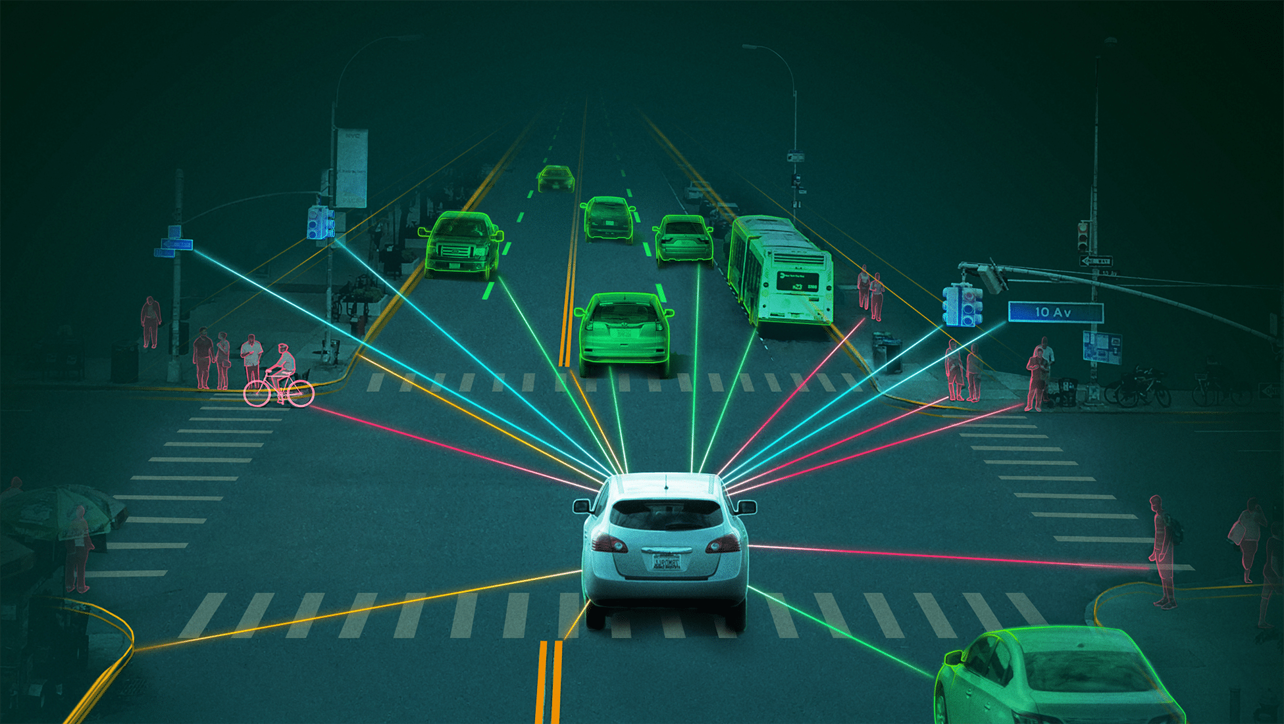
Application: Autonomous driving
  Vehicles that are capable of operating without a human driver.
  These vehicles use a combination of sensors, software, and communication technologies to navigate roads and make decisions based on real-time data.

Slide 31
Components of Big Data
Big-Data Libraries
Mlib (Machine Learning), NetworkX,
Data Visualization
Analytics and Algorithm
Similarity Search, Recommendation Systems, Link Analysis
Distributed Computing
Dask, MapReduce (Hadoop and Google), Resilient Distributed Dataset (Spark)
Big Data Distributed Storage
Hadoop Distributed File System (HDFS), Key-value stores

Slide 32
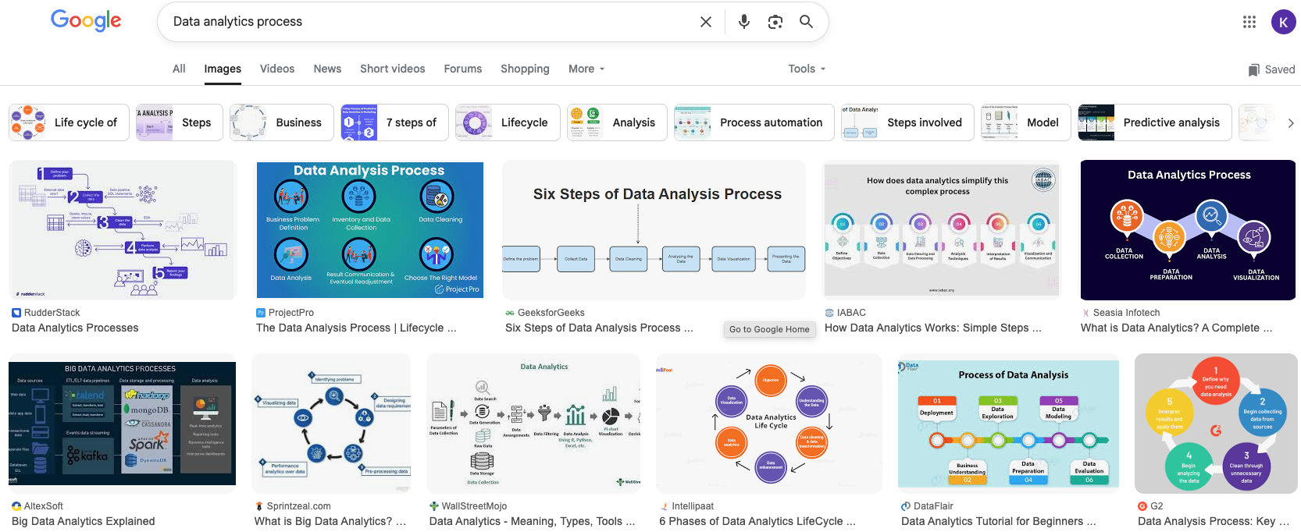
Data Analytics Process
  If you google “Data analytics process”, you will see out a bunch of different models out there. But they sharing same core principles.

Slide 33
Data Analytics Process
  The data analytics process is a high-level description of the data analytics workflow
Ask a question
Obtain Data
Understand the World
Understand the Data
Reports, Decisions, and Solutions

Slide 34
Problem Formulation
  What do we want to know ?
  What problems are we trying to solve?
  What are the hypotheses we want to test?
  What are our metrics for success?

Slide 35
Data Acquisition and Cleaning
  What data do we have and what data do we need?
  How will we sample more data?
  Is our data representative of the population we want to study?

Slide 36
Exploratory Data Analysis (EDA) & Visualization
  How is our data organized and what does it contain?
  Do we already have relevant data?
  What are the biases, anomalies, or other issues with the data?
  How do we transform the data to enable effective analysis?

Slide 37
Prediction and Inference
  What does the data say about the world?
  Does it answer our questions or accurately solve the problem?
  How robust are our conclusions and can we trust the predictions?

Slide 38
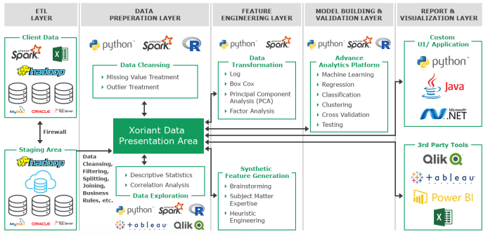
Data Analytics Process

Slide 39
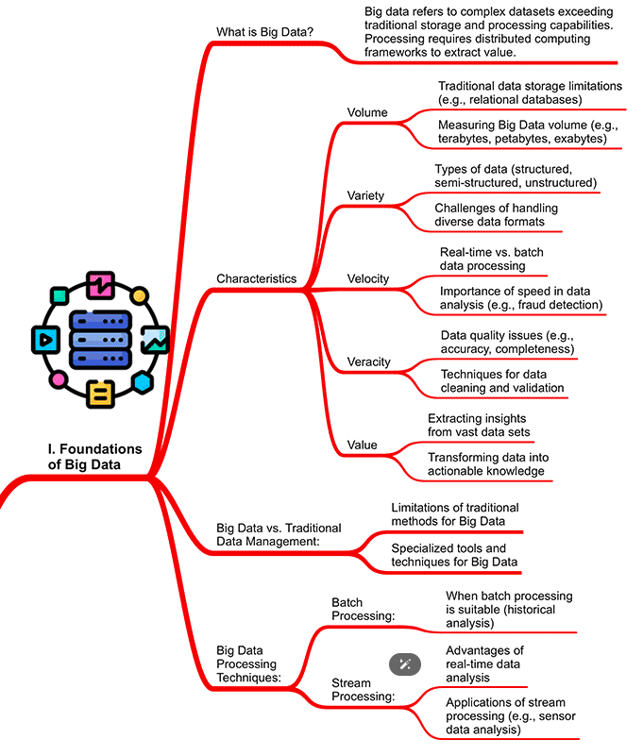

MindMap of Big Data Analytics

Slide 40
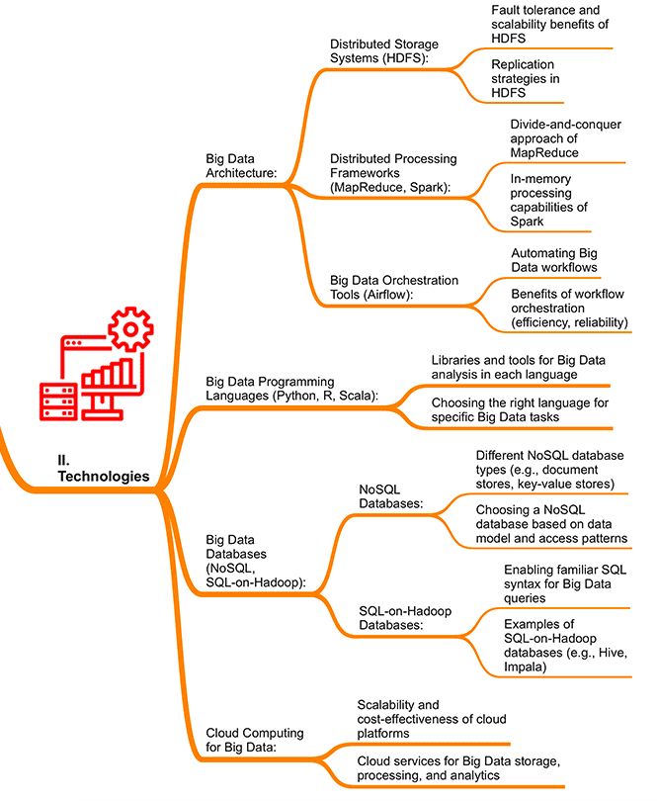
MindMap of Big Data Analytics

Slide 41
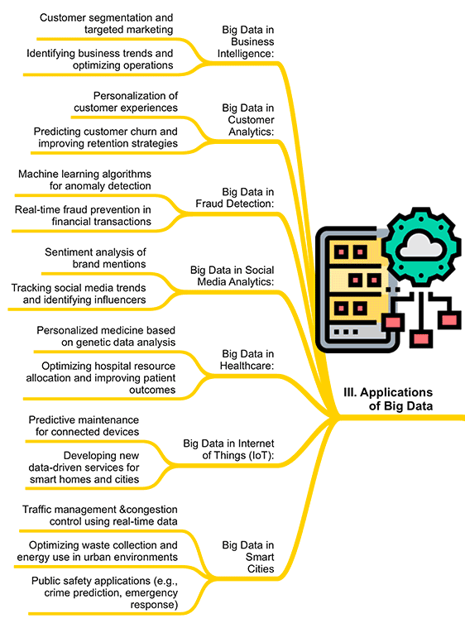
MindMap of Big Data Analytics

Slide 42

Any Questions?

