Slide 1

DSAI4205 Big Data Analytics
Examination Review

Slide 2

Scope of the Examination
  Cover Lecture 1 to Lecture 10
Topic | Included in Multiple Choice | Included in Long Questions
L01: Introduction to Big Data Analytics
L02: The path to Parallelism
L03: Spark
L04: Exploring Hive, Shark, and SparkSQL in Big Data Systems
L05+L06: Intro to NLP, LLM
L07: Link Analysis (PageRank)
L08: Graph Analytics
L09: Big Data Storage, NoSQL
L10: Recommendation

Slide 3
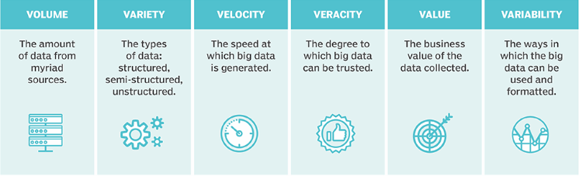
The Six Vs of Big Data

Slide 4
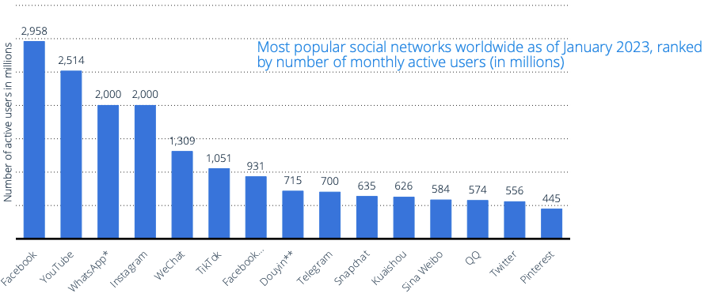
Volume
  The amount of data. The Data volume is increasing exponentially.
    Generated by huge number of devices and sensors.
    The number of smartphone mobile network subscriptions worldwide reached almost 6.4 billion in 2022

Slide 5
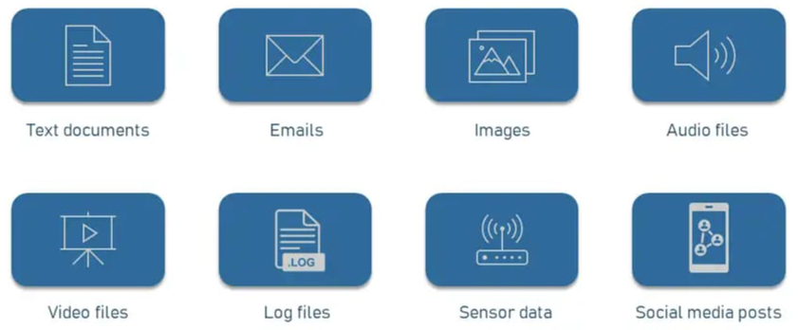
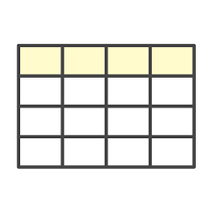
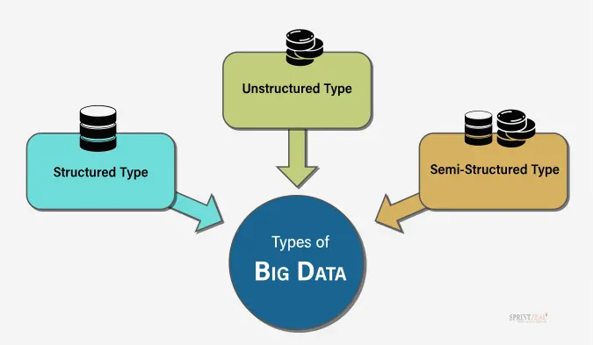

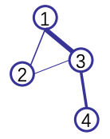
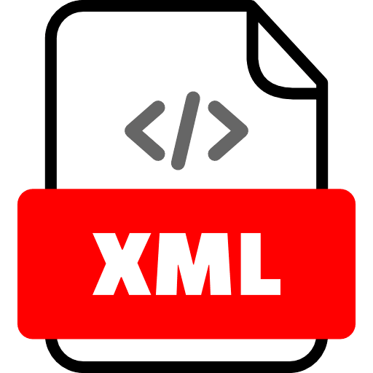
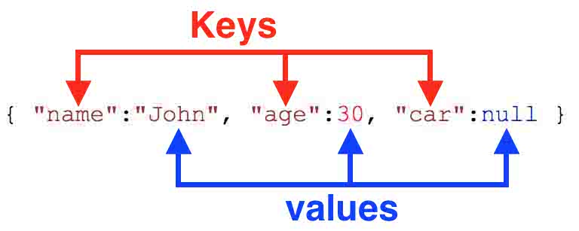
Variety
  The diversity of data types.
    A single application may generate/collect many types of data
Columns
Rows

Slide 6
Velocity
  How quickly data is generated and processed. (streaming data)
  Data is generated fast and need to be processed fast.
    Big Data velocity data flows in from sources like machines, networks, social media, mobile phones, etc.
    Example: There are approximately 16.4 billion searches on Google every day
    Streaming data: continuous flow of big data
      Make decision in real time or near real time.
      Online Data Analytics: late decisions mean missing opportunities
      Recommendation:
        Based on your current location and your purchase history, send promotions right now for store next to you
      Medical devices monitoring:
        Sensors monitoring your activities and body, notify you if there are abnormal measurements

Slide 7
Veracity
  The quality and accuracy of data (Trustworthiness of Data)
    It is useless if the data being analysed are inaccurate or incomplete.
    Data which is available can sometimes
      Get messy
      Quality and accuracy are difficult to control
        Measurement error
        Human errors like typos in names/addresses
        Data from different sources may not be consistent

Slide 8
Value
  The usefulness of data for an enterprise
    Not all the data collected has real business value.
    The value characteristics is related to the veracity
      The higher the data fidelity, the more value it holds for the business
    The data may not match your big data problem.
      Need to ensure the data is relevant and understand its potential business value.
    Value is also related to how long data processing takes.
      The longer it takes for data to be turned into meaningful information, the less value it has for a business

Slide 9

Variability
  How fast and to what extent data under investigation is changing.
    Data may change over time.
    A single word may have multiple meanings
    E.g. Netflix user’s preference, users’ taste changes over time.
      Viewing habits and preferences due to factors like new content releases, personal experiences, or cultural trends.

Slide 10
Practice question
Netflix, a leading global streaming service, processes over 500 million hours of content watched daily across 190+ countries, generating terabytes of user data per hour from viewing habits, search queries, ratings, and device interactions. This data arrives in real-time as users binge-watch, with diverse formats including structured logs (timestamps, user IDs), semi-structured JSON metadata, and unstructured text from reviews or subtitles. The platform analyzes this to deliver personalized recommendations, but faces challenges like data privacy regulations (e.g., GDPR compliance) and ensuring accurate insights from potentially noisy user feedback. Netflix's AI-driven system handles high-velocity updates during peak hours (e.g., evenings) to predict trends and reduce churn, turning raw data into actionable value like $1B+ in annual savings from optimized content acquisition.
Please classify the 4 characteristics of Big Data (from the 4 V's: Volume, Velocity, Variety, Veracity) against the Netflix profile. For each, provide 1 specific evidence from the profile and explain the possible solutions for each of them

Slide 11
Practice question
  Volume: May addresses via distributed storage
  (e.g., Spark for batch processing).
  Velocity: Handled with streaming pipelines (e.g., Spark Streaming for live recommendations).
  Variety: Uses SparkSQL to query diverse formats unified in data lakes.
  Veracity: Mitigated by data validation rules and anomaly detection ML models.

Slide 12
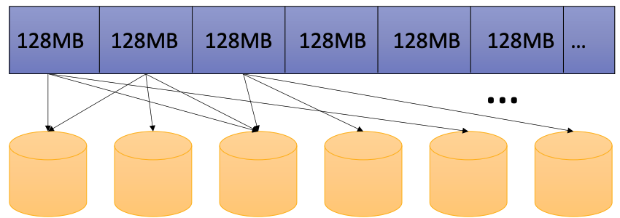
Hadoop Distributed File System (HDFS)
  The most widely used distributed file system
    Fixed-sized partitioning
    3-way replication
    Write-once read-many

Slide 13

Replication Mechanism
A
B
C
D
E
A
B
D
D
E
C
C
A
B
E
D
C
A
D
A
B
C
A
D
B
B
Node 1
Node 2
Node 3
Node 4
Node 5
Input File

Slide 14

Dask
  Complex data structures enable data science in Python
    E.g. Numpy Array, Pandas series and dataframes, etc.
    But datasets are getting larger all the time.
    What if my dataset is too big to fit into the memory of the computer.
    What if the analysis is too long to complete.
  Dask is an open-source Python library:
    Enable us to perform parallel computing
    Scales Python packages such as Numpy, Pandas, etc.
      From one machine to thousand core machine such as HPC clusters.

Slide 15
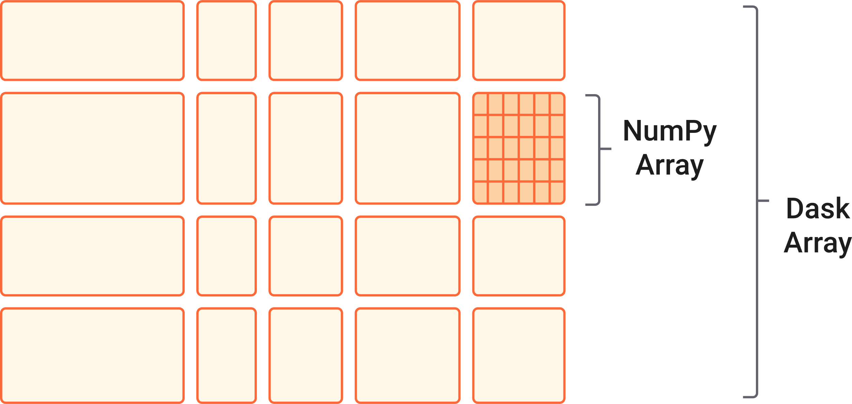
Dask Arrays
It only use whatever it needs !
Dask is Lazy:
The operations on Dask array are evaluated just in time when the results are needed!
  Parallelized version of NumPy arrays for processing data sets that cannot fit in the memory.
  Used as a replacement for NumPy arrays,
    With a similar API as a subset of NumPy functions.
  Effectively reduces the memory of large array computations
    Split the arrays into smaller pieces (called chunks)
      Able to fit into memory and stream the data from disk.

Slide 16
Block Algorithms
  The algorithm splits large computation into smaller segment which operate on subsets of the data (chunks)
  The workers only focus the computation on the assigned smaller piece of data.
import numpy as np
import dask.array as da
data = np.array([
[1,2,3,4],
[5,6,7,8],
[9,10,11,12],
[13,14,15,16]
])
dask_arr = da.from_array(data, chunks=(2,2))
1 | 2 | 3 | 4
5 | 6 | 7 | 8
9 | 10 | 11 | 12
13 | 14 | 15 | 16

Slide 17
Block Algorithms
  Suppose we would like to compute the sum of this array using dask_arr.sum() which is similar to numpy.
  When we take the sum of the dask_arr:
    First compute the sum of each chunk
    Take the sum of the results from each chunk
1 | 2
5 | 6
3 | 4
7 | 8
14
22
136
9 | 10
13 | 14
11 | 12
15 | 16
46
54

Slide 18
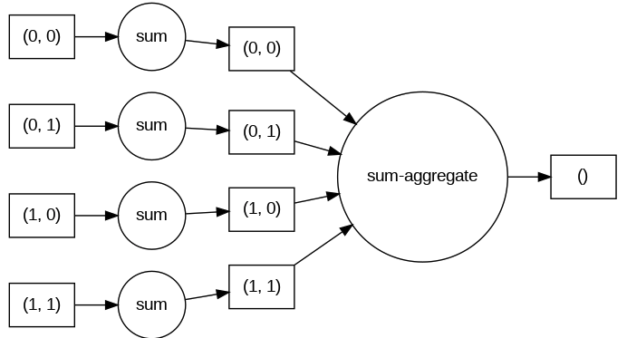
Task Graph
dask_arr.sum().visualize(rankdir="LR")
Instructs Graphviz to arrange the nodes in the graph from left to right instead.
  Symbolic representation of the computations that are needed.
  The task graph defines:
    (1) The relationships between tasks
    (2) The order in which they should be executed.
  Each node in a graph represents a task
  Each line represent the dependencies/relationships between tasks

Slide 19
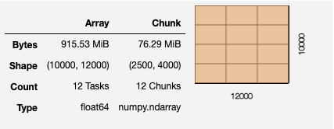
Large data example
  Now try a with a larger array.
data = np.ones((10000, 12000))
data
array([[1., 1., 1., ..., 1., 1., 1.],
[1., 1., 1., ..., 1., 1., 1.],
[1., 1., 1., ..., 1., 1., 1.],
...,
[1., 1., 1., ..., 1., 1., 1.],
[1., 1., 1., ..., 1., 1., 1.],
[1., 1., 1., ..., 1., 1., 1.]])
dask_data = da.ones((10000, 12000))
dask_data

Slide 20
Splitting Chunks
  Notice that the way that arrays are chunked can significantly affect total performance.
  Make use the chunks argument when creating the dask.array
    Be careful: chunk argument represent the shape of the chunk, not the number of chunks.
      E.g. if you put 1 in chunks argument, it means one element in each of the chunk

Slide 21
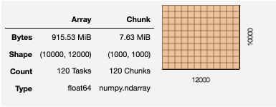

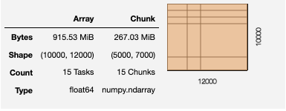
Splitting Chunks
  There are several ways to define chunks:
    We can have same size of chunks
      A chunk size like 1000, meaning chunks of size 1000 in each dimension.
    We can have different size of chunks
      A chunk shape like (1000, 2000), meaning chunks of size 1000 in the first axis, 2000 in the second axis
      A dictionary specifying chunk size per dimension like
      {0: 1000, 1: 2000}
      Fully explicit sizes of all blocks for all dimensions, like ((1000,1000,1000,5000,2000),(3000,2000,7000))

Slide 22
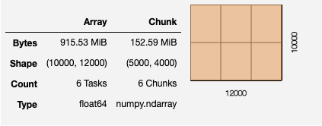
Splitting Chunks
  Suppose we would like to split the data into 6 chunks
    da.ones((10000, 12000,chunks=(5000,4000))

Slide 23
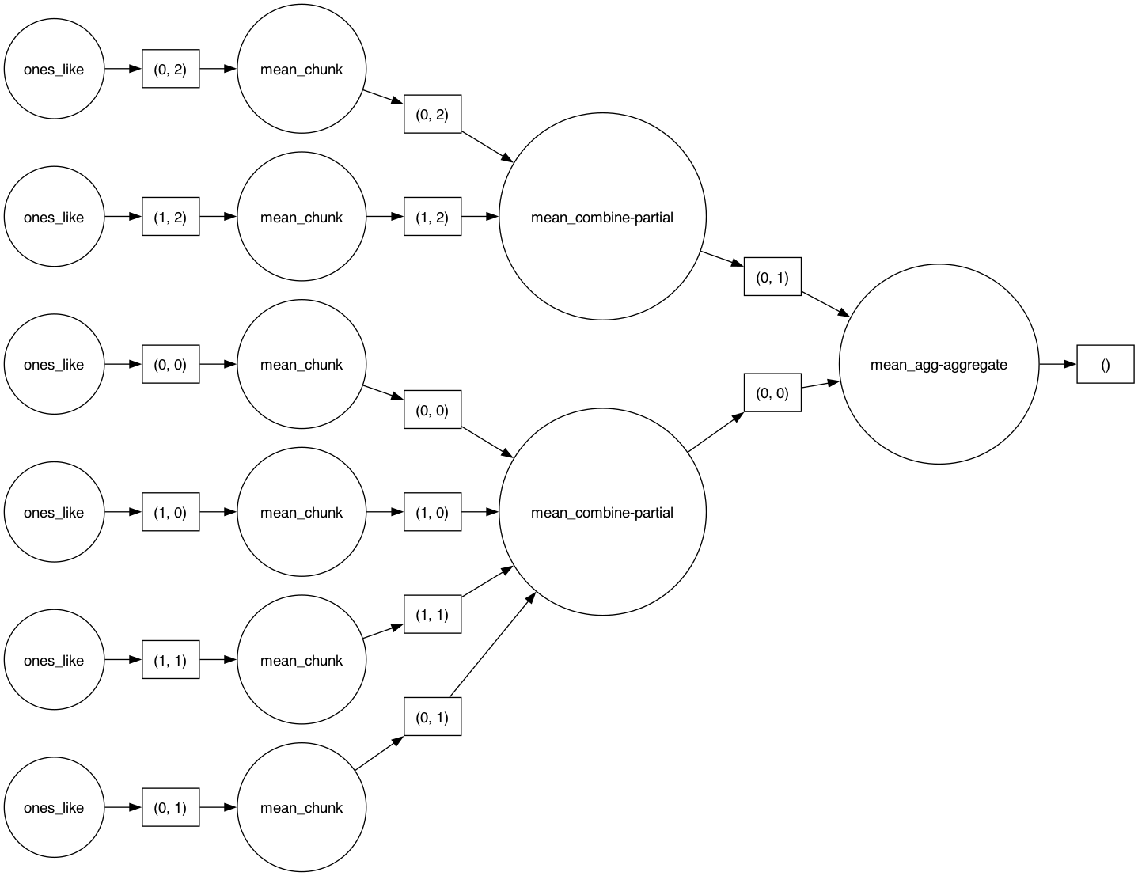
Task Graph
  When working with large Dask arrays, we want to avoid generate the data right away by compute function
  We should perform some computations that reduce the data size
    E.g. compute statistics like the mean or standard deviation

Slide 24
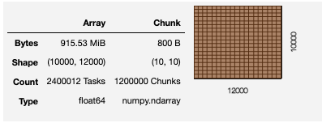
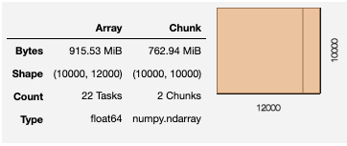
Rechunking Arrays
  Change the chunking after the creation of a Dask array.
  Note that: Rechunking Dask arrays can be expensive
dask_data.rechunk(10,10)
dask_data.rechunk(10000,10000)
CPU times: user 5min 22s, sys: 1min 29s, total: 6min 52s
Wall time: 7min 13s
CPU times: user 183 ms, sys: 12.8 ms, total: 196 ms
Wall time: 86.2 ms
Consider on Chunk Size:
Too small: will be bad because introducing too much overhead
Too large: may not fit well in main memory
Chunk size recommended in Dask Guideline: 100MB to 1GB

Slide 25


Parallelize Systems – Divide and Conquer
Data
Partitions
…
Partition 1
Partition 2
Partition N-1
Partition N
…
Workers
A Worker can be:
a distinct server in different locations
a local machine
a CPU core in a machine, etc.
Worker 1
Worker 2
Worker N-1
Worker N
…
Sub-result 1
Sub-result 2
Sub-result N-1
Sub-result N
Combined Results

Slide 26
Data Model
  In HDFS, assume that data is stored in flat files.
  A file = A bag of (key, value) pairs
  Map reduce program:
    Input: a bag of (key, value) pairs
    Output: a bag of (key, value) pairs
      key is optional in the output.
      E.g. if we would like to count the number of pairs,
      then we do not care what are the keys in our results.

Slide 27
Map Reduce Example
  Counting the number of occurrences of each word in a large collection of documents.
  Each document:
    The key = document id (did)
    The value = set of words (word)
map(String key, String value):
// key: document name
// value: document contents
for each word w in value:
emitIntermediate(w, 1)
reduce(String key, Iterator values):
// key: a word
// values: a list of counts
sum = 0
for each v in values:
sum += v
emit(key, sum)

Slide 28
Map Reduce Example
Map
Shuffle
Reduce
(did1, v1)
(did1, v2)
...
(did2, v1)
(did2, v2)
...
(w1,1)
(w2,1)
(w3,1)
…
(w1,1)
(w2,1)
…
(w1, (1,1,1,…1))
(w2, (1,1,…))
(w3, (1,…))
(w1,25)
(w2,77)
(w3,12)
…

Slide 29
Map Reduce Example
I often repeat repeat myself
I often repeat repeat
I don’t don’t know why know why
I simply know that I I I
am am inclined to say to say
a lot a lot this way this way
I often repeat repeat myself
I often repeat repeat
Mapper1
I: 1, often: 1, repeat: 1, repeat: 1, myself: 1, I: 1, often: 1, repeat: 1, repeat: 1, I: 1, don’t: 1, don’t: 1, know: 1, why: 1, know: 1, why: 1
I often repeat repeat myself
I often repeat repeat
I don’t don’t know why know why
Mapper2
I simply know that I I I
am am inclined to say to say
a lot a lot this way this way
I: 1, simply: 1, know: 1, that: 1, I: 1, I: 1, I: 1, am: 1, am: 1, inclined: 1, to: 1, say: 1, to: 1, say: 1, a: 1, lot: 1, a: 1, lot: 1, this: 1, way: 1, this: 1, way: 1
Mapper3
I often repeat repeat myself
I often repeat repeat
I: 1, often: 1, repeat: 1, repeat: 1, myself: 1, I: 1, often: 1, repeat: 1, repeat: 1

Slide 30
Map Reduce Example
Reducer 1
I: 1, often: 1, repeat: 1, repeat: 1, myself: 1, I: 1, often: 1, repeat: 1, repeat: 1, I: 1, don’t: 1, don’t: 1, know: 1, why: 1, know: 1, why: 1
a: [1,1]
am: [1,1]
don’t: [1,1]
I: [1,1,1,1,1,1,1,1,1]
inclined: [1]
know: [1,1,1]
lot: [1,1]
myself: [1,1]
often: [1,1,1,1]
repeat: [1,1,1,1,1,1,1,1]
say: [1, 1]
simply: [1]
that: [1]
this: [1,1]
to: [1,1]
way: [1,1]
why: [1,1]
a: 2
am: 2
don’t: 2
I: 9
inclined: 1
know: 3
a: 2
am: 2
don’t: 2
I: 9
inclined: 1
know: 3
lot: 2
myself: 2
often: 4
repeat: 8
say: 2
simply: 1
that: 1
this: 2
to: 2
way: 2
why: 2
Reducer 2
I: 1, simply: 1, know: 1, that: 1, I: 1, I: 1, I: 1, am: 1, am: 1, inclined: 1, to: 1, say: 1, to: 1, say: 1, a: 1, lot: 1, a: 1, lot: 1, this: 1, way: 1, this: 1, way: 1
lot: 2
myself: 2
often: 4
repeat: 8
say: 2
simply: 1
Reducer 3
I: 1, often: 1, repeat: 1, repeat: 1, myself: 1, I: 1, often: 1, repeat: 1, repeat: 1
that: 1
this: 2
to: 2
way: 2
why: 2

Slide 31

Issues with MapReduce
…
map
reduce
  In MapReduce:
    Everything must be expressed using mappers and reducers
    Write all intermediate results to disk for fault tolerance
    Only way to share data between iterations / phases is through shared storage
    Slow due to replication and disk I/O, but necessary for fault tolerance
  Ideally, through memory instead of disk-based storage
…
operation
operation

Slide 32
Challenges
  How to design a distributed memory abstraction that is both fault-tolerant and efficient?
  Existing storage systems enable precise modifications to the state.
    In-memory key-value stores (e.g., Redis, Memcached) store data in RAM as simple key-value pairs (e.g., key: "user1", value: "John").
    Requires replicating data or logs across nodes for fault tolerance
      Costly for data-intensive apps
      10-100x slower than memory write
    Require costly on-the-fly replication for mutations
  Idea: to apply similar coarse-grained approach that transform the entire dataset per operation, which is similar to MapReduce (batch processing)
allow precise updates to small pieces of data
copying changes to other nodes in real-time as mutations occur.

Slide 33

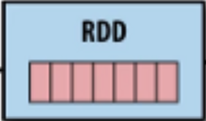
Solution: Resilient Distributed Dataset (RDDs)
  RDD is a fundamental data structure used in Apache Spark.
  Restricted form of distributed shared memory
    an immutable, distributed collection of objects/records
    Can only be build through coarse-grained, deterministic transformations
      Such as map, filter, join, etc.
  Efficient fault recovery using lineage
    Log one operation to apply to many elements
    Recompute lost partitions on failure
    No cost if nothing fails

Slide 34
Resilient Distributed Dataset
Spark Core is embedded with RDDs (Resilient Distributed Datasets), an immutable, distributed collection of objects that can be operated in parallel on multiple machines/nodes)
RDD
S
Transformation
Action
Spark Core
These are operations (e.g., filter, join, union) that are performed on an RDD that yields a new RDD containing the results
These are operations (e.g., count) that return a value after running a computation on an RDD
Action: (RDD → Output)
Transformation: (RDD₁ → RDD₂)

Slide 35
Spark SQL
Spark SQL framework component is used for structured and semi-structured data processing
Spark SQL Architecture
Data Frame API
Data Source API
CSV
JSON
…
Structured Data
Semi-Structured Data

Slide 36
Resilient Distributed Datasets (RDD)
  A Resilient Distributed Dataset (RDD) is the basic abstraction (i.e., object) in Spark. Represents an immutable, partitioned collection of elements that can be operated on in parallel.
  Lazy evaluation:
    Operators are not executed immediately
    A operator tree is constructed in memory
    Computation only done when results needed (to write file, make plot, etc.)
  Data lineage:
    Record series of operations on the data necessary to obtain results
  Immutability:
    You can’t change an RDD, but you can define a new one

Slide 37
Partitions
  Granularity of Data Flow in Transformations
  Whole Dataset: The entire dataset can be processed through one transformation at a time. However, this approach may not fit into memory.
  Row: Each row can be processed independently in this pipeline. While this allows for flexibility, it is likely to be slower than processing in bulk.
  Partition: Users of Spark can define the number of partitions for a Resilient Distributed Dataset (RDD).
This breakdown should help clarify the options for data flow granularity during transformations
sc.parallelize(data, 2)
A | 1
B | 2
A | 3
B | 4
A | 1
B | 2
A | 3
B | 4
partition 1
partition 2
single partition
sc.parallelize(data, 1)

Slide 38
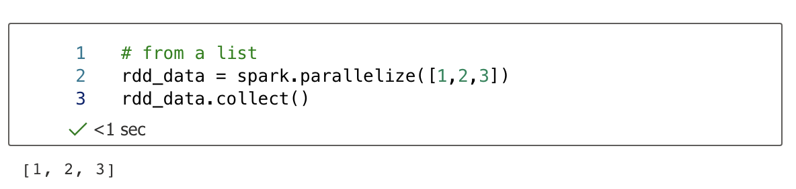
How to create RDD
RDD
Transformation
Action
These are operations (e.g., filter, join, union) that are performed on an RDD that yields a new RDD containing the results
These are operations (e.g., count) that return a value after running a computation on an RDD
  parallelize(): distribute a local python object to form an RDD
  collect(): to obtain values from RDD

Slide 39
Transformations & Actions Example
  Let's return double the value and filter the results where the key is 'A'.
data = (“A”, 1), (“B”, 2), (“A”, 3), (“B”, 5)]
spark = ss.sparkContext
rdd = spark.parallelize(data)
double = rdd.map(multipleTwoToTheValue)
doubleA = double.filter(filterA)
doubleA.collect()
def multipleTwoToTheValue(item):
key, value = item
return(key, value * 2)
map()
def filterA(item):
key, value = item
return key == 'A'
[('A', 2), ('A', 6)]
filter()
  The computation is a sequence of FOUR operations in TWO types.
    Transformation (parallelize, map and filter): Create a new RDD (lazy, no execution yet)
    Action (collect): Perform all operations in the graph to get the actual result.

Slide 40
Tutorial 3 – TODO #2
Write a module to read the "wordCountEx.txt" file, split the word by space and do a word count and sort the result descending.
1 2 3 4 5 6 7 8 9 10 11 12 | from pyspark.sql import SparkSession from operator import add ss = SparkSession.builder.master("local[1]")\ .appName("T03").getOrCreate() spark = ss.sparkContext
['The quick brown fox jumps over the lazy dog. This sentence is often used to test typing skills. It contains every letter of the alphabet. Students can use this text to practice counting words or analyzing letter frequency. Have fun learning!']
textRDD = spark.textFile('wordCountEx.txt')
textRDD = textRDD.flatMap(lambda x: x.split())
textRDD = textRDD.map(lambda x: (x.lower(), 1))
textRDD = textRDD.reduceByKey(add)
textRDD = textRDD.sortBy(lambda x: x[1], ascending=False)
['The','quick', 'brown', 'fox', 'jumps', 'over', 'the', 'lazy', 'dog.', 'This', 'sentence', 'is', 'often’, 'used', 'to',
'test', 'typing', 'skills.', 'It’, 'contains', 'every’, 'letter', 'of', 'the', 'alphabet.', 'Students', 'can', 'use', 'this', 'text', 'to', 'practice', 'counting', 'words', 'or', 'analyzing', 'letter', 'frequency.', 'Have', 'fun', 'learning!']
[('the', 1),('quick', 1), ('brown', 1),
..., ('fun', 1), ('learning!', 1)]
[('the', 3),('quick', 1), ('brown', 1),
…, ('this', 2),… ,('to', 2),… ,('letter', 2),…, ('fun', 1),('learning!', 1)]

Slide 41
Tutorial 3 – TODO #3
Given a small DNA file named dna_small.txt, create a module that count continuous patterns of size k in a DNA string. For instance, if k = 5 and the DNA string: dna_str = 'gcctaagccta', the continuous patters are: 'gccta', 'cctaa', 'ctaag', 'taagc', 'aagcc', 'agcct', 'gccta'
line[0:5], line[1:6], … line[len(line)-length+1, len(line)+1]
1 2 3 4 5 6 7 8 9 10 11 12 | … spark = ss.sparkContext textRDD = spark.textFile('dna_small.txt’) def generatePattern(line, length): sequence = [(line[i:i+length], 1) for i in range(len(line) - length + 1)] return sequence seqRDD = dnaRDD.flatMap(lambda line: generatePattern(line,k)) \ .reduceByKey(add).sortBy(lambda x: x[1], ascending=False)
['gcctaagcctaagcctaagcctaagcctaagcctaagcctaagcctaagcctaagcctaagcctaagcctaagcctaagc','ctaagcctaagcctaagcctaagcctaagcctaagcctaagcctaagcctaagcctaagcctaagcctaagcctaagcct’,… ]
[('ctaag', 103),('gccta', 96), ('aagcc', 94), ('cctaa', 93),
('agcct', 92), ('taagc', 91), ('ttttt', 30), ('aaaaa', 20),
('aaaat', 20), ('atttt', 18), ('aaatt', 16), ('actaa', 15),
('ttttc', 13), ('aattt', 13), ('taaga', 12), ('tttta', 12),
('gtttt', 11), ('gaaaa', 10), ('caaaa', 10), ('aagac', 9), … ]

Slide 42
Tutorial 3 – TODO #4
Improve the solution from TODO 3 to filter for palindrome patterns that occur more than once. Palindrome patterns are sequences that read the same forwards and backwards.
1 2 3 4 5 6 7 8 9 10 11 12 | … spark = ss.sparkContext textRDD = spark.textFile('dna_small.txt’) … seqRDD = seqRDD.filter(lambda x: x[1] > 1) .map(lambda x: palindromesPattern(x)) \ .filter(lambda x: x[1] == True) \
1 2 3 4 5 6 7 8 9 10 11 12 13 14 15 | def palindromesPattern(item): l = r = ’’ key = item[0] for i in range(len(key)): l += key[i] for i in range(-1, -1*len(key)-1, -1): r += key[i] if l == r: palindromesPattern = (key, True) else: palindromesPattern = (key, False) return palindromesPattern

Slide 43
Take Home Exercise
Please implement the inverted index using PySpark RDDs
You may assume that the input is stored in the file documents.txt.
from pyspark.sql import SparkSession from operator import add ss = SparkSession.builder \ .appName("Spark PageRank") \ .master("local[4]")\ .getOrCreate() spark = ss.sparkContext # TODO 1: read and convert the documents.txt to RDD #TODO 2: split the data into two parts (document Id, words) #TODO 3: Form a pair for each distinct word (e.g. (brown, D2), (brown, D3), …) #TODO 4: Group the results in TODO3 #TODO 5: Perform sorting
Here are some functions you might need:
textFile()
map()
flatMap()
distinct()
groupByKey()
sortByKey()
collect()

Slide 44
Take Home Exercise (Solution)
# TODO 1: read and convert the documents.txt to RDD
#TODO 2: split the data into two parts (document Id, words)
1 2 | rdd = spark.textFile('documents.txt')
['D1 || the cat sat on the mat ',
'D2 || a quick brown fox jumps ',
'D3 || the quick brown fox ',
'D4 || sat on the brown mat']
1 2 3 | rdd = spark.textFile('documents.txt') rdd = rdd.map(lambda x: x.split('||’)) \ .map(lambda parts: (parts[0].strip(), parts[1].strip()))
[('D1', 'the cat sat on the mat'),
('D2', 'a quick brown fox jumps'),
('D3', 'the quick brown fox'),
('D4', 'sat on the brown mat')]

Slide 45
Take Home Exercise (Solution)
#TODO 3: Form a pair for each distinct word (e.g. (brown, D2), (brown, D3), …)
#TODO 4: Group the results in TODO3
1 2 3 4 | rdd = spark.textFile('documents.txt') rdd = rdd.map(lambda x: x.split('||’)) \ .map(lambda parts: (parts[0].strip(), parts[1].strip())) rdd = rdd.flatMap(lambda pair: [(word.strip().lower(), pair[0]) for word in pair[1].split()])
[('the', 'D1'), ('cat', 'D1'), ('sat', 'D1'), ('on', 'D1'),
('the', 'D1'), ('mat', 'D1'), ('a', 'D2'), ('quick', 'D2'),
('brown', 'D2'), ('fox', 'D2'), ('jumps', 'D2'), ('the', 'D3'),
('quick', 'D3'), ('brown', 'D3'), ('fox', 'D3'), ('sat', 'D4'),
('on', 'D4'), ('the', 'D4'), ('brown', 'D4'), ('mat', 'D4')]
1 2 3 4 5 6 | rdd = spark.textFile('documents.txt') rdd = rdd.map(lambda x: x.split('||’)) \ .map(lambda parts: (parts[0].strip(), parts[1].strip())) rdd = rdd.flatMap(lambda pair: [(word.strip().lower(), pair[0]) for word in pair[1].split()]) rdd = rdd.distinct() rdd = rdd.groupByKey()
[('the', <pyspark.resultiterable.ResultIterable at 0x78280f81a150>),
('cat', <pyspark.resultiterable.ResultIterable at 0x78280f81a180>),
('sat', <pyspark.resultiterable.ResultIterable at 0x78280f81a360>),
…,
('jumps', <pyspark.resultiterable.ResultIterable at 0x78280f81a8a0>)]

Slide 46
Take Home Exercise (Solution)
#TODO 5: Perform sorting
1 2 3 4 5 6 | rdd = spark.textFile('documents.txt') rdd = rdd.map(lambda x: x.split('||’)) \ .map(lambda parts: (parts[0].strip(), parts[1].strip())) rdd = rdd.flatMap(lambda pair: [(word.strip().lower(), pair[0]) for word in pair[1].split()]) rdd = rdd.distinct() rdd = rdd.groupByKey().map(lambda x: (x[0], sorted(list(x[1])))).sortByKey()
[('a', ['D2']),
('brown', ['D2', 'D3', 'D4']),
('cat', ['D1']),
('fox', ['D2', 'D3']),
('jumps', ['D2']),
('mat', ['D1', 'D4']),
('on', ['D1', 'D4']),
('quick', ['D2', 'D3']),
('sat', ['D1', 'D4']),
('the', ['D1', 'D3', 'D4'])]

Slide 47
Transformation: Narrow vs Wide
  Any transformation where a single output partition can be computed from a single input partition is a narrow transformation.
  Others are wide transformations.
  Wide transformations often require network resources. Unless all input partitions are on the same machine, some will need to be transferred.
A | 1
B | 2
A | 3
B | 4
A | 1
B | 2
A | 3
B | 4
A | 1
A | 3
B | 2
B | 4
A | 1
A | 3
filtered
(narrow)
sortBy
(wide)

Slide 48
Join and Partition
Anthony | 1
Bob | 2
Anthony | M
Bob | M
Anthony | 1 | M
Bob | 2 | M
Machine 1
⨝
=
Machine 2
Cindy | 3
Cindy | F
Cindy | 3 | F
Anthony | 11
Anthony | 12
Anthony | 13
Bob | 21
Bob | 22
Cindy | 33
Cindy | 34
Cindy | 7
Bob | 9
Anthony | 2
Bob | 4
Anthony | 3
Bob | 1
Cindy | 8
If partitioning doesn’t match, then need to carry out all-to-all network communication to match pairs.
Machine 1
To ensure rows with the same key (e.g., a join key) are on the same node. Each node sends portions of its data to all other nodes (or a subset, depending on the partitioning) and receives data from all other nodes.
Machine 2

Slide 49
Join and Partition
If the two tables (RDDs or DataFrames) are partitioned in the same way:
using the same key (e.g., customer_id), the same partitioner (e.g., HashPartitioner for RDDs or equivalent hashing for DataFrames), and the same number of partitions.
Anthony | 11
Anthony | 12
Anthony | 13
Bob | 21
Bob | 22
Cindy | 33
Cindy | 34
Anthony | 2
Anthony | 3
Bob | 1
Bob | 4
Bob | 9
Cindy | 7
Cindy | 8
Machine 1
partitionBy()is specific to key-value pair RDDs. It is used to partition RDDs based on keys, by default using a hash partitioner
Machine 2

Slide 50
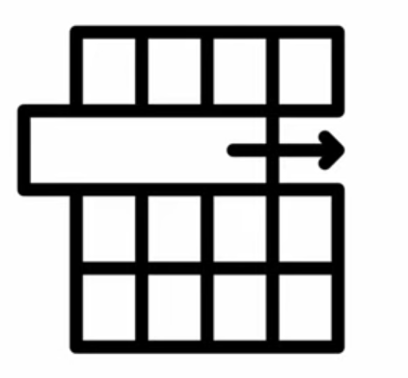
DataFrame
  A DataFrame is a Dataset organized into named columns.
  It is conceptually equivalent to a table in a relational database or a data frame in Python, but with richer optimizations under the hood.
  Data frame can be constructed from a wide array of sources such as:
    structured data files, tables in Hive, external databases, or existing RDDs.
  The DataFrame API is available in many programming languages
  (e.g., Python, Scala, Java and R).
  In the Python API, DataFrame is simply a type alias of Dataset[Row], users can use Dataset<Row> to represent a DataFrame.
  Spark DataFrames are Lazy:
    Each DataFrame object represents a logical plan to compute a dataset.
    But no execution occurs until the user call a special “output operation”
    E.g. count(), save(), show(), etc.

Slide 51
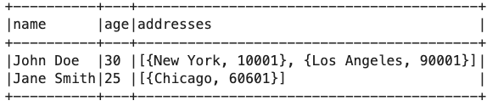
Data Model for DataFrame
  Spark DataFrame support Nested Data Model.
    spark = SparkSession.builder.appName("Nested DataFrame").getOrCreate()
    # Define schema with nested structure
    schema = StructType([
    StructField("name", StringType(), True),
    StructField("age", IntegerType(), True),
    StructField("addresses", ArrayType(StructType([
    StructField("city", StringType(), True),
    StructField("zip", StringType(), True)
    ])), True)
    ])
    # Create DataFrame
    data = [
    ("John Doe", 30, [{"city": "New York", "zip": "10001"}, {"city": "Los Angeles", "zip": "90001"}]),
    ("Jane Smith", 25, [{"city": "Chicago", "zip": "60601"}])
    ]
    df = spark.createDataFrame(data, schema)
    # Show DataFrame
    df.show(truncate=False)

Slide 52
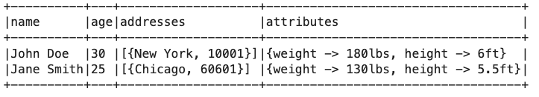
Data Model for DataFrame
  Spark DataFrame Supports:
    primitive SQL types: boolean, integer, double, decimal, string, data, timestamp
    Complex types: structs, arrays, maps, and unions
    User defined types
  Full integration of complex data types:
data = [
("John Doe", 30, [{"city": "New York",
"zip": "10001"}], {"height": "6ft",
"weight": "180lbs"}),
("Jane Smith", 25, [{"city": "Chicago",
"zip": "60601"}], {"height": "5.5ft",
"weight": "130lbs"})
]
schema = StructType([
StructField("name", StringType(), True),
StructField("age", IntegerType(), True),
StructField("addresses", ArrayType(StructType([
StructField("city", StringType(), True),
StructField("zip", StringType(), True)
])), True),
StructField("attributes", MapType(StringType(), StringType()), True)
])

Slide 53
RDD vs DataFrame
In RDD
In SparkSQL
Python/Java/Scala
Transformation
(e.g. map or filter)
DataFrame API or SQL queries
Logical Plan
Catalyst Optimizer
JVM backend
Physical Execution

Slide 54
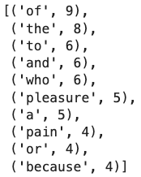
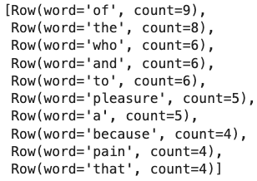
RDD vs DataFrame
Text Data:
But I must explain to you how all this mistaken idea of denouncing pleasure and praising pain was born and I will give you a complete account of the system, and expound the actual teachings of the great explorer of the truth, the master-builder of human happiness. No one rejects, dislikes, or avoids pleasure itself, …
    spark = SparkSession.builder.appName(‘DataFrame-Demo’).getOrCreate()
    sc = spark.sparkContext
    rdd = sc.textFile(”/tmp/data.txt”)
    result_rdd = rdd.flatMap(lambda line: line.split(“ ”)) \
    .map(lambda word: (word, 1)) \
    .reduceByKey(lambda a, b: a+b)\
    .sortBy(lambda x: x[1], ascending=False)
    result_rdd.take(10)
    from pyspark.sql.functions import desc
    df = spark.read.text(“/tmp/data.txt”)
    result_df = df.selectExpr(“explode(split(value, ‘ ’)) as word”) \
    .groupby(“word”).count().orderBy(desc(“count”))
    result_df.take(10)
  DataFrame is user-friendly and optimized approach for structured data in Apache Spark !

Slide 55
DataFrame Operations
  Allow to perform relational operations on DataFrame using a Domain Specify Language (DSL) similar to R data frames and Python Pandas.
  Support all common relational operators
    Projection: (select)
    Filter (where)
    Join
    Aggregation (groupBy)
  These operators take expression objects
  For example:
  Operators build up an abstract syntax tree (AST), which is then optimized by Catalyst
Expressions describe operations without executing them
employees.join(dept, employees.deptId == dept.id) # Join condition .where(employees.gender == "female") # Filter condition .groupBy(dept.id, dept.name) # Group by .agg(count("name").alias("employee_count"))
employees is a DataFrame
employees.deptId is the expression represent the deptId column

Slide 56
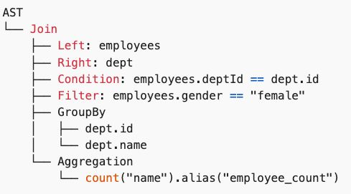
DataFrame Operations
  Operators build up an abstract syntax tree (AST), which is then optimized by Catalyst
  This structure helps Spark understand the operations to perform, their order, and how to optimize the execution plan for the query.
employees.join(dept, employees.deptId == dept.id) # Join condition .where(employees.gender == "female") # Filter condition .groupBy(dept.id, dept.name) # Group by .agg(count("name").alias("employee_count"))

Slide 57
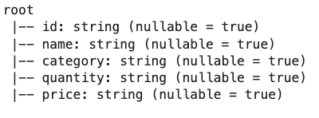
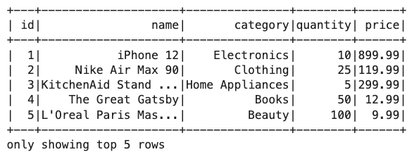
DataFrame Creation
id,name,category,quantity,price
1,iPhone,Electronics,10,899.99
2,Macbook,Electronics,5,1299.99
3,iPad,Electronics,15,499.99
…
  We can create DataFrame by reading a .csv file
from pyspark.sql import SparkSession
spark = SparkSession.builder.appName("Create-DataFrame").getOrCreate()
csv_file_path = "./data/products.csv"
df = spark.read.csv(csv_file_path, header=True)
# Display schema of DataFrame
df.printSchema()
# Display content of DataFrame
df.show(5)
In DataFrame, data are stored in column. We can view the columns using .columns
# Display columns
df.columns

Slide 58
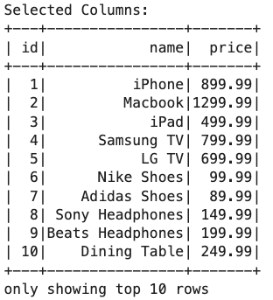
DataFrame Operations
  Selecting columns: to choose specific columns
# Select specific columns
selected_columns = df.select("id", "name", "price")
print("Selected Columns:")
selected_columns.show(10)

Slide 59
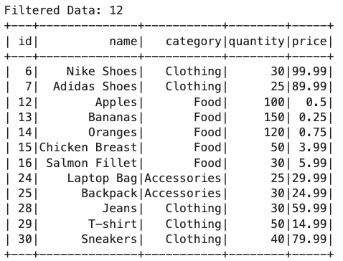
DataFrame Operations
  Apply conditions to filter rows
# Filter rows based on a condition
filtered_data = df.filter(df.quantity > 20)
print("Filtered Data:", filtered_data.count())
filtered_data.show()

Slide 60
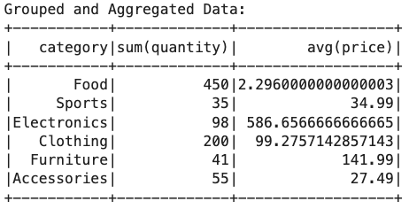
DataFrame Operations
  PySpark provides many built-in standard Aggregate functions (e.g., sum, mean).
  Aggregate functions operate on a group of rows and calculate a single return value for every group. For example, max, min, sum, mean.
# GroupBy and Aggregations
grouped_data = df.groupBy("category").agg({"quantity": "sum", "price": "avg"})
print("Grouped and Aggregated Data:")
grouped_data.show()

Slide 61
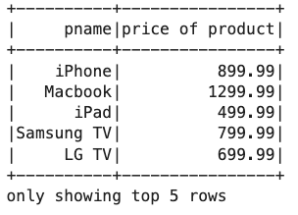
DataFrame Creation
  We can create a new DataFrame from existing DataFrame using toDF() and display the results using show()
df.select('name', 'price').toDF('pname', 'price of product').show(5)

Slide 62
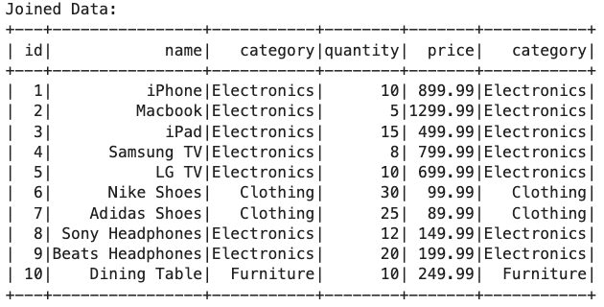
DataFrame Operations
  Join: Combine multiple DataFrames based on specified columns.¶
# Join with another DataFrame
df2 = df.select("id", "category").limit(10)
joined_data = df.join(df2, "id", "inner")
print("Joined Data:")
joined_data.show()

Slide 63
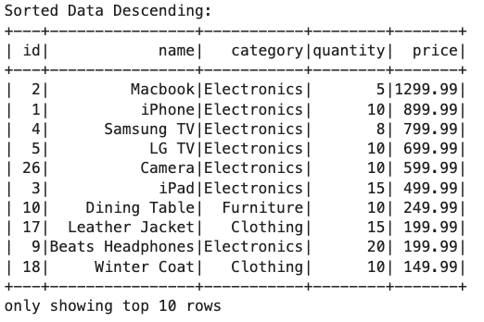
DataFrame Operations
  Sort: Arrange rows based on one or more columns.
# Sort by a column desc
from pyspark.sql.functions import col, desc
sorted_data = df.orderBy(col("price").desc(), col("id").desc())
print("Sorted Data Descending:")
sorted_data.show(10)

Slide 64
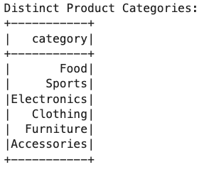
DataFrame Operations
  Distinct: Get unique rows.
# Get distinct product category
distinct_rows = df.select("category").distinct()
print("Distinct Product Categories:")
distinct_rows.show()

Slide 65
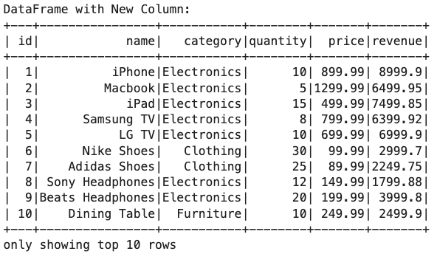
DataFrame Operations
  WithColumn: Add new calculated columns.
# Add a new calculated column
df_with_new_column = df.withColumn("revenue", df.quantity * df.price)
print("DataFrame with New Column:")
df_with_new_column.show(10)

Slide 66
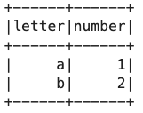
DataFrame Creation
  We can also create DataFrame from Python object (e.g., list)
my_list = [['a', 1], ['b', 2]]
df = spark.createDataFrame(my_list, ['letter', 'number'])
df.show()

Slide 67
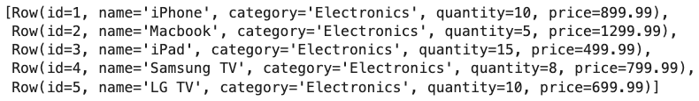
DataFrame to RDD
  To execute data processing in a distributed manner, it is necessary to convert the DataFrame into an RDD.
    This can be done by calling the pyspark.sql.DataFrame.rdd()
    Each element in the returned RDD is an pyspark.sql.Row object.
    An Row is a list of key-value pairs.
data_file_path = "./data/stocks.txt"
df = spark.read.csv(data_file_path, header=True, inferSchema=True)
df_rdds = df.rdd
df_rdds.take(5)

Slide 68
RDD Examples: map() and mapValue()
  With an RDD object, we can apply a set of mapping functions, such as map()and mapValue()
  map()applies a function to each elements of the RDD.
    Each element has to be a valid input to the function.
    The returned RDD has the function outputs as its new elements
  The mapValues()function requires that each element in the RDD has a key/value pair structure.
    For example, a tuple of 2 items, or a list of 2 items.
    The mapValues() applies a function to each of the element values. The element key will remain unchanged

Slide 69
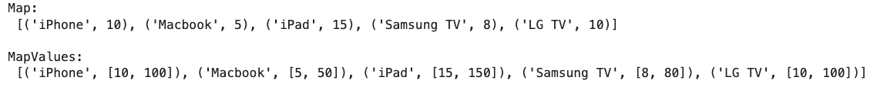
RDD Examples: map() and mapValue()
# retrieve the 'name' and 'quantity' columns from df
df_rdds_map = df_rdds.map(lambda x: (x['name'], x['quantity']))
print('Map: \n', df_rdds_map.take(5), '\n')
# multiply each value in 'quantity' by 10
df_rdds_mapvalues = df_rdds_map.mapValues(lambda x: [x, x*10])
print(‘MapValues: \n', df_rdds_mapvalues.take(5), '\n')

Slide 70
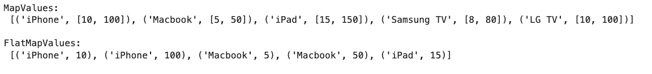
flatMapValues()
  Sometimes we want to flatten multiple output elements for each input elements. The operation to do this is called flatMapValues()
  map()will not flatten the results. Hence, there will have multiple output.
  In contrast, flatMap()flatten the output, so there always have 1 output.
# multiply each value in 'quantity' by 10
df_rdds_mapvalues = df_rdds_map.mapValues(lambda x: [x, x*10])
print('MapValues: \n', df_rdds_mapvalues.take(5), '\n')
df_rdds_mapvalues = df_rdds_map.flatMapValues(lambda x: [x, x*10])
print('FlatMapValues: \n', df_rdds_mapvalues.take(5), '\n')

Slide 71
Common Tasks in Text Processing
  Data Cleaning: Strip unwanted characters/markup (e.g. HTML tags, punctuation, numbers, etc.)
  Tokenization: Tokenization is the process of segmenting text into units called tokens.
  Stemming: reduce inflected word to their word stems
    computational → comput
    computing → comput
  Lemmatization: return the word in its root form (e.g., run, ran > run)
  Stop words removal: Remove frequent words that are not informative
    e.g. a, an, the, it, she, it, …
  POS Tagging: extract the word form of text (e.g., noun, verb, etc.)

Slide 72
Subword Tokenization
  The scheme consists of THREE algorithms
    Token learner:
      Processes a raw training corpus to generate a set of tokens, referred to as the vocabulary.
      Training Steps:
        1. Starts with splitting the input words into single characters (each of them corresponds to a symbol in the final vocabulary)
        2. Find the most frequent occurring pair of symbols from the current vocabulary
        3. Add this to the vocabulary and size of vocabulary increases by one
        4. Repeat steps (2) and (3) till the defined number of tokens are built or no new combination of symbols exist with required frequency
    Token Segmenter (Encoder)
      Utilizes the vocabulary and a raw test sentence to segment the sentence into tokens.
    Token Merger (Decoder)
      Takes a sequence of tokens and reconstructs the original sentence.

Slide 73
Byte Pair Encoding (BPE) Learner Example
  Given the sample sentence "hug", "pug", "pun", "bun", "hugs”
  The base vocabulary will then be ["b", "g", "h", "n", "p", "s", "u"]
  ("hug", 10), ("pug", 5), ("pun", 12), ("bun", 4), ("hugs", 5)
  We start the training by splitting each word into characters (the ones that form our initial vocabulary) so we can see each word as a list of tokens:
h | u | g |  | p | u | g |  | p | u | n |  | b | u | n |  | h | u | g | s
vocab = ['b', 'g', 'h', 'n', 'p', 's', 'u', 'Ġ']
h | ug |  | p | ug |  | p | u | n |  | b | u | n |  | h | ug | s
vocab = ['b', 'g', 'h', 'n', 'p', 's', 'u', ‘Ġ’, ‘ug’]
h | ug |  | p | ug |  | p | un |  | b | un |  | h | ug | s
vocab = ['b', 'g', 'h', 'n', 'p', 's', 'u', ‘Ġ’, ‘ug’, ‘un’]
hug |  | p | ug |  | p | un |  | b | un |  | hug | s
vocab = ['b', 'g', 'h', 'n', 'p', 's', 'u', ‘Ġ’, ‘ug’, ‘un’, ‘hug’]
hug | p | ug | p | un |  | b | un |  | hug | s
vocab = ['b', 'g', 'h', 'n', 'p', 's', 'u', ‘Ġ’, ‘ug’, ‘un’, ‘hug’, ‘Ġp’]
If size of vocab = 20:
Merge Rules:
{('u', 'g'): 'ug', ('u', 'n'): 'un', ('h', 'ug'): 'hug', ('Ġ', 'p'): 'Ġp', ('Ġ', 'hug'): 'Ġhug', ('Ġp', 'un'): 'Ġpun', ('Ġp', 'ug'): 'Ġpug', ('b', 'un'): 'bun', ('Ġhug', 's'): 'Ġhugs', ('Ġ', 'bun'): 'Ġbun’}
Vocab:
['<|endoftext|>', 'b', 'g', 'h', 'n', 'p', 's', 'u', 'Ġ', 'ug', 'ug', 'un', 'hug', 'Ġp', 'Ġhug', 'Ġpun', 'Ġpug', 'bun', 'Ġhugs', 'Ġbun']
Spaces are converted in a special character (the Ġ )

Slide 74
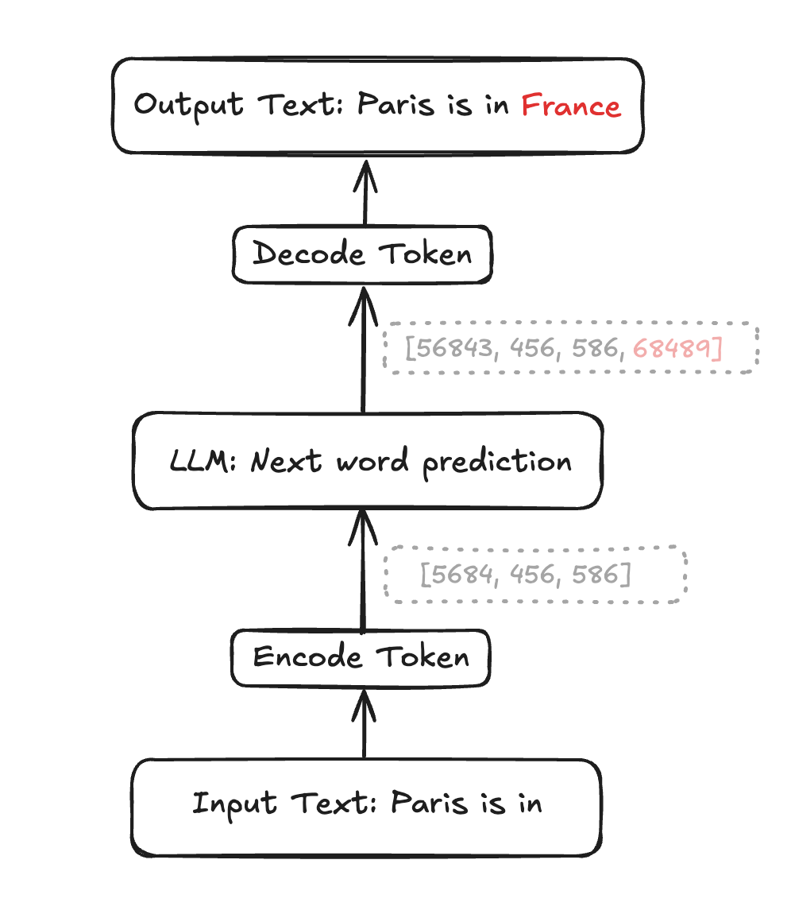
Tokenizing a new sentence
  fred fed ted bread, and ted fed fred bread
  vocabulary = {‘a’, ‘b’, ‘d’, ‘e’, ‘f’, ‘n’, ‘r’, ‘t’, ‘ ‘}
  vocabulary = {‘a’, ‘b’, ‘d’, ‘e’, ‘f’, ‘n’, ‘r’, ‘t’, ‘ ‘, ’d ‘, ‘ed ’, ‘fr’, ‘fred’}
  Tokenize a new sentence
1
2
3
4
5
6
7
8
9
10
11
12
13
  Decoder: reconstructs the original sentence
t | e | d | _ | a | n | d | _ | f | r | e | d | _ | a | r | e | _ | f | r | i | e | n | d | s
t | e | d_ | a | n | d_ | f | r | e | d_ | a | r | e | _ | f | r | i | e | n | d | s
t | ed_ | a | n | d_ | f | r | ed_ | a | r | e | _ | f | r | i | e | n | d | s
t | ed_ | a | n | d_ | fr | ed_ | a | r | e | _ | fr | i | e | n | d | s
t | ed_ | a | n | d_ | fred_ | a | r | e | _ | fr | i | e | n | d | s
8
11
1
6
10
13
1
7
4
9
12
?
4
6
3
?

Slide 75
Stop Words
  Some words are frequent words that are not informative. E.g., I, a, an, the
  It is typical to exclude high-frequency words:
    They have little semantic content: the, a, and, to, be, he, she, it
    Typical stop word list has 200 to 300 words
  However, it is little harm for not considering stop words. Consider these phrases:
    Phrase queries: “President of University of Hong Kong”
    Various song titles, etc.: “Let it be”, “To be or not to be”
    “Relational” queries: “flights to London”
  Phrases: require NLP (natural language processing) analysis
    Example: Name Entities Recognition (NER)

Slide 76
Stemming
  Reduce terms to their “roots” form
  “Stemming” suggests crude affix chopping
    language dependent
    e.g., give, giving, gave, given all reduced to give.
for example compressed
and compression are both
accepted as equivalent to
compress.
for exampl compress and
compress are both accept
as equival to compress

Slide 77
Porter’s Stemming
  Common algorithm for stemming English
    Results suggest it’s at least as good as other stemming options
  Five phases of reductions
    phases are applied sequentially
    each phase consists of a set of commands
RULE EXAMPLE
s → cats → cat
sses → ss classes → class
ies → i companies → compani
ational → ate international → internate
tional → tion conventional → convention
(m > 1)ement → replacement → replac
cement → cement

Slide 78
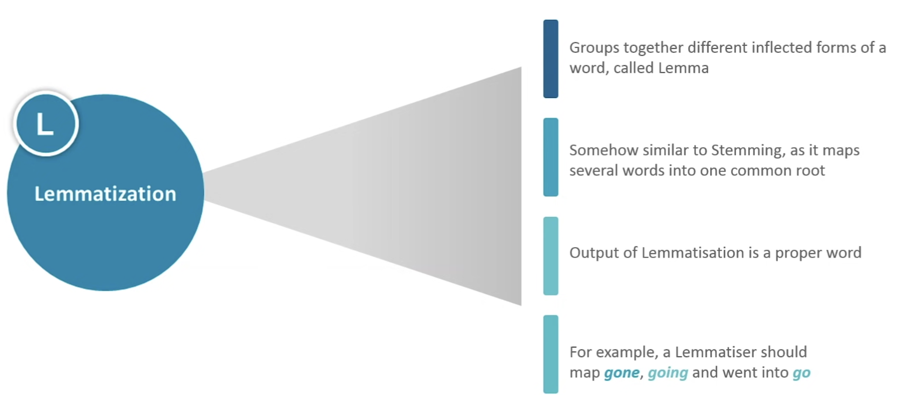
Lemmatization

Slide 79
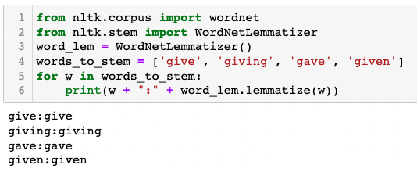
Lemmatization
  Reduce inflectional/variant forms to base form. E.g.,
    am, are, is → be
    car, cars, car's, cars' → car
    the boy's cars are different colors → the boy car be different color
  Lemmatization implies doing “proper” reduction to dictionary headword form

Slide 80
One Hot Encoding
  Encodes categorical data as real numbers such that the magnitude of each dimension is meaningful.
  For each distinct possible value (unique value), a new feature is created.
  Example:
 | name | kind | age
0 | Goldy | Fish | 0.5
1 | Scooby | Dog | 7.0
2 | Brian | Dog | 3.0
3 | Francine | Cat | 10.0
4 | Goldy | Dog | 1.0
Q: How one hot encoding turns data into numerical data ?
A: For each distinct possible value for each feature, create a new binary variable.

Slide 81
One Hot Encoding
 | name | kind | age
0 | Goldy | Fish | 0.5
1 | Scooby | Dog | 7.0
2 | Brian | Dog | 3.0
3 | Francine | Cat | 10.0
4 | Goldy | Dog | 1.0
 | age
0 | 0.5
1 | 7.0
2 | 3.0
3 | 10.0
4 | 1.0
name_Brian | name_Francine | name_Goldy | name_Scooby
0 | 0 | 1 | 0
0 | 0 | 0 | 1
1 | 0 | 0 | 0
0 | 1 | 0 | 0
0 | 0 | 1 | 0
kind_Cat | kind_Dog | king_Fish
0 | 0 | 1
0 | 1 | 0
0 | 1 | 0
1 | 0 | 0
0 | 1 | 0

Slide 82
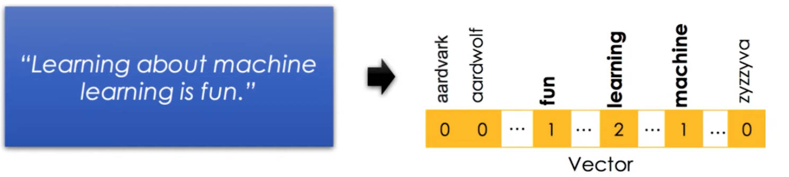
Bag of Words Model
  Extracts features from text
    Stop words should not be included
    Word order is lost
    Sparse encoding

Slide 83
Levenshtein Distance
  Levenshtein Distance is the minimum number of single-character edits required to change one word into the other.
    insertions, deletions, substitutions
  Example: let's consider the two words "kitten" and "sitting":
    "kitten" -> "sitten" (replace "k" with "s")
    "sitten" -> "sittin" (replace "e" with "i")
    "sittin" -> "sitting" (insert "g" at the end)
    Therefore, the Levenshtein Distance between "kitten" and "sitting" is 3.
      Three operations to transform one word into the other.

Slide 84
Operations of Levenshtein Distance
  Operations:
    Replace
    Insert
    Delete
A | N
0 | 1
A | N | T
0 | 1 | 2
Match
B | U | T
0 | 1 | 2
B | U
0 | 1
Convert to sub-problem

Slide 85
Operations of Levenshtein Distance
  Operations:
    Replace
    Insert
    Delete
U
1
A | N
0 | 1
Perform one operation of a replacement
A
0
B
0
B | U
0 | 1
Proceed to the next sub problem

Slide 86
Operations of Levenshtein Distance
  Operations:
    Replace
    Insert
    Delete
A | N
0 | 1
U
2
A | N
0 | 1
B
0
B | U
0 | 1
Proceed to the next sub problem

Slide 87
Operations of Levenshtein Distance
  Operations:
    Replace
    Insert
    Delete
A | N
0 | 1
A
0
B | U
0 | 1
B | U
0 | 1
Proceed to the next sub problem

Slide 88
DP table for BUT to ANT
Source Word
 | ”” | A | N | T
””
B
U
T
 | ”” | A | N | T
”” | 0 | 1 | 2 | 3
B
U
T
Steps to convert from ANT to “”
Target Word
Steps to convert from AN to “”
Deletions
Steps to convert from “” to “”
Steps to convert from A to “”

Slide 89
DP table for BUT to ANT
Source Word
 | ”” | A | N | T
””
B
U
T
 | ”” | A | N | T
”” | 0 | 1 | 2 | 3
B | 1
U | 2
T | 3
Target Word
Steps to convert from “” to B
Steps to convert from “” to BU
(Insertions)
Steps to convert from “” to BUT

Slide 90
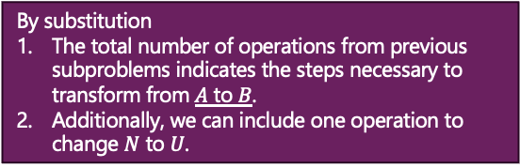
DP table for BUT to ANT
By substitution
The total number of operations from previous subproblems indicates the steps necessary to transform from $A$ to $B$.
Additionally, we can include one operation to change $N$ to $U$.
Source Word
 | ”” | A | N | T
””
B
U
T
 | ”” | A | N | T
”” | 0 | 1 | 2 | 3
B | 1 | 1 | 2
U | 2 | 2
T | 3
DP[1][1] + 1 = 2
By insertion:
We consider how to transform AN to B, by remove N from AN and substitute A to B, this take two operations.
Target Word
DP[1][2] + 1 = 3
AN
U
AN→B
BU
By deletion:
We consider how to transform A to BU, by remove N from AN and substitute A to B, this take two operations.
The minimum steps require to transform AN → BU
DP[2][1] + 1 = 3
AN
A→BU
BU

Slide 91
DP table for BUT to ANT
Source Word
 | ”” | A | N | T
”” | 0 | 1 | 2 | 3
B | 1 | 1 | 2 | 3
U | 2 | 2 | 2 | 3
T | 3 | 3 | 3 | 2
Target Word

Slide 92
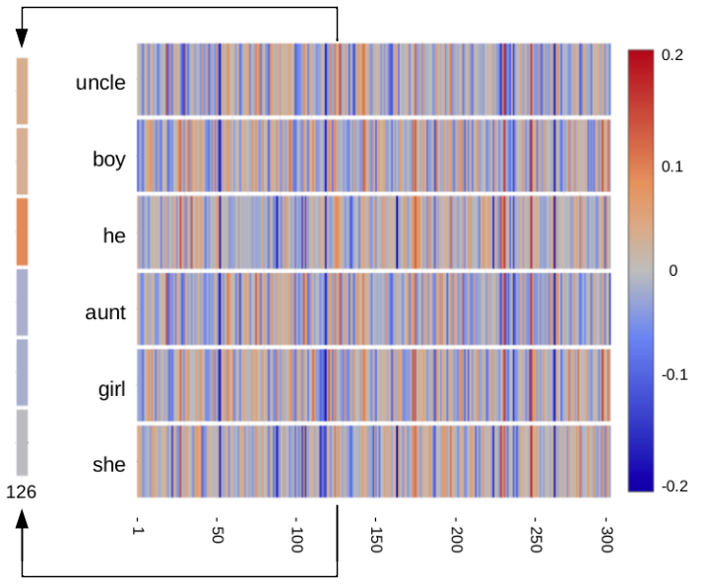
Word Embeddings
  Each word is represented by 300 numbers with values between -0.2 and +0.2.
  Component number 126 is shown magnified to the left.
    Component 126 appears to correlate with gender
Demo: https://www.cs.cmu.edu/~dst/WordEmbeddingDemo/index.html

Slide 93
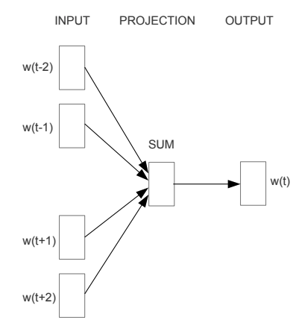
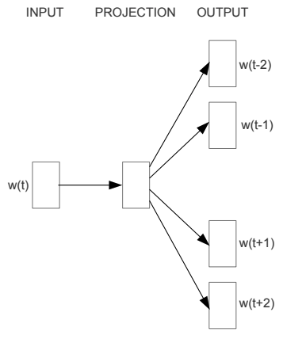
Word2Vec
  Word2vec (Mikolov et al, 2013) is a framework for learning word embeddings.
  Based on the idea that is the foundation of many modern NLP approaches.
    A word’s meaning is given by the words that frequently appear close-by.
  Two model variants:
    Skip-grams: Predicting context words by given the center word
    Continuous bag-of-words (CBOW): Predicting center word by given the context words
    (the words surrounding the center word)
CBOW
Skip-gram

Slide 94









Skip-gram
  Example window in skip-gram:
$$P(w_{t}−2|w_{t})$$
$$P(w_{t}+2|w_{t})$$
$$=P(son|loves)$$
window
…
since
the
man
loves
his
son
so
much
…
$$P(w_{t}−1|w_{t})$$
$$P(w_{t}+1|w_{t})$$
$$P(w_{t}−2|w_{t})$$
$$P(w_{t}+2|w_{t})$$
window
…
since
the
man
loves
his
son
so
much
…
$$P(w_{t}−1|w_{t})$$
$$P(w_{t}+1|w_{t})$$

Slide 95
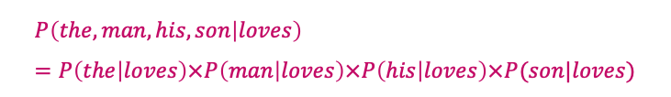


Skip-gram
  Three assumptions of Skip-gram:
    Each window is identically and independently distributed sample.
      Each of these windows can be treated as an independent input/output sample.
      Input: center word
      Output: the context words, the words appear before/after the center word.
    Each context word is conditionally independent by given the center word.
    Only model the probability of a word that occurs somewhere in the context window, we do not care about the sequence.
    No matter whether the word is 1 word before the center word, 2 words before the center word, or after the center word.
$$P(w_{t}−2|w_{t})$$
$$P(w_{t}+2|w_{t})$$
window
the
man
loves
his
son
$$P\left(the, man, his, son | loves\right)=P\left(the | loves\right)×P\left(man | loves\right)×P\left(his | loves\right)×P(son|loves)$$
$$P(w_{t}−1|w_{t})$$
$$P(w_{t}+1|w_{t})$$

Slide 96
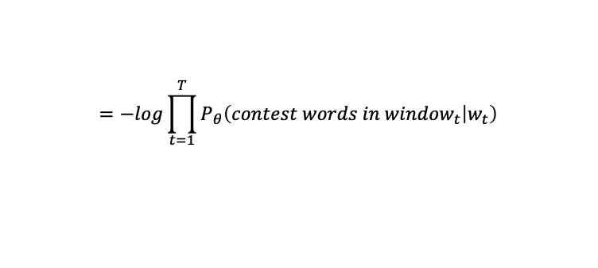




Loss function
From the 1st assumption, each window is independent
End up with multiplying the probabilities of each of the window together
  Skip-gram loss function
    Minimize the negative log likelihood (NLL) of the parameters.
    $J\left(θ\right)=−\log\left[P_{θ}\left(win_{1} | w_{1}\right)×P_{θ}\left(win_{2} | w_{2}\right)×…×P_{θ}\left(win_{T} | w_{t}\right)\right]$
$$=−log\prod_{t=1}^{T}{P_{θ}\left(contest words in window_{t} | w_{t}\right)}$$
$$=−log\prod_{t=1}^{T}{P_{θ}\left(w_{t−M}, ⋯, w_{t−1, }w_{t+1},⋯,w_{t+M} | w_{t}\right)}$$
$$=−log\prod_{t=1}^{T}{\prod_{−M≤j≤M, j≠0}{p_{θ}\left(w_{t+j} | w_{t}\right)}}$$
$$=−\sum_{t=1}^{T}{\sum_{−M≤j≤M, j≠0}{logP_{θ}(w_{t+j}|w_{t})}⁡}$$

Slide 97





Skip-gram Model Structure
  How do we model $P_{θ}(w_{t+j}|w_{t})$?
  Based on the third assumption, each context word can be predicted from the center word in the same way regardless of the position.
    E.g. the prediction of $w_{t−2}$and $w_{t−1}$ is done the same way from $w_{t}$.
  For each word, we have two word-vectors:
    $v_{w}$ when w is a center word (center-word embeddings)
    $u_{w}$ when w is a context word (context-word embeddings)
  For center word c and context word o we use the following model:
    $p_{θ}\left(w_{t+j}=o | w_{t}=c\right)=p\left(o | c\right)$
$$\vec{v_{c}} ⋅\vec{u_{o}}$$
When we consider all the different types of words that can be used in a context, their sum should equal to 1
$$e$$
$$=softmax_{o}(U⋅V_{c})$$
${\sum_{k=1}^{V}{e}}^{\vec{v_{c}} ⋅\vec{u_{k}}}$
Normalize the value to a range between 0 and 1

Slide 98






High Level Neural Network Diagram
passes
Output layer
$$f_{θ}(w_{t}=c)$$
$$w_{t}=c$$
Logits
$$u_{1}⋅v_{c}$$
$$u_{2}⋅v_{c}$$
men
softmax
sum to 1
$$u_{3}⋅v_{c}$$
sentence
$$u_{o}⋅v_{c}$$
should
the

Slide 99





Continuous bag-of-words (CBOW)
  The continuous bag of words (CBOW) predicts a center word by given the context words.
$$w_{t}−2$$
$$w_{t}+2$$
$$P(love|the, man, his, son)$$
…
since
the
man
loves
his
son
so
much
…
$$w_{t}−1$$
$$w_{t}+1$$
Same assumption:
1. Each window is identically and independently distributed sample.
2. Characterize each of the context words in the same way regardless of its position

Slide 100

Loss function
  CBow loss function
    Minimize the negative log likelihood (NLL) of the parameters.
    $J\left(θ\right)=−log\prod_{t=1}^{T}{P_{θ}\left(w_{t} | w_{t−M},w_{t−M+1},⋯,w_{t−1},w_{t+1},⋯,w_{t+M}\right)}$
    $=−\sum_{t=1}^{T}{logP_{θ}\left(w_{t} | w_{t−M},w_{t−M+1},⋯,w_{t−1},w_{t+1},⋯,w_{t+M}\right)}$
    We need to define a structure on how do we to output this probability for Center word by given the context words.
context words
center word

Slide 101


Model Structure of CBOW
    To take the dot product between the center word embedding (u_{c}) and context words embedding (V_{o})
    For CBOW, it is common to use the context vectors as our word embeddings
    (denoted as v for CBOW)
$$P_{θ}\left(w_{t}=c | w_{t−M}=o1,w_{t−M+1}=o2,⋯, w_{t+M}=o2M\right)$$
=$\frac{e^{\frac{1}{2m}\vec{u_{c}} ⋅(v_{o1}+v_{o2}+v_{o3}+⋯+v_{o2m})}}{\sum_{k=1}^{V}{e^{\frac{1}{2m}\vec{u_{k}} ⋅(v_{o1}+v_{o2}+v_{o3}+⋯+v_{o2m})}}}$

Slide 102








CBOW Example
$$W=\left[\begin{matrix}0.38 & 0.42 \\ −0.12 & 0.46 \\ −0.11 & 0.1 \\ −0.24 & 0.29\end{matrix}\right]$$
cat | 1
sit | 0
on | 0
mats | 0
$$W^{′}=\left[\begin{matrix}0.2 & −0.3 & 0.1 & 0.4 \\ −0.1 & 0.5 & 0.2 & −0.2\end{matrix}\right]$$
$$\frac{1}{2m}\vec{u_{c}} ⋅(v_{o1}+v_{o2}+v_{o3}+⋯+v_{o2m})$$
$$\frac{0.38+(−0.11)}{2}=0.135$$
one hot encoding of “cat”
$$∑$$
cat | 0.001
sit | 0.0895
on | 0.0655
mats | 0.002
cat | 0.2404
sit | 0.2626
on | 0.2564
mats | 0.2406
cat | 0
sit | 0
on | 1
mats | 0
$$∑$$
one hot encoding of “on”
$$\frac{0.42+0.1}{2}=0.26$$
$$Loss =−\sum_{i=1}^{T}{\log\left(p_{θ}\right)}$$
$$Loss = −\log\left(0.2626\right)$$

Slide 103





Skip-gram with Negative Sampling (SGNS)
  Mikolov (2013) proposed an extension of original skip-gram to overcome some of its shortcoming.
  In standard skip-gram:
  Negative sampling:
    Treat this as a binary logistic regression problem
    y = 1, when a center word $w_{t} = c$is paired with a word $w_{t+j}=o$occurring in its context window.
    y = 0, when a center word $w_{t} = c$ is paired with a randomly sampled word $w_{t+j}=k$ not occurring in the same context.
$$\vec{v_{c}} ⋅\vec{u_{o}}$$
$p_{θ}\left(w_{t+j}=o | w_{t}=c\right)=p\left(o | c\right)=$
$$e$$
${\sum_{k=1}^{V}{e}}^{\vec{v_{c}} ⋅\vec{u_{k}}}$
The normalization is over V terms, v can be a huge number
The idea is to train a model which doesn’t give us the probability of context word by given the center word p(o|c).
Instead, the model should return either 1 or 0.
positive sampling
negative sampling

Slide 104


Skip-gram with Negative Sampling (SGNS)
Taking the dot product between center word embeddings and context word embedding
  The model becomes
    If the dot product is extremely large, the sigmoid function will output 1.
    Otherwise, if the dot product is extremely small (i.e. a negative value),
    then the sigmoid function will output 0.
  If we consider a single positive sampling pair ($w_{t}=c, w_{t+j}=o$) in
  the training set.
    The negative log likelihood (NLL) would be:
  If we only had the positive example (y = 1), we could easily hack the loss by just making $\vec{u_{o}}⋅\vec{v_{c}}$ really large.
    To address this issue, we need negative sampling !
$p_{θ}\left(y=1 | w_{t}=c, w_{j+t}=o\right)=p\left(o | c\right)=σ\left(\vec{u_{o}}⋅\vec{v_{c}}\right)=\frac{1}{1+e^{−\vec{u_{o}}⋅\vec{v_{c}}}}$
$$J_{c,o}\left(θ\right)=−logP_{θ}\left(y=1 | w_{t=c},w_{t+j}=o\right)=−logσ\left(\vec{u_{o}}⋅\vec{v_{c}}\right)$$

Slide 105

PageRank: Matrix Formulation
  Stochastic adjacency matrix 𝑴
  Assume page $i$ has $d_{i}$ outgoing links
    If $i → j$, then $M_{ji} = 1/d_{i}$.
    Otherwise, $M_{ji}=0$.
  M is a column stochastic matrix
    Columns sum to 1.
y
a
m
Source
 | y | a | m
y | ½ | ½ | 0
a | ½ | 0 | 1
m | 0 | ½ | 0
Destination

Slide 106


Power Iteration Method
  Given a web graph with $n$ nodes, where the nodes are pages and edges are hyperlinks.
  Power iteration:
    Suppose there are $N$ web pages
    Initialize: $r^{(0)}={\left[\frac{1}{N}, …,\frac{1}{N}\right]}^{T}$
    Iterate: $r^{(t+1)}=M⋅r^{(t)}$
    Stop when $\left|r^{\left(t+1\right)}−r^{\left(t\right)}\right|<ε$
$$r_{j}^{(t+1)}=\sum_{i→j}{\frac{r_{i}^{(t)}}{d_{i}}}$$

Slide 107
Problems of PageRank
  Problem 1: Some pages are dead ends (have no outgoing links)
    Random walk has “no where” to go …
    Such page cause importance to “leak out”
  Problem 2: Spider traps
    All outgoing links are within the group
      Random walked get ”stuck” in a trap
      Eventually, spider traps absorb all importance
Dead end
Spider trap

Slide 108



Spider Traps Problem
  Power Iteration:
    Set
    $Step 2: r=r′$
    Goto Step 1
y
$$r_{j}′=\sum_{i→j}{\frac{r_{i}}{d_{i}}}$$
(for each page in the rank vector r)
a
m
m is a spider trap
$$\left({\begin{aligned}r_{y} \\ r_{a}\end{aligned} \atop r_{m}}\right)=$$
 | y | a | m
y | 1/2 | 1/2 | 0
a | 1/2 | 0 | 0
m | 0 | 1/2 | 1
1/3
1/3
1/3
2/6
1/6
3/6
3/12
2/12
7/12
5/24
3/24
16/24
 | 0
… | 0
 | 1

Slide 109

Solution: Teleports
  Solution:
    At each time step, the random surfer has two options.
      with probability $β$, follow a link at random.
      with probability (1-$β$), jump to some random page.
      Common values for $β$ are in the range 0.8 to 0.9.
    Surfer will teleport out of spider trap within a few time steps.
y
y
a
m
a
m

Slide 110
Dead Ends Problem
  Power Iteration:
    Set
    $Step 2: r=r′$
    Goto Step 1
y
$$r_{j}′=\sum_{i→j}{\frac{r_{i}}{d_{i}}}$$
(for each page in the rank vector r)
a
m
m is a dead-end
$$\left({\begin{aligned}r_{y} \\ r_{a}\end{aligned} \atop r_{m}}\right)=$$
 | y | a | m
y | 1/2 | 1/2 | 0
a | 1/2 | 0 | 0
m | 0 | 1/2 | 0
1/3
1/3
1/3
2/6
1/6
1/6
3/12
2/12
1/12
5/24
3/24
2/24
 | 0
… | 0
 | 0

Slide 111
Solution: Teleport again !
  Teleports: Follow random teleport links with probability 1.0 from dead-ends.
    Adjust matrix accordingly
y
y
a
m
a
m
 | y | a | m
y | ½ | ½ | 0
a | ½ | 0 | 0
m | 0 | ½ | 0
 | y | a | m
y | ½ | ½ | ⅓
a | ½ | 0 | ⅓
m | 0 | ½ | ⅓

Slide 112
Why Teleports solve the problems?
  Why do teleports solve both problems?
    Spider-traps are not a problem.
    But with traps, PageRank scores are NOT what we want.
      Solution: Never get stuck in a spider trap by teleporting out of it in a finite number of steps.
    Dead-ends are a problem.
      The matrix is not column stochastic, so our initial assumptions are not met.
        Solution: Make matrix column stochastic by always teleporting when there is nowhere else to go
 | y | a | m
y | ½ | ½ | 0
a | ½ | 0 | 0
m | 0 | ½ | 0

Slide 113


Solution: Random Teleports
  At each step, random surfer has two options:
    With probability $β$, follow a link at random
    With probability $1−β$, jump to some random page
  PageRank equation [Brin-Page, 98]
$$r_{j}=\sum_{i→j}{β \frac{r_{i}}{d_{i}}}+(1−β)\frac{1}{N}$$

Slide 114



The Google Matrix
  PageRank equation [Brin-Page, 98]
  The Google Matrix A:
    Our recursive problem become $r = A⋅ r$
    And the Power method still work.
  What is $β$?
    In practice, $β=0.8, 0.9$
$$r_{j}=\sum_{i→j}{β \frac{r_{i}}{d_{i}}}+(1−β)\frac{1}{N}$$
$$A=βM+\left(1−β\right){\left[\frac{1}{N}\right]}_{N×N}$$

Slide 115


Random Teleport ($β$ = 0.8)
M
[1/N]_{NxN}
7/15
y
 | y | a | m
y | 1/2 | 1/2 | 0
a | 1/2 | 0 | 0
m | 0 | 1/2 | 1
 | y | a | m
y | 1/3 | 1/3 | 1/3
a | 1/3 | 1/3 | 1/3
m | 1/3 | 1/3 | 1/3
0.8
+ 0.2
7/15
1/15
7/15
1/15
13/15
 | y | a | m
y | 7/15 | 7/15 | 1/15
a | 7/15 | 1/15 | 1/15
m | 1/15 | 7/15 | 13/15
a
7/15
m
1/15
1/15
A
$$\left({\begin{aligned}r_{y} \\ r_{a}\end{aligned} \atop r_{m}}\right)=$$
1/3
1/3
1/3
0.33
0.20
0.46
0.28
0.20
0.52
0.26
0.18
0.56
 | 7/33
… | 5/33
 | 21/33

Slide 116

In an undirected graph
In an undirected graph (or network), the nature of the relationship is symmetric
  If node $i$is connected to node $j$, then $j$ is also connected to $i$
  Facebook friendship is symmetric
Let $N$ denotes the number of nodes/vertices in $G$
What is the possible number of links or edges in a graph $G$ with $N$ number of nodes ?
  |edges| = $\left(n−1\right)+\left(n−2\right)+…+1 =\frac{n\left(n−1\right)}{2}$

Slide 117


In an undirected graph
The degree $k_{i}$ of a node $i$ is:
    The number of edges that are incident to the vertex
      The number of adjacent vertices.
The average degree $k=\frac{\sum_{i∈G}{k_{i}}}{N}$
The actual number of edges in a graph: $M=\frac{Nk}{2}$
Density of the graph
    actual number of edges / maximum number of edges $\frac{Nk/2}{N(N−1)/2}=\frac{k}{N−1}≈\frac{k}{N}$
    For any fixed k, as N become sufficient large, the network will be “sparse”.
      much fewer links than the possible maximum number of links

Slide 118



Degree Distribution
Degree distribution $P(k)$
    Probability that a random chosen node has degree $k$
      Let $N_{k}$ be the number of nodes with degree $k$
      $P\left(k\right)=\frac{N_{k}}{N}$

Slide 119


Paths in a graph
A path is a sequence of nodes in which each node is linked to the next one.
    $P_{n}=\left\{{(i}_{0}, i_{1}), \left(i_{1}, i_{2}\right), (i_{2}, i_{3}), …, (i_{n−1}, i_{n})\right\}$
Path can intersect itself and pass through the same edge multiple times.
    E.g. ACBDCDEG
    In a directed graph, a path can only follow the direction of the “arrow”

Slide 120



Distance in a Graph
In undirected graphs
    Distance (shortest path)
      The distance between a pair of nodes is defined as the number of edges along the shortest path connecting the nodes
        i.e., $d_{B,D}=2$
      If the two nodes are not connected, the distance is usually defined as infinite.
        i.e., $d_{A, X}= ∞$

Slide 121


Distance in a Graph
In directed graphs
    Each paths need to follow the direction of the arrows
      i.e., $d_{B,c}=1$
    Distance is not symmetric
      i.e. $d_{B,c}≠d_{C,B}$
        $d_{B,c}=1$, $d_{C,B}=2$

Slide 122



Network Diameter
Diameter: The maximum (shortest path) distance between any pair of nodes in a graph
Average path length $l_{G}$:
    For a connected graph or a strongly connected directed graph
      The average distance between any two nodes in a graph.
      $l_{G}= \frac{W\left(G\right)}{n(n−1)} where W\left(G\right)= \sum_{i,j≠i}{w_{i,j}}$

Slide 123








Clustering Coefficient
  What portion of $i^{′}s$ neighbors are connected ?
    Node $i$ with degree $k_{i}$
    $C_{i}∈[0, 1]$, $C_{i} =\frac{2e_{i}}{k_{i}\left(k_{i }−1\right)}$
    Average clustering coefficient: $C=\frac{1}{N}\sum_{i}^{N}{C_{i}}$
where $e_{i}$ is the number of edges between the neighbors of node $i$
$$c_{i}=1$$
$$c_{i}=0.5$$
$$c_{i}=0$$

Slide 124

Connectivity
Size of the largest connected component
    Largest set where any two vertices can be joined by a path
    Largest component = Giant component
How to find connected components ?
Start from random node and perform BFS (Breadth First Search)
Label the nodes BFS visited
If all nodes are visited, the network is connected.
Otherwise, find an unvisited node and repeat BFS.

Slide 125

Types of Centrality Measures
  Geometric Measures
    Importance is a function of distance to other nodes
  Connectivity-based centralities
    Based on the eigen-structure of some graph related matrix
Highest betweenness centrality
Best closeness centrality
Highest eigenvector centrality
Degree Centrality

Slide 126


Closeness Centrality
Geometric measures
    Closeness Centrality:
    Who are the bridges?
    $C_{clos}\left(x\right)=\frac{1}{\sum_{y}{d(y,x)}}$
    Nodes that are more central have smaller distances
d(y, x) is the distance (length of the shortest path) between vertices x and y.

Slide 127


Closeness Centrality
Geometric measures
    Closeness Centrality:
    How much a vertex can communicate without relying on third parties for his messages to be delivered.
$$C_{clos}\left(x\right)=\frac{1}{\sum_{y}{d(y,x)}}$$
d(y, x) is the distance (length of the shortest path) between vertices x and y.
How to compute C_{clos}(A) ?
Nodes that are more central have smaller distances

Slide 128

Closeness Centrality
  What’s your average distance with regards to the rest of the network?
    To normalize this score so that it represents the average length of the shortest paths rather than their sum.
    Highest closeness = More central
    Closeness=1: directly connected to all other nodes
    Well defined only on connected networks
$$C_{close}\left(x\right)=\frac{n−1}{\sum_{y}{d(y,x)}}$$

Slide 129



Limitation of Closeness Centrality
We get null values for all nodes, if the graph is not connected.
Distance is infinity if a pair of nodes x and y are not connected. Any number divided by infinity is zero.

Slide 130

Harmonic Centrality
  Replace the average distance with the harmonic mean of all distances.
    The $n(n−1)$ distances between every pair of distinct nodes.
    $C_{har}\left(x\right)=\sum_{x≠y}{\frac{1}{d(y,x)}}$
    Strongly correlated to closeness centrality
    Naturally also accounts for nodes y that cannot reach node x.
    Can be applied to graphs that are not strongly connected

Slide 131


Harmonic Example
$$C_{harm}=\frac{1}{1}+\frac{1}{2}\left(2\right)+\frac{1}{3}+\frac{1}{4}=2.5$$

Slide 132



Betweenness Centrality
Intuition:
    How many pairs of individuals would have to go through you in order to reach one another in the minimum number of hops.
$$C_{bet}\left(v\right)=\sum_{s,t∈V}{\frac{g_{s,t}\left(v\right)}{g_{s,t}}}$$
where $g_{s,t}$ = the number of shortest paths connecting node s with node $t$

Slide 133


Example of Betweenness
$$C_{bet} =\frac{5\left(5−1\right)}{2}$$

Slide 134

Example of Betweenness
  A lies between no two other vertices
  B lies between A and 3 other vertices: C, D, and E
  C lies between 4 pairs of vertices (A,D),(A,E),(B,D),(B,E)
  There are no alternate paths for these pairs to take, so C gets full credit.

Slide 135

Example of Betweenness
Why do C and D each have betweenness of 1 ?
Why B has betweenness of 3.5 ?
What is the betweenness of node E ?

Slide 136
Correctness of a database: ACID
  Atomicity: all operations in the transactions happen or none of them happen. (ALL or nothing)
  Consistency: If each transaction is consistent and the DB start in a consistent state, then it should also end up with a consistent state.
    The database always reflects a logically valid state of the world.
    All queries return logically correct answers based on defined rules.
  Isolation: Execution of one transaction is isolated from that of other transactions.
  If a user issue a transaction to DB system, the transaction should be executed as if I am the single solo user.
  Durability: If a transaction commits, its effects persistent.

Slide 137
Distributed RDBMS: A consistency bottleneck
  Partitioning - Use multiple machines to distribute data
    Write performance ok
    Read performance suffers!
      Join across servers may have huge network IO cost
  Replication - Create multiple copies of each database partition
    Improves fault tolerance
    Read performance ok
    Write performance suffers!
      Need to write same value to multiple servers
  RDBMS scaling makes consistency hard
    Partitioning- Need to coordinate server actions
    Replication - Need to prevent inconsistent versions
ACID is hard to maintain

Slide 138


What is NoSQL?
  NoSQL (Looser data model) refers to a non-relational database
    stores data in a format other than relational tables
  ”SQL” refers to traditional relational database management systems (“DBMS”)
    NoSQL systems can involve SQL-like querying languages in many cases.
  NoSQL has come to stand for “Not Only SQL”
    using relational and non-relational databases alongside one another,
    each for the tasks they are most suited for
  Give up built-in ACID consistency - Availability more important than consistency
        Don’t care if I don’t see every “like” in real time
        Do care if I can’t send a “like”
        Don’t care if my cart forgot an item
        Do care if I can’t put an item into my cart

Slide 139
We need to Sacrifice - CAP Theorem
  In a distributed data store, can only provide two of the following three guarantees:
    Consistency
      A read from any node results in the same data across multiple nodes (i.e., data must be up-to-date, same data across nodes)
    Availability
      a read/write request will always be noticed in the form of success or a failure (i.e., nodes always available)
    Partition tolerance
      the system can continue to operate even there are message drop or delay during data transmission between nodes (i.e., message drop/delay is okay)

Slide 140
CA vs CP vs AP
  CA: When consistency (C) and availability (A) are needed
    The system always has response, with the latest data,
    Then partition tolerance (P) is not possible (i.e., message delay/drop is NOT okay)
  CP: When consistency (C) and partition tolerance (P) are needed
    The system always return latest data.
    Then nodes cannot remain available (A)
      The nodes will become unavailable while achieving a state of consistency (C)
      (e.g., data may lock for update)
  AP: ﻿When availability (A) and partition tolerance (P) are needed
    Then consistency (C) is not possible
      Because of the data communication requirement between the nodes.
      The database can remain available (A) but with inconsistent results

Slide 141
We need to Sacrifice - CAP Theorem
  In a distributed data store:
    Partition tolerance is unavoidable (i.e., network failure)
    We need to choose among Consistency or Availability
  Traditional SQL chose Consistency + Partition tolerance:
    Strong consistency
    But unavailable during outages
  NoSQL chose Availability + Partition tolerance:
    Always available
    But eventually consistent

Slide 142


Strong vs Eventual Consistency
balance = 100
balance = 200
balance = 200
balance = 100
balance = 200
balance = 100
balance = 100
balance = 200
balance = 200
balance = 200
balance = 100
balance = 100
The value will be outdated while the update is propagating.
set balance = 200
set balance = 100
set balance = 100
set balance = 200
200
200
100
200
200
100
Strong consistency:
Any read operation that begins after a write has completed will return the updated value, as seen by all clients.
Eventual consistency:
If the system is given sufficient time to propagate changes, all subsequent reads will eventually return the most recent written value.
Implications:
Eventual consistency offers better availability at the cost
of a much weaker consistency guarantee. This may be acceptable for some applications (e.g. social network feed) but not for others (e.g. financial transactions)

Slide 143
BASE consistency model
  NoSQL system have the BASE consistency model
    BASE is a database design principle based on the CAP theory and applied by database systems that use distributed technology.
    Basically Available
      When a database is basically available (BA), it will always acknowledge requests, no matter it is in the form of the requested data or a success/failure message
    Soft state
      It means that a database can be in an inconsistent state, where some nodes contain the up-to-date data while some not
    Eventually consistent
      The database will attain consistency when all changes have been propagated to all nodes

Slide 144

RDBMS vs NoSQL Systems: Consistency
  CP: Consistency + Partition tolerance
    Consistency: Every read receives the most recent write or an error
    Partition tolerance: Continued operation in presence of dropped or delayed messages
RDMS Model
DB Node 1
DB Node 2
Tries, but fails, to
check consistency
of V
V₁
V₀
V₀
Error / Timeout
Read V
write v₁
Client

Slide 145
RDBMS vs NoSQL Systems: Availability
  AP: Availability + Partition tolerance
    Availability: Every request must respond with a non-error
    Partition tolerance: Continued operation in presence of dropped or delayed messages
NoSQL Model
DB Node 1
DB Node 2
Tries, but fails, to
check consistency
of V
V₁
V₀
V₀
V₀
Read V
write v₁
Client

Slide 146

Any Questions?

