Slide 1
The Relational Model
COMP2411

Slide 2
Relational Data Model
The Relational Data Model, proposed by E. F. Codd is perhaps the most widely used Database Model and is Record-Based
The Structure
  Relations
    Data Stored as tables (called relations); each with a unique name
    A relation consists of rows (called tuples) and columns (called attributes)
  Attributes
    An attribute has a ‘domain’ (a set of permitted values)

Slide 3
Relational Data Model
What does the schema look like?
  Employee(emp#, name, address, hkid, worksOnProject)
  Project(proj#, name, budget)
What does this look like in practice?
Employee
emp# | name | address | hkid | worksOnProject
1 | Holmes D. | 86 Queen | A450361 | 3
5 | Chan B. | 21 Minto | C461378 | 2
35 | Hui J. | 16 Peak | F562916 | 1
8 | Bell G. | 53 Water | A417394 | 2
15 | Wing R. | 58 Aster | C538294 | 3
Project
proj# | name | budget
1 | E-commerce | 200,000
2 | Stock control | 100,000
3 | Web store | 500,000

Slide 4
Relational Data Model
A quick summary of terms
Relational Model |  | Representation | Notation
Relation | ⬄ | table | R(A₁, A₂, …, A_{n})
Attribute | ⬄ | column | A_{i}
Domain | ⬄ | type and range of attribute values | dom(A_{i})
Tuple / Record | ⬄ | row
Attribute value | ⬄ | value in table cell
Examples of attribute domains:
Attribute | Domain
age | [0-100]
name | Up to 100 alphabetic characters
salary | non-negative integer

Slide 5
Keys Refresher
Keys are distinct for each Relation
  i.e. no two entities can share the same key
Superkey: A set of attributes which, taken together, uniquely identifies the Relation
Candidate Key: A minimal set of attributes which, taken together, uniquely identifies the Relation
Primary Key: A selected Candidate Key (usually the smallest option)

Slide 6
Characteristics of Relations
Ordering of tuples in a relation r(R): The tuples are not considered to be ordered, even though they appear in order in the table form.
Ordering of attributes in a relation schema R (and of values within each tuple): We will consider the attributes in R(A1, A2, ..., An) and the values in t=<v1, v2, ..., vn> to be ordered .
Values in a tuple: All values are considered atomic (indivisible). A special null value is used to represent values that are unknown or inapplicable to certain tuples.

Slide 7
Null Attributes
Usually when designing a Relational Model, each attribute or the relation is assessed and determined whether they can be null or not
Example: Student
  StudentID – NOT NULL
  Name – NOT NULL
  DateOfBirth – NOT NULL
  Phone# - NULL
  Address – NULL
Null is not the same as 0 or “”, it is the absence of anything yet still takes up memory (How can this be?)
The Primary Key can never be Null

Slide 8
Mapping an ER Diagram into a Relational Model
Our goal is to transform an ER Diagram into a Relational Schema (or set of tables)
From the Relational Schema, we can directly build the real Database

Slide 9
Notation
In general for these slides we will use this written notation:
  Relation1(KeyAttribute1, Attribute2, Attribute3)
  Relation2(KeyAttribute2, KeyAttribute3, Attribute4, Attribute5)
  Relation2(Attribute5) References Relation1(KeyAttribute1)
    This is a Foreign Key, more on these in a second

Slide 10
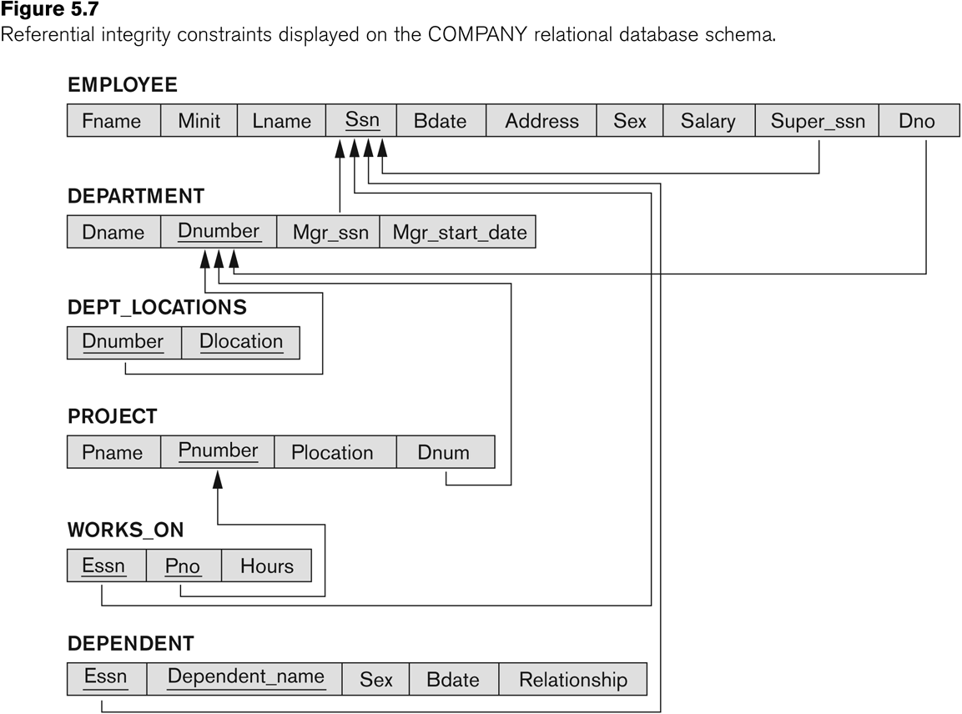
Notation
You can also just draw out the ‘Tables’:

Slide 11
Which Notation to Use?
Table Notation can feel easier to write (most people think of relations as tables anyway) but can get messy for larger databases
It is ultimately your choice
For ‘Table’ notation, make sure your arrows are clear and try to avoid crossing lines

Slide 12
7 Steps of Mapping
Entity Mapping
Weak Entity Mapping
Multi-Valued Attribute Mapping
1: 1 Binary Relationship Mapping
1: N Binary Relationship Mapping
N: M Binary Relationship Mapping
N-ary Relationship Mapping

Slide 13
7 Steps of Mapping
Entity Mapping
Weak Entity Mapping
Multi-Valued Attribute Mapping
1: 1 Binary Relationship Mapping
1: N Binary Relationship Mapping
N: M Binary Relationship Mapping
N-ary Relationship Mapping

Slide 14
Entity Mapping
For each (Strong) Entity Type E, we create a relation will all of its attributes
  Include only the simple (outer) components of its composite attributes
  Don’t include derived attributes
  Also ignore multi-valued attributes (for now)
  Underline the Primary Key in your relation as well
GivenName
FamilyName
Name
DateOfBirth
StaffID
Phone#
Staff
Age
Staff(StaffID, GivenName, FamilyName, DateOfBirth)

Slide 15
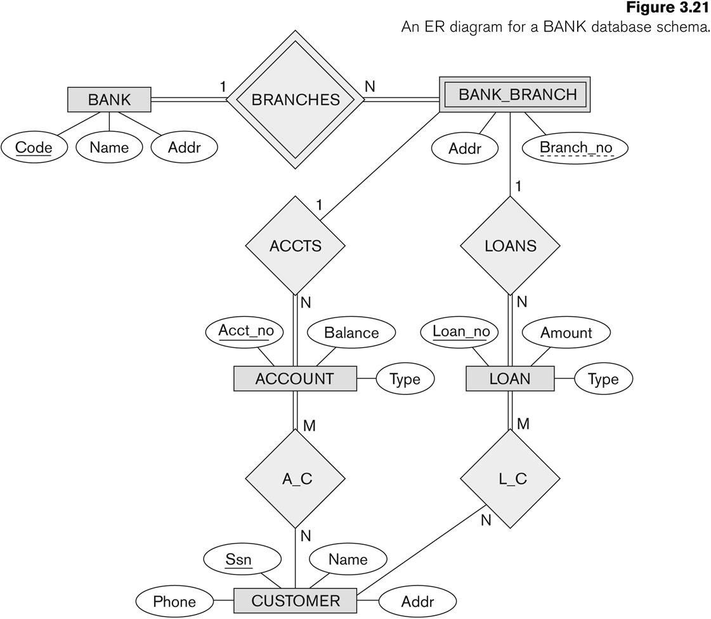

Slide 16
Bank(Code, Name, Addr)
Account(Acct_no, Balance, Type)
Loan(Loan_no, Amount, Type)
Customer(Ssn, Name, Phone, Addr)

Slide 17
7 Steps of Mapping
Entity Mapping
Weak Entity Mapping
Multi-Valued Attribute Mapping
1: 1 Binary Relationship Mapping
1: N Binary Relationship Mapping
N: M Binary Relationship Mapping
N-ary Relationship Mapping

Slide 18
Weak Entity Mapping
Weak Entities largely follow the same rule as normal Entities
  Except the Primary Key of a Weak Entity is the combination of its Partial Key and the Primary Key of the Entity on the other side of the Identifying Relationship
Number
Name
1
Supports
N
Staff
Dependent
Relationship
Staff(StaffID, GivenName, FamilyName, DateOfBirth)
Dependent(StaffID, Number, Name, Relationship)
Dependent(StaffID) refers to information from Staff(StaffID), what does this mean?

Slide 19
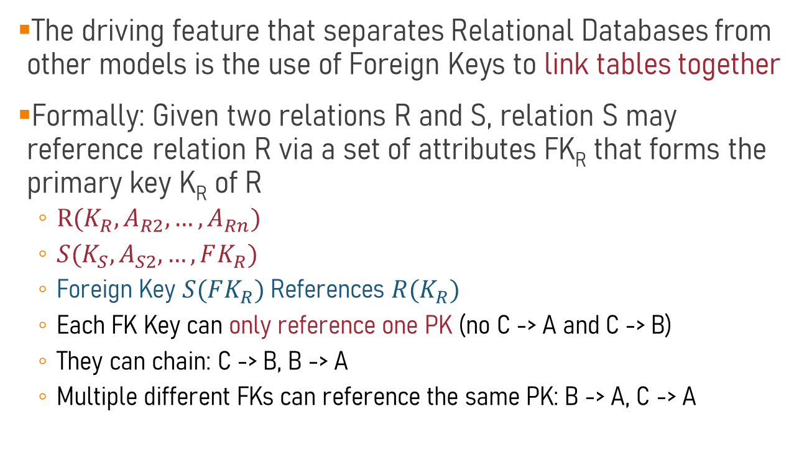
Foreign Keys
The driving feature that separates Relational Databases from other models is the use of Foreign Keys to link tables together
Formally: Given two relations R and S, relation S may reference relation R via a set of attributes FK_{R} that forms the primary key K_{R} of R
  $R(K_{R}, A_{R2}, …, A_{Rn})$
  $S(K_{S}, A_{S2}, …, FK_{R})$
  Foreign Key $S(FK_{R})$ References $R(K_{R})$
  Each FK Key can only reference one PK (no C -> A and C -> B)
  They can chain: C -> B, B -> A
  Multiple different FKs can reference the same PK: B -> A, C -> A

Slide 20
Foreign Keys
Think of it like this
  Employee(emp#, name, address, hkid, worksOnProject)
  Project(proj#, name, budget)
  Employee(worksOnProject) References Project(proj#)
Employee
emp# | name | address | hkid | worksOnProject
1 | Holmes D. | 86 Queen | A450361 | 3
5 | Chan B. | 21 Minto | C461378 | 2
35 | Hui J. | 16 Peak | F562916 | 1
8 | Bell G. | 53 Water | A417394 | 2
15 | Wing R. | 58 Aster | C538294 | 3
Project
proj# | name | budget
1 | E-commerce | 200,000
2 | Stock control | 100,000
3 | Web store | 500,000
If we want to find more information about the project an employee works on, we should go to the Project table, find that proj# and find the details

Slide 21
Foreign Keys
There are two types of Foreign Key notation:
Writing out the foreign keys specifically:
  Employee(emp#, name, address, hkid, worksOnProject)
  Project(proj#, name, budget)
  Employee(worksOnProject) references Project(proj#)
Using arrows:
  Employee(emp#, name, address, hkid, worksOnProject)
  Project(proj#, name, budget)
Both are fine but arrows can get messy when there are many foreign keys

Slide 22
Weak Entity Mapping
Formal steps for Weak Entity Mapping
  Create a new relation for the Weak Entity W
  Set the Primary Key of W to be the Partial Key and the Primary Key of the Strong Entity S connected to W
  Add a Foreign Key the attributes of W that are the Primary Key of S
a1
a2
b1
b2
1
N
S
W
S[a1, a2]
W[a1, b1, b2]
W(a1) References S(a1)

Slide 23
Bank(Code, Name, Addr)
Account(Acct_no, Balance, Type)
Loan(Loan_no, Amount, Type)
Customer(Ssn, Name, Phone, Addr)

Slide 24
Bank(Code, Name, Addr)
Account(Acct_no, Balance, Type)
Loan(Loan_no, Amount, Type)
Customer(Ssn, Name, Phone, Addr)
Bank_Branch(Code, Branch_no, Addr)
Foreign Keys
Bank_Branch(Code) -> Bank(Code)

Slide 25
7 Steps of Mapping
Entity Mapping
Weak Entity Mapping
Multi-Valued Attribute Mapping
1: 1 Binary Relationship Mapping
1: N Binary Relationship Mapping
N: M Binary Relationship Mapping
N-ary Relationship Mapping

Slide 26
Multi-Valued Attribute Mapping
For each Multi-Valued Attribute m, we create a new relation R in which the Primary Key is the m combined with the Primary Key of the Entity E
  Add a Foreign Key for the new relation
Why do we need to create a new relation?
a3
a4
E[a1, a3, a4]
a1
a2
m
R[a1, m]
Why is all the attributes in R the Primary Key?
E

Slide 27
Multi-Valued Attribute Mapping
GivenName
FamilyName
Name
DateOfBirth
StaffID
Staff
Age
Phone#
Staff(StaffID, GivenName, FamilyName, DateOfBirth)
StaffPhone(StaffID, Phone#)
StaffPhone(StaffID) References Staff(StaffID)

Slide 28
7 Steps of Mapping
Entity Mapping
Weak Entity Mapping
Multi-Valued Attribute Mapping
1: 1 Binary Relationship Mapping
1: N Binary Relationship Mapping
N: M Binary Relationship Mapping
N-ary Relationship Mapping

Slide 29
1: 1 Relationship Mapping
For each Binary 1: 1 Relationship, connecting Entities A and B
  Choose one relation (let’s say B) and include a Foreign Key which is the Primary Key of A
    If one side has total participation it is better to put the Foreign Key on that side
  For any attributes on this relation, also add it to the same side where the Foreign Key was added
a1
a2
c1
b1
b2
1
R
1
B
A
A[a1, a2]
B[b1, b2, a1, c1]
B(a1) References A(a1)

Slide 30
1: 1 Relationship Mapping
FamilyName
GivenName
Code
DateOfBirth
Name
1
Name
1
Heads
Staff
Department
StaffID
Building
StartDate
Staff(StaffID, GivenName, FamilyName, DateOfBirth)
Department(Code, Name, Building, DepartmentHead, StartDate)
Department(DepartmentHead) References Staff(StaffID)
You can change the name of Foreign Key attributes to make things more clear

Slide 31
7 Steps of Mapping
Entity Mapping
Weak Entity Mapping
Multi-Valued Attribute Mapping
1: 1 Binary Relationship Mapping
1: N Binary Relationship Mapping
N: M Binary Relationship Mapping
N-ary Relationship Mapping

Slide 32
1: N Mapping
Same rules as 1: 1 Mapping, only the Foreign Key always goes on the N side (even if it is only Partial Participation)
  Remember to declare the Foreign Key as well as move any relationship attributes to the N side
  No need to redo Identifying Relationships, their FKs are already added
a1
a2
c1
b1
b2
1
R
N
B
A
A(a1, a2)
B(b1, b2, a1, c1)
B(a1) References A(a1)

Slide 33
Bank(Code, Name, Addr)
Account(Acct_no, Balance, Type)
Loan(Loan_no, Amount, Type)
Customer(Ssn, Name, Phone, Addr)
Bank_Branch(Code, Branch_no, Addr)
Foreign Keys
Bank_Branch(Code) -> Bank(Code)

Slide 34
Bank(Code, Name, Addr)
Account(Acct_no, Balance, Type, Code, Branch#)
Loan(Loan_no, Amount, Type, Code, Branch#)
Customer(Ssn, Name, Phone, Addr)
Bank_Branch(Code, Branch_no, Addr)
Foreign Keys
Bank_Branch(Code) -> Bank(Code)
Account(Code, Branch#) ->
BankBranch(Code, Branch_no)
Loan(Code, Branch#) ->
BankBranch(Code, Branch_no)
Notice how we do not use:
Account (Code) -> BankBranch (Code)
Account(Branch#) -> BankBranch(Branch_no)

Slide 35
What is the correct mapping for:
StaffID
Heads
Code
1
1
Staff
Department
N
1
WorkIn
Staff(StaffID)
Department(Code, DepartmentHead, Staff)
Department(DepartmentHead) References Staff(StaffID)
Department(Staff) References Staff(StaffID)
A
Staff(StaffID, Department)
Department(Code, DepartmentHead)
Department(DepartmentHead) References Staff(StaffID)
Staff(Department) References Department(Code)
B
Staff(StaffID, Department)
Department1(Code, DepartmentHead)
Department2(Code)
Department1(DepartmentHead) References Staff(StaffID)
Staff(Department) References Department2(Code)
C

Slide 36
What is the correct mapping for:
StaffID
Supervisor
1
Staff
Supervises
Name
Supervisee
StartDate
N
Staff(StaffID, Name, SupervisorID, StartDate)
Staff(SupervisorID) References Staff(StaffID)
A
Supervisor(StaffID, Name)
Supervisee(StaffID, Name, SupervisorID, StartDate)
Supervisee(SupervisorID) References Supervisor(StaffID)
B
Staff(StaffID, Name)
Supervisor(StaffID, Name)
Supervisee(StaffID, Name, SupervisorID, StartDate)
Supervisor(StaffID) References Staff(StaffID)
Supervisee(StaffID) References Staff(StaffID)
Supervisee(SupervisorID) References Supervisor(StaffID)
C

Slide 37
7 Steps of Mapping
Entity Mapping
Weak Entity Mapping
Multi-Valued Attribute Mapping
1: 1 Binary Relationship Mapping
1: N Binary Relationship Mapping
N: M Binary Relationship Mapping
N-ary Relationship Mapping

Slide 38
N: M Mapping
N: M requires the creation of a new Relation
For each N: M Relationship R, connecting entities A and B:
  Create a new Relation R with the Primary Key combining the Primary Keys of A and B
  There are two Foreign Keys, one that refers to A’s Primary Key and the other refers to B’s Primary Key
  Include all relationship attributes in R
a1
a2
c1
b1
b2
N
R
M
A
B
A(a1, a2)
R(a1, b1, c1)
B(b1, b2)

Slide 39
Bank(Code, Name, Addr)
Account(Acct_no, Balance, Type, Code, Branch#)
Loan(Loan_no, Amount, Type, Code, Branch#)
Customer(Ssn, Name, Phone, Addr)
Bank_Branch(Code, Branch_no, Addr)
Foreign Keys
Bank_Branch(Code) -> Bank(Code)
Account(Code, Branch#) ->
BankBranch(Code, Branch_no)
Loan(Code, Branch#) ->
BankBranch(Code, Branch_no)

Slide 40
Bank(Code, Name, Addr)
Account(Acct_no, Balance, Type, Code, Branch#)
Loan(Loan_no, Amount, Type, Code, Branch#)
Customer(Ssn, Name, Phone, Addr)
Bank_Branch(Code, Branch_no, Addr)
CusAcc (SSN, Acct#)
CusLoa (SSN, Loan#)
Foreign Keys
Bank_Branch(Code) -> Bank(Code)
Account(Code, Branch#) ->
BankBranch(Code, Branch_no)
Loan(Code, Branch#) ->
BankBranch(Code, Branch_no)
CusAcc(SSN) -> Customer(SSN)
CusAcc(Acct#) -> Account(Acct_no)
CusLoa(SSN) -> Customer(SSN)
CusLoa(Loan#) -> Loan(Loan_no)

Slide 41
A Note on N: M Mapping
You can technically map 1: 1 and 1: N relationships by building a new relation
Staff(StaffID, GivenName, FamilyName, DateOfBirth)
Department(Code, Name, Building, DepartmentHead, StartDate)
Department(DepartmentHead) References Staff(StaffID)
VS
Staff(StaffID, GivenName, FamilyName, DateOfBirth)
Department(Code, Name, Building)
DepartmentHead(StaffID, Code, StartDate)
DepartmentHead(StaffID) References Staff(StaffID)
DepartmentHead(Code) References Department(Code)
This has upsides and downsides, mainly depending on the number of Nulls you are expecting

Slide 42
7 Steps of Mapping
Entity Mapping
Weak Entity Mapping
Multi-Valued Attribute Mapping
1: 1 Binary Relationship Mapping
1: N Binary Relationship Mapping
N: M Binary Relationship Mapping
N-ary Relationship Mapping

Slide 43
N-ary Relationship Mapping
Like N: M Mapping, for each N-ary Relationship we create a new Relation
Ternary Example connecting Entities A, B and C:
  Create a new Relation R with the Primary Key combining the Primary Keys of A, B and C
  There are three Foreign Keys, one referring to each connecting entity
  Include all relationship attributes in R
A(a1, a2) B(b1, b2) C(c1)
ABC(a1, b1, c1, d1)
ABC(a1) -> A(a1)
ABC(b1) -> B(b1)
ABC(c1) -> C(c1)
a1
a2
d1
b1
b2
N
R
M
A
B
P
c1
C

Slide 44
A Harder Example
Referee
RefID
TeamName
P
Match
Home
N
Q
Tournament
Code
Football
Team
Away
M
Score
How do you map this?

Slide 45
A Harder Example
Referee
RefID
TeamName
P
Match
Home
N
Q
Tournament
Code
Football
Team
Away
M
Score
Referee(RefID), Tournament(Code)
FootballTeam(TeamName)
Match(HomeTeam, AwayTeam, RefID, TournamentCode, Score)
Match(HomeTeam) -> FootballTeam(TeamName), Match(AwayTeam) -> FootballTeam(TeamName)
Match(RefID) -> Referee(RefID), Match(TournamentCode) -> Tournament(Code)

Slide 46
Objectives
Understand the Relational Data Model and its notation
Explain what Primary and Foreign Keys are
Create a Relational representation of any ER-Diagram by following the 7 steps of mapping

