Slide 1
Relational Algebra
COMP2411

Slide 2
What is Relational Algebra
Relational Algebra is a formal method of manipulating relations in a database via a set of operations. It is usually used to specify queries (i.e. DML).
  It is the building blocks of SQL
Relational Algebra allows us to break down a complex query into individual operations on the relations

Slide 3
Relational Algebra
Basic operations:
  Projection (π ): deletes unwanted columns from relation
  Selection (σ ): selects a subset of rows from relation
  Set-difference (−): finds tuples in table 1, but not in table 2
  Union (∪): finds tuples that belong to table 1 or table 2
  Cross-product (×): allows us to combine two relations
  Rename (ρ): allows us to rename a relation and/or its attributes
Additional operations:
  Intersection (∩), join (⋈), division (/): Not essential, but (very!) useful

Slide 4


Projection $π_{L}(R)$
The Projection function takes a relation R and deletes all attributes not in the project list L
  Essentially it keeps only the columns from R in L
Projection also eliminates duplicate tuples in the new relation
Plane
Maker
Model_No
Airbus
A310
Airbus
A320
$$π_{Maker}(Plane)$$
Maker
Airbus
MD
Airbus
A330
Airbus
A340
MD
DC10
MD
DC9

Slide 5
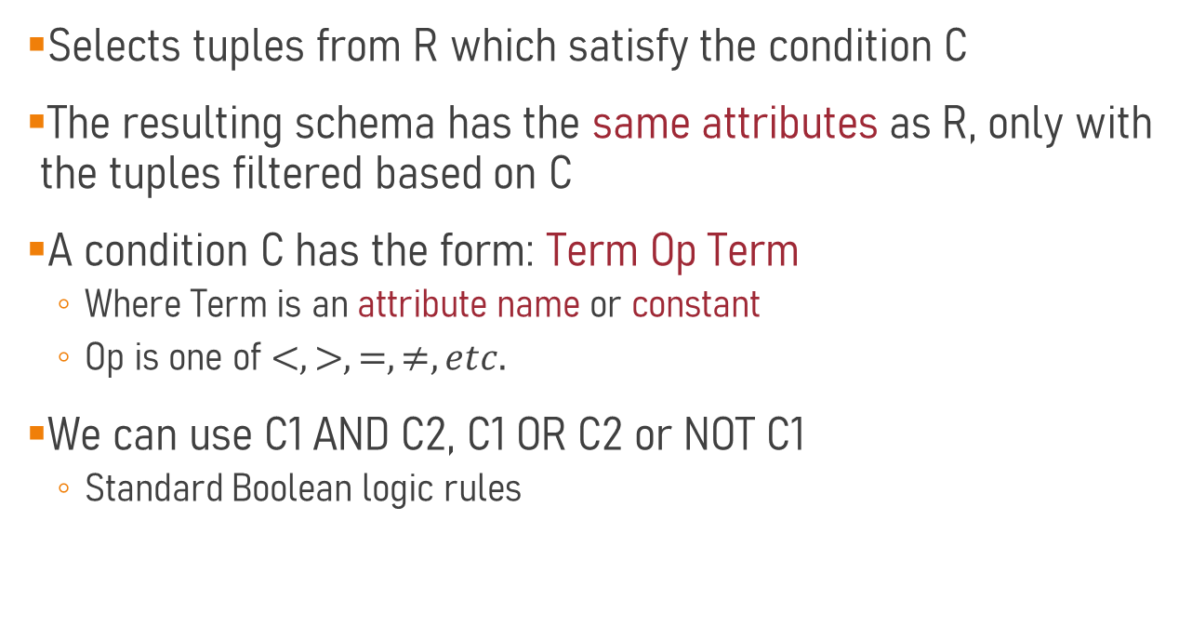

Selection $σ_{C}(R)$
Selects tuples from R which satisfy the condition C
The resulting schema has the same attributes as R, only with the tuples filtered based on C
A condition C has the form: Term Op Term
  Where Term is an attribute name or constant
  Op is one of $<, >, =, ≠, etc.$
We can use C1 AND C2, C1 OR C2 or NOT C1
  Standard Boolean logic rules

Slide 6

Selection Example
Plane
Maker
Model_No
$$σ_{Maker="MD"}(Plane)$$
Maker | Model_No
MD | DC10
MD | DC9
Airbus
A310
Airbus
A320
Airbus
A330
Airbus
A340
MD
DC10
MD
DC9

Slide 7
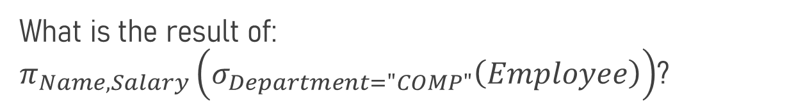
Projection and Selection
Employee
Emp# | Name | Department | Salary | Age
1 | Alice | COMP | 800,000 | 45
2 | Bob | DSAI | 900,000 | 67
3 | Charlie | COMP | 500,000 | 30
4 | Diana | COMP | 950,000 | 64
5 | Eli | BIO | 500,000 | 26
What is the result of: $π_{Name,Salary}\left(σ_{Department="COMP"}\left(Employee\right)\right)$?

Slide 8
Employee
Emp# | Name | Department | Salary | Age
1 | Alice | COMP | 800,000 | 45
2 | Bob | DSAI | 900,000 | 67
3 | Charlie | COMP | 500,000 | 30
4 | Diana | COMP | 950,000 | 64
5 | Eli | BIO | 500,000 | 26
$$π_{Name,Salary}\left(σ_{Department="COMP"}\left(Employee\right)\right)$$
Name | Salary
Alice | 800,000
Charlie | 500,000
Diana | 950,000
What is the SQL for this?

Slide 9
Employee
Emp# | Name | Department | Salary | Age
1 | Alice | COMP | 800,000 | 45
2 | Bob | DSAI | 900,000 | 67
3 | Charlie | COMP | 500,000 | 30
4 | Diana | COMP | 950,000 | 64
5 | Eli | BIO | 500,000 | 26
$$π_{Name,Salary}\left(σ_{Department="COMP"}\left(Employee\right)\right)$$
Name | Salary
Alice | 800,000
Charlie | 500,000
Diana | 950,000
SELECT Name, Salary
FROM Employee
WHERE Department = “COMP”;

Slide 10
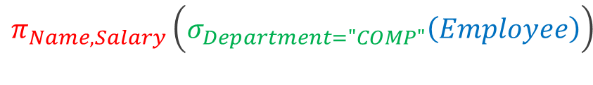
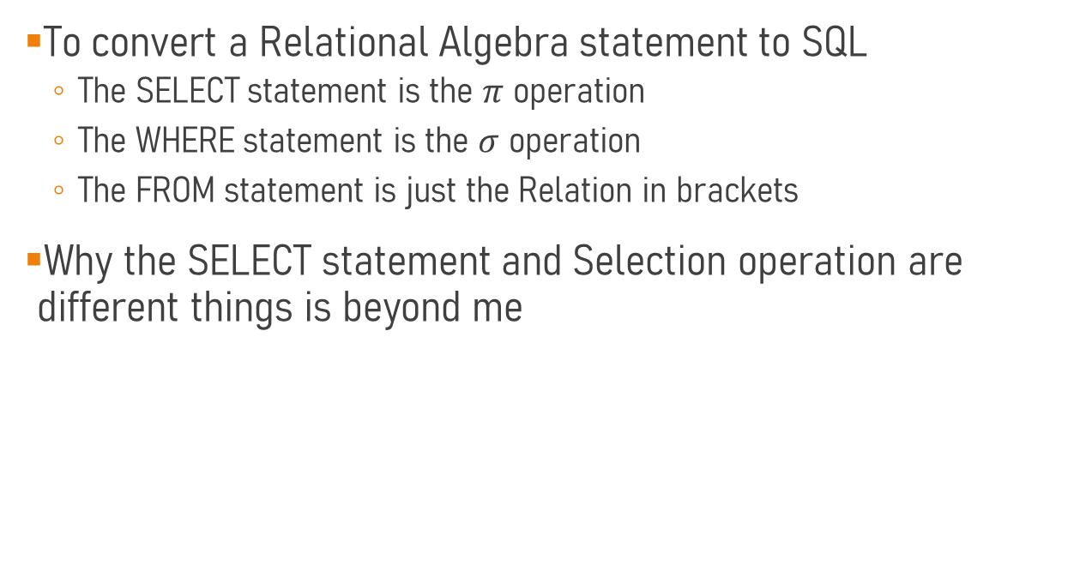
Relational Algebra to SQL
To convert a Relational Algebra statement to SQL
  The SELECT statement is the $π$ operation
  The WHERE statement is the $σ$ operation
  The FROM statement is just the Relation in brackets
Why the SELECT statement and Selection operation are different things is beyond me
$$π_{Name,Salary}\left(σ_{Department="COMP"}\left(Employee\right)\right)$$
SELECT Name, Salary
FROM Employee
WHERE Department = “COMP”;

Slide 11
Employee
Emp# | Name | Department | Salary | Age
1 | Alice | COMP | 800,000 | 45
2 | Bob | DSAI | 900,000 | 67
3 | Charlie | COMP | 500,000 | 30
4 | Diana | COMP | 950,000 | 64
5 | Eli | BIO | 500,000 | 26
$$π_{Name,Salary}\left(σ_{Department≠"COMP"}\left(Employee\right)\right)$$
$$π_{Name,Department}\left(σ_{Salary>600000 AND Salary≤900000}\left(Employee\right)\right)$$
$$σ_{Department≠"COMP"}\left(π_{Name,Salary,Department}\left(Employee\right)\right)$$

Slide 12
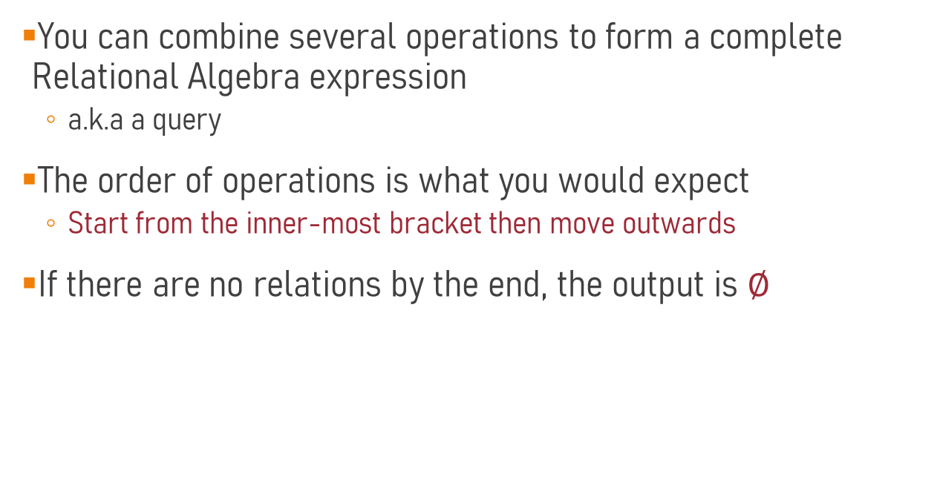
Projection and Selection
You can combine several operations to form a complete Relational Algebra expression
  a.k.a a query
The order of operations is what you would expect
  Start from the inner-most bracket then move outwards
If there are no relations by the end, the output is $∅$

Slide 13



Rename $ρ_{x}(R)$
Rename allows us to change the name of the relation and its attributes to the form $x$.
  $x$ is of the form <table_name>(<attribute_name1>, <attribute_name2>,…)
Plane
Maker
Model_No
Airbus
A310
Airbus
A320
$${ρ_{Org\left(Name\right)}(π}_{Maker}(Plane))$$
Name
Airbus
MD
Org
Airbus
A330
Airbus
A340
MD
DC10
MD
DC9

Slide 14

Rename $ρ_{x}(R)$
You can also choose to be more selective about which attributes you rename
$ρ_{R^{′}\left(N_{1}→N_{1}^{′}, N_{3}→N_{3}^{′}\right)}(R)$
Plane
Maker
Model_No
$${ρ_{Plane\left(Maker→Brand\right)}(σ}_{Maker="MD"}(Plane))$$
Airbus
A310
Airbus
A320
Airbus
A330
Brand | Model_No
MD | DC10
MD | DC9
Plane
Airbus
A340
MD
DC10
MD
DC9

Slide 15
Set Operations
Main Set Operations
  Union
  Intersection
  Set Difference
These operations take two input relations which are union-compatible:
  Same number of fields
  Fields have corresponding types
Outputs a single relation with no duplicates

Slide 16

Set Union
Combines two relations together, removing duplicates
HKPlanes $∪$SZPlanes
HKPlanes
SZPlanes
Maker
Model_No
Airbus
A310
Maker
Model_No
Maker
Model_No
Airbus
A320
Airbus
A310
Boeing
B727
Airbus
A330
Airbus
A320
Boeing
B747
Airbus
A340
Airbus
A330

=
Boeing
B757
Boeing
B727
Airbus
A340
MD
DC10
Boeing
B747
MD
DC10
Boeing
B757
MD
DC9
MD
DC9
MD
DC10
MD
DC9

Slide 17

Set Intersection
Finds the common elements of the two relations
HKPlanes
SZPlanes
Maker
Model_No
Maker
Model_No
HKPlanes $∩$SZPlanes
Airbus
A310
Boeing
B727
Maker
Model_No
Airbus
A320

Boeing
B747
=
MD
DC9
Airbus
A330
Boeing
B757
Airbus
A340
MD
DC10
MD
DC10
MD
DC10
MD
DC9
MD
DC9

Slide 18

Set Difference
R1 – R2
  Results in records that appear in R1 but not R2
HKPlanes
SZPlanes
HKPlanes $−$SZPlanes
Maker
Model_No
Maker
Model_No
Airbus
A310
Maker
Model_No
Boeing
B727
Airbus
A310
Airbus
A320
Boeing
B747
Airbus
A330
—
=
Airbus
A320
Boeing
B757
Airbus
A330
Airbus
A340
MD
DC10
MD
DC10
Airbus
A340
MD
DC9
MD
DC9

Slide 19
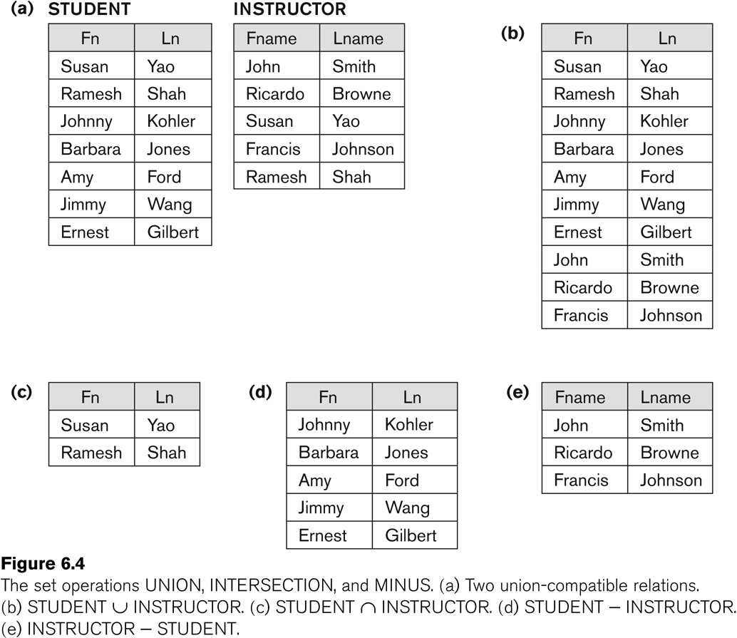

Let’s Try
Answer the following:
  Student $∪$ Instructor
  Student $∩$ Instructor
  Student $−$ Instructor
  Instructor $−$ Student

Slide 21
Set Operators in SQL
We can actually use all of these in SQL
SELECT Fn, Ln
FROM Student
UNION
SELECT Fname, Lname
FROM Instructor;
SELECT Fn, Ln
FROM Student
INTERSECT
SELECT Fname, Lname
FROM Instructor;
SELECT Fn, Ln
FROM Student
MINUS
SELECT Fname, Lname
FROM Instructor;
SELECT Fname, Lname
FROM Instructor
MINUS
SELECT Fn, Ln
FROM Student;

Slide 22
Cartesian Product
CanFly X Plane
Emp_No | Model_No | Maker | Model#
1001 | B727 | Airbus | A310
1001 | B727 | Airbus | A320
1001 | B727 | Airbus | A330
1001 | B727 | Airbus | A340
1001 | B727 | Boeing | B727
1001 | B727 | Boeing | B747
1001 | B727 | Boeing | B757
1001 | B727 | MD | DC10
1001 | B727 | MD | DC9
1001 | B747 | Airbus | A310
1001 | B747 | Airbus | A320
1001 | B747 | Airbus | A330
1001 | B747 | Airbus | A340
1001 | B747 | Boeing | B727
1001 | B747 | Boeing | B747
1001 | B747 | Boeing | B757
1001 | B747 | MD | DC10
1001 | B747 | MD | DC9
1001 | B727 | Airbus | A310
1001 | B727 | Airbus | A320
… | … | … | …
Combines each row of one table with every row of the other table
CanFly
Plane
Emp_No
Model_No
Maker
Model#
1001
B727
Airbus
A310
1001
B747
Airbus
A320
=
1001
DC10
Airbus
A330
1002
A320

Airbus
A340
1002
A340
Boeing
B727
1002
B757
Boeing
B747
1002
DC9
Boeing
B757
1003
A310
MD
DC10
1003
DC9
MD
DC9

Slide 23
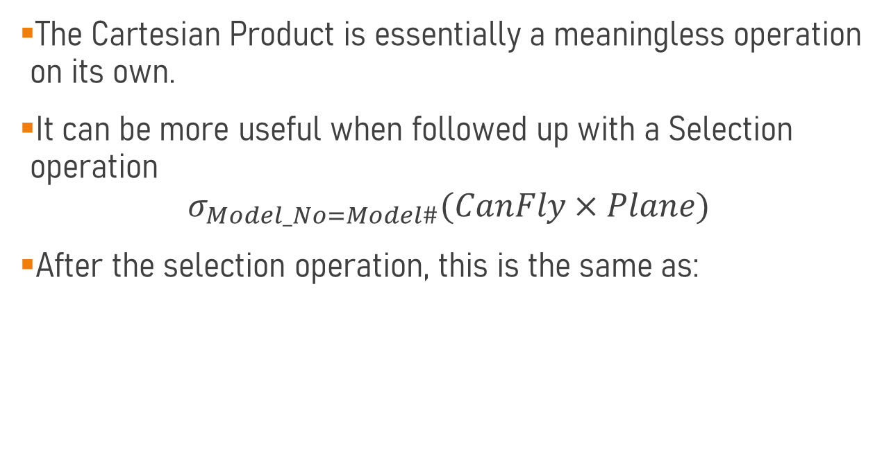
Cartesian Product
The Cartesian Product is essentially a meaningless operation on its own.
It can be more useful when followed up with a Selection operation
$$σ_{Model_No=Model\#}(CanFly×Plane)$$
After the selection operation, this is the same as:
SELECT *
FROM CanFly, Plane
WHERE Model_No = Model#;

Slide 24
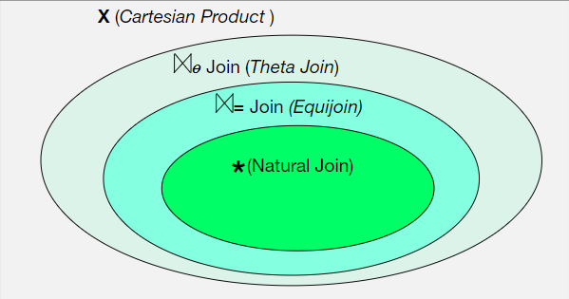
Joins

Slide 25


$θ$-Join
$R1⋈_{θ}R2$
$θ$ can be any join condition (including $<, >, ≤,≥,≠, =$)
Num
Origin
Dest
Dep_Time
Arr_Time
Num
Origin
Dest
Dep_Time
Arr_Time
334
ORD
MIA
12:00
14:14
334
ORD
MIA
12:00
14:14
335
MIA
ORD
15:00
17:14
335
MIA
ORD
15:00
17:14
336
ORD
MIA
18:00
20:14
336
ORD
MIA
18:00
20:14
337
MIA
ORD
20:30
23:53
337
MIA
ORD
20:30
23:53
394
DFW
MIA
19:00
21:30
394
DFW
MIA
19:00
21:30
395
MIA
DFW
21:00
23:43
395
MIA
DFW
21:00
23:43
$$R1⋈_{\left(R1.Dest=R2.Origin\right)AND\left(R1.Arr_Time<R2.Dep_ Time\right)}R2$$

Slide 26

$θ$-Join
$R1⋈_{θ}R2$
$$R1⋈_{\left(R1.Dest=R2.Origin\right)AND\left(R1.Arr_Time<R2.Dep_ Time\right)}R2$$
Flight1.Num
Flight1.Origin
Flight1.Dest
Flight1.Dep_Time
Flight1.Arr_Time
Flight2_1.Num
Flight2.Origin
Flight2.Dest
Flight2.Dep_Time
Flight2.Arr_Time
334
ORD
MIA
12:00
14:14
335
MIA
ORD
15:00
17:14
335
MIA
ORD
15:00
17:14
336
ORD
MIA
18:00
20:14
336
ORD
MIA
18:00
20:14
337
MIA
ORD
20:30
23:53
334
ORD
MIA
12:00
14:14
337
MIA
ORD
20:30
23:53
336
ORD
MIA
18:00
20:14
395
MIA
DFW
21:00
23:43
334
ORD
MIA
12:00
14:14
395
MIA
DFW
21:00
23:43
The order of the tuples is a little weird but order doesn’t matter for relational DBs

Slide 27


Equijoin
$R1⋈_{=}R2$
An Equijoin can only have equalities in its join condition
CanFly
Plane
Emp_No
Model_No
Maker
Model#
1001
B727
Airbus
A310
1001
B747
Airbus
A320
1001
DC10
Airbus
A330
1002
A320
Airbus
A340
1002
A340
Boeing
B727
1002
B757
Boeing
B747
1002
DC9
Boeing
B757
1003
A310
MD
DC10
1003
DC9
MD
DC9
$$CanFly⋈_{Model_No=Model\#}Plane$$

Slide 28


Equijoin
$R1⋈_{=}R2$
$$CanFly⋈_{Model_No=Model\#}Plane$$
Emp_No
Model_No
Maker
Model#
1001
B727
Boeing
B727
1001
B747
Boeing
B747
1001
DC10
MD
DC10
1002
A320
Airbus
A320
1002
A340
Airbus
A340
1002
B757
Boeing
B757
1002
DC9
Boeing
DC9
1003
A310
Airbus
A310
1003
DC9
MD
DC9
There are duplicate columns we can get rid off with a Projection Statement

Slide 29


Natural Join
$R1∗R2$
Joins equal values on attributes with the same name
  The duplicate column is automatically deleted
CanFly
Plane
Emp_No
Model#
Maker
Model#
1001
B727
Airbus
A310
1001
B747
Airbus
A320
1001
DC10
Airbus
A330
1002
A320
Airbus
A340
$$CanFly∗Plane$$
1002
A340
Boeing
B727
1002
B757
Boeing
B747
1002
DC9
Boeing
B757
1003
A310
MD
DC10
1003
DC9
MD
DC9

Slide 30


Natural Join
$R1∗R2$
$$CanFly∗Plane$$
Emp_No
Model#
Maker
1001
B727
Boeing
1001
B747
Boeing
1001
DC10
MD
1002
A320
Airbus
1002
A340
Airbus
1002
B757
Boeing
1002
DC9
Boeing
1003
A310
Airbus
1003
DC9
MD
Natural Joins require very strict naming sense and understanding of the system

Slide 31
Joins
It is possible to use any higher-level join and Selection/Projection statements to create the lower-level joins

Slide 32
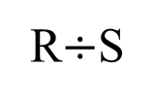


Set Division
$R$ contains attributes $XY$
$S$ contains attributes $Y$
$R÷S$ outputs all attributes $X$, such that for all $Y$ tuples in $S$, there is a $XY$ tuple in $R$
R
x | y
s1 | p1
s1 | p2
s1 | p3
s1 | p4
s2 | p1
s2 | p2
s3 | p2
s4 | p2
s4 | p4
S
R$÷$S
$$÷$$
y
=
x
p2
s1
p4
s4

Slide 33
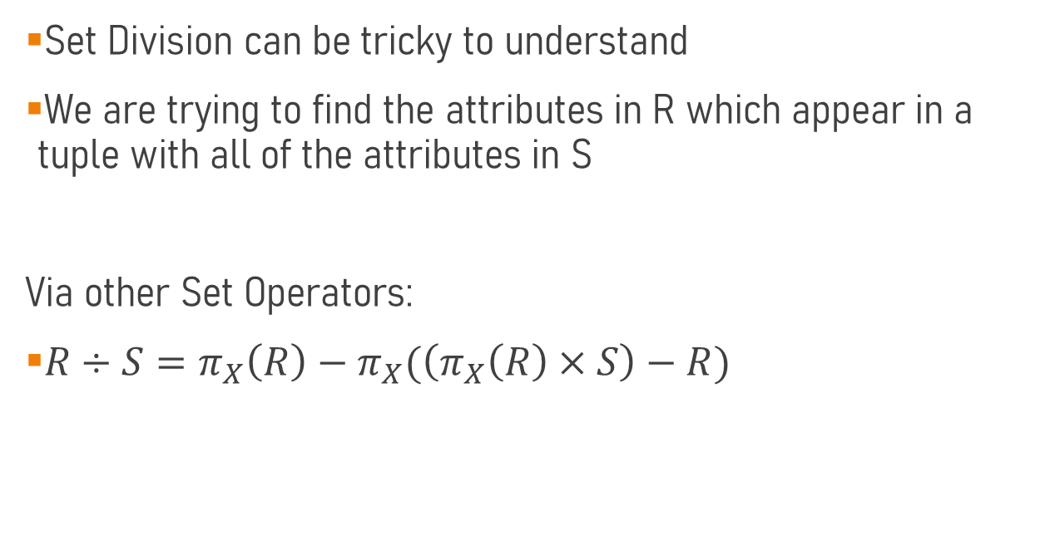
Set Division
Set Division can be tricky to understand
We are trying to find the attributes in R which appear in a tuple with all of the attributes in S
Via other Set Operators:
$R÷S=π_{X}\left(R\right)−π_{X}(\left(π_{X}\left(R\right)×S\right)−R)$

Slide 34


Set Division
It may help to see an example of a query using division
“Which Pilots can fly all planes in MDPlanes?”
CanFly
Emp_No
Model_No
1001
B747
MDPlanes
CanFly$÷$MDPlanes
1001
DC10
1002
A320
$$÷$$
Model_No
=
Emp_No
1003
1002
A340
DC9
1002
B757
DC10
1002
DC9
1003
A310
1003
DC9
1003
DC10

Slide 35
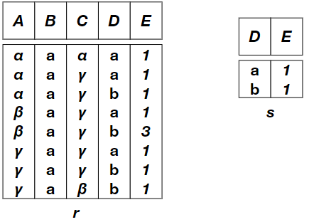

A Harder Question
What is $r÷s$ this time?
We need the attributes of s to appear in the same tuple for it count

Slide 36
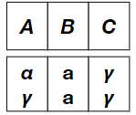

A Harder Question
$$r÷s$$

Slide 37
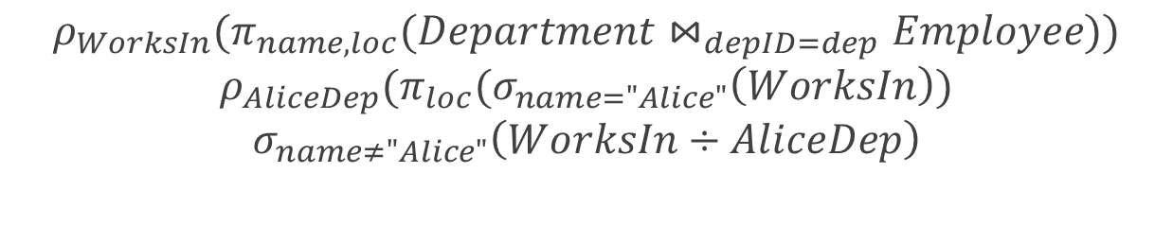

Relational Algebra
You can use multiple lines of Relational Algebra to answer a query if you want
  Benefit is it’s neater
  Rename is useful here to give a name to the table for future reference
$$ρ_{WorksIn}(π_{name, loc}(Department⋈_{depID=dep}Employee))$$
$$ρ_{AliceDep}(π_{loc}(σ_{name="Alice"}\left(WorksIn\right))$$
$$σ_{name≠"Alice"}\left(WorksIn÷AliceDep\right)$$
$$VS$$
$$σ_{name≠"Alice"}\left(π_{name, loc}(Department⋈_{depID=dep}Employee)÷π_{loc}(σ_{name="Alice"}\left(π_{name, loc}(Department⋈_{depID=dep}Employee\right)\right))$$

Slide 38
Objectives
Understand the operations of relational algebra
Create a series of expressions to answer a query in English using Relational Algebra
Transform a Relational Algebra statement into a SQL statement and vice versa

