Slide 1
DBMS and the Entity-Relationship Model
COMP2411

Slide 2
What is Data?
Data is recorded or observable facts such as age, address, height, etc.
Data is everywhere and there is a lot of it
Each piece of data takes up space on a computer, so how do we store it efficiently and effectively?
Student ID Student name Year Course Course Name Grade
50000000 Peter Wong 4 CM2411 Database Systems B+
50000000 Peter Wong 4 CS2302 Data Structures A
50000000 Peter Wong 4 …. …. ..
50000001 Mary Tsui 2 CM2411 Database Systems A-
50000002 Bob Lee 3 CM2411 Database Systems B

Slide 3
Databases and the DBMS
What is a Database (DB)?
  A non-redundant, persistent collection of logically related records/files that are structured to support various processing and retrieval needs
Database Management System (DBMS)
  A set of software programs for creating, storing, updating, and accessing the data of a DB.
Accounting
Sales
DB
Marketing
DBMS

Slide 4
Databases and the DBMS
Difference between DBMS and other programming systems
  the ability to manage persistent data
  Primary goal of DBMS: to provide an environment that is convenient, efficient, and robust to use in retrieving & storing data
Other DBMS capabilities
  data modeling
  high-level languages to define, access and manipulate data
  transaction management & concurrency control
  access control
  recovery

Slide 5
Data Abstraction
Databases can be complex and depending on your role what you need to understand about the system is limited
Data Abstraction is simplifying or hiding details of the data depending on what you need to know
Levels of Abstraction (Lowest to Highest)
  Physical/Internal Level: How data is actually stored on disk/cloud
  Logical/Conceptual Level: The schema, what data is actually stored
  External/View Level: A partial schema, irrelevant information is removed or simplified

Slide 6
Data Abstraction
COMP
Student
Finance Office
External Level
view 1
view 2
view n
..……...
Conceptual Level
Logical
view
PolyU database
Physical
view
Files on disks/cloud
Physical Level

Slide 7
Models, Schemas and Instances
Data Model
  A collection of conceptual tools for describing data, relationships between data, operations and consistency details
  We will be studying the Entity-Relationship (ER) Model
Data Schema
  Each level of Data Abstraction is defined by a schema
  Logical Schema: Defines the logical/conceptual structure of the database
  Physical Schema: Defines the file formats/locations
Data Instance
  The actual contents of the database at a specific period of time
  The instance conforms to the schema

Slide 8
Data Independence
Data Independence is the ability to modify a schema at one level without affecting schemas at higher levels
Physical Data Independence
  The ability to modify the physical schema without altering the conceptual schema and thus, without causing the application programs to be rewritten
Logical Data Independence
  The ability to modify the conceptual schema without causing the application programs to be rewritten

Slide 9
Data Independence
COMP
Student
Finance Office
External Level
view 1
view 2
view n
..……...
Logical Data Independence
Conceptual Level
Logical
view
PolyU database
Physical Data Independence
Physical
view
Files on disks/cloud
Physical Level

Slide 10
The Language of Databases
Data Definition Language (DDL)
  A language for defining the DB Schema
  DDL statements compile to a data dictionary which if a file containing metadata, e.g. descriptions about the tables
Data Manipulation Language (DML)
  A language that enables users to manipulate data
  An important subset for retrieving data is called a Query Language
  Two types of DML:
    Procedural: User specifies what data is required and how to get it
    Declarative: User only species what data is required and not where it is

Slide 11
Who Uses Databases?
Database/End Users:
  Naïve Users
    Interact with the database via application programs
    Interact with the database via a Graphical User Interface (GUI)
  Application Programmers
    Develop applications that interact with the DBMS via DML
  Sophisticated/Interactive Users
    Issues queries either directly via a Query Language (such as SQL) or via tools such as analysis software

Slide 12
Who Uses Databases?
Database Administrator (DBA)
  The DBA are the people who holds central control over the DB and coordinates its activities
  Functions of the DBA
    Define and Maintain the schemas
    Define and Maintain the physical storage organization
    Monitors and Optimizes DB performance
    Monitors and Grants authorization for data access
    Maintains the integrity of the DB

Slide 13
Naïve user
Application Programmer
Sophisticated user
DBA
Application
interfaces
Application
programs
(SQL) query
DB schema
DML compiler
Query processor
DDL compiler
Application programs object code
Database manager
DBMS
File manager
Data files
disk storage
DB
Data dict.

Slide 14
System Architecture
File Manager
  Allocates space on disk/cloud and controls operations on files
Database Manager
  Interfaces between stored data and applications programs/queries
  Translates conceptual commands to physical commands
  Responsible for:
    Access Control
    Concurrency Control
    Backup and Recovery
    Integrity

Slide 15
System Architecture
Query Processor
  Translates high-level queries into tangible instructions
  Optimizes queries to improve performance
DML (Pre-)compiler
  Translates DML statements embedded in application programs into procedure calls
DDL (Pre-)compiler
  Converts DDL states to data dictionary items (e.g. table descriptions)

Slide 16
Naïve user
Application Programmer
Sophisticated user
DBA
Application
interfaces
Application
programs
(SQL) query
DB schema
DML compiler
Query processor
DDL compiler
Application programs object code
Database manager
DBMS
File manager
Data files
disk storage
DB
Data dict.

Slide 17
Course Topics
ER Model: Plan the data in your database and how they related to each other
Relational Model: Turn a conceptual ER diagram into tables/schema
SQL: The language of writing queries
Relational Algebra: A logical way to represent queries
Normalization and Integrity Constraints: Making tables efficient and robust
File Organization: Structure files to speed up queries
Query Optimization: Make queries more efficient
Transaction and Concurrency Controls: Handle concurrent operations and guarantee correctness of the DB

Slide 18
The Entity-Relationship Model
The most widely understood database model, it is a logical schema for record-based databases
Proposed by P. Chen in 1976
ER Diagrams are a critical tool of efficiently conveying the structure of the DB

Slide 19
Entities
An Entity is a real-world ‘thing’ or ‘object’ which is distinguishable from other objects via its attributes
  Examples: John Chan, PolyU, HSBC, etc.
An Entity Set is the set of entities which are of the same type and (largely) share the same types of attributes
  Examples: Student, University, Bank, etc.
Entity Sets (often just shortened to Entities) in an ER Diagram are represented by rectangles
Student

Slide 20
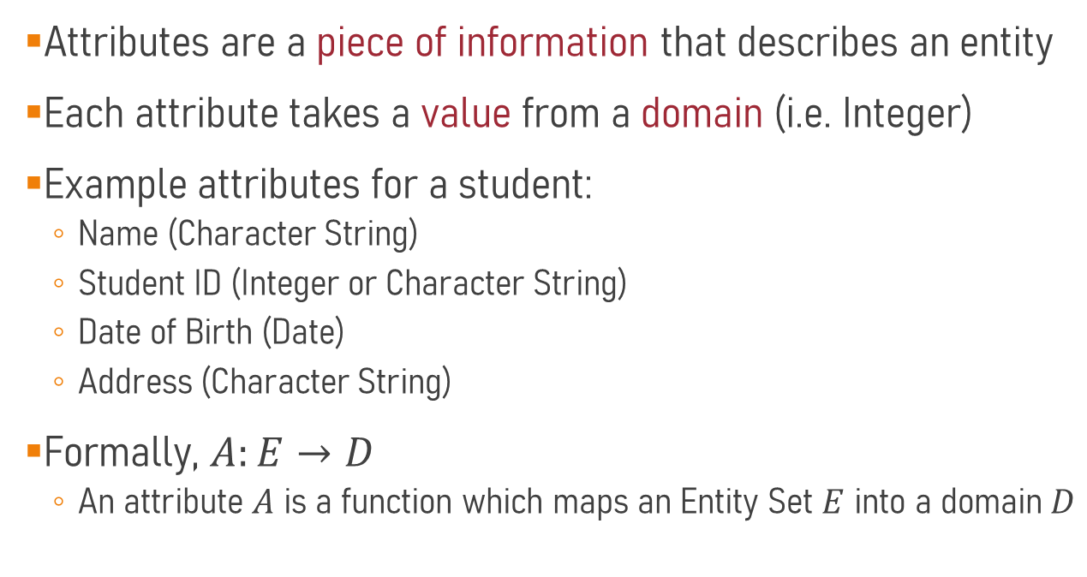
Attributes
Attributes are a piece of information that describes an entity
Each attribute takes a value from a domain (i.e. Integer)
Example attributes for a student:
  Name (Character String)
  Student ID (Integer or Character String)
  Date of Birth (Date)
  Address (Character String)
Formally, $A:E→D$
  An attribute $A$ is a function which maps an Entity Set $E$ into a domain $D$

Slide 21
Attributes
On an ER Diagram, Attributes are represented as ovals connected to entities
  Domain information is often omitted in the ER Diagram
StudentID
Date_of_Birth
Name
Address
Student

Slide 22
Spot the Entities and Attributes
“I would like to create a network for our PolyU cinema. Each movie has has a MovieID, title, and genre. Each screening includes has a ScreeningID, date and time, and room. The customers record their name, email and unique customer number. A movie can have multiple screenings and each customer can attend multiple screenings. Also, customers can give as many movies as they want a rating.
Based on this project brief, what are the entities and their attributes for this potential database?

Slide 23
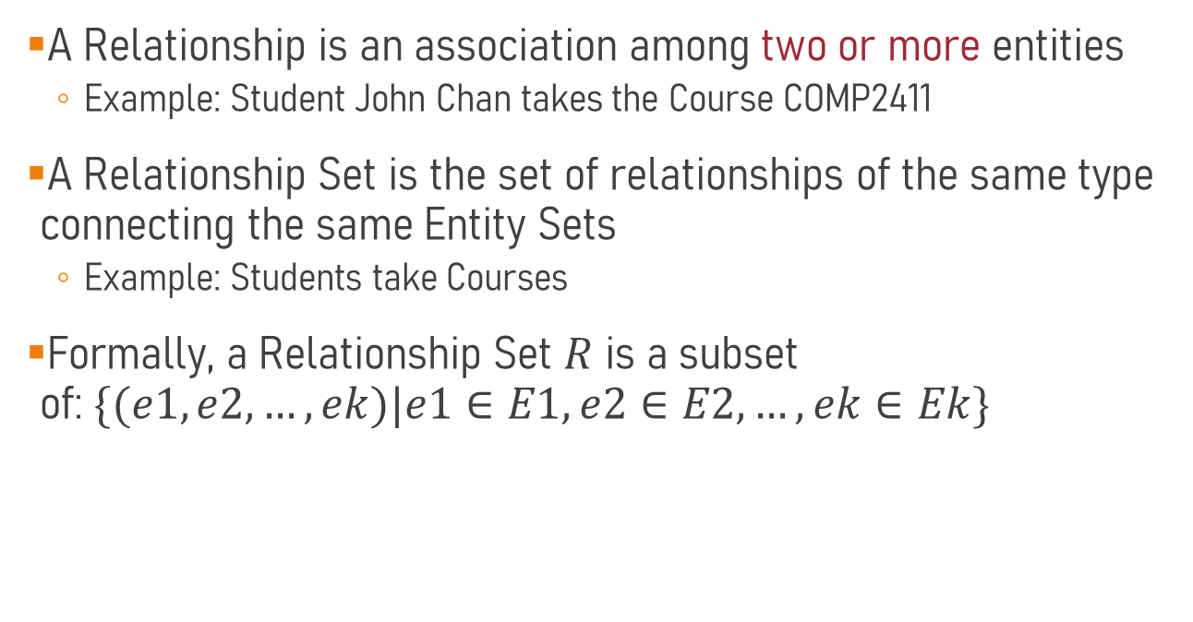
Relationships
A Relationship is an association among two or more entities
  Example: Student John Chan takes the Course COMP2411
A Relationship Set is the set of relationships of the same type connecting the same Entity Sets
  Example: Students take Courses
Formally, a Relationship Set $R$ is a subset of:$\{(e1, e2, …, ek)|e1∈E1, e2∈E2, …, ek∈Ek\}$

Slide 24
Relationships
On an ER Diagram, Relationship Sets (again often shortened to Relationships) are represented by a diamond that connects two or more Entities
Relationships may have attributes
StudentID
Grade
Code
Name
Title
Student
Takes
Course
Date_of_Birth
Address
Attributes of connected entities do not need to be added to the entity (i.e. Students doesn’t need Course Code attribute)

Slide 25
Relationship Degree
The degree of a relationship is the number of participating entity types
Binary Relationship
  The most common relationship type between two entities
Student
Takes
Course

Slide 26
Relationship Degree
Recursive Relationship
  Sometimes a relationship can connect two Entities of the same Entity Type
  In order to differentiate between the two sides of the relationship we use labels called Role Indicators
Supervisor
Employee
Supervises
Supervisee

Slide 27
Relationship Degree
Sometimes 3 entities are involved in a relationship, in which case this is referred to as a Ternary Relationship
  A ternary relationship can sometimes be broken into 3 binary relationships but not always
For a relationship with n entities, this is called a n-ary Relationship
  This is exceedingly rare for n > 3
Student
Takes
Course
Lecturer

Slide 28
Relationship Degree
Are these two different?
Student
Takes
Course
Lecturer
Student
Takes
Course
Has
Lecturer
Has

Slide 29
Keys
For an Entity Set, a Key is a set of attributes which are distinct for each Entity in the Entity Set
  i.e. no two entities can share the same key
Superkey: A set of attributes which, taken together, uniquely identifies an Entity
  Example: {Student ID, Name} uniquely identifies a Student
  The Trivial Superkey is just all the attributes of entity
Candidate Key: A minimal set of attributes which, taken together, uniquely identifies an Entity
  Example: Student ID can be a Candidate Key, but Name cannot (Why?)

Slide 30
The Primary Key
Out of the set of Candidate Key, one is selected to be the Primary Key, denoted by an underline (a.k.a. Key Attribute)
  This is usually the smallest Candidate Key
  If the PK consists of two or more attributes, all are underlined
Student_ID
Date_of_Birth
Name
Address
Student

Slide 31
The Primary Key
When the Primary Key consists of two or more attributes, this is called a Composite Primary Key and all attributes in the Primary Key are underlined
In Strong Entities, these are rare and when they exist are often replaced with the use of an ID for elegance assuming physical memory permits
Name
Name
Number
ProjectID
Number
Project
Project

Slide 32
Spot the Primary Keys
“I would like to create a network for our PolyU cinema. Each movie has has a MovieID, title, and genre. Each screening includes has a ScreeningID, date and time, and room. The customers record their name, email and unique customer number. A movie can have multiple screenings and each customer can attend multiple screenings. Also, customers can give as many movies as they want a rating.
Based on this project brief, what are the entities and their relationships for this potential database?

Slide 33
Other Attribute Types
Multivalued Attribute:
When an Entity may have multiple different instances of the same attribute
Phone#
Derived Attribute:
An attribute which can be derived from other information (e.g. Age can be derived from Date of Birth)
Age
GivenName
FamilyName
Composite Attribute:
An attribute which can be broken up into smaller attributes which combine to form a whole
Name

Slide 34
Attribute vs Entity
Sometimes it seems difficult to decide whether something should be an attribute or an entity
  Example: The degree of a student
In general, you model as an entity if it has its own attributes which are of different types or other relationships with other entities
  If they are of the same general type of information, just split into different parts, maybe it can just be a composite attribute

Slide 35
An Example
Create an ER Diagram for the following paragraph
Students have a unique StudentID, as well as a name which is split into given and family names. They also have an address which stores their flat number, street number, street name and district. Their date of birth is also stored which can be used to calculate their age based on the current date.

Slide 36
An Example
Street#
Given Name
Family Name
Flat#
Street Name
Address
District
Name
StudentID
Date_of_Birth
Student
Phone#
Age
When selecting attributes for your ER diagram, think about what you actually need in your system

Slide 37
Weak Entities
Sometimes, an entity does not have enough attributes to form a primary key as there is no unique combination
In this instance, it borrows the Primary Key of a Strong Entity to combine with its own attributes to form its own Primary Key
  The attributes selected to join with the Strong Entities Primary Key is called the Partial Key

Slide 38
Weak Entities
In an ER Diagram, a Weak Entity is denoted by double rectangles connected via an Identifying Relationship (double diamonds)
  The Weak Entity is connected to the Identifying Relationship with double lines
  The Partial Key is denoted by a dashed line
Number
StaffID
Name
Name
Staff
Supports
Dependent
Date_of_Birth
Address
Relationship

Slide 39
Relationship Constraints
Relationships also have constraints given to them based on what these relationships are describing
The two types of constraints:
  Participation Constraints: Which entities must participate in the relationship
  Cardinality Constraints: How many times can each entity participate in this relationship

Slide 40
Participation Constraints
Partial Participation: The entity can exist even if it is not ever involved with this relationship.
  Example: A department can exist without offering any courses
  This is denoted by a single line
Total Participation: The entity cannot exist independently if it not in this relationship.
  Example: A course cannot exist without being offered by a department
  This is denoted by double lines
Department
Offers
Course

Slide 41
Cardinality Constraints
  1-to-1 (1: 1)
    Both Entities can participate in only one relationship instance
  1-to-Many (1: N) or Many-to-1 (N: 1)
    One Entity can participate in many relationship instances
  Many-to-Many (N: M)
    Both Entities can participate in many relationship instances
1: 1
1: N
N: 1
N: M

Slide 42
Cardinality Constraints
On an ER diagram, this is denoted by labels on the lines connecting the entities to the relationships
1
1
1: 1
Staff
Heads
Department
1
N
1: N
Department
Offers
Course
Students
N
Takes
M
Course
N: M

Slide 43
Spot the Relationships
“I would like to create a network for our PolyU cinema. Each movie has has a MovieID, title, and genre. Each screening includes has a ScreeningID, date, time, and room. The customers record their name, email and unique customer number. A movie can have multiple screenings and each customer can attend multiple screenings. Also, customers can give as many movies as they want a rating.”
What are the relationships and their cardinalities?
Can we assume any participation constraints?

Slide 44
ScreeningID
MovieID
Room
Title
Date
N
Has
1
Screening
Movie
Time
Genre
N
M
Attends
Rates
M
N
Customer#
Customer
Rating
Name
Email

Slide 45
Cardinality Constraints
Cardinality Constraints for Ternary Relationships read the same way
N
Takes
M
Student
Course
P
Lecturer
But isn’t this kind of meaningless?
Or at least too vague?

Slide 46
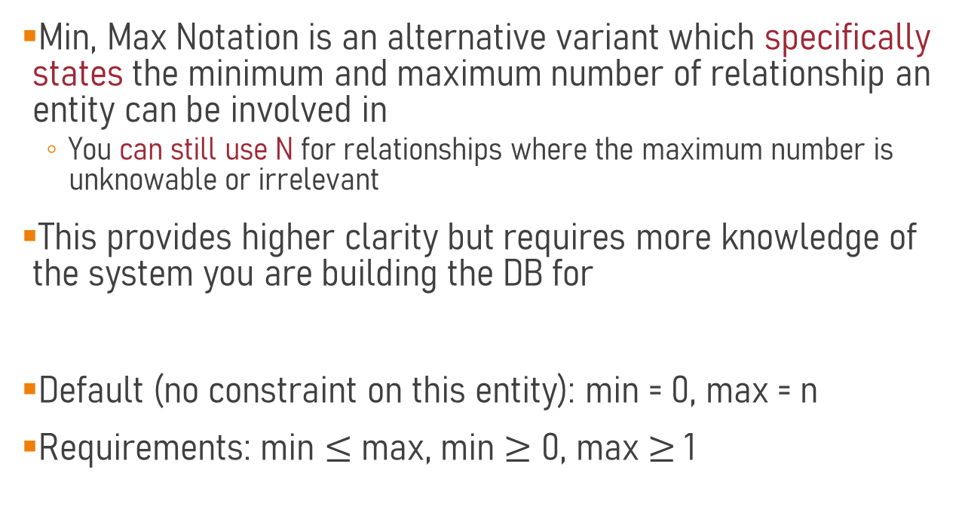
Min, Max Notation
Min, Max Notation is an alternative variant which specifically states the minimum and maximum number of relationship an entity can be involved in
  You can still use N for relationships where the maximum number is unknowable or irrelevant
This provides higher clarity but requires more knowledge of the system you are building the DB for
Default (no constraint on this entity): min = 0, max = n
Requirements: min $≤$ max, min $≥$ 0, max $≥$1

Slide 47
Binary Example
Staff
(0,1)
Heads
(1,1)
Department
(0,N)
Offers
(1,1)
Department
Course
Students
(1,4)
Takes
(1,N)
Course
(min, max) notation ‘looks away’ from the entity
e.g. A staff can manage 0 to 1 departments and a department must have 1 to 1 managers.

Slide 48
Ternary Example
(1, 4)
Sessions
(1, 3)
Student
Course
(1, 2)
Lecturer
A Students can take 1 to 4 Sessions
A Course can offer 1 to 3 Sessions
A Lecturer can teach 1 to 2 Sessions
This can make things more clear

Slide 49
Objectives
Understand the overview concepts of databases and the DBMS model
Understand the ER Model and the meaning behind the corresponding notation
Describe what any given ER model is trying to represent
Create an ER model based on an English project brief or other paragraph

Slide 50
Extra Question
A bank, identified by its code, name and head office address, can have several branches. Each branch within a given bank has a branch number and address. One branch can have several accounts, each identified by a unique AC number. Every account has a type, current balance, and one or more account holders. A branch can also have several loans, each given by a unique loan number, type, amount and one or more loan holders. The name, address, phones and unique id of all customers of the bank are recorded and maintained.

